Slide 1
Employment Trends in Computer and Mathematical Occupations
United States
2013 - 2017
Winnie Wu
Rob Seaberg
& Lei Qin

Slide 2
Objective:
The purpose of this project is to analyze US employment data to observe trends in computer and mathematical occupations based on location and job title
1. Which states have the fastest growing job market for computer and mathematical occupations ?
2. Does a larger state population translate to higher job growth?
3. Which specific occupations are the most and least in demand?
4. How do computer and mathematical occupations stack up against other occupation types?
5. Which specific occupations had the highest number of employees in 2017?
6. Which state had the most people working in computer and mathematical related occupations in 2017?

Slide 3


Sources
Bureau of Labor Statistics
https://www.bls.gov/oes/oes_emp.htm The Occupational Employment Statistics (OES) program conducts a semiannual survey designed to produce estimates of employment and wages for specific occupations.
US Census
https://www.census.gov/data/tables/time-series/demo/popest/2010s-state-total.html Used for state population estimates (as of 7/1) from 2013 through 2017

Slide 4
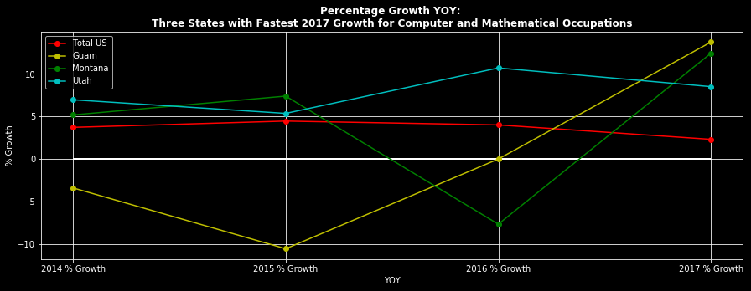
Job titles included:
Computer and Mathematical Occupations, Computer and Information Research Scientists, Computer Systems Analysts, Information Security Analysts, Computer Programmers, Software Developers (Applications), Software Developers (Systems Software), Web Developers, Database Administrators, Network and Computer Systems Administrators, Computer Network Architects, Computer User Support Specialists, Computer Network Support Specialists, Computer Occupations - All Other, Actuaries, Mathematicians, Operations Research Analysts, & Statisticians
States chosen based on fastest YOY growth for 2017 vs 2016. Included US as a comparison point
Overall US grew in 2017, but not as fast as it did in 2016 and 2015
Top 3 fastest states/territories are Guam, Montana, and Utah. Both Guam and Montana show a volatile job market from 2014-2017
Utah also did not grow as much as it did in 2016, like the overall US, but continued to experience a strong job market

Slide 5
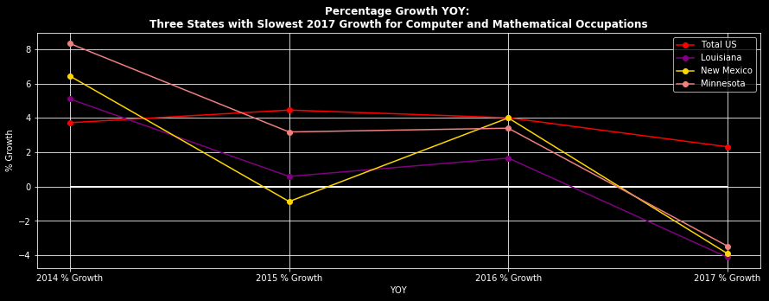
Job titles included:
Computer and Mathematical Occupations, Computer and Information Research Scientists, Computer Systems Analysts, Information Security Analysts, Computer Programmers, Software Developers (Applications), Software Developers (Systems Software), Web Developers, Database Administrators, Network and Computer Systems Administrators, Computer Network Architects, Computer User Support Specialists, Computer Network Support Specialists, Computer Occupations - All Other, Actuaries, Mathematicians, Operations Research Analysts, & Statisticians
Bottom three states chosen based on slowest YOY growth for 2017 vs 2016. Included US as a comparison point
The three bottom states are Louisiana, New Mexico, and Minnesota. All three of these states experienced growth in 2016. Out of the three, New Mexico experienced the largest % decline
All three of these state outgrew total US in 2014, but did not exceed overall US growth in 2015, 2016, or 2017

Slide 6
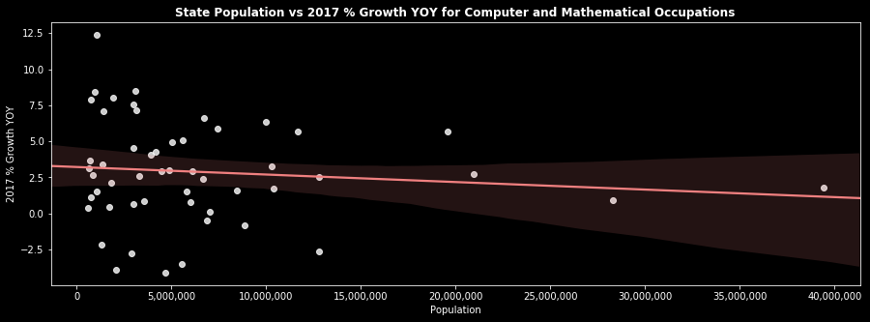
Compared US population by state vs the YOY growth rate (2017 vs 2016) for Computer and Mathematical Occupations
Surprisingly, a larger population did not necessarily translate to higher job growth in this case
Highest growth rates seen for states with less than 5MM people

Slide 7
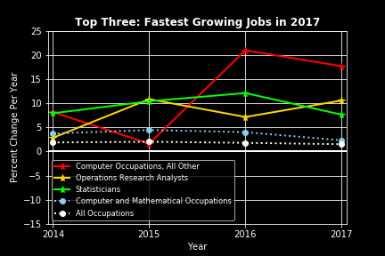
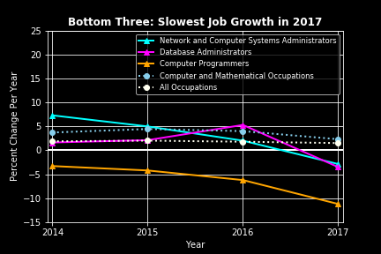
Which Occupations have the Highest and Lowest demands?

Slide 8
Findings
Occupation | % Change 2017 | Avg. % Change 2013-2017
Computer Occupations, All Other | 17.65 | 12.10
Information Security Analysts | 10.57 | 7.85
Statisticians | 7.63 | 9.51
Web Developers | -2.86 | 2.86
Software Developers, Systems Software | -3.48 | 1.40
Computer Programmers | -11.19 | -6.22
Computer and Mathematical Occupations | 2.31 | 3.62
All Occupations | 1.51 | 1.80
Occupations with high growth in 2017 also had higher average yearly growth over the four preceding years.
Occupations with low growth in 2017 also had lower average yearly growth over the four preceding years.
Both Computer and Mathematical Occupations and All Occupations showed steady growth. However, Computer and Mathematical Occupations had consistently higher growth that All Occupations

Slide 9
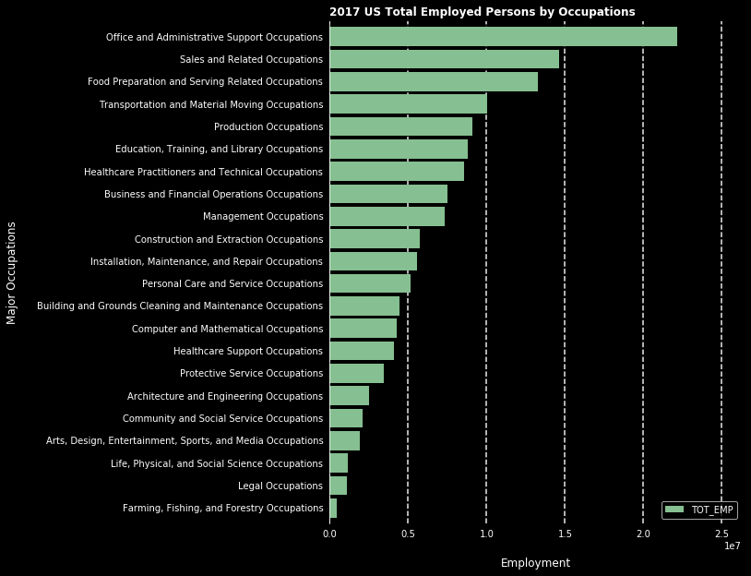
The overall employment status by occupations in US: 2017

Slide 10
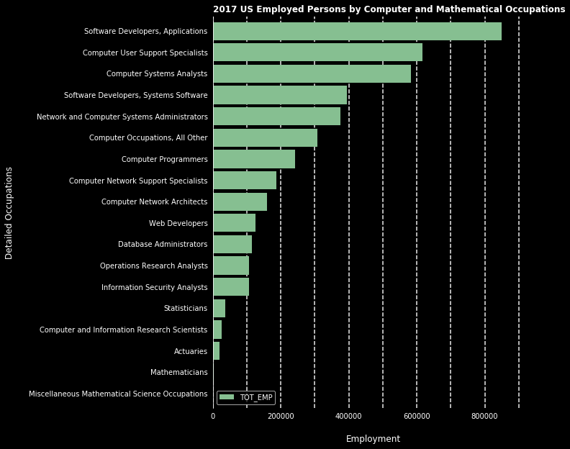
The employment status in Computer and Mathematical Occupation in US: 2017

Slide 11
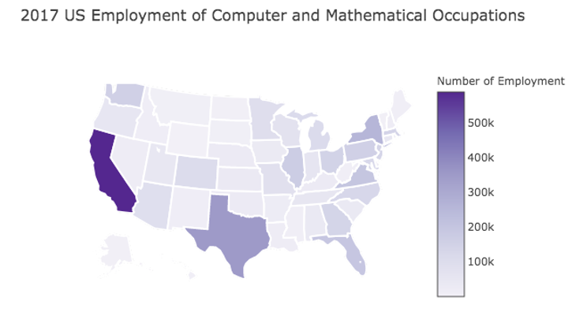

Slide 12
Summary
The overall employment status by occupations in US in 2017
Nation level top 3: administrative Support, sales and food preparation and serving
Computer and Mathematical occupations rank No. 14 among 22 major occupation categories
The employment status in Computer and Mathematical Occupation in US
Top 3 states: California, Texas, and New York
Top 3: software developers, computer user support specialists and computer analysts are the highest

Slide 13
TAKE-AWAYS
Fastest YOY growth for 2017 vs 2016: Guam
Slowest YOY growth for 2017 vs 2016: Louisiana
Larger population did not mean higher job growth
Occupation with fastest YOY growth for 2017 vs 2016 : Computer Occupations, All Other
Occupation with slowest YOY growth for 2017 vs 2016 : Computer Programmers
Computer and Mathematical Occupations is 14th out of 22 occupation types in the US
Within Computer and Mathematical Occupations, Software Developers (Applications) had the highest number of employees in 2017
California had the most people working in computer and mathematical related occupations in 2017

Slide 14
Data Limitations
The BLS included calculations for the percent relative standard error (RSE) for total employment numbers. Looking at a sample of the RSEs, there were concerns about the precision of certain estimates
Estimates for detailed occupations do not sum to the totals because the totals include occupations not shown separately
Estimates do not include self-employed workers
The most recent BLS data went to 2017 only
BLS data covers full-time and part-time wage and salary workers in nonfarm industries. It does not cover self-employed, owners and partners in unincorporated firms, household workers, or unpaid family workers.

Slide 15
Next steps
We would like to utilize job search APIs such as LinkedIn, GoogleCloud, or Indeed to find insight about the volume of job searches and postings.
APIs would also give us more current information than BLS which only went up to 2017. In a rapidly changing employment sector, such up to date information would be essential in painting an accurate picture of the current job market.
If given more time we would have liked to narrow our results to gender, race, age, and educational background of employees

Slide 16
Thank you!
Questions?

