Slide 1
Employment Trends in Computer and Mathematical Occupations
United States
2013 - 2017

Slide 2
Objective:
The purpose of this project is to analyze US employment data to observe trends in computer and mathematical occupations based on location and job title
Our goal was to find the fastest growing occupations in the overall United States as well as the States with the fast growing job markets in computer and math related fields.

Slide 3
Sources
Bureau of Labor Statistics
US Census

Slide 4
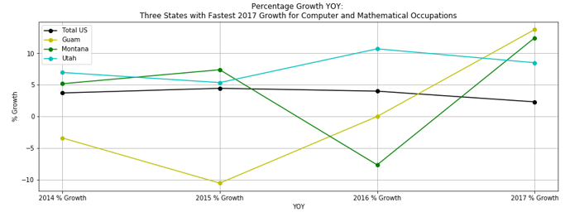
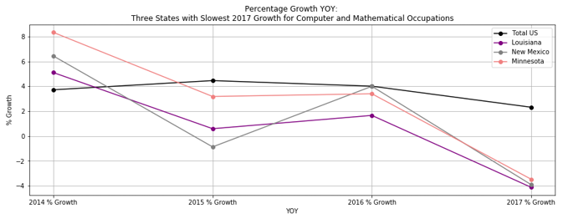
First graph shows 3 states with fastest YOY (2017 vs 2016) growth vs the US
Second graph shows 3 states with slowest YOY (2017 vs 2016) growth vs the US
Job titles included:
Computer and Mathematical Occupations, Computer and Information Research Scientists, Computer Systems Analysts, Information Security Analysts, Computer Programmers, Software Developers (Applications), Software Developers (Systems Software), Web Developers, Database Administrators, Network and Computer Systems Administrators, Computer Network Architects, Computer User Support Specialists, Computer Network Support Specialists, Computer Occupations - All Other, Actuaries, Mathematicians, Operations Research Analysts, & Statisticians

Slide 5
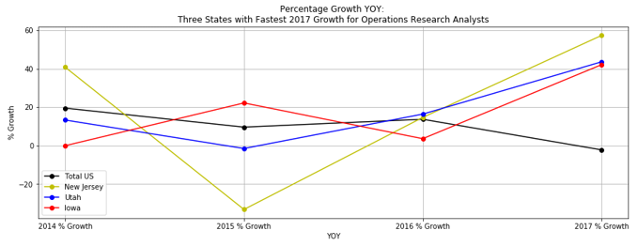
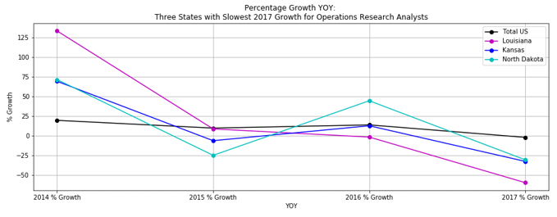
Focused on Operations Research Analysts:
Per the BLS, this includes people who “Formulate and apply mathematical modeling and other optimizing methods to develop and interpret information that assists management with decision making, policy formulation, or other managerial functions. May collect and analyze data and develop decision support software, service, or products.”

Slide 6
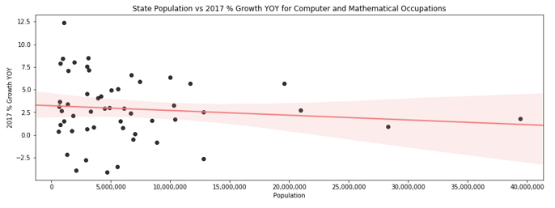
Compared US population by state vs the YOY growth rate (2017 vs 2016) for Computer and Mathematical Occupations
Surprisingly, a larger population did not necessarily translate to higher job growth in this case

Slide 7
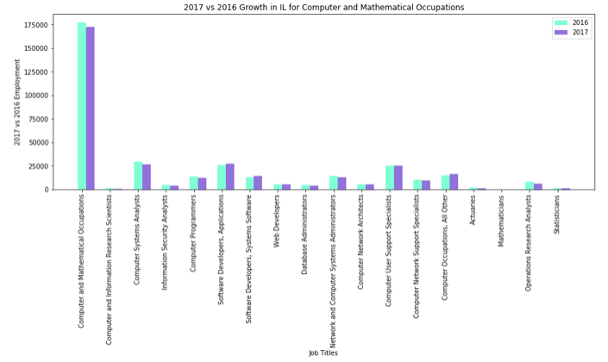
Focus on Illinois job growth (2017 vs 2016 employment #s) for Computer and Mathematical Occupations

Slide 8
Rob

Slide 9
Rob

Slide 10
Rob

Slide 11
Rob
847-208-5631

Slide 12
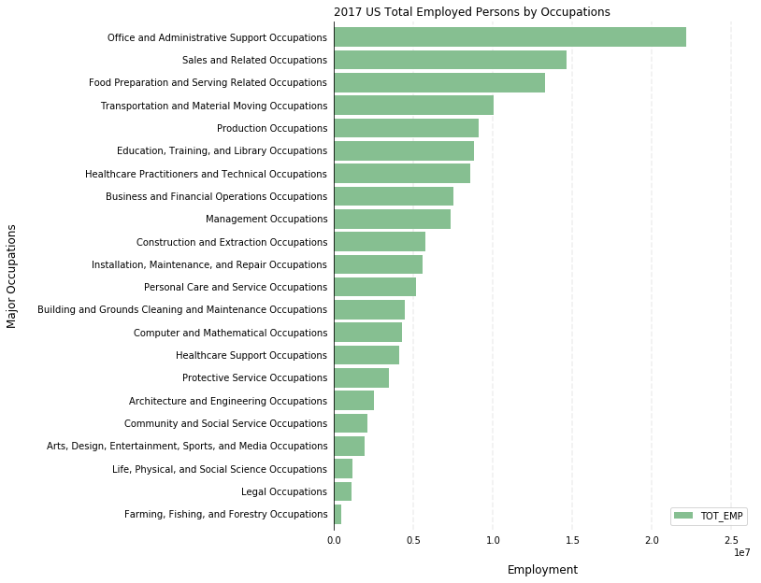
The overall employment status by occupations in US

Slide 13
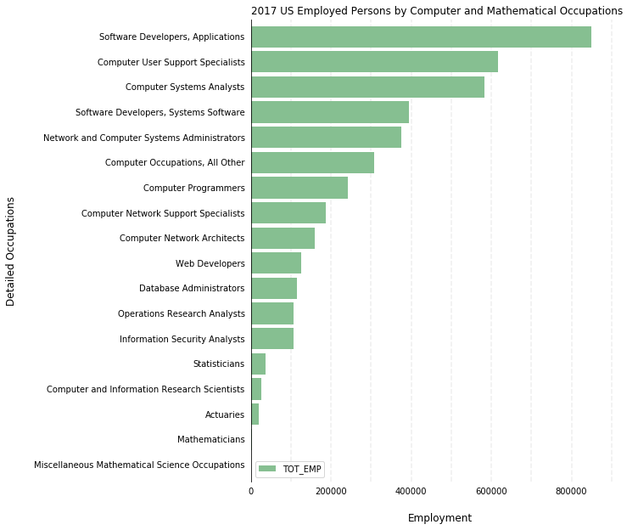
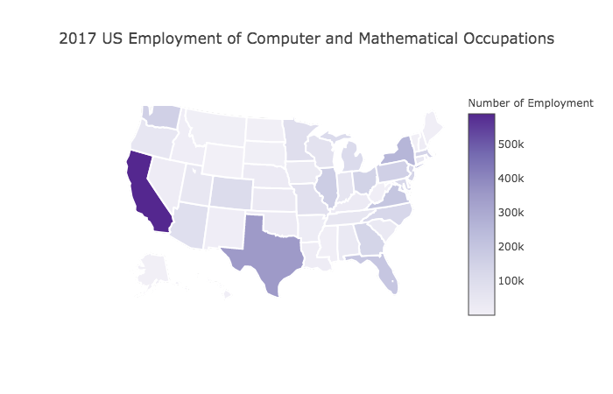
The employment status in Computer and Mathematical Occupation in US

Slide 14
Wages?

Slide 15
Summary
The overall employment status by occupations in US in 2017
Nation level top 3: administrative Support, sales and food preparation and serving
Computer and Mathematical occupations rank No. 14 among 22 major occupation catergories
The employment status in Computer and Mathematical Occupation in US
Top 3 states: California, Texas, and New York
Top 3: software developers, computer user support specialists and computer analysts are the highest

Slide 16
Lei

Slide 17
Overall Summary
Big take-aways

Slide 18
Data Limitations
Bureau of Labor Statistics data is based on employment of individuals over 16 only (?)
The BLS included calculations for the percent relative standard error (RSE) for total employment #s. Looking at a sample of the RSEs, there were concerns about the precision of certain estimates
Estimates for detailed occupations do not sum to the totals because the totals include occupations not shown separately.
Estimates do not include self-employed workers.
The most recent BLS data went to 2017 only

Slide 19
Next steps
We would like to utilize job search APIs such as LinkedIn, GoogleCloud, or Indeed to find insight about the volume of job searches and postings.
APIs would also give us more current information than BLS which only went up to 2017. In a rapidly changing employment sector, such up to date information would be essential in painting an accurate picture of the current job market.
If given more time we would have liked to narrow our results to gender, race, age, and educational background of employees

Slide 20
Thank you slide

