Slide 1
Vortex phase transition in [100] iron-based superconductor

Slide 2
Content
Brief review of iron based superconductor and main feature of [100] vortex
Vortex phase transition in TI and DSM
Vortex phase transition in three band model

Slide 3
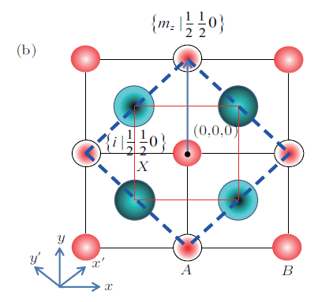
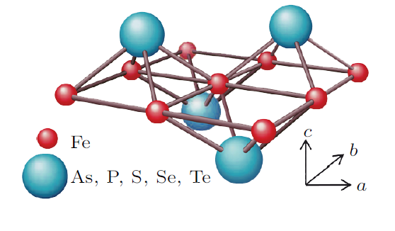
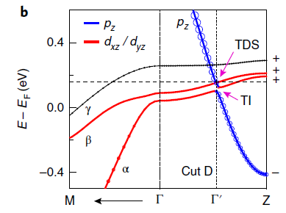
Iron based superconductor
Crystal structure
Band structure

Slide 4
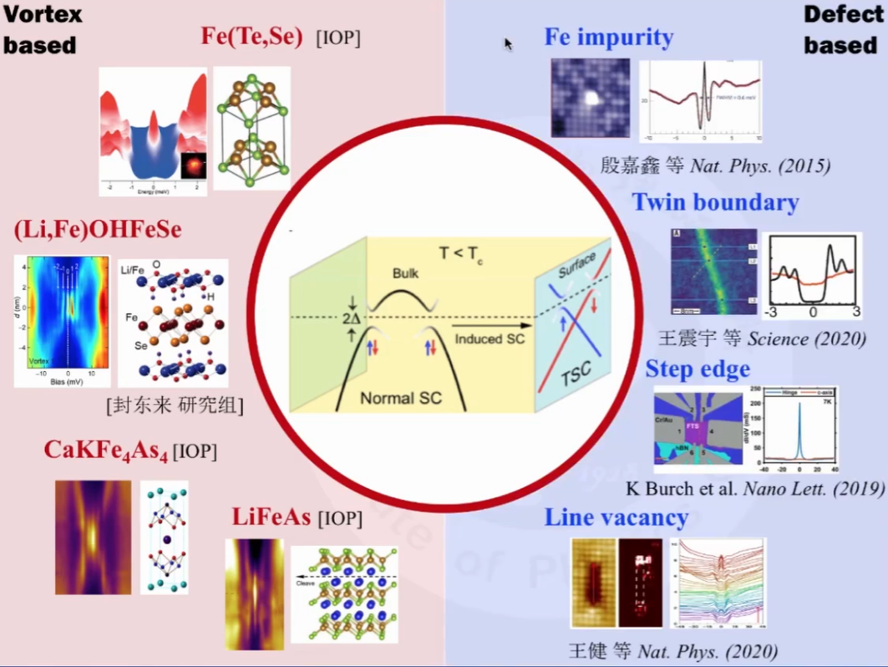
Majorana zero model in iron-based superconductor
铁马平台

Slide 6


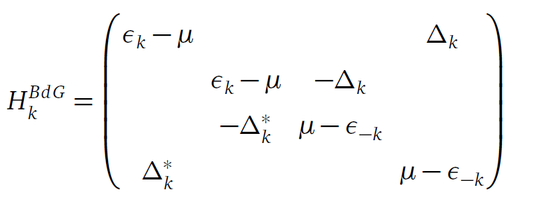
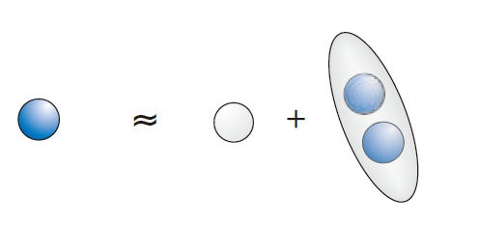
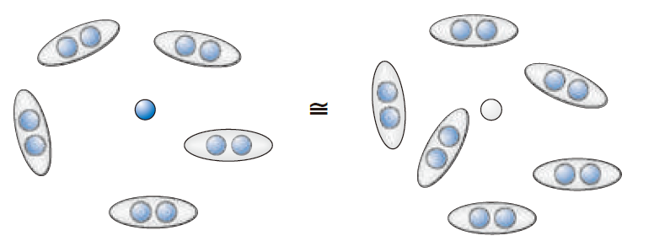




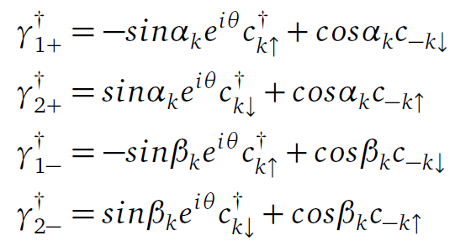


Why zero model？
Majorana fermion:
the real solution for Dirac equation
In condensed matter physics, Bogoliubov quasiparticle
In the Nambu basis
Frank Wilczek. Majorana returns
You can find it anticommute
Kane. Topological superconductor

Slide 7
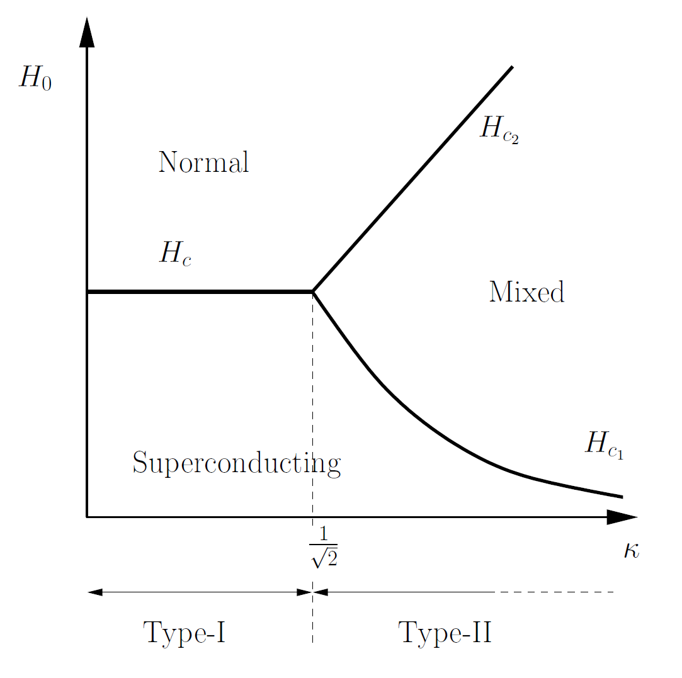
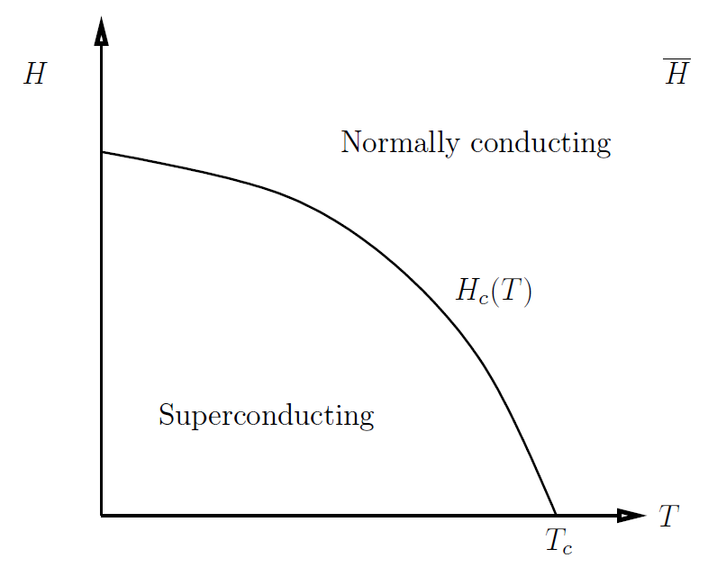
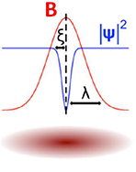
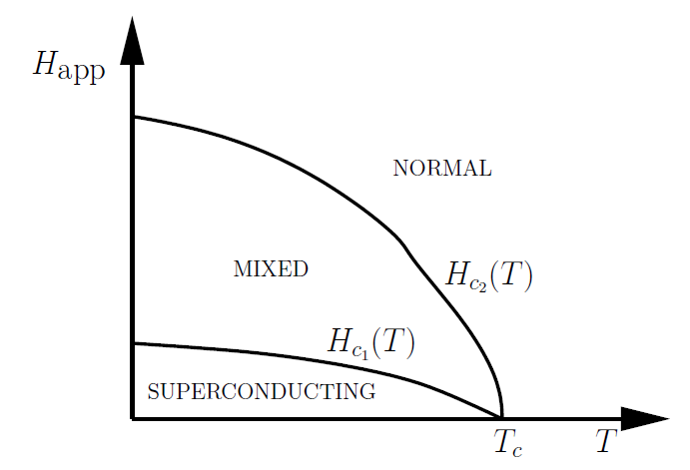
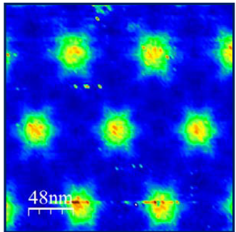

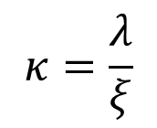
Zero model in vortex system
Vortex in superconductor
The type of superconductor
Type Ⅰ superconductor
Type Ⅱ superconductor
$$κ=\frac{λ}{ξ}$$
penetration depth
Coherence length

Slide 8

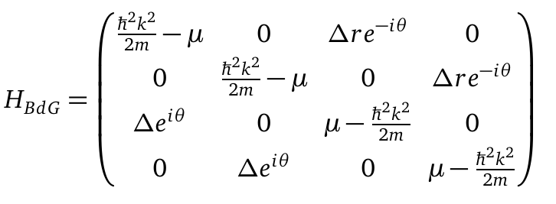

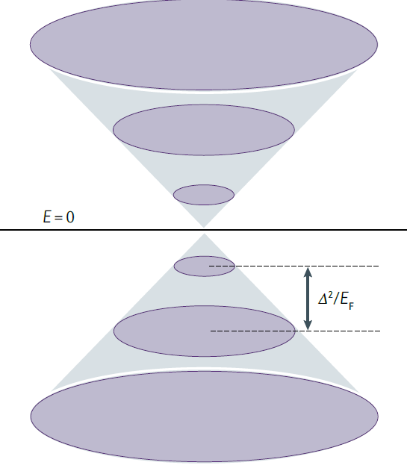



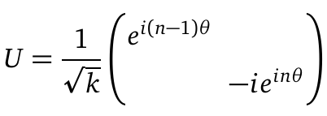

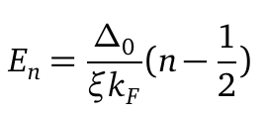
Zero model in vortex system
In gap states in vortex—— CdGM states
In the Nambu basis $\left\{c_{k↑},c_{k↓},c_{−k↓}^{+},−c_{−k↑}^{+}\right\},$ The BdG Hamiliton is

Slide 9
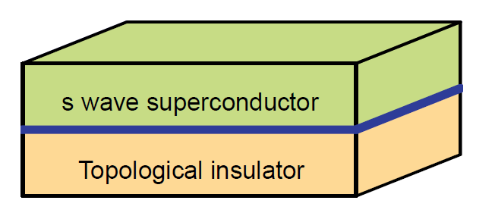
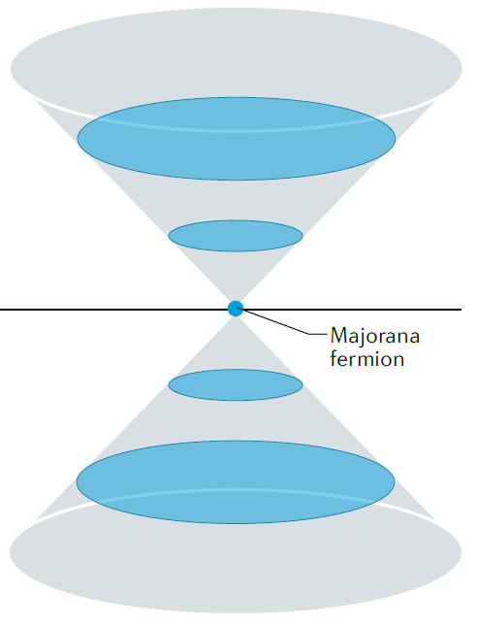

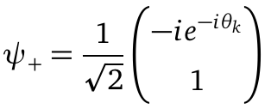


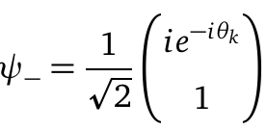

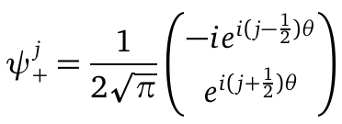
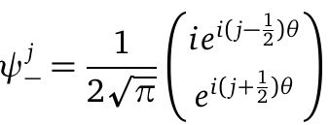




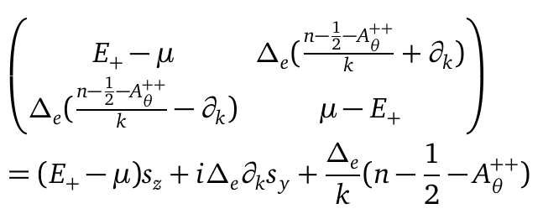

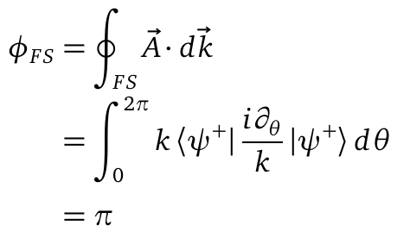



Fu-Kane model
For the Dirac surface states
$$θ$$
In the basics
$$k$$
Change to $ψ_{+}^{−\frac{1}{2}}$, $ψ_{−}^{−\frac{1}{2}}$

Slide 10
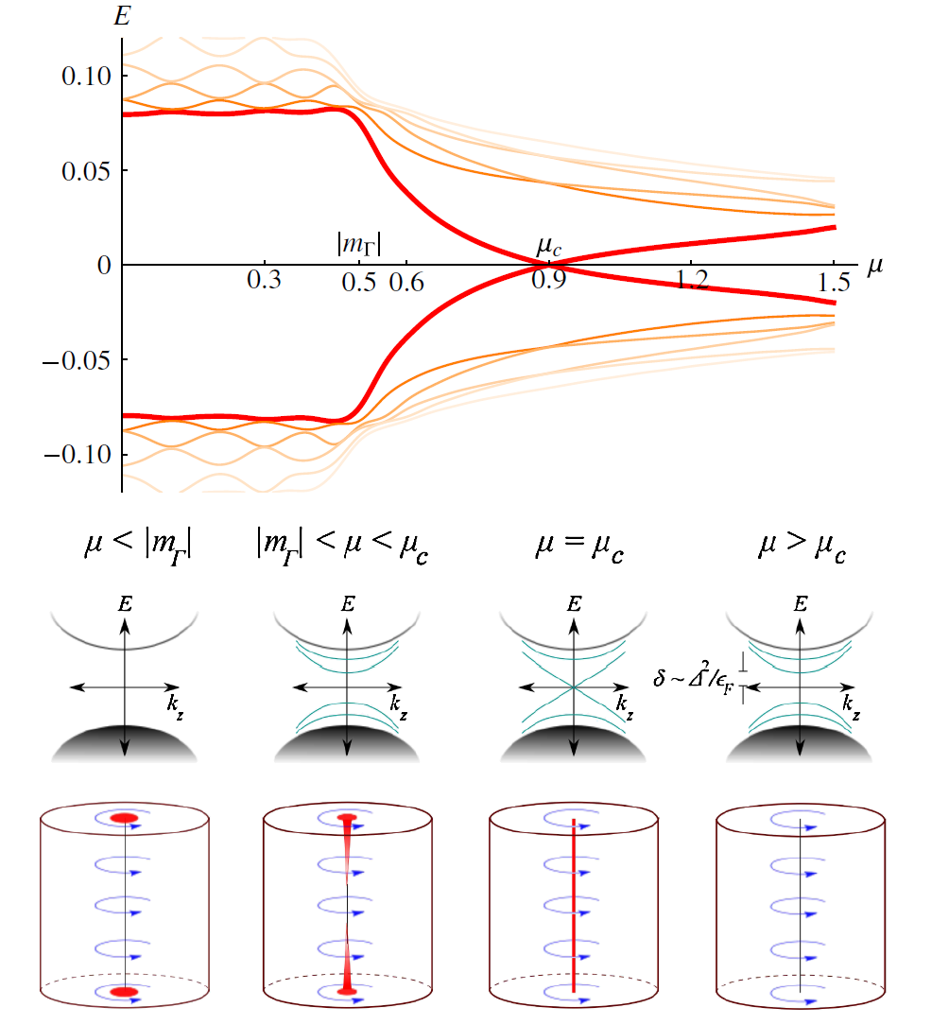

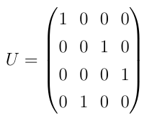
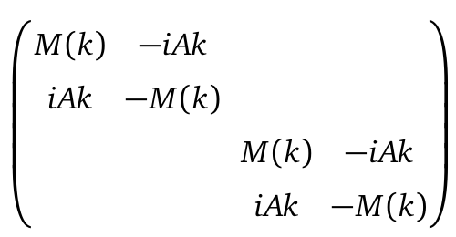


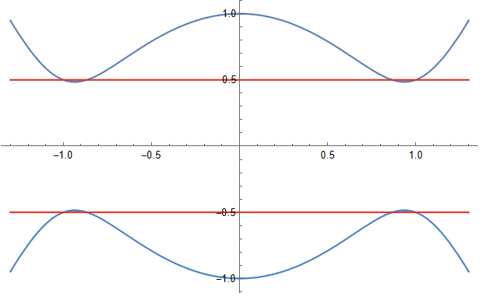
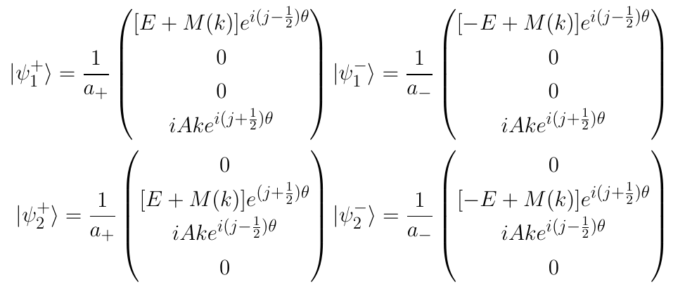














Vortex phase transition in Topological Insulator(TI)
symmetry
Consider $k_{z}=0$
$$E_{+}$$
$$E_{−}$$
Ashvin Vishwanath. PRL(2011)
When M(k)=0,will get zero solution

Slide 11
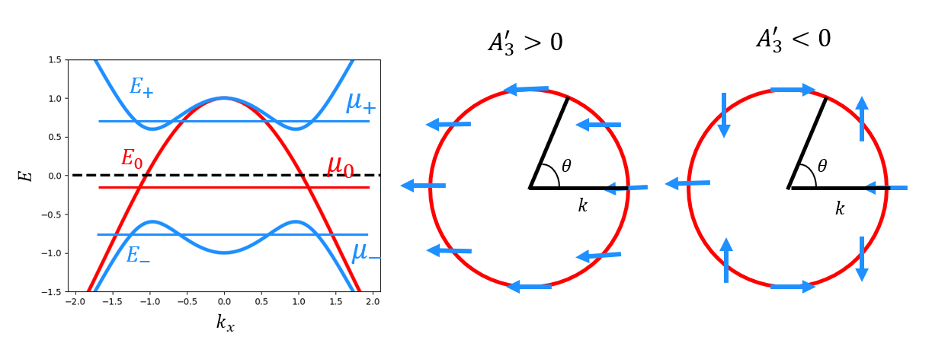
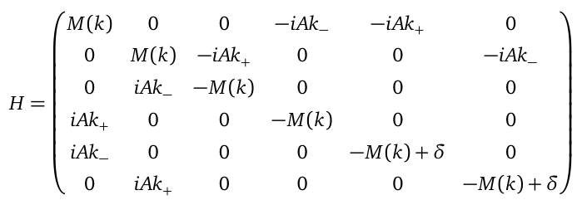
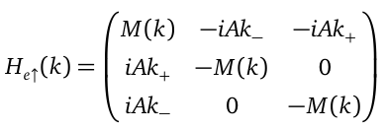




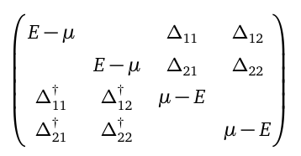


Vortex phase transition in Three band model
Consider $k_{z}=0$
Consider SOC is zero

