Slide 1
Vortex phase transition in iron-based superconductor

Slide 2
Content
Brief review of iron based superconductor
Vortex phase transition in TI and DSM
Vortex phase transition in three band

Slide 3
Iron based superconductor

Slide 4
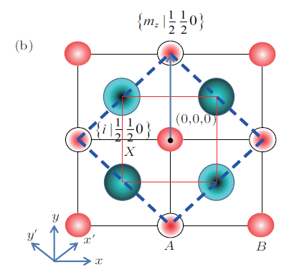
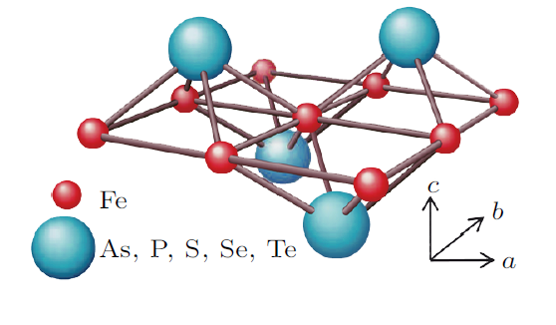
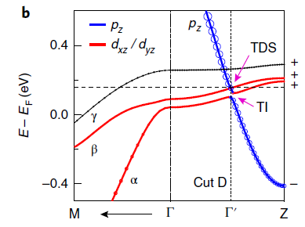
Iron based superconductor
Crystal structure
Band structure

Slide 5
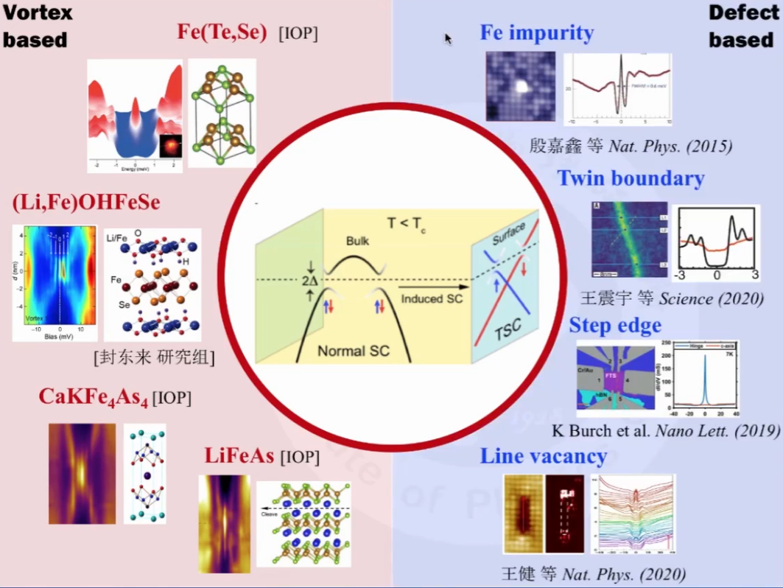
Majorana zero model in iron-based superconductor
铁马平台

Slide 6


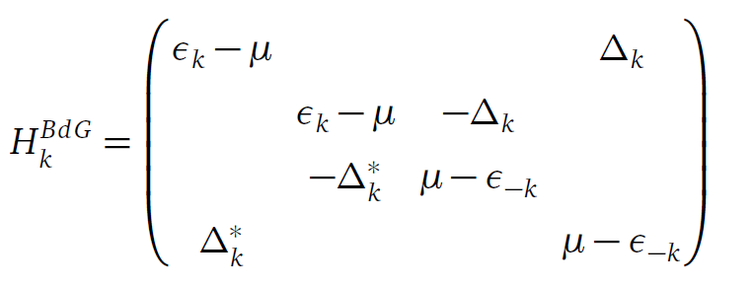
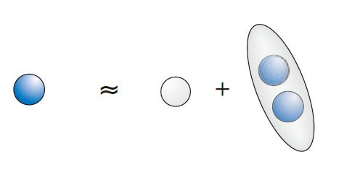
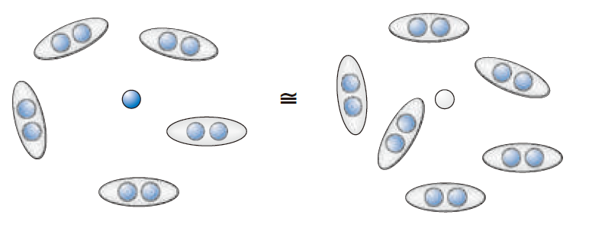


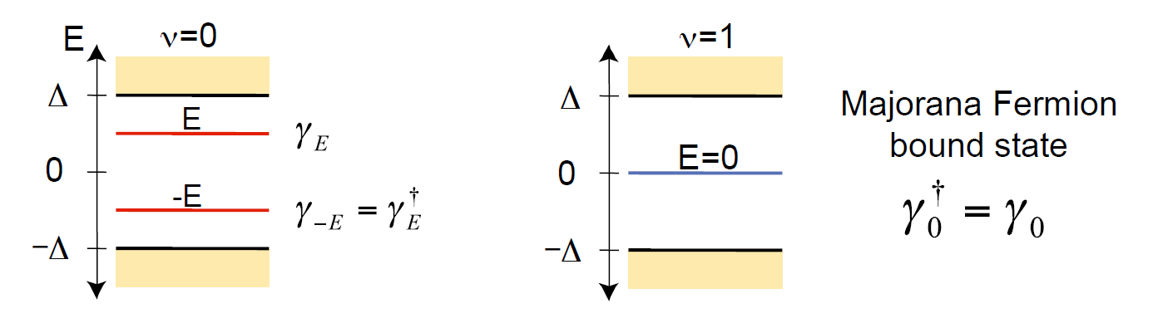

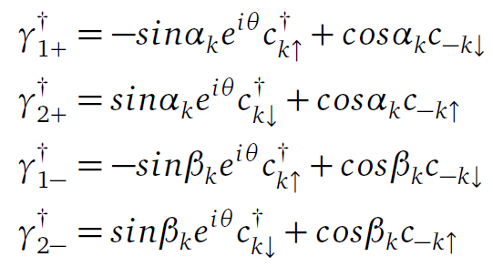


Why zero model？
Majorana fermion:
the real solution for Dirac equation
In condensed matter physics, Bogoliubov quasiparticle
In the Nambu basis
Frank Wilczek. Majorana returns
You can find it anticommute
Kane. Topological superconductor

Slide 7
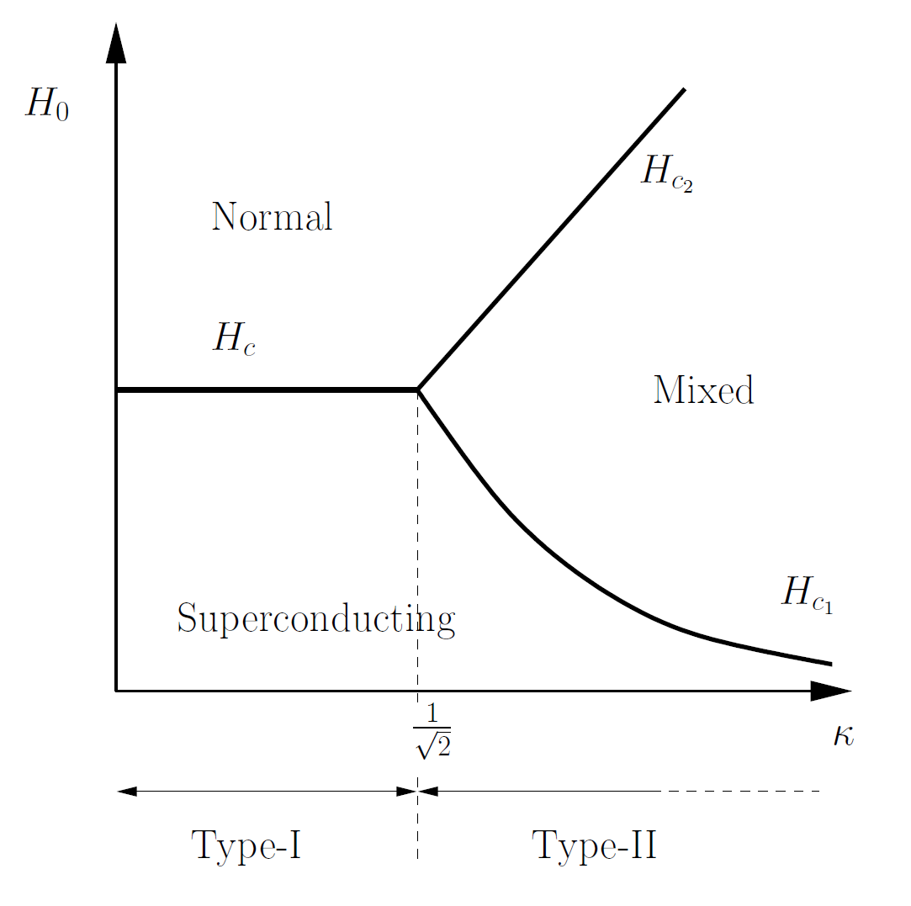
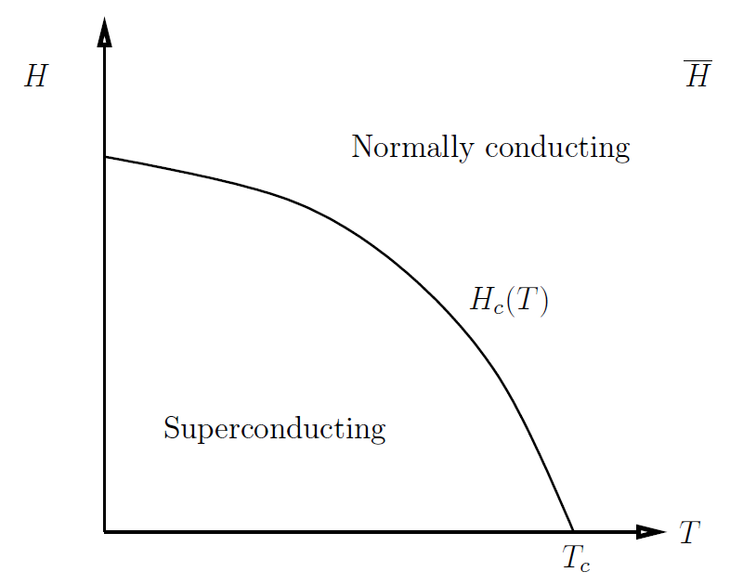
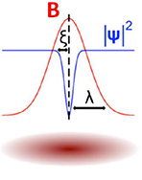
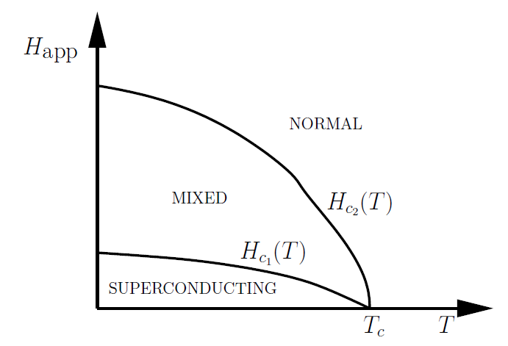
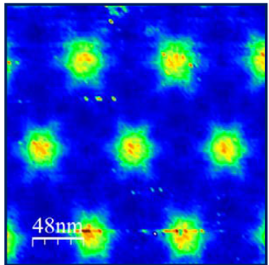
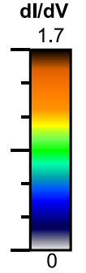
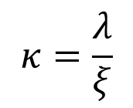
Zero model in vortex system
Vortex in superconductor
The type of superconductor
Type Ⅰ superconductor
Type Ⅱ superconductor
$$κ=\frac{λ}{ξ}$$
penetration depth
Coherence length

Slide 8
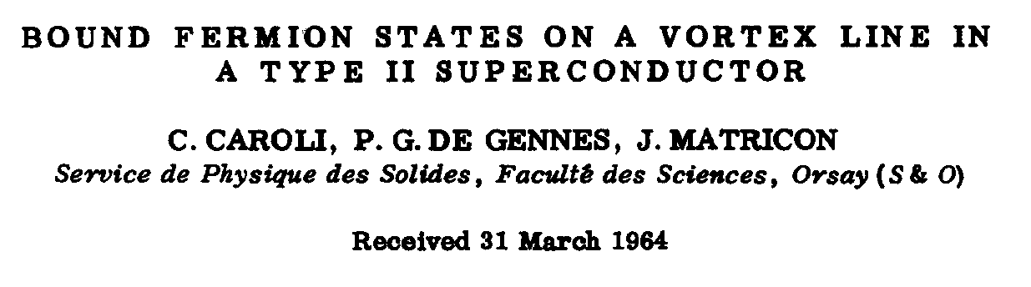
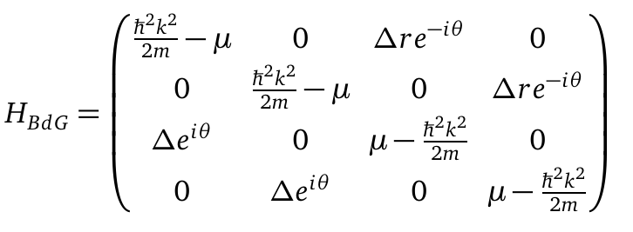
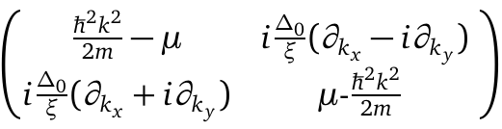
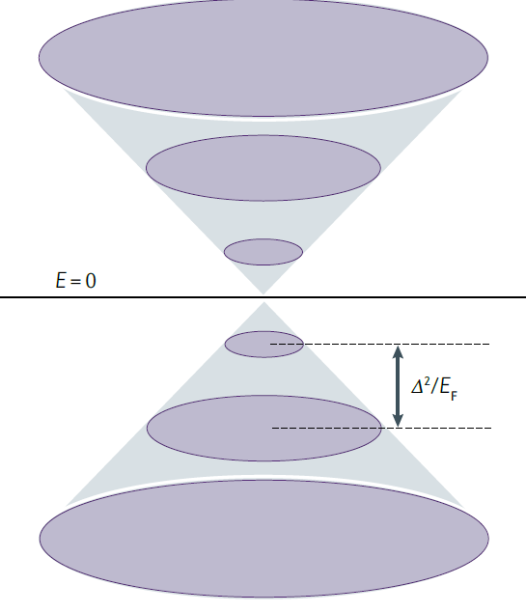


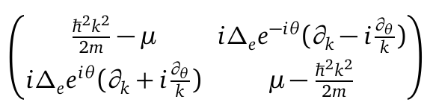
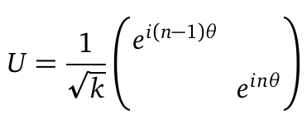
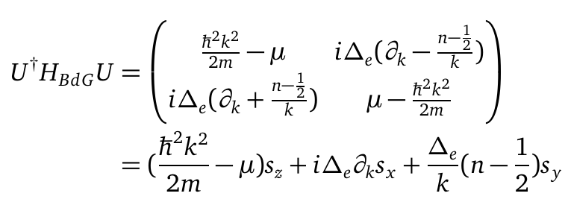
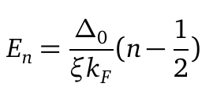
Zero model in vortex system
In gap states in vortex—— CdGM states
In the Nambu basis $\left\{c_{k↑},c_{k↓},c_{−k↓}^{+},−c_{−k↑}^{+}\right\},$ The BdG Hamiliton is

Slide 9
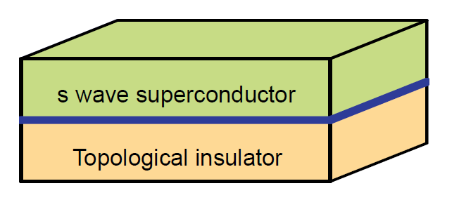

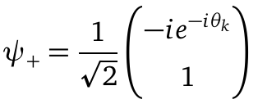
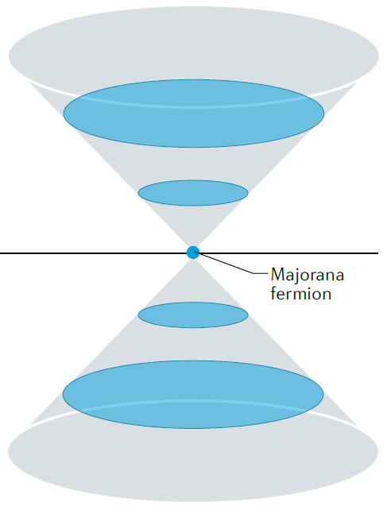


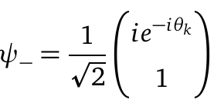

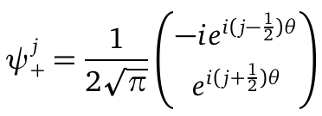
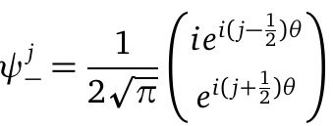

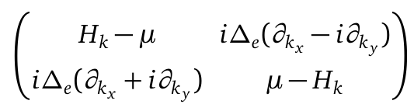

Fu-Kane model
For the Dirac surface states
In the basics
Change to $ψ_{+}^{−\frac{1}{2}}$, $ψ_{−}^{−\frac{1}{2}}$

Slide 10
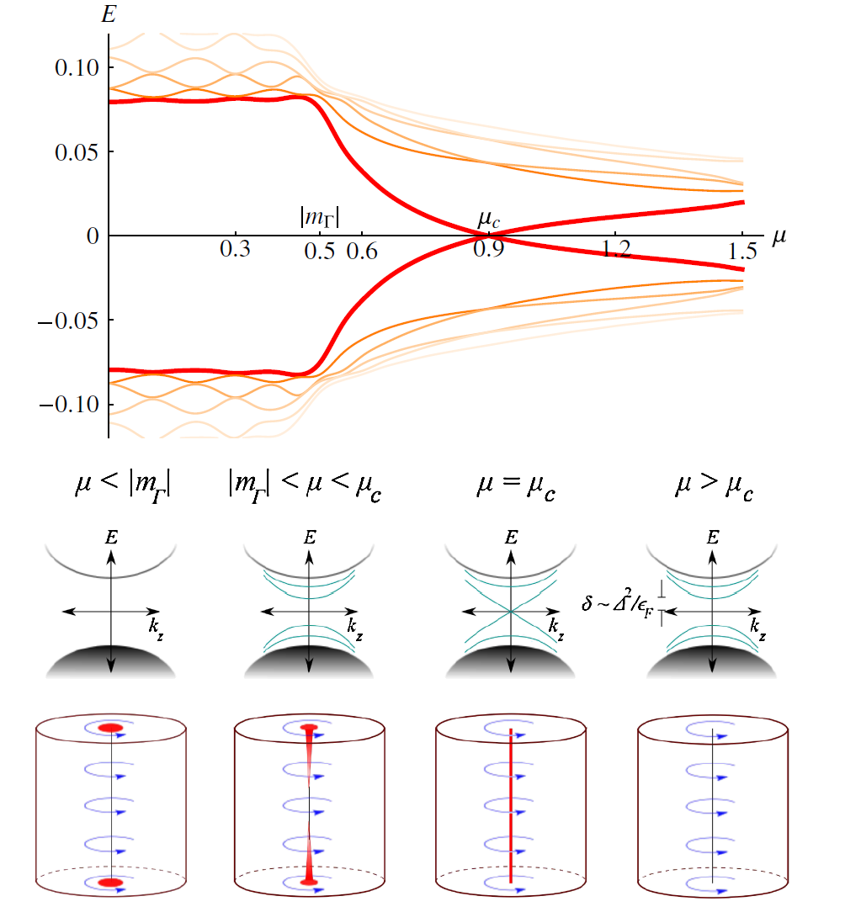
Vortex phase transition in Topological Insulator(TI)
Ashvin Vishwanath. PRL(2011)

Slide 11
Vortex phase transition in Three band model

Slide 12
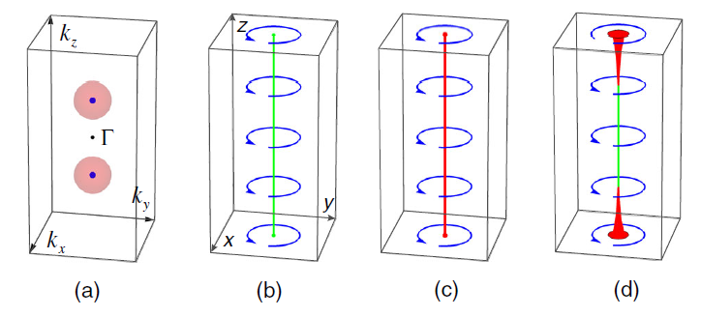
“Kiteav vortex” and “nodal vortex”
Bulk is not insulator
So change TI to DSM, can hold too?
Can hold MZM too
Ashvin Vishwanath. PRL(2011)

Slide 13
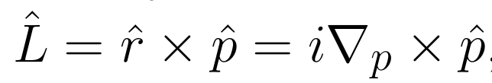
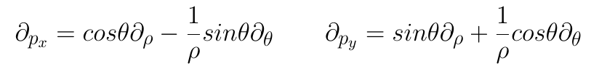
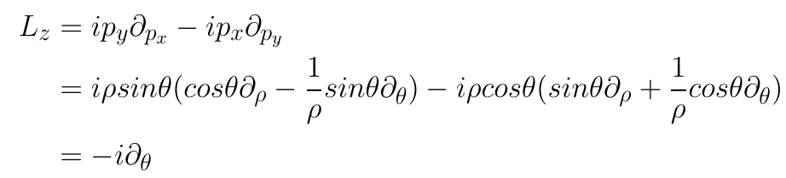


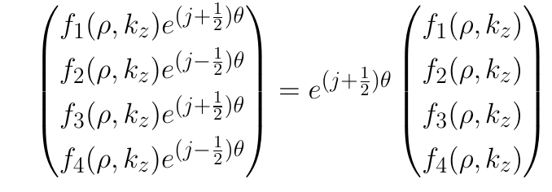








Solved in k space
$$k_{z}$$
The orbit angular momentum
$$k_{z}$$
$$k_{y}$$
$$θ$$
$$ρ$$
$$k_{x}$$
Eigenstates of $J_{z}$
$θ,ρ,k_{z}$ are variables

Slide 14
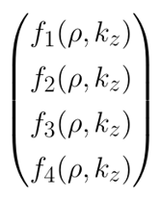
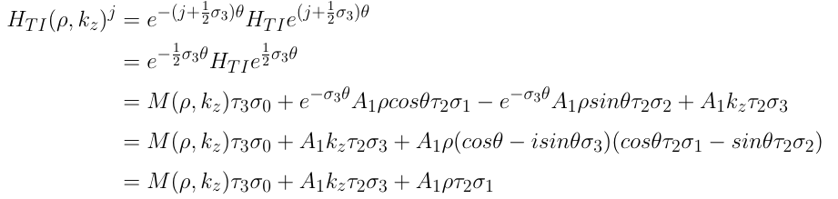
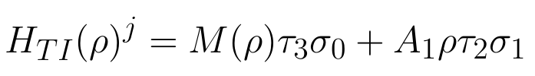

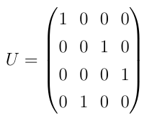
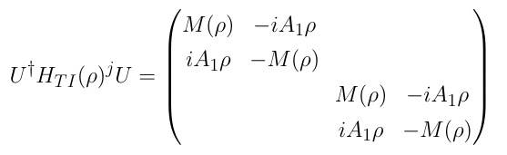
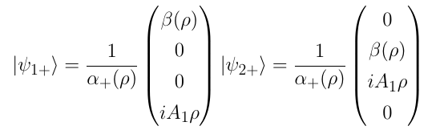




Solved in k space
The effective H for
Consider the band inversion point in $k_{z}=0$
The eigenstates for $H_{TI}{\left(ρ\right)}^{j}$

