Slide 1
Presenti AI - Smart Presentation
Report：Presenti AI

Slide 2
Content
01 Product Introduction
02 What We Can Do
03 About Presenti AI Team

Slide 3
Chapter1. Product Introduction

Slide 4
Product Introduction
Presenti AI is a presentation creation tool powered by advanced AI. It streamlines the process of organizing content and building polished, complete presentations in minutes.​
Category | Key Details
Key Features | AI-powered tools: 1-click PPT outline generation, text-to-PPT, file-to-PPT conversion, smart formatting, AI text optimization
Innovations | AI-driven automation replaces manual formatting/creation- Seamless mix of AI functionality and user-friendly collaboration (online editing, cloud sync)
Target Audience | Individuals (beginners/non-designers), students, teachers, enterprises, teams needing efficient PPT creation)

Slide 5
Chapter 2. What We Can Do

Slide 6
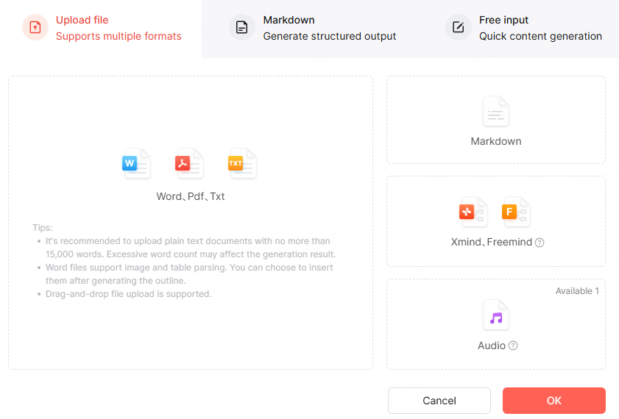
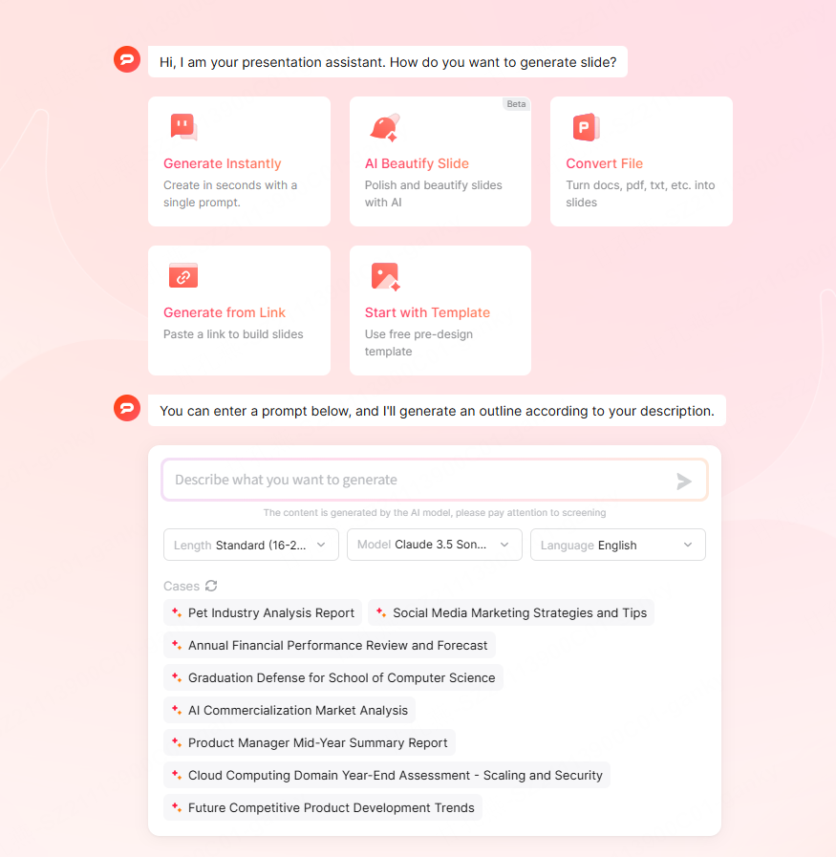
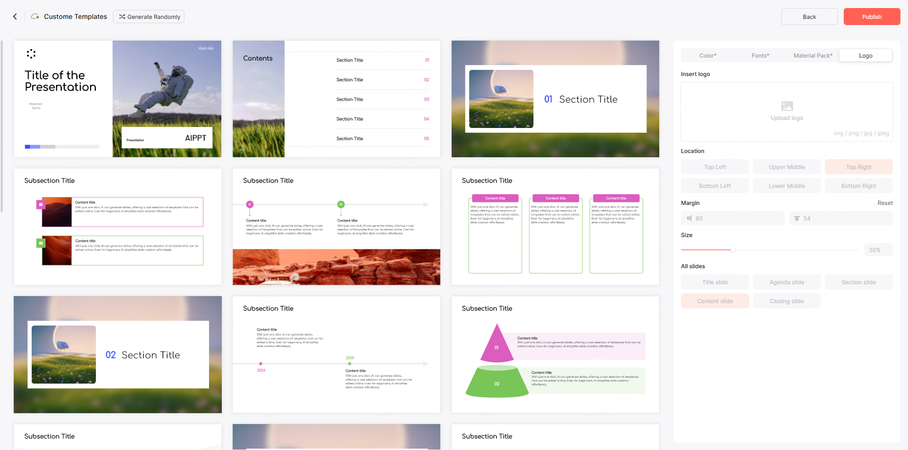
What We Can Do
AI Generated Presentation
Customize Presentation Templates
AI Generation：Break free from traditional presentation creation—AI generates your presentation in one click, unlocking a new way to build slides. Presenti AI helps you easily craft stunning, professional presentations. Start for free and explore the endless possibilities of AI!
Customize your template: Set your own template theme, colors, fonts, assets, and logo to create a personalized template. Use it directly when generating presentations with AI—giving you total freedom to build slides that fit your style.
Generate Presentations from Imported Files
Import your files to create a presentation: Upload a file, and Presenti AI will automatically extract key content to generate a polished presentation. Say goodbye to tedious formatting and make your slides stand out. We support multiple file formats, including Word, PDF, TXT, and Markdown, to meet all your needs.

Slide 7
What We Provide
Structured Outline Analysis​: Let AI automatically generate your presentation outline—with dynamic analysis, plus the flexibility to edit and customize it as you like. Presenti AI saves you significant time, so you can focus on crafting great content. Start your creation journey for free!
Smart Formatting & AI Rewriting​: Say goodbye to manual formatting: Presenti AI handles layout automatically. It comes with multiple preset color schemes covering styles like business, education, and technology. AI also polishes your presentation—fixing grammar errors and refining sentence structure for better flow.
Vast Library of Premium Templates​: Choose from a huge collection of high-quality templates, plus various themes and scenarios to match all your needs. Easily replace existing content into any template—no manual format or layout adjustments required. AI makes building presentations simpler than ever.

Slide 8
Chapter 3: About Presenti AI Team

Slide 9
About Presenti AI Team
About the Presenti AI Team​: The Presenti team brings over a decade of experience in the collaborative office space, with a proven track record of successful client implementations. We hold strong expertise in graphic design algorithms (for creative visualization) and real-time collaboration technology—skills that power our flagship product, Presenti AI.​
Our Goal​: We are committed to investing in ongoing R&D and market expansion for Presenti AI. Our mission is to help individuals and enterprises build more efficient, innovative, and secure ways of creating and collaborating on presentations.

Slide 10
Thank You!

