Slide 1

Capital Investment Group

Slide 2


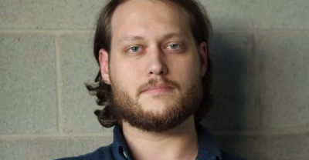
Today’s Venture Capitalists
Laurie Breem
Jamie King
Danny Hurley

Slide 3
Why a Travel Site?
People like travel.
People don’t like being bored when they travel.
People don’t like having bad experiences when they go to a new place.
Travel sites give people a clear picture of what to do, and what not to do.

Slide 4
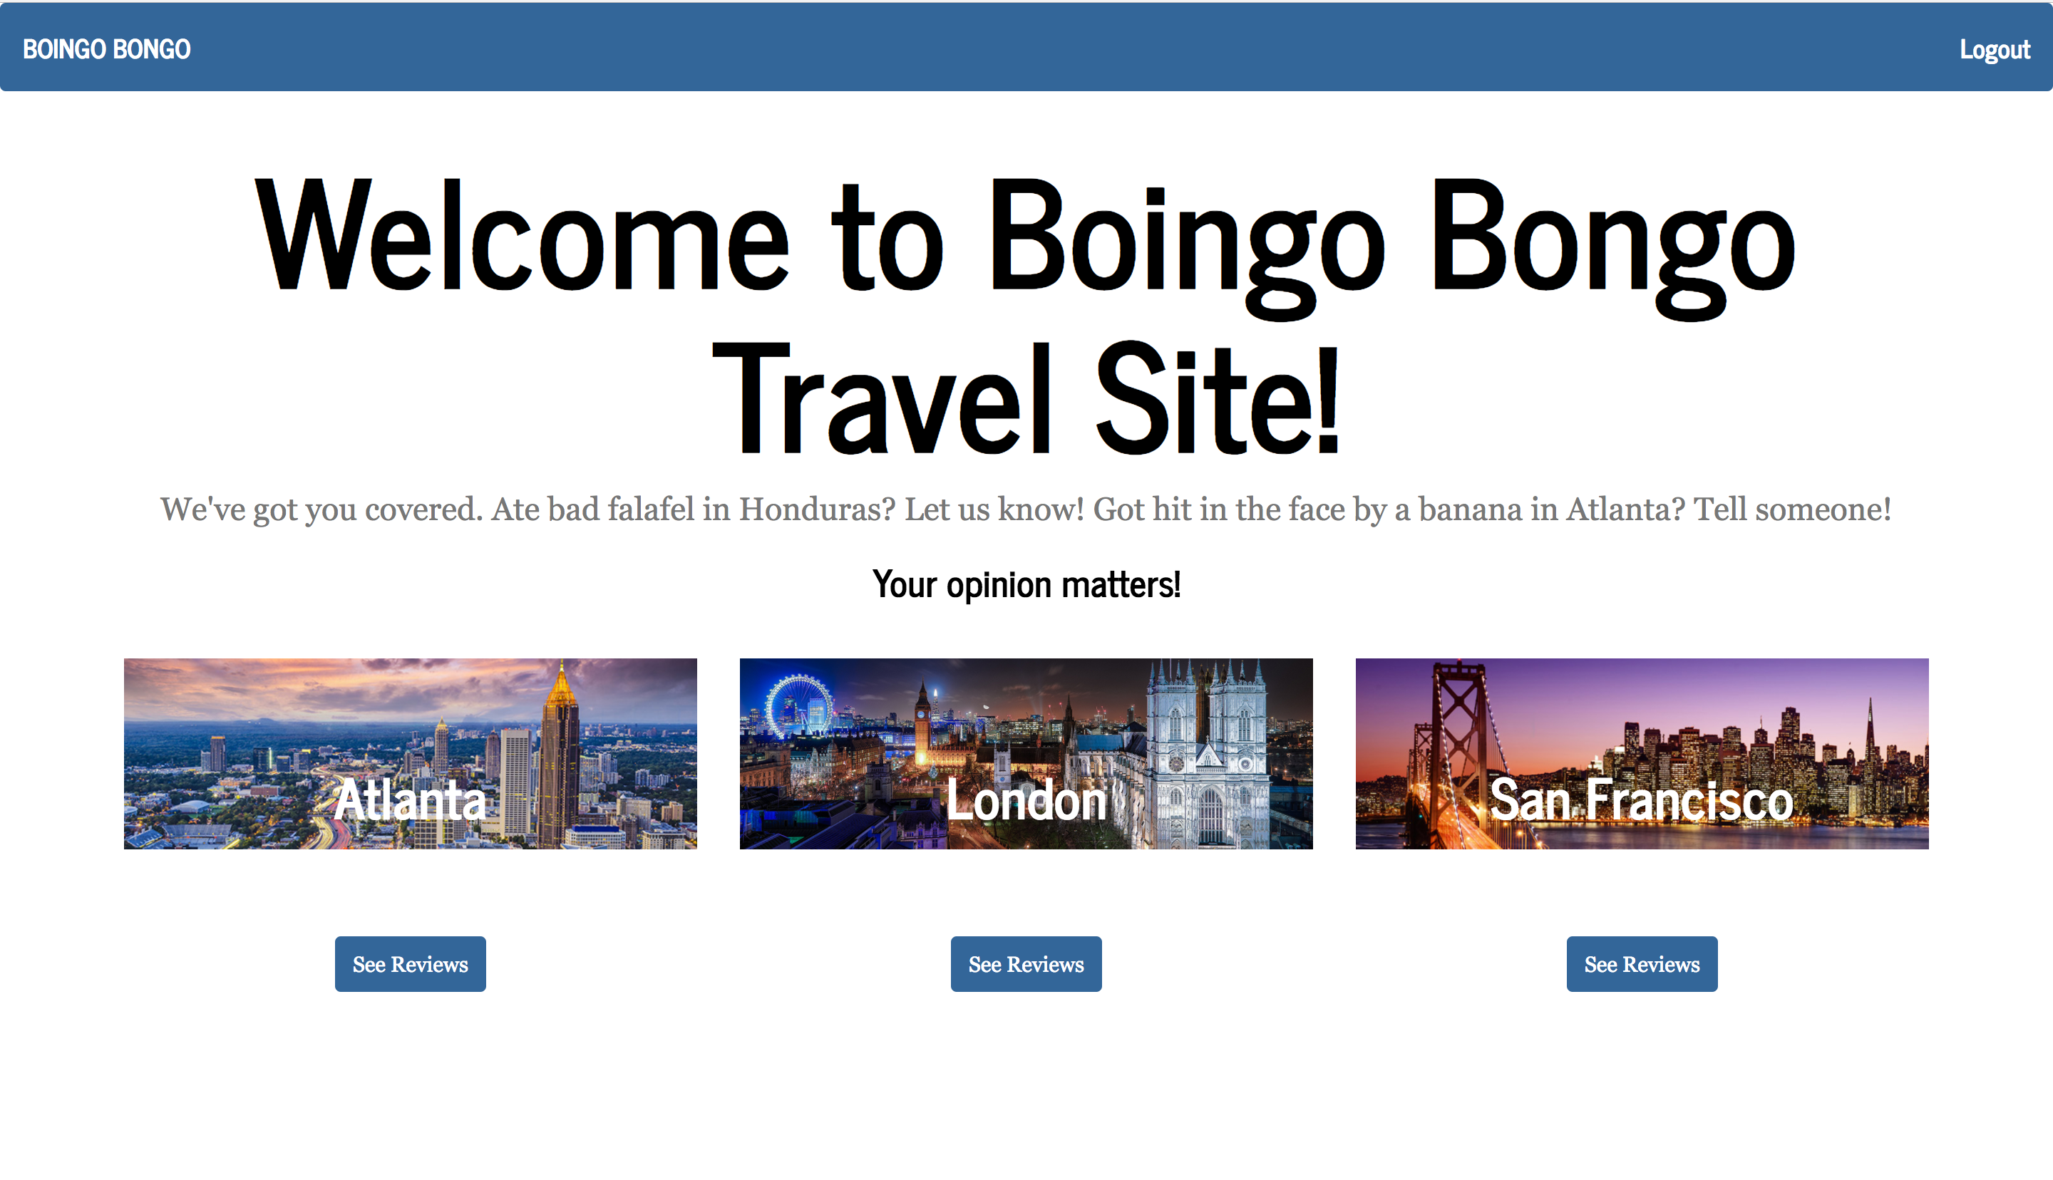
Why Boingo Bongo?

Slide 5
Boingo Bongo Brings:
Top of the line, high quality, user-sourced information for the cities you want to visit.
Global, Local, Social consciousness to every feature. We’re GloLoSo, Bro!
A White Label product that your brand can customize, rather than wasting time fixing someone else’s vision.

Slide 6
Want To Customize Users?
No problem! We have basic email and password(hashed) functionality. Tell us your next user requirement and we can add it in with no technical debt!

Slide 7
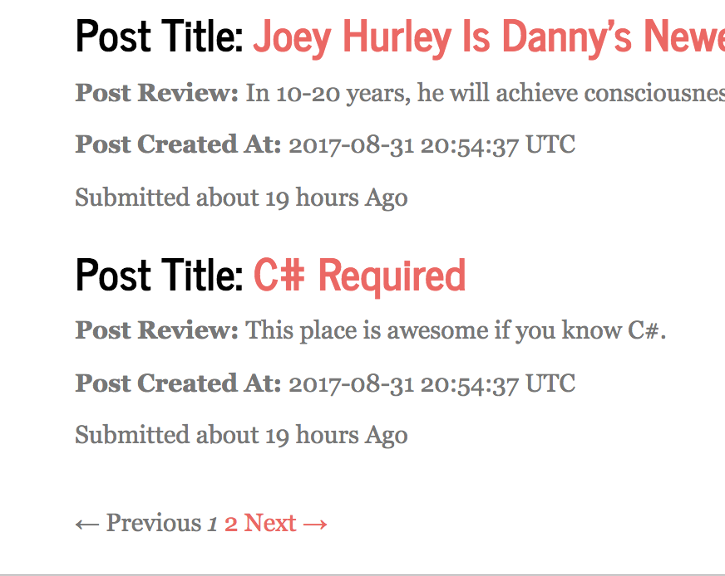
User-Requested Features
Pagination to limit the need for scrolling.

Slide 8
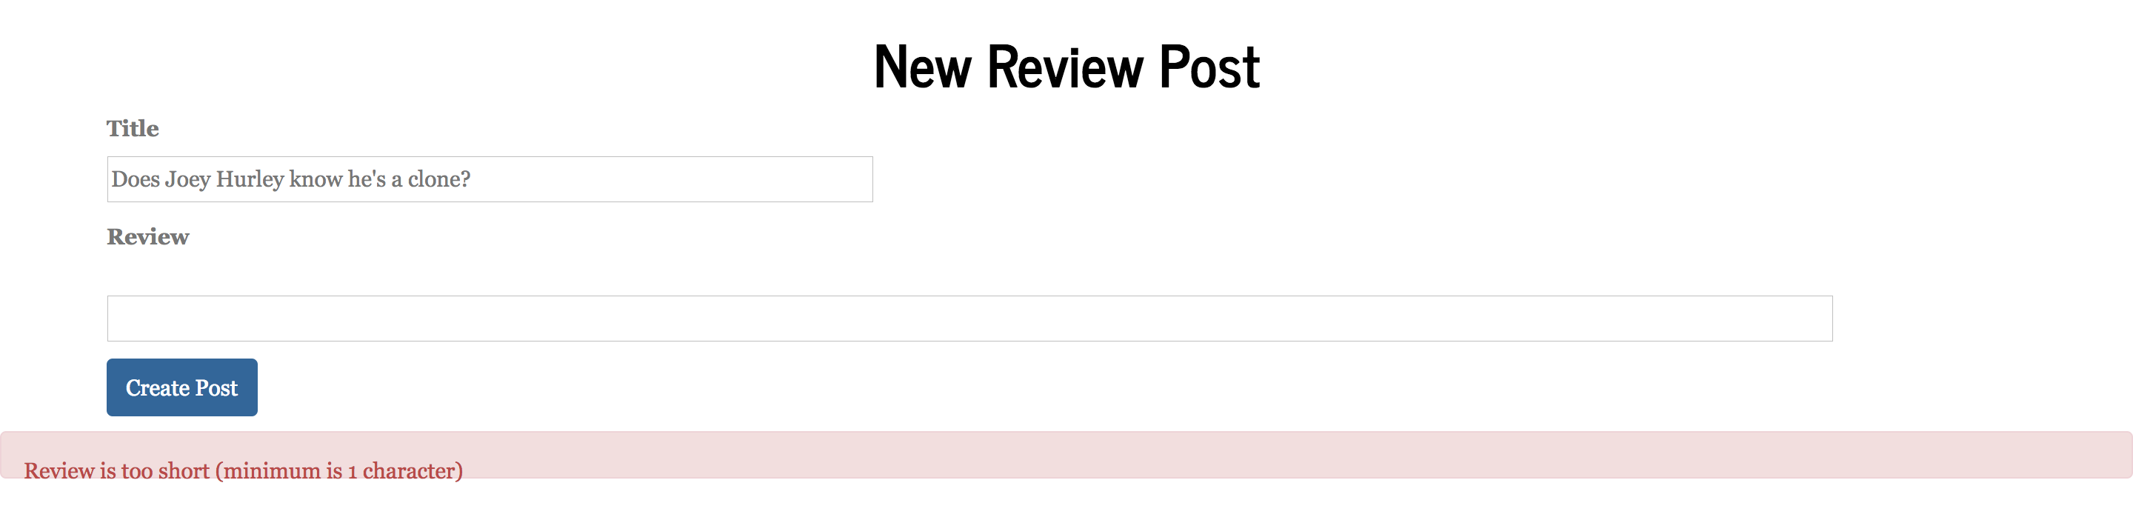
More User-Requested Features
Validate post length to ensure only good reviews make it to the page!

Slide 9
I would buy Boingo Bongo if I weren’t dead.
-Steve Jobs

Slide 10
Conclusion
Your company needs to monetize the Travel Site space. We can help.
Give us all your money.
Boingo Bongo™ . . . Making the world a better place, one crappy review at a time.

