Slide 1
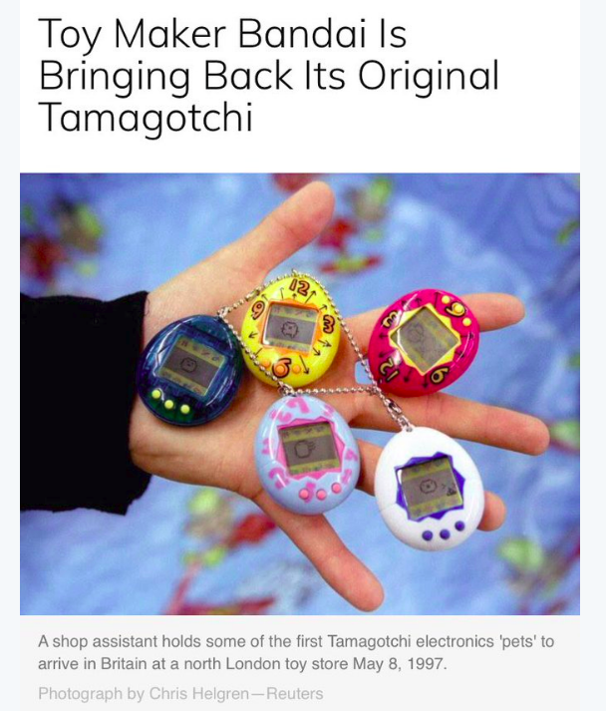
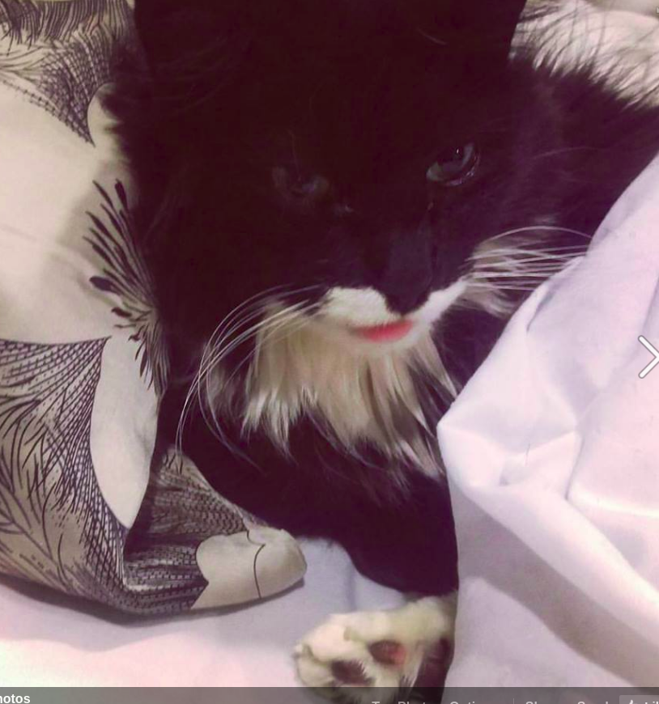
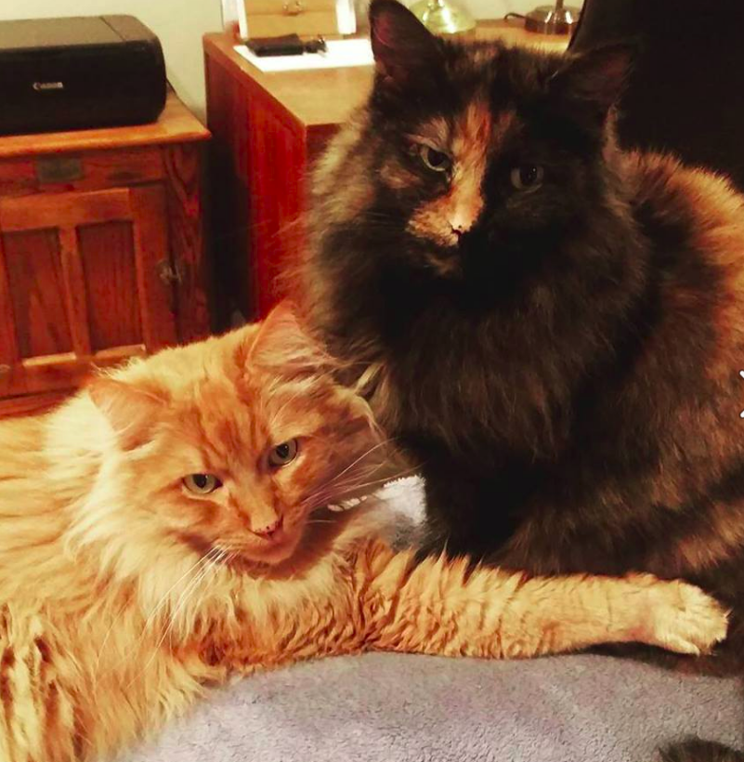
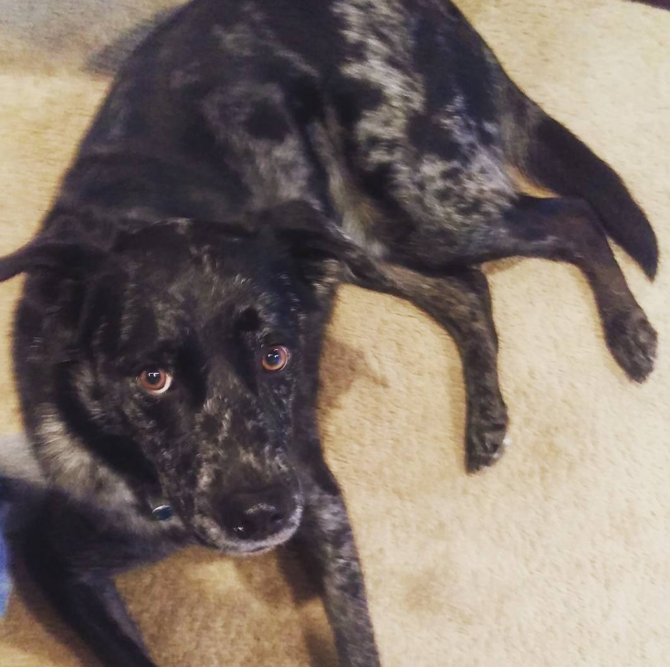
Tamagotchi

Slide 2
Rules
Don’t let your pet die
Feed your pet
Don’t let your pet die
Pick up the poop
Don’t let your pet die
Have fun with your pet
Don’t let your pet die

Slide 3
Process
1) jot initial ideas down on paper.
ex wireframe/pseudocode
2) start with one game element at a time
ex) get feeding working 100% before introducing variety of foods
3) break up the data from the display
Makes it easier to debug when the two are separated
4) review previous code, try to find patterns, and simplify

Slide 4
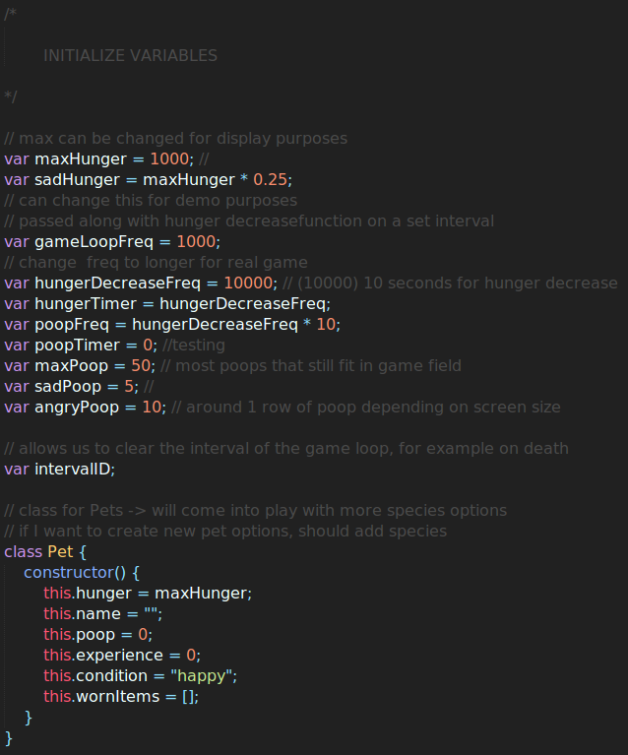

Slide 5
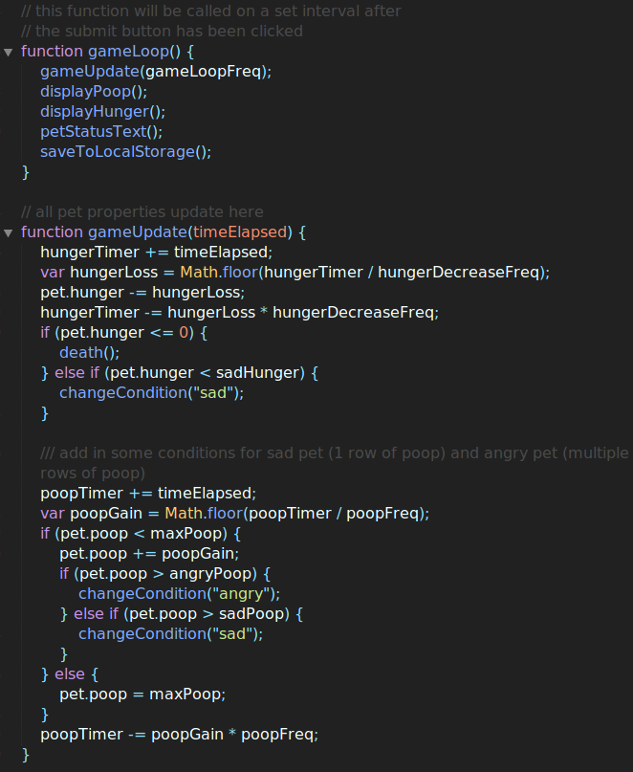

Slide 6
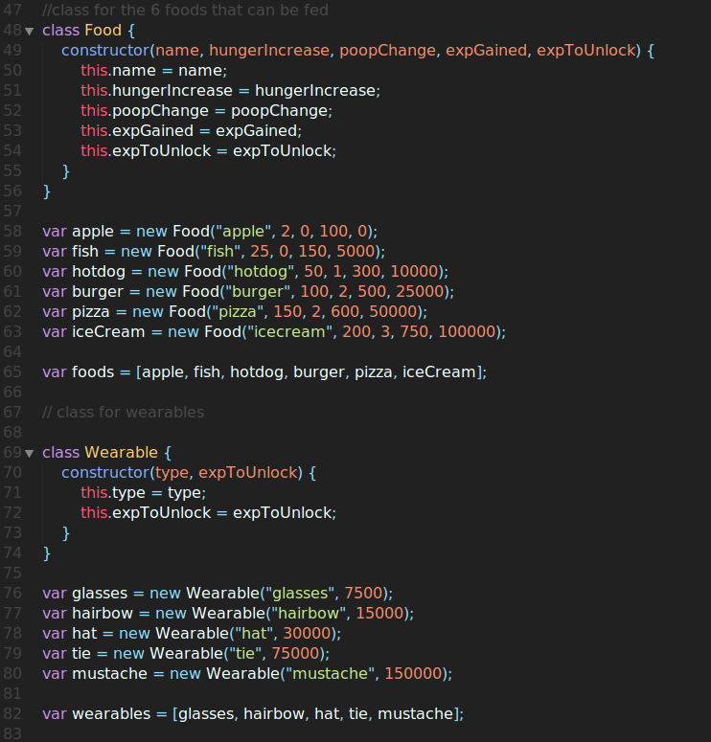

Slide 7
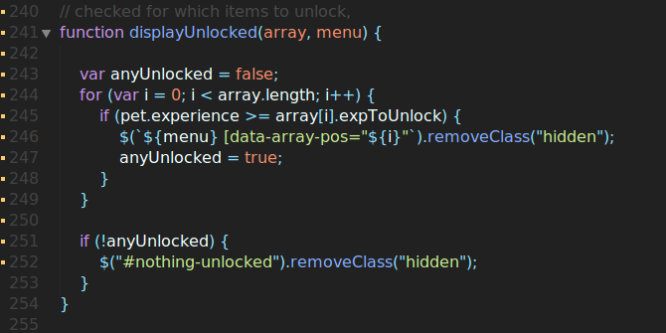
Biggest win – adding experience and unlocking items

Slide 8
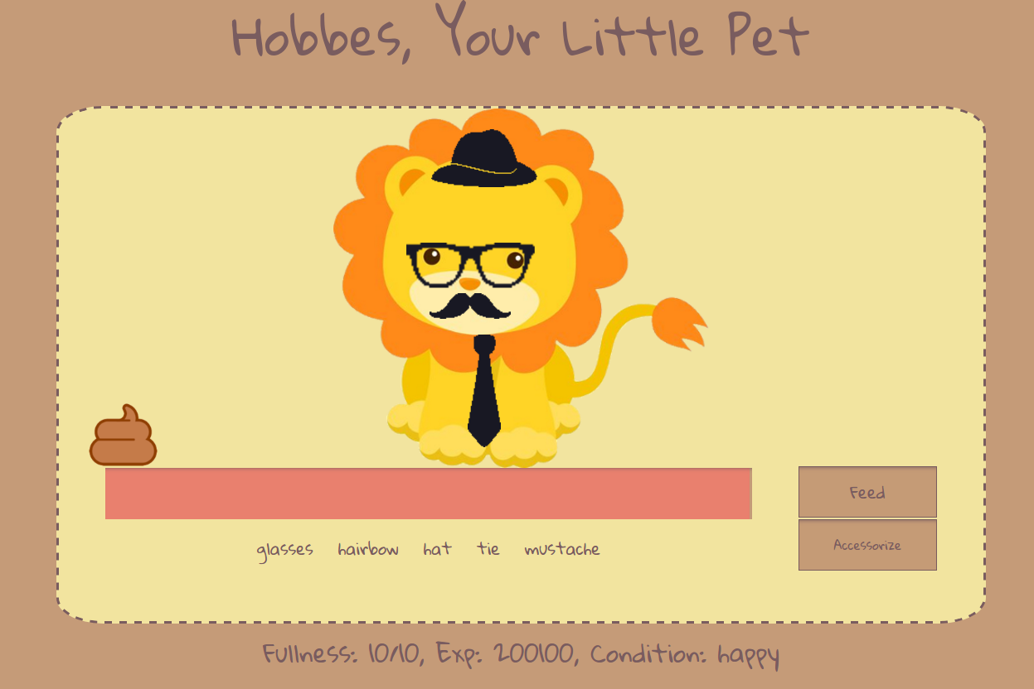
Challenge – lining up the accessories on different screen sizes

Slide 9
If I had one more week:
1) research ways to make the accessories line up right
2) add sleep to prevent pet dying overnight
3) add user experience to unlock different types of animals as a pet
4) those different pets may have a preferred food that triggers a super happy reaction
5) unlock different backgrounds for your pet

