Slide 1
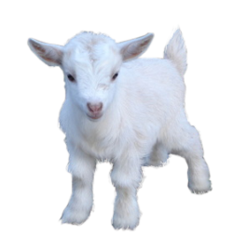
Battleship aka GOATS

Slide 2
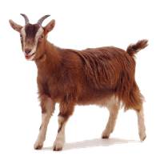

Slide 3
Rules
Place your goats in herds of three in the meadow.
Guess where the computer’s herds are.
The first to find all of the opponent’s goats wins.

Slide 4
Process
Random Board Generator
  Uses random number generator
  Places either a row or column of three goats
  Checks to make sure no overlapping groups
Computer Guessing Algorithm
  Random guessing
  “Near hit” tagging/scanning
UI / Gameplay
  Goats

Slide 5
Gameplay
/home/mdg/Videos/goat-demo.mkv

Slide 6
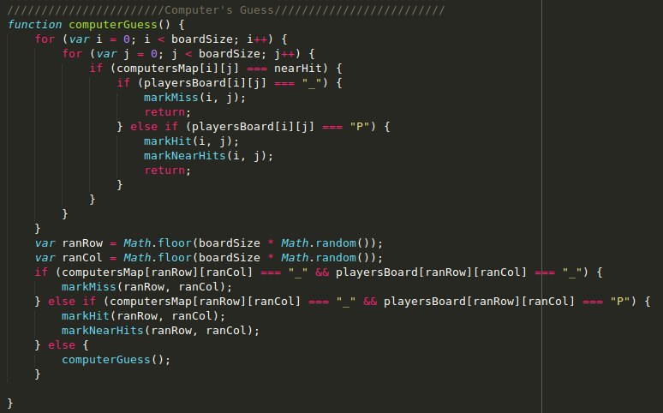
Code Highlights

