Slide 1


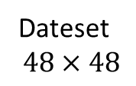
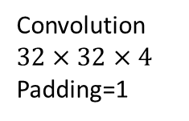

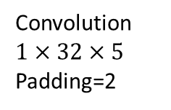
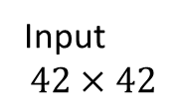
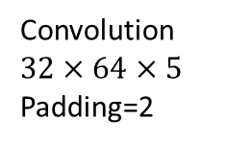
Dateset
$$48×48$$
Input
$$42×42$$
dropout
0.4
dropout
0.4
…….
…….
Convolution$1×32×5$
Padding=2
MAX Polling
$$2×2$$
Convolution$32×32×4$
Padding=1
MAX Polling
Convolution$32×64×5$
Padding=2
MAX Polling
$$2×2$$
fc1
2048
fc2
1024
output
7

