Slide 1
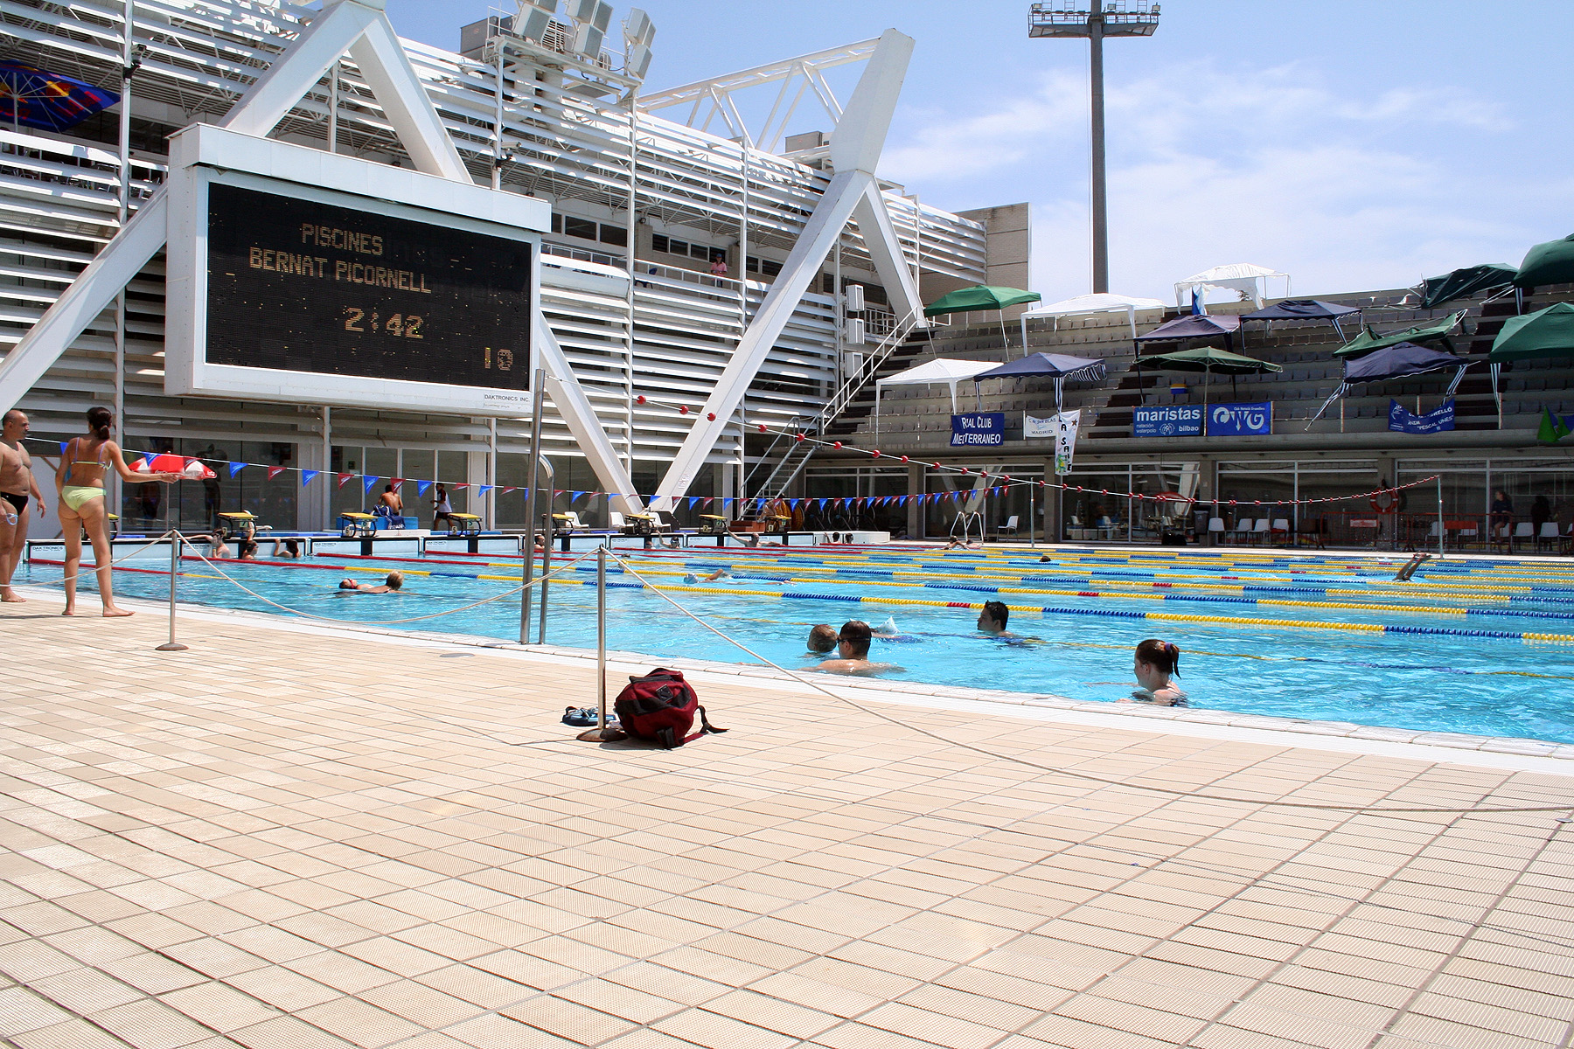
校園故事
水中的勇氣
(Animaze)
Notes:
https://www.stockvault.net/photo/98335

Slide 2

1. 目標
Notes:
https://www.stockvault.net/photo/174237

Slide 3

2. 阻礙
Notes:
https://www.stockvault.net/photo/196576

Slide 4
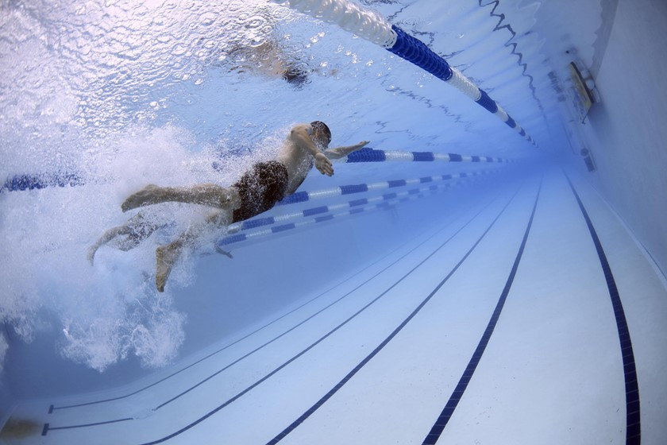
3. 努力
Notes:
https://www.stockvault.net/photo/234073

Slide 5
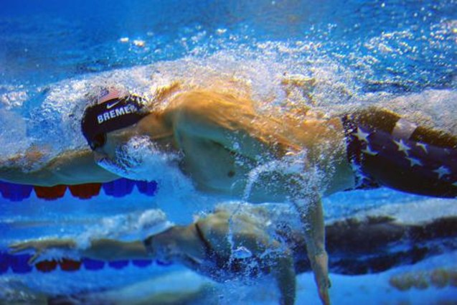
4. 結果
Notes:
https://www.stockvault.net/photo/203511

Slide 6
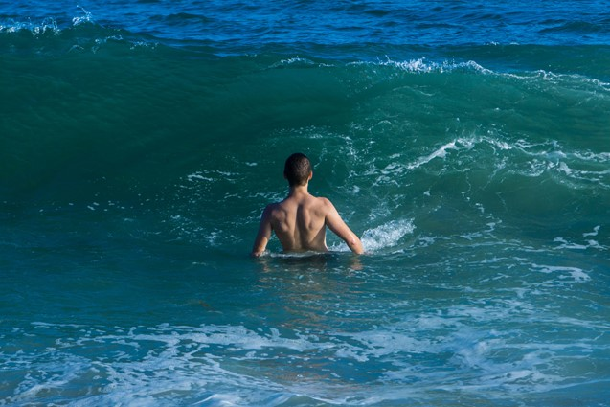
5. 意外
Notes:
https://www.stockvault.net/photo/190306

Slide 7
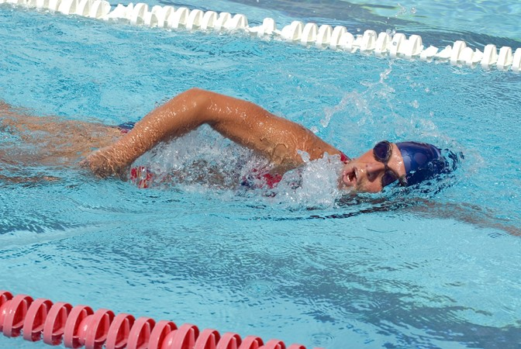
6. 轉彎
Notes:
https://www.stockvault.net/photo/203403

Slide 8
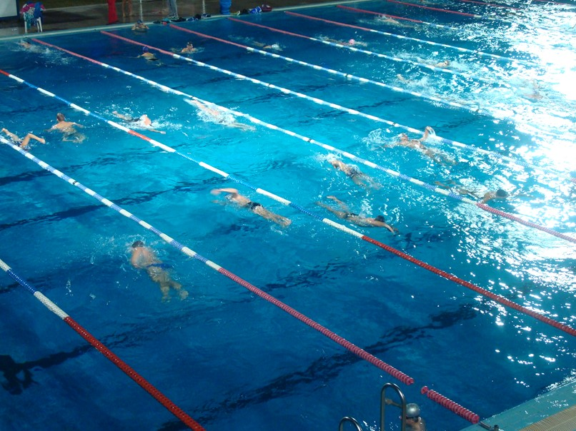
7. 結局
Notes:
https://www.stockvault.net/photo/141202

