Slide 1

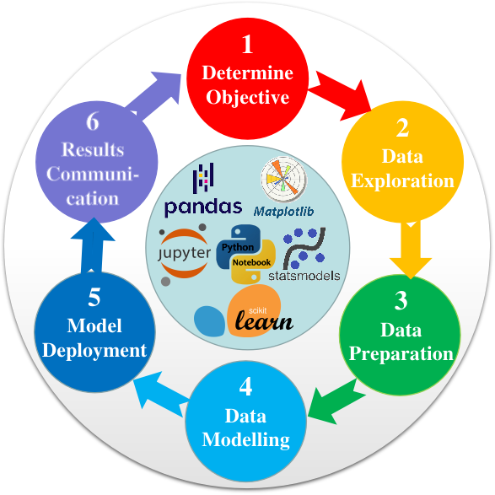

SDIT
Shouke Data Intelligence Technology
Master Python Data Analysis and Modelling Essentials
A Real-World Project using Jupyter notebook, Numpy, SciPy, Pandas, Matplotlib, Statmodels, Scikit-learn, and many more
Instructor: Shouke Wei, Ph.D. Professor

Slide 2
Contents
Master Python Data Analysis and Modelling Essentials
A Real-World Project using Jupyter notebook, Numpy, SciPy,
Pandas, Matplotlib, Seaborn, Statsmodels, Scikit-learn, and more
Instructor: Shouke Wei, Prof. Ph.D.

Slide 3
Section 1:
Introduction
Section 2:
Setting Up Python Environment
Section 3:
Data Exploration
Content
Section 4:
Data Preparation
Section 5:
Classic Statistical Linear Regression Models
Section 6:
Machine Learning Linear Regression Models

Slide 4
Lecture 1: Introduction to Course Contents
Section 1:
Introduction
2
Lectures
Lecture 2: Introduction to Data Analysis and Modelling

Slide 5
Lecture 3: Installing Anaconda Python
Lecture 4: Required Packages
Section 2:
Setting Up Python Environment
4
Lectures
Lecture 5: Installing Required Packages
Lecture 6: Creating and Accessing Working Directory

Slide 6
Lecture 7: Reading and Write Data
Lecture 8: Accessing Basic Information of Data
Lecture 9: Renaming Columns of DataFrame
Lecture 10: Slicing DataFrame
Section 3:
Data Exploration
Lecture 11: Sorting DataFrame
8
Lectures
Lecture 12: Filtering DataFrame
Lecture 13: Grouping DataFrame
Lecture 14: Calculating Summary Statistics

Slide 7
Lecture 15: Detecting Missing Values
Lecture 16: Imputing Missing Values
Lecture 17: Detecting Outliers
Lecture 18: Treating Outliers
Section 4:
Data Preparation
Lecture 19: Correlation Analysis and Feature Selection
8
Lectures
Lecture 20: Encoding Categorical Values
Lecture 21: Data Splitting
Lecture 22: Data Normalization

Slide 8
Lecture 23: Statistical Modelling Process
Lecture 24: Data Normalization in Classic Statistical Regression
Lecture 25: Model Estimation and Result Interpretation
Section 5:
Classic Statistical Linear Regression Models
Lecture 26: Multicollinearity
7
Lectures
Lecture 27: Model Improvement
Lecture 28: Model Evaluation
Lecture 29: Model Result Visualization

Slide 9
Lecture 30: machine Learning Modelling Process
Lecture 31: Model Trainning
Section 6:
Machine Learning Linear Regression Models
Lecture 32: Model Evaluation
5
Lectures
Lecture 33: Model Improvement
Lecture 34: Model Result Visualization

