Slide 1





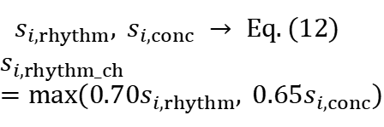
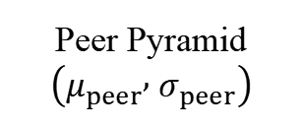
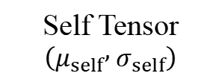








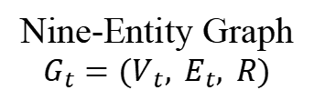


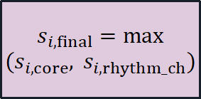
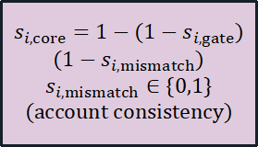
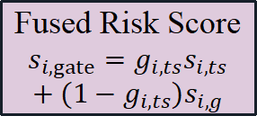


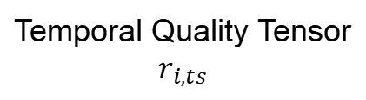



Module A: Score-Time Data & Multi-Scale Temporal Modeling
Module B: Stage-Aware Heterogeneous Graph Risk Propagation
Multi-Scale Feature Tensor
Self Tensor
$$\left(μ_{self} , σ_{self}\right)$$
Intra-Relation
Affinity Tensor
Transition
Matrix Block
$$X_{i,q,w}(t)$$
Nine-Entity Graph
$$G_{t}=(V_{t}, E_{t}, R)$$
Amount Freq
Stage YoY
Robust Directional
Scoring
$$c_{ij,r}=b_{r}[\text{stage}]·exp(−β_{r}Δt)·h_{ij}$$
$$\hat{W}=\sum_{r}{ζ_{r}}P^{\left(r\right)},\sum_{r}{ζ_{r}}=1$$
$$z_{i}^{+}=\frac{max(0, x_{i}−μ_{i})}{max(σ_{i}, σ_{min})+ε}$$
Unit
Payee
Project
PPR Diffusion
$$s_{i,g}(t)$$
Peer Pyramid
$$\left(μ_{peer} , σ_{peer}\right)$$
Application
Indicator
3D Transition
Tensor Stack
$$s_{i,ts}$$
Voucher
$$s_{i,ts}=\sum_{q,w}{ω_{q,w}}·tanh\left(κ_{q,w}z_{i,q,w}\right)$$
Item
Category
$$P^{\left(r\right)}$$
$$a_{max}≤t_{score}$$
7d 30d QTD YTD
Account
$$s_{i,rhythm}, s_{i,conc} → Eq.(12)$$
$$s_{i,rhythm_ch}=max(0.70s_{i,rhythm}, 0.65s_{i,conc})$$
$$s_{i,g,k+1}=ρs_{i,ts}+(1−ρ)\hat{W}s_{i,g,k}$$
Shrinkage Weight λ
$$q=(h+v)/2,λ=clip[0.1+0.8q, 0.1, 0.9]$$
$$μ_{i}=λμ_{i,self}+(1−λ)μ_{i,peer}$$
Relation Mixing $\sum_{r}{ζ_{r}}=1$
Module C: Node-Level Evidence Quality & Reliability Gating
Module D: Empirical Shrinkage Thresholding & Verifiable Audit Evidence
Temperature Gate:
Hierarchical Shrinkage Threshold
$$g_{i,ts}=\frac{exp(r_{i,ts}/T)}{exp(r_{i,ts}/T)+exp(r_{i,g}/T)}$$
Temporal Quality Tensor
$$r_{i,ts}$$
$$θ_{c}^{′}=\left[\frac{n_{c}}{n_{c}+γ}\right]θ_{c}+\left[\frac{γ}{n_{c}+γ}\right]θ_{global},γ=30$$
Feature
(x, μ, z
deviation)
History
(self/peer
trajectory)
$$s_{i,ts}$$
(effective history
· feature coverage
· robust scale stability)
Fused Risk Score
$$s_{i,gate}=g_{i,ts}s_{i,ts}$$
$$+ (1−g_{i,ts})s_{i,g}$$
$$s_{i,core}=1−(1−s_{i,gate})$$
$$(1−s_{i,mismatch})$$
$$s_{i,mismatch}∈\{0,1\}$$
$$\text{(}\text{account} \text{consistency}\text{)}$$
Graph Quality Tensor
$$r_{i,g}$$
Rule
(Rule ID,
version)
Relation
(top-k
PPR paths)
$$s_{i,g}$$
(valid neighbours
· relation-type coverage
· topology stability)
$$s_{i,final}=max$$
$$(s_{i,core}, s_{i,rhythm_ch})$$
Normal / Warning / HighRisk
Risk Spectrum
Verifiable Evidence Package
$$E_{i}$$

