Slide 1
MEDICARE BILLING ANALYTICS
Healthcare Fraud
Detection System
An AI-powered pipeline that analyzes Medicare billing data to identify suspicious providers combining peer-group benchmarking, machine learning anomaly detection, and federal exclusion list cross-referencing.
44,528
3,842
1,247
Providers Analyzed
High Risk Flagged
Critical Priority

Slide 2
The Challenges
Medicare fraud costs the U.S. healthcare system an estimated $60–100 billion annually.
Massive Scale
Hidden Anomalies
Upcoding Abuse
Millions of billing records to review — far beyond manual capacity.
Unusual billing is only visible when providers are benchmarked against peers.
Providers may bill for higher-complexity services than actually performed.
Duplicate Claims
Active Exclusions
Repeated submissions go undetected without systematic pattern analysis.
OIG-excluded providers may still appear in active CMS billing records.

Slide 3
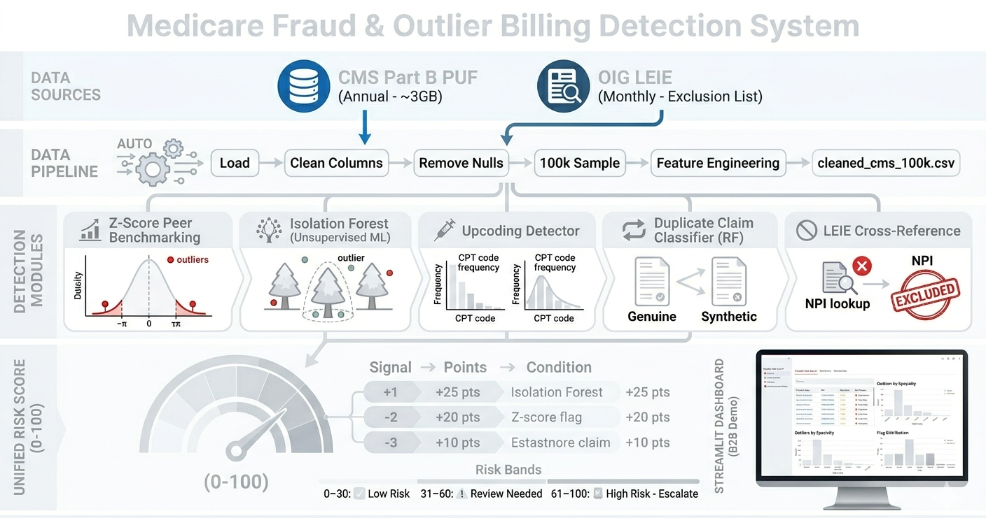
Our Approach

Slide 4
Key Outcomes
44,528
3,842
1,247
~96%
Total Providers Analyzed
High Risk Providers Identified
Critical Priority Cases
Duplicate Classifier Accuracy
2,914
1,200+
90+
11,276
Upcoding Flags
Peer Groups
Provider Types
Medium Risk Providers
DELIVERABLES
— Risk-scored provider dataset with Fraud Risk Score per provider
— Prioritized shortlists: Critical, High, and Top-100 suspicious providers
— Duplicate claim report and Random Forest classification report
— Upcoding scores for all E&M codes (99211–99215)
— LEIE cross-reference: active exclusion matches with NPI-level detail
— Visual charts and executive summary report for investigator use

