Slide 1
AI-POWERED FRAUD DETECTION
Healthcare Fraud
Detection System
Detecting Suspicious Medicare Billing Patterns
using Machine Learning & OIG LEIE Cross-Reference
CMS Medicare Data
OIG LEIE Exclusions
Isolation Forest
Random Forest
Z-Score Analysis

Slide 2
What is This Project?
Project Overview
Providers Analyzed
44,500+
An AI-powered system that analyzes Medicare billing data to detect suspicious providers engaging in fraud, waste, or abuse.
Built using real CMS (Centers for Medicare & Medicaid Services) data combined with the OIG LEIE exclusion list — a federal database of healthcare providers barred from Medicare.
The system combines rule-based analysis, peer-group benchmarking, and machine learning to assign a Fraud Risk Score to every provider.
Peer Groups Created
1,200+
High Risk Flagged
3,842
ML Models Deployed
4
⚠ Important: This system identifies suspicious providers for investigation — it does not prove fraud.

Slide 3
Problem Statement
$60–100B
Manual Review
Need:
Automated &
Scalable
Detection
is slow, inconsistent
& misses patterns at scale
lost annually to Medicare
fraud, waste & abuse
📊
🔍
⚠️
Massive Scale
Hidden Patterns
Exclusion Gaps
Millions of Medicare billing records — impossible to review manually
Fraudulent providers disguise claims within normal-looking billing
Excluded providers still active in CMS data undetected

Slide 4
Project Objectives
01
02
03
Detect Billing Outliers
Apply Anomaly Detection
Catch Upcoding Fraud
Identify providers whose billing patterns deviate significantly from peers in same specialty & state using Z-score analysis.
Use Isolation Forest ML model to flag statistically unusual providers based on payment, service volume & HCPCS diversity.
Detect providers over-billing high-value E&M codes (99211–99215) compared to their peer group average.
04
05
Flag Duplicate Claims
Cross-Reference LEIE
Train a Random Forest classifier to identify providers with duplicate-like billing patterns.
Match providers against OIG's federal exclusion list — flagging any still-active excluded provider found in CMS data.

Slide 5
Data Sources & Methodology
📂 CMS Medicare Data
🚫 OIG LEIE Exclusion List
MUP_PHY Physician & Practitioner Services file
Columns: NPI, Provider Type, State, HCPCS codes, payments, services, beneficiaries
Large file loaded in chunks (100K rows/chunk)
Federal list of providers excluded from Medicare participation
Columns: NPI, name, exclusion type, exclusion date, reinstatement date
Downloaded directly from OIG website
Analysis Pipeline
Data
Ingest
Clean &
Engineer
Peer Group
Benchmark
ML
Models
Risk
Scoring
Reports &
Deliverables

Slide 6
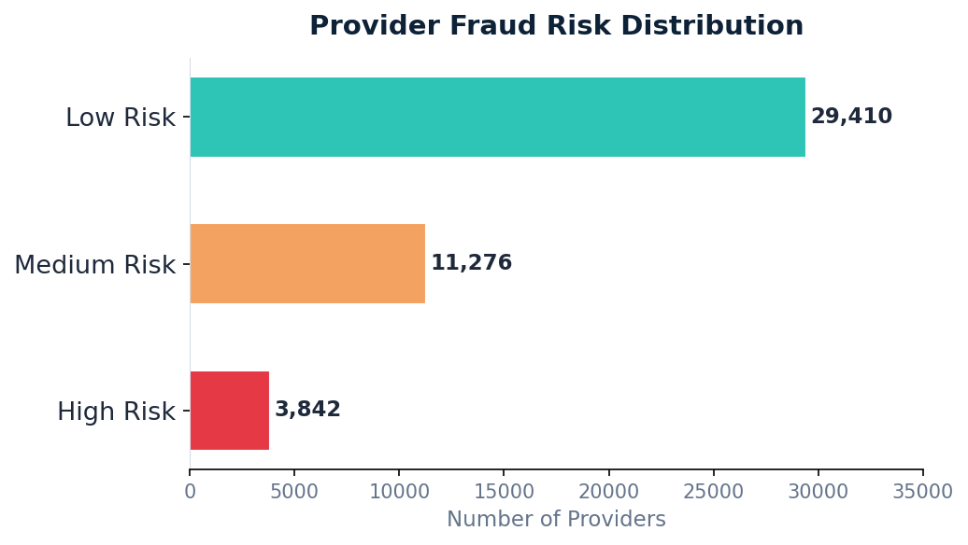
ML Models & Detection Methods
Z-Score Outlier Detection
Flag providers with any metric > 3 std devs above peer mean
Isolation Forest
Unsupervised anomaly detection (contamination=5%, 200 trees)
E&M Upcoding Detector
Flag providers over-billing HCPCS 99211–99215 codes
Random Forest Classifier
Detect duplicate-like claim patterns (supervised)
Project Output: Risk Distribution
LEIE NPI Cross-Reference
Match active excluded providers from OIG federal list

Slide 7
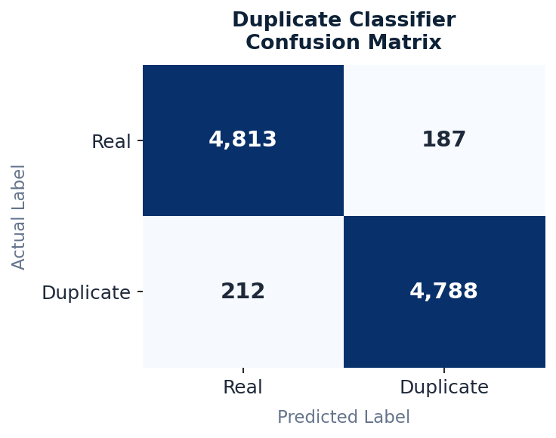
Deliverables & Results
44,528
3,842
Total Providers
Analyzed
High Risk
Providers Flagged
1,247
2,914
Critical Priority
Providers
Upcoding
Flags
1,200+
96%
Peer Groups
Created
Classifier
Accuracy
Key Output Files:
Duplicate Classifier Performance
outlier_flags.csv | upcoding_scores.csv | critical_priority_providers.csv | duplicate_classifier_report.csv | leie_matches.csv

Slide 8
Conclusion & Solution
What the System Achieves
Fraud Risk Score
✔ Automated detection of billing outliers across 44,000+ providers
✔ Peer-group benchmarking by specialty & state (1,200+ groups)
✔ ML models (Isolation Forest + Random Forest) for anomaly & duplicate detection
✔ E&M upcoding detection for over-billed consultation codes
✔ LEIE cross-reference to catch excluded providers still billing Medicare
🔴 High Risk
Score ≥ 3
🟠 Medium Risk
Score 1–2
🟢 Low Risk
Score = 0
Key Takeaway
This project provides a scalable, data-driven solution for healthcare fraud detection — replacing slow manual audits with an automated investigation pipeline that prioritizes the highest-risk providers for review.

