Slide 1
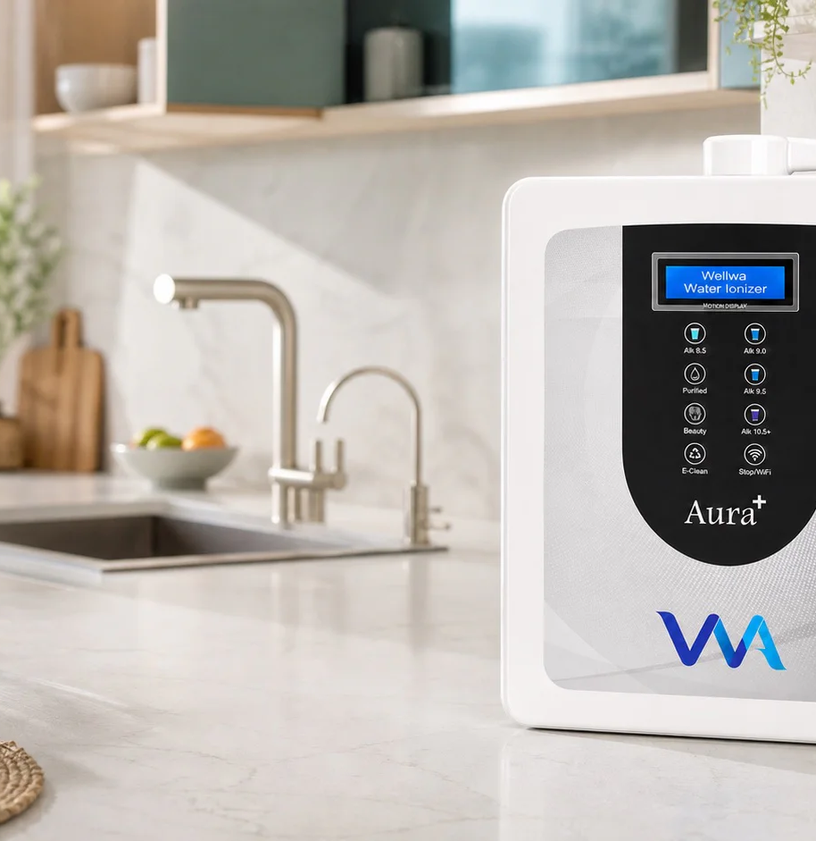

Smart water.
Connected care.
Wellwa distributor business opportunity overview
Product-led • Demo-led • Service-supported
Verified product information • August 2026
Notes:
[Sources]
- https://wellwalife.com/
- Official Wellwa asset: /images/wellwa-aura-plus-kitchen-hero.webp

Slide 2
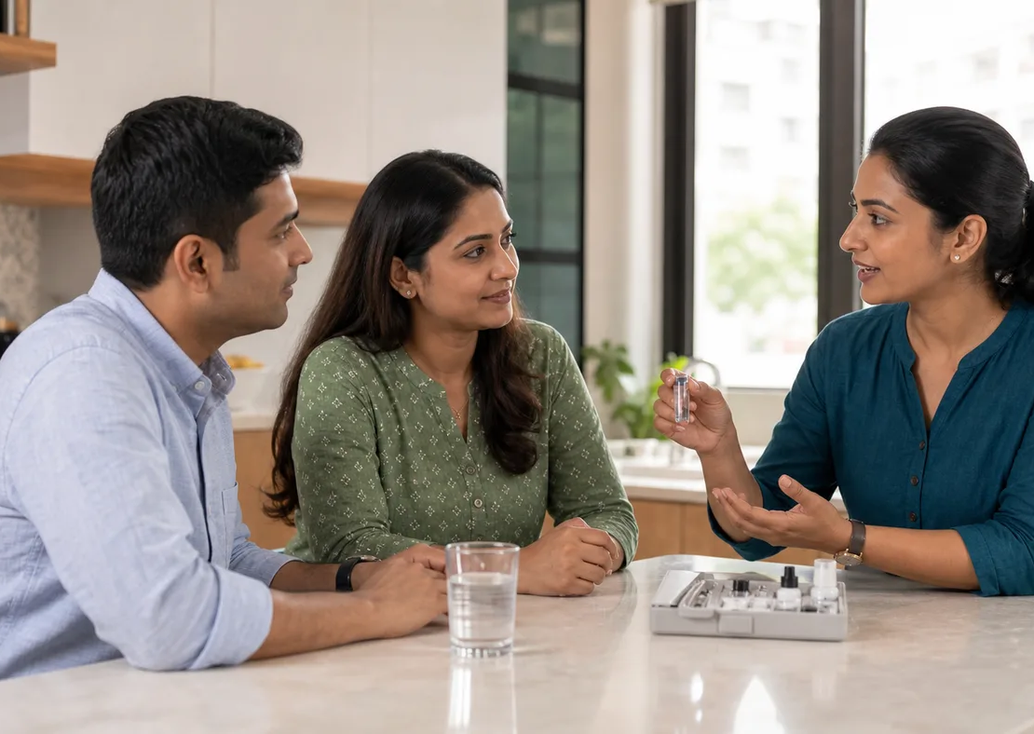
CUSTOMER FIRST
The proposition begins with a better consultation
A responsible distributor helps a household make an informed choice—not a medical promise.
01
Review the source water
City, source, TDS, hardness and pre-filtration affect compatibility.
02
Compare the right model
Use household size, daily usage and desired connected features.
03
Set expectations clearly
Published output varies with water quality, temperature, flow and calibration.
WELLWA LIFE • BUSINESS OPPORTUNITY OVERVIEW 02
Notes:
The image is illustrative and does not depict a named customer or an actual Wellwa demo.
[Sources]
- https://wellwalife.com/
- OpenAI-generated illustrative asset: home-demo-consultation.png

Slide 3
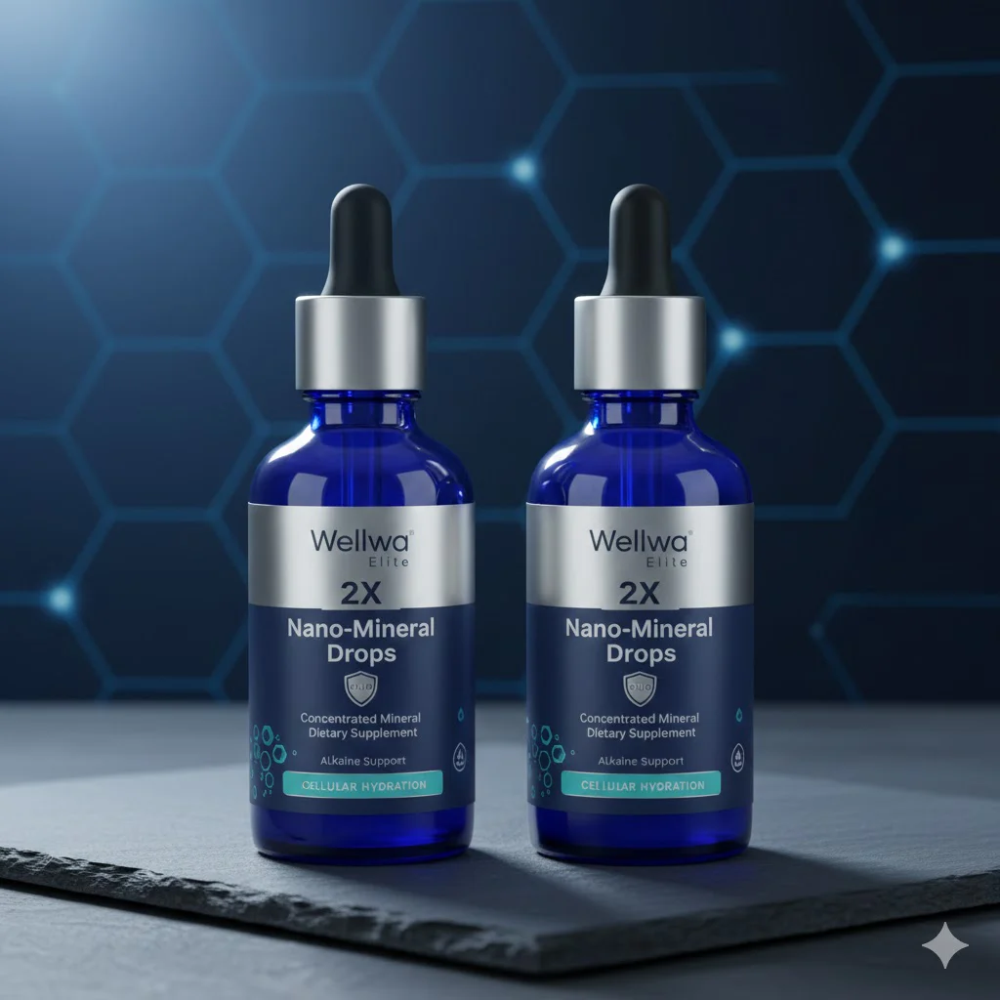
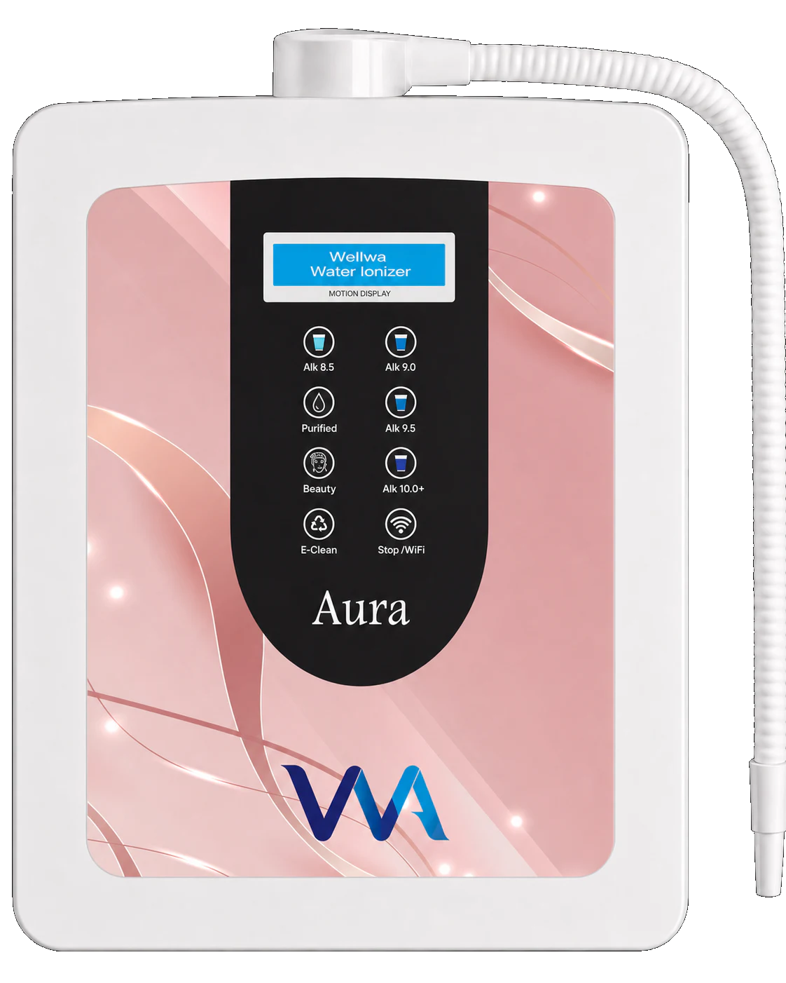
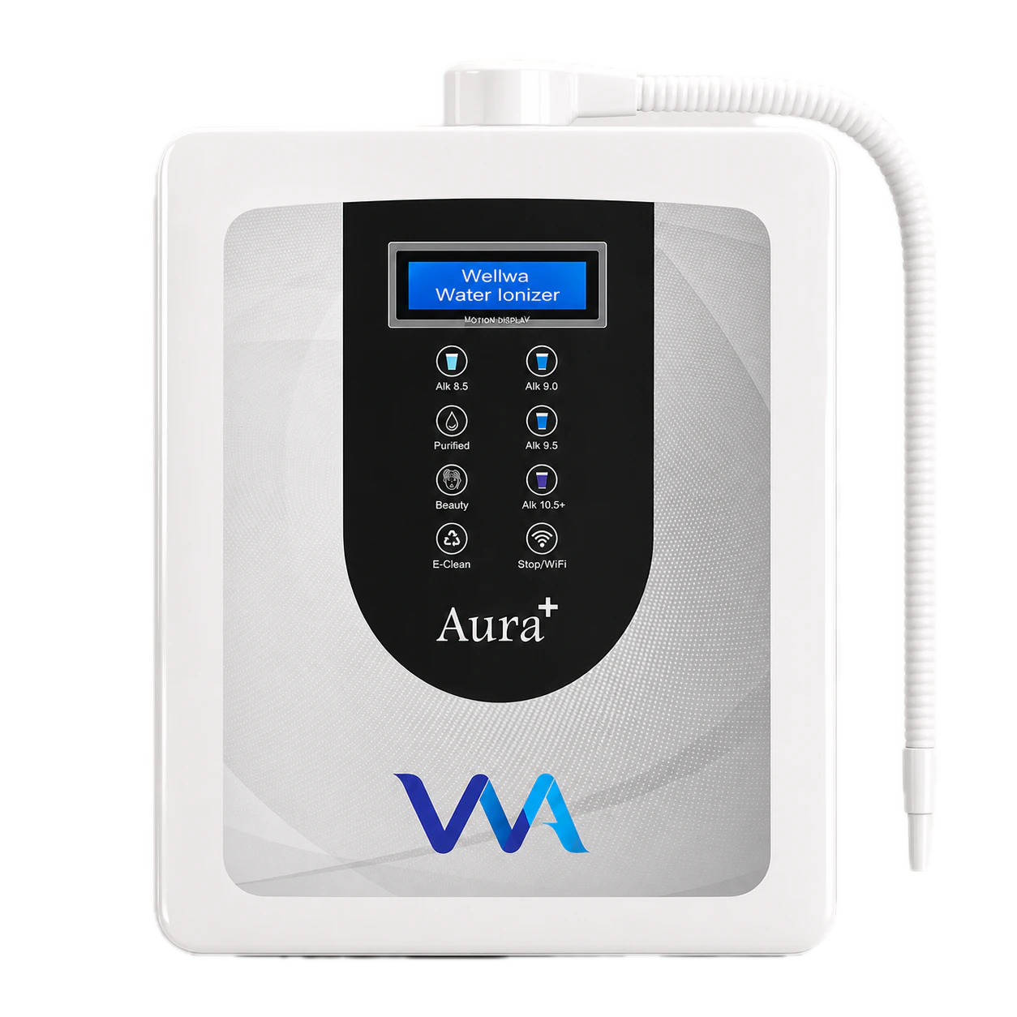
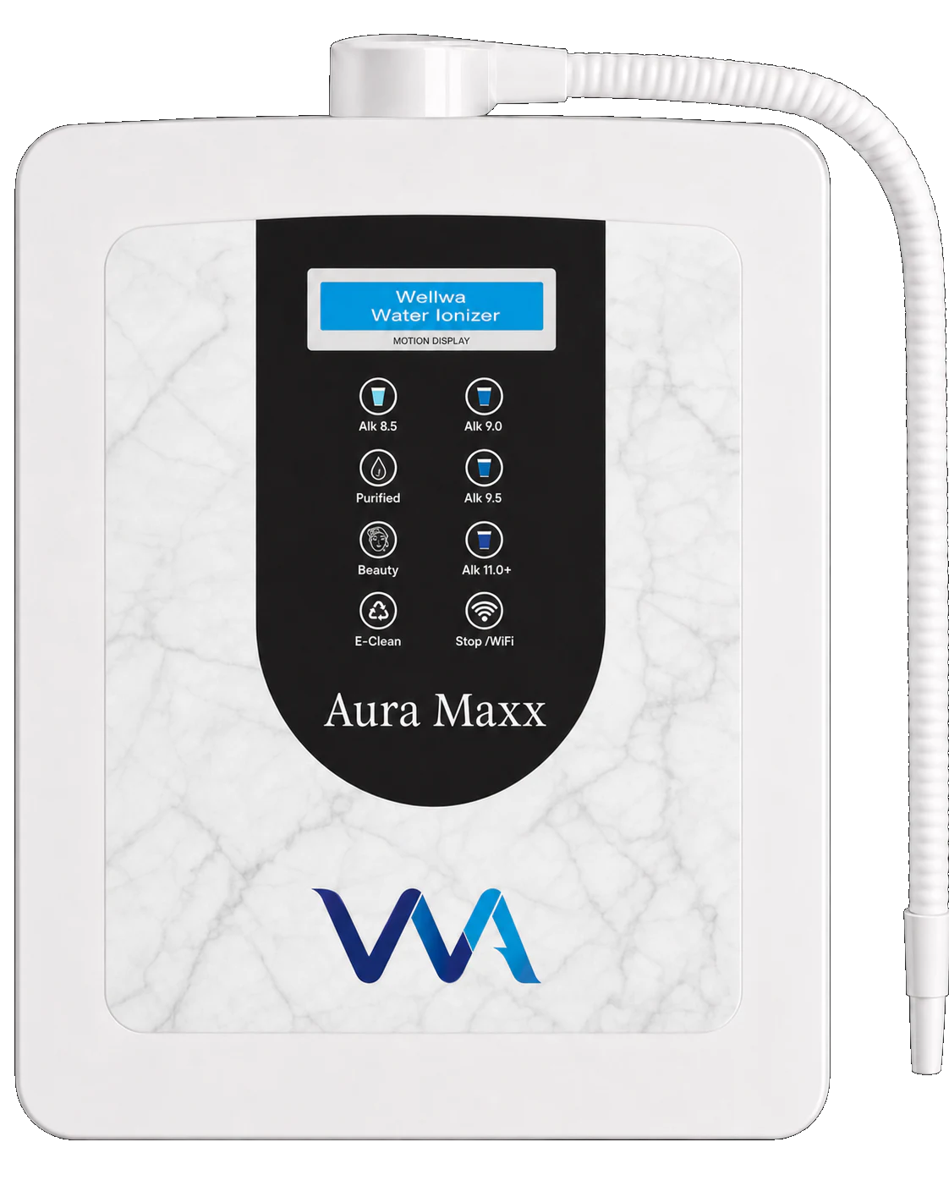
PRODUCT RANGE
Four entry points serve different household needs
START HERE
ESSENTIAL
MOST POPULAR
MAX PERFORMANCE
Starter Pack
Aura
Aura Plus
Aura Maxx
Wellness starter
Smart 5-plate ionizer
Smart 7-plate ionizer
Smart 8-plate ionizer
₹11,800
₹90,000
₹1,25,000
₹1,50,000
Published retail prices shown. Confirm current stock, tax, installation and commercial terms before sale.
WELLWA LIFE • BUSINESS OPPORTUNITY OVERVIEW 03
Notes:
[Sources]
- https://wellwalife.com/
- https://wellwalife.com/products
- Official Wellwa product image assets under https://wellwalife.com/products/

Slide 4
AURA COMPARISON
Model choice is a fit decision—not a ranking
AURA
AURA PLUS
AURA MAXX
Compact everyday use
Balanced family flagship
Larger families / high usage
Electrolysis
5 plates
Electrolysis
7 plates
Electrolysis
8 plates
Published pH
4.0–10.0+
Published pH
3.5–10.5+
Published pH
3.0–11.0+
ORP estimate
Up to −750 mV
ORP estimate
Up to −800 mV
ORP estimate
Up to −850 mV
Hydrogen H₂
Up to 1,500 ppb
Hydrogen H₂
Up to 1,600 ppb
Hydrogen H₂
Up to 1,800 ppb
Actual pH, ORP and dissolved hydrogen vary with source water, mineral content, temperature, flow rate and calibration.
WELLWA LIFE • BUSINESS OPPORTUNITY OVERVIEW 04
Notes:
[Sources]
- https://wellwalife.com/
- https://wellwalife.com/compare

Slide 5
TECHNOLOGY
Connected care extends the relationship after installation
01
Remote controls
02
Live machine health
Start, stop and choose supported water modes.
Connection, operating state and care alerts.
03
Remote diagnostics
04
OTA-ready updates
Service teams can review supported telemetry.
Supported firmware can be maintained remotely.
Guided setup uses a compatible 2.4 GHz Wi‑Fi network. The machine’s water function and supported app features should be explained separately.
WELLWA LIFE • BUSINESS OPPORTUNITY OVERVIEW 05
Notes:
[Sources]
- https://wellwalife.com/
- https://wellwalife.com/technology

Slide 6
CUSTOMER EXPERIENCE
A clear ownership journey builds trust
01
02
03
04
Water review
Model consultation
Installation
Connected care
Source, usage and compatibility
Compare the Aura range
Plumbing, setup and handover
App pairing, alerts and support
The distributor owns the education and follow-up; trained service teams own technical installation and diagnostics.
WELLWA LIFE • BUSINESS OPPORTUNITY OVERVIEW 06
Notes:
[Sources]
- https://wellwalife.com/

Slide 7

BUSINESS MODEL
The distributor role is local, practical and relationship-led
Educate
Explain the product, water compatibility and connected features accurately.
Demonstrate
Arrange consultations and product demonstrations where available.
Convert
Help the household select a model and complete the official buying process.
Follow up
Support app adoption, care reminders and service escalation.
No medical claims • No guaranteed income • Written terms only
WELLWA LIFE • BUSINESS OPPORTUNITY OVERVIEW 07
Notes:
The image is illustrative and does not depict a named distributor or an actual Wellwa event.
[Sources]
- https://wellwalife.com/distributor/apply
- OpenAI-generated illustrative asset: distributor-training.png

Slide 8
90-DAY LAUNCH PATH
Start with capability before scale
DAYS 1–15
DAYS 16–30
DAYS 31–60
DAYS 61–90
Learn
Practice
Activate
Improve
Product range
Water-source basics
Claims & compliance
Demo script
Objection handling
CRM follow-up
Local consultations
Referral partners
Weekly content
Review funnel
Strengthen follow-up
Escalate service well
Before investing, request the current official agreement, fees, margin/commission schedule, returns policy, territory rules and support commitments in writing.
WELLWA LIFE • BUSINESS OPPORTUNITY OVERVIEW 08
Notes:
This launch path is a practical operating recommendation, not an official compensation plan or earnings projection.
[Sources]
- https://wellwalife.com/distributor/apply

Slide 9
NEXT STEP
Experience the product.
Then evaluate the business.
Book a product consultation, review the Aura range, and request the current official distributor terms before making a decision.
wellwalife.com/distributor/apply
+91 74109 95599 • info@wellwalife.com
Notes:
[Sources]
- https://wellwalife.com/
- https://wellwalife.com/distributor/apply

