Slide 1
Elderly People Care ~With Empathy, More Love~
Felecan Maria – Iulia
Gherasim Delia – Catalina
933 - PPI

Slide 2
Table of contents
01
02
03
04
06
07
Market Opportunities
Needs met
Client Profile
05
Value Proposition
Business model
Functionalities
Artificial Intelligence
Deployment
08

Slide 3
Market Opportunities
Lack of control
Technological Struggles
Illness
As people age, they feel powerless in their health struggles, lacking control over their life
Elderly people have a hard time with technology
Even the smallest health issues should be monitored to ensure prevention

Slide 4
Currently, there are 153 million elderly people in Europe
81%
30%
94%
81% elderly in France believe technology could improve the monitoring of their daily health
In Spain 2020, 30% of the elderly population were diagnosed with depression
94% of seniors in Italy believe having digital skills is important

Slide 5
Our Mission
Improve cognitive abilities and provide learning opportunities
Communicate directly with the user’s general health provider
Improve overall health through different
games
Offer an easy to use platform designed for elderly people
Give relatives peace of mind with access to loved one's health info.
01
02
03
04
05

Slide 6
Easiest way for seniors to have control over their health, but … How?
Physical benefits :
Save time by automating health tracking
Predict and prevent a possible disease
Build healthy habits over time
Statistics about user's health are easy to access, and periodically sent to the user’s contacts (doctor and relative)
Psychological benefits :
Be cared for and feel included
Have an online secure journal, where they can write their feelings safely, without judgement
Read positive health news
Enjoy stress-free and intuitive navigation on the platform

Slide 7
Client Profile
Between 30 and 50 years old, compassionate and worried about the elderly people in their lives
In 2015, over three quarters of people expressed concern over caring for elderly relatives
.
Struggles with not being
able to take care of their relatives
as much as they would want
Our Client should feel at ease when thinking about their elderly relatives

Slide 8
User Profile
Over 65 years old, has a curious personality and wants to improve their health
Needs: Medical advice, understanding and compassion
Goal: Improve life quality and keep track of symptoms for a possible diagnosis
Struggles: going to the doctor is
inconvenient / inaccessible
Hard time using technology
Our ﻿ user deserves to have a trustworthy and easy to use platform to track their health

Slide 9
Bussiness Model
Key partners
Customer relationships
Healthcare Providers
Senior Care Organizations
Mental Health Experts
Insurance Companies
Weekly: send summaries of health progress
As needed: push notifications
Key resources
Key activities
Technology
Medical Expertise
Marketing Team
Customer Support
Legal Team
Free and subscription model
Referral programs
Customer support
Free and premium subscription options, allowing users to choose the experience that best suits their needs
Key Propositions
Peace of mind for caregivers
Improved quality of life for users
Personalized health care
Companionship and security
Channels
Digital advertising
Partnerships
Offline Outreach

Slide 10
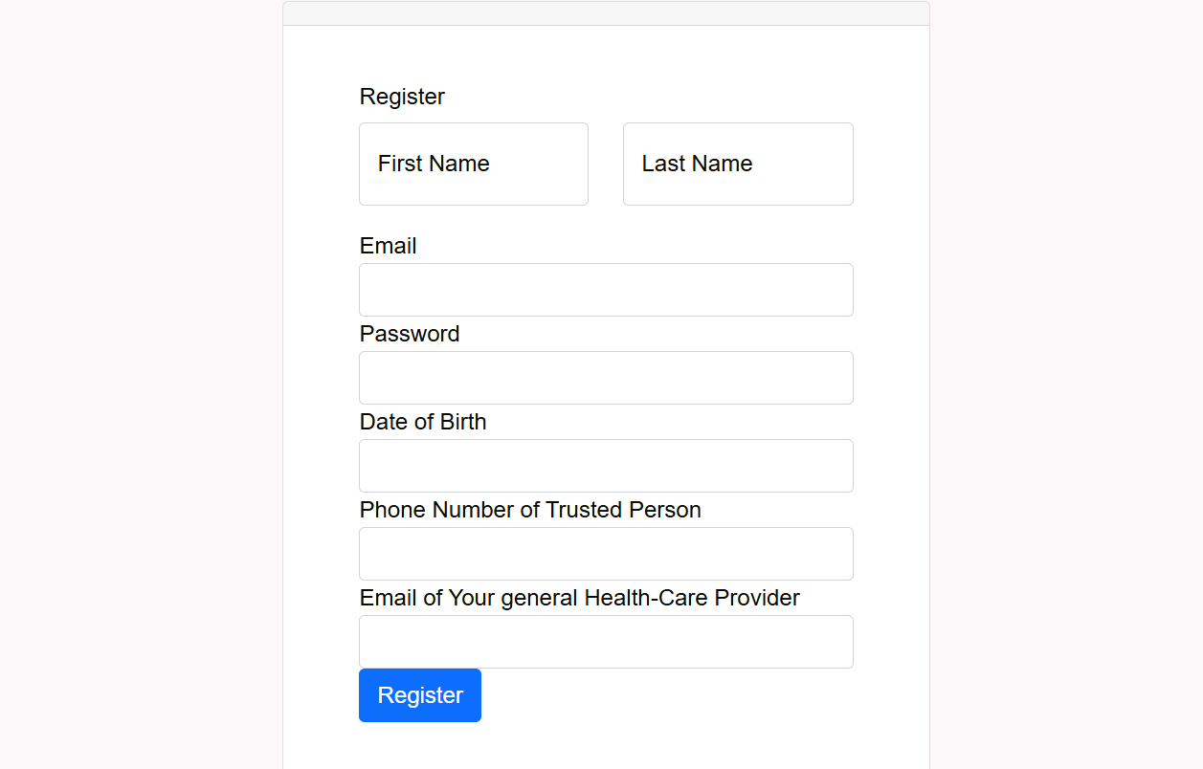
Log In and Register
Users can easily create an account
If a user forgets their password, they can easily change it from their email
Each user’s data is securely stored in a private database, through different hashing methods
Future implementations of the app will allow the user to detail their pre-existing health conditions

Slide 11
Statistics
Articles
A detailed overview of one’s health issues in time, which can be downloaded and are sent periodically to the user’s health care provider and relatives
We provide both a custom search engine and positive articles about the user’s symptoms
Games
Calendar
Score based, entertaining quizzes and challenges meant to improve the user’s health
See the reported symptoms and feelings, sorted chronologically for a better understanding of patterns

Slide 12
AI Diagnosis Tool
Balanced Accuracy: 0.89
Trained on the Disease-Symptom-Extensive-Clean dataset.
When a user provides details about their physical and mental state, our diagnosis engine is notified and provided with the new symptoms.
The model predicts a new diagnosis taking into consideration recent symptoms and sends it to our server so the new possible diagnosis can be displayed to the user.
Random Forest Classifier
Handles imbalanced data well
Can capture complex relationships between symptoms and diseases
Deployment via Flask API
/search_symptoms: Allows users to search symptoms and get matching suggestions
/predict: Accepts symptoms and returns the predicted disease

Slide 13
Feelings
The user can describe how they are feeling, knowing that their mental state is kept safe in a digital journal
The user can select from a list of symptoms, provide a description and intensity rating
Symptoms

Slide 14
Deployment
Google Cloud Platform
Deploy API to GCP
-> We used GCP App Engine to host the Flask application container.
->We configured the endpoint URLs and enable HTTPS to ensure secure communication.
Deploy ASP.NET Application
-> Host Application: We host the ASP.NET app on GCP App Engine or Compute Engine.
-> Frontend Integration: We ensure the frontend communicates with the Flask API securely via HTTPS.

Slide 15
—Shannon L. Alder
“One of the most important things you can do on this earth is to let people know they are not alone.”

Slide 16
Thank You!

