Slide 1

The Movie Dataset Analysis
Group Name: Q
CHEN ZHILONG (MB955229)
CHAO HOU KIT (MB955428)
WENG ZHENKUN(MB955482)
Faculty of Science and Technology
UNIVERSITY OF MACAU

Slide 2
01
Introduction to dataset
02
Python Library
CONTENT
03
Data Processing
04
Data Analysis
05
Conclusion

Slide 3
1
PART ONE
Introduction to Dataset

Slide 4
Dataset
The dataset is from Kaggle (The Movies Dataset)
1. movies_metadata.csv (32.8MB)
2. credits.csv (181MB)
movies = pd.read_csv('movies_metadata.csv',encoding='utf-8',low_memory=False)
credits = pd.read_csv('credits.csv',encoding='utf-8')

Slide 5
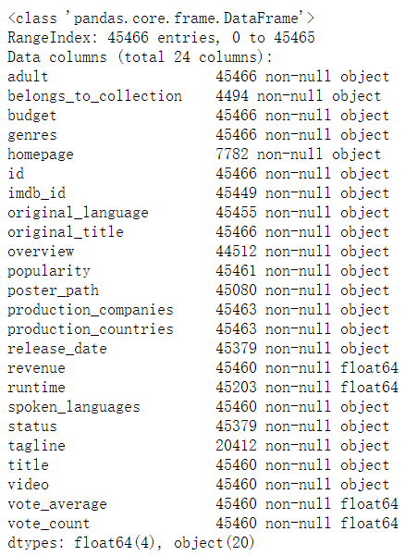
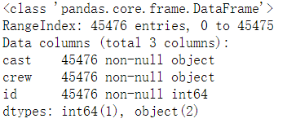
Dataset Column Information

Slide 6
2
PART TWO
Python Library

Slide 7
Python Library
1. Abstract Syntax Tree (AST)
Abstract Syntax Tree (AST) is a very strong features in Python. Python AST module allows us to interact with Python code itself and modify it.
movies[i]=movies[i].apply(ast.literal_eval).apply(json.dumps)
movies[i]=movies[i].apply(json.loads)

Slide 8
Python Library
2. SEABORN
Seaborn is a library for making statistical graphics in Python. It is built on top of matplotlib and closely integrated with pandas data structures.
seaborn.replot() → Regression Line in scatterplot

Slide 9
3
PART THREE
Data Processing

Slide 10
Data Processing
production_countries not in json type → ‘[]’
2. Extract related information in some fields
3. Change the type of ‘id’ and etc. from string to float.
movies['id']=movies['id'].apply(pd.to_numeric,errors = 'coerce’)
Merge two datasets, movies and credits.
df = pd.merge(movies,credits,how='left',on='id')

Slide 11
Data Processing
5. Drop Useless Column and Rename Column
credits.rename(columns={'crew':'director'},inplace = True)
del credits['cast’]
df.drop(['homepage’, 'overview', 'status','video'],axis=1,inplace=True)
6. Nan Values Processing
df['runtime']=df['runtime'].fillna(df.runtime.mean())
df=df.dropna(axis=0,how='any',subset=['director','release_date’])
df.isnull().sum().sort_values(ascending=False)

Slide 12
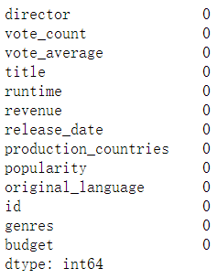
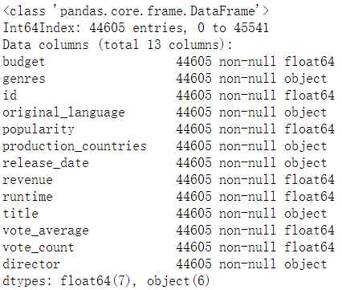
Data Processing Result

Slide 13
4
PART FOUR
Data Analysis

Slide 14
Fields Explanation
1) title: movie title
2) director: director
3) budget: budget (USD)
4) genres: style list, movie type
5) id: identification number
6) popularity: relative page views on Movie Database
7) production_countries: production countries
8) release_date: release time
9) revenue: revenue (USD)
10) runtime: movie duration
11) vote_average: average rating
12) vote_count: number of ratings
13) original_language: movie language

Slide 15
Purpose
The amount of movie over year.
The amount of movie in different genres.
The most profitable and popularity movie genres.
The amount of movie from different countries.
Revenue and budget and vote average(rating).
The director who shoots the most movies.

Slide 16
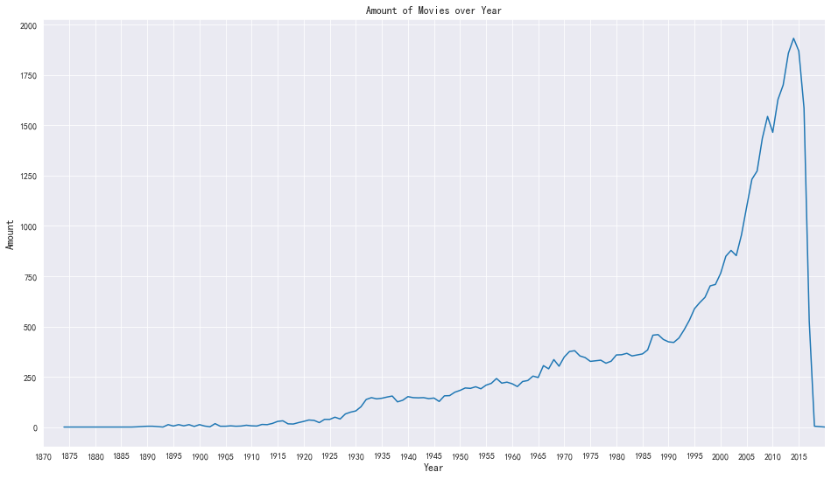
1. The amount of movie over year
The amount of movie has a significant increasing from 1990.

Slide 17
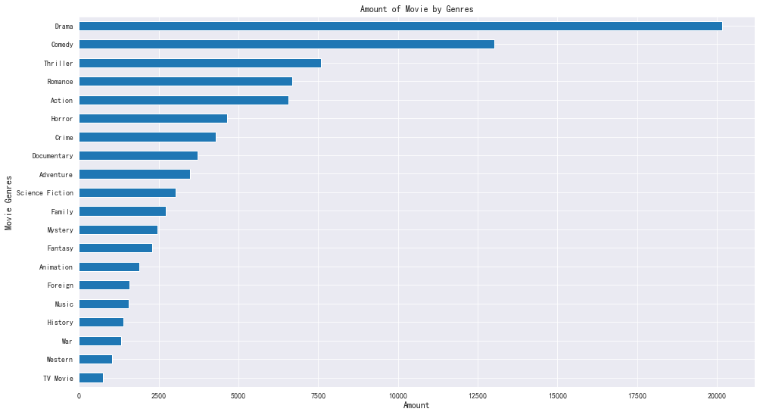
2. The amount of movie in different genres.
The total amount of Drama and Comedy is the most.

Slide 18
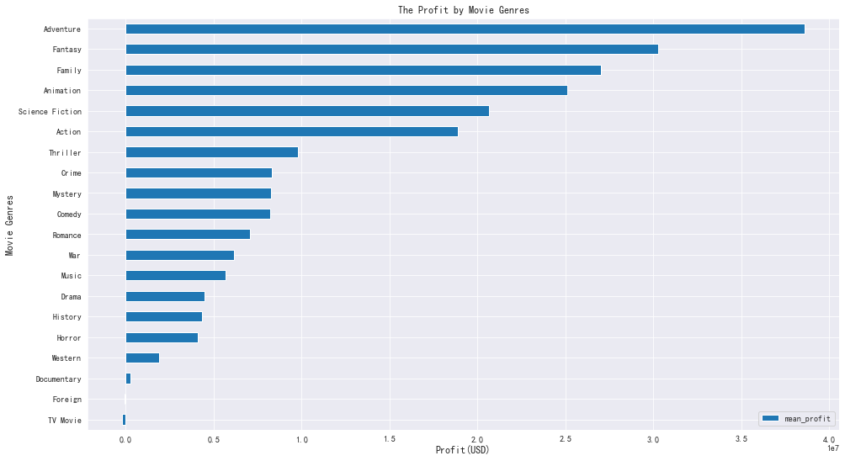
3. The most profitable and popularity movie genres.
Adventure, Fantasy and Family are the most profitable.
Foreign is not profitable and TV Movie is loss.

Slide 19
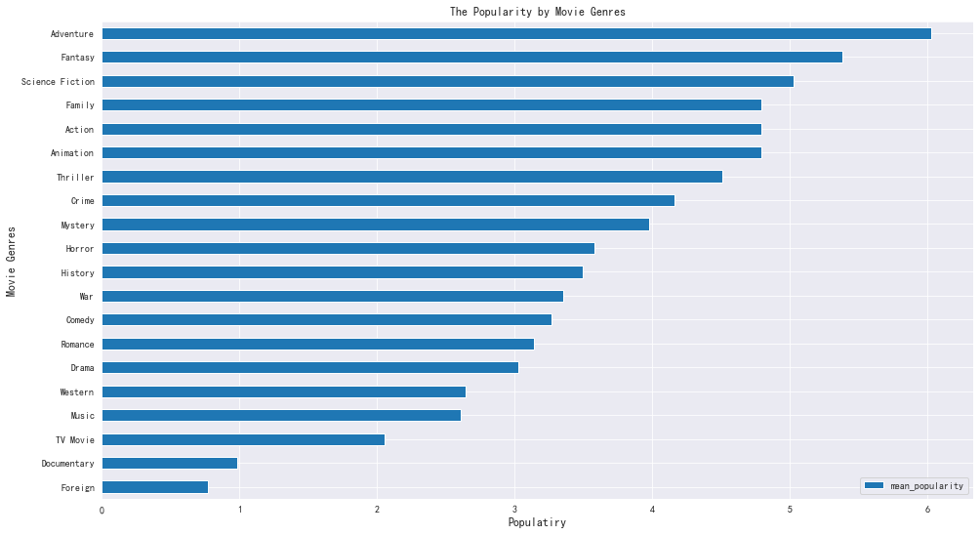
3. The most profitable and popularity movie genres.
The most popularity movie genres are Adventure, Fantasy, Science Fiction and Family.

Slide 20
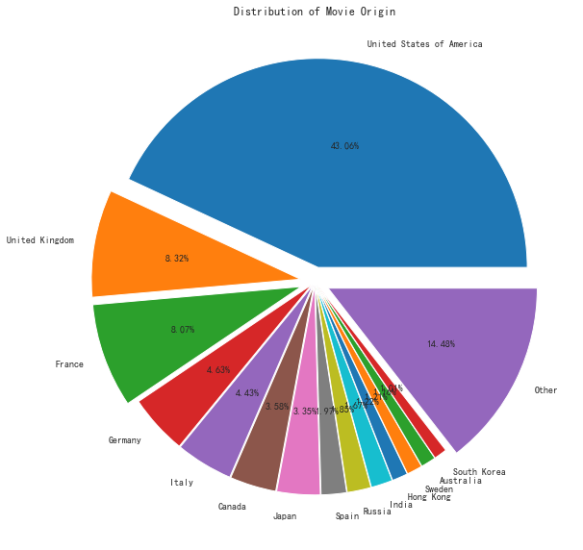
4. The amount of movie from different countries.
United States of America has the most movie production and it is 43.06% of the total.

Slide 21
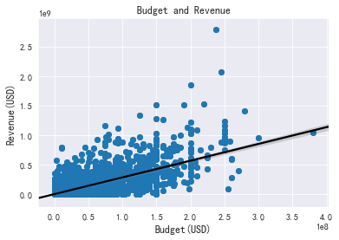
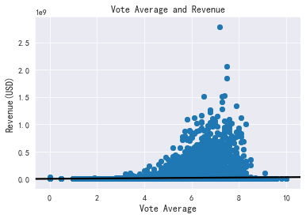
5. Revenue Vs. Budget and Vote Average(rating).
Positive Correlations
No Correlations

Slide 22
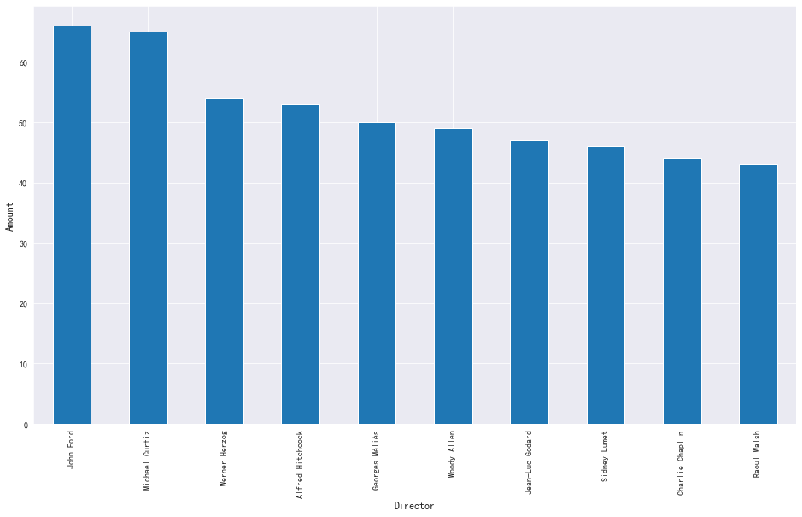
6. The director who shoots the most movies.
Top 3 :
John Ford
Michael Curtiz
Werner Herzog.

Slide 23
5
PART FOUR
Conclusion

Slide 24
Conclusion
1. The movies industry has grown rapidly since 1990, and Drama, Comedy have a significant increasing and have the most amount.
2. Adventure, Fantasy and Family are recommended for company to shoot. They are the most profitable and popularity movie genres.
3. Movie company should increase the budget which is beneficial for improving the movie quality.

Slide 25


Slide 26
Thanks For Attention!

Slide 27
Reference
[1] https://kite.com/python/docs/ast.literal_eval
[2] https://seaborn.pydata.org/
[3] https://xbuba.com/questions/53042478
[4] https://www.kaggle.com/rounakbanik/the-movies-dataset
[5] https://blog.csdn.net/xc_zhou/article/details/81458388

