Slide 1
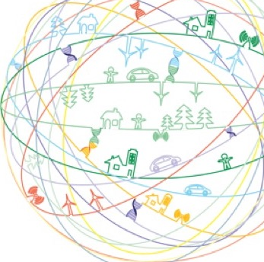




EIPS On Location Privacy in Fingerprinting-based Indoor Positioning System: An Encryption Approach Wenlu Wang

Slide 2
01
02
03
IPS
Motivation
Preliminary
04
05
06
Overview
EIPS
Experiments

Slide 3
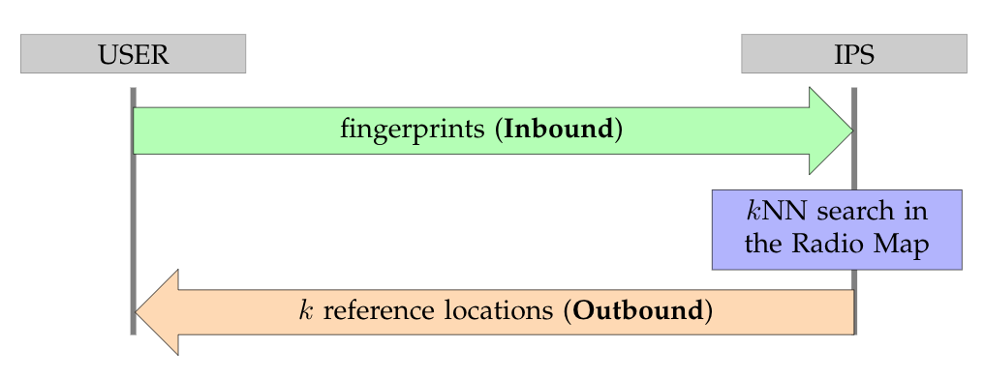
Indoor Positioning System (IPS)
GPS signals are not available in indoor spaces. An IPS is a network of devices used to locate users or objects.
WiFi
Bluetooth
Radio Frequency Identification (RFID)
Smartphones are popular and easy to acquire, so we target WiFi Fingerprinting-based IPS.

Slide 4
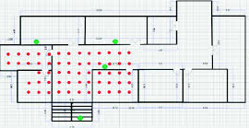
[IPS] Off-line Radio Map initialization
Reference Location
Access Point (AP)
RSS1
RSS2
RSS3
RSS4
Figure ref: Indoor Positioning Using Adaptive KNN Algorithm Based Fingerprint Technique.
In International Conference on Broadband Communications, Networks and Systems
Store the received signal strength (RSS) at all the reference locations, named as Radio Map.
<[RSS1, RSS2, RSS3, RSS4], coordinate of >

Slide 5
[IPS] Online localization

Slide 6
01
02
03
IPS
Motivation
Preliminary
04
05
06
Overview
EIPS
Experiments

Slide 7
Motivation
[Privacy Concerns] The localization operations are uncontrollable by users since the Radio Map are stored and operated on the server-side. The server is able to track a user at a fine granularity.
[SOTA] TVM retrieves extra reference records to anonymize the real ones using bloom filter, which incurs extensive memory cost on smart phones.
[Challenges]
An IPS should not receive a user’s query (e.g., fingerprints) in plain text.
An IPS should not be able to infer a user’s location based on the query.

Slide 8
01
02
03
IPS
Motivation
Preliminary
04
05
06
Overview
EIPS
Experiments

Slide 9
Preliminary
IPS involves kNN search -> We propose to use a privacy-preserving encryption-based kNN search: Asymmetric Scalar-product Preserving Encryption (ASPE).
ASPE does not resist known plain text attack (KPA).
We introduce a centralized server (who holds the encryption key), called EDS (Encryption & Decryption Server).
Alleviate the burden of smartphones.
EDS is neutral.

Slide 10
01
02
03
IPS
Motivation
Preliminary
04
05
06
Overview
EIPS
Experiments

Slide 11
Overview
We propose to develop a bidirectional commutative cipher to resist KPA with the help of EDS.
Commutative Cipher + ASPE: privacy-preserving kNN
We propose our own additional operations to resist KPA.
Benefit I: We use encrypted databases that support encrypted query.
Benefit II: Our proposed communication scheme resists KPA.
In summary, we tackle the technical challenges of enabling users to acquire their positions from IPS while preserving their privacy.
Notes:
We alleviate the computation burden of smartphones, and transfer the workload to centralized servers, even though such transformation incurs extra I/Os, which is minimum compared with high computation cost on smartphones.
Under the assumption that the centralized server which holds the encryption key is neutral, we can safely assume the users’ locations remain private to users without loss of accuracy and efficiency.

Slide 12
Main Ideas
Instead of anonymizing the real locations using extra fake records, we use encryption to achieve anonymity.
Encryption is considerably vulnerable towards KPA, we take advantages of features of ASPE, commutative ciphers, and cryptographic techniques to address this challenge.

Slide 13
Pros
No computational or memory requirement for smartphones.
Highly secure under privacy attacks.
Cons
Increase the number of transitions.
Another party EDS is introduced.

Slide 14
01
02
03
IPS
Motivation
Preliminary
04
05
06
Overview
EIPS
Experiments

Slide 15
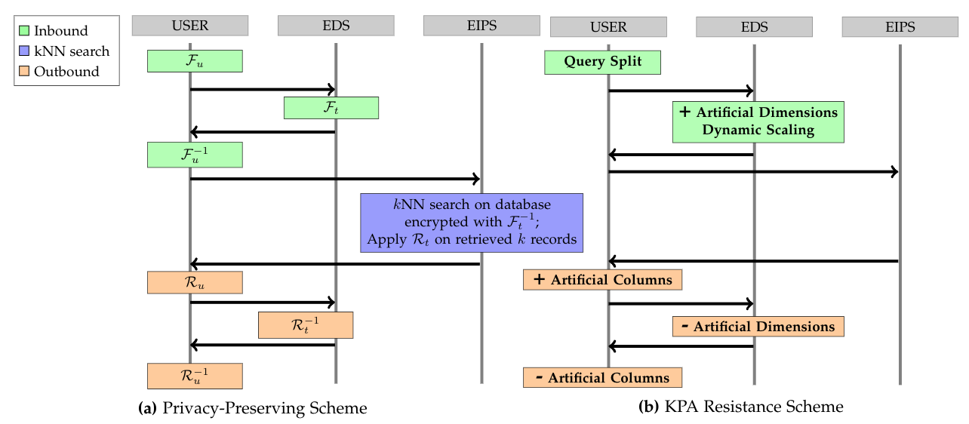
Two Buildingblocks of EIPS

Slide 16
Dynamic Scaling
An important property of Asymmetric Scalar-product Preserving Encryption (ASPE): dynamic scaling of query q does not affect the localization accuracy.
Artificial Dimensions/Columns
Encryption1: matrix transformation Encryption2: column-wise scale Highlighted are plain/cipher text pair
Original
+ Artificial Dimension
+ Artificial Columns
encryption1
encryption2
EDS
user
user
user
EDS
- Artificial Dimension
- Artificial Columns
decryption1
dncryption2
EDS
user
EDS
user
Notes:
Here we are using an example to show how artificial elements achieve privacy-preserving without affecting the IPS accuracy.
Because of the commutative ciphers,
EDS is able to insert artificial dimensions so attackers can not use KPA disguised as users
Users are able to insert artificial columns so EDS can not infer the location of users for privacy-preserving purpose.

Slide 17
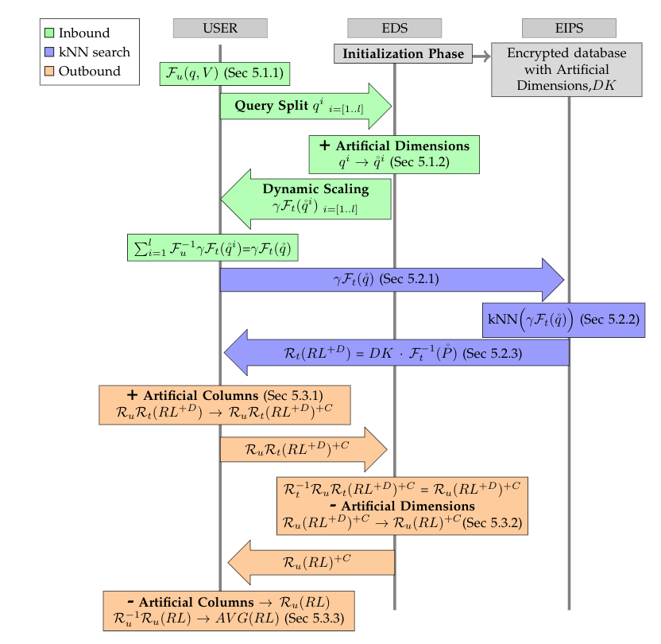
EIPS Workflow

Slide 18
01
02
03
IPS
Motivation
Preliminary
04
05
06
Overview
EIPS
Experiments

Slide 19
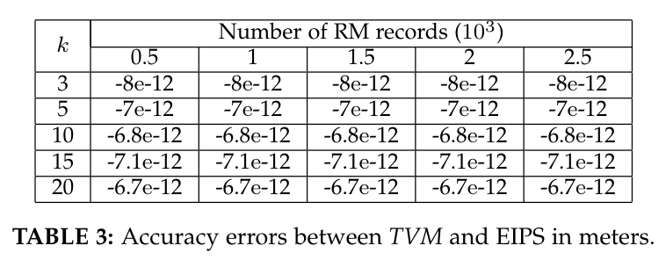
Experiments
Notes:
The error is introduced by encryption and decryption, which can be omited.

Slide 20
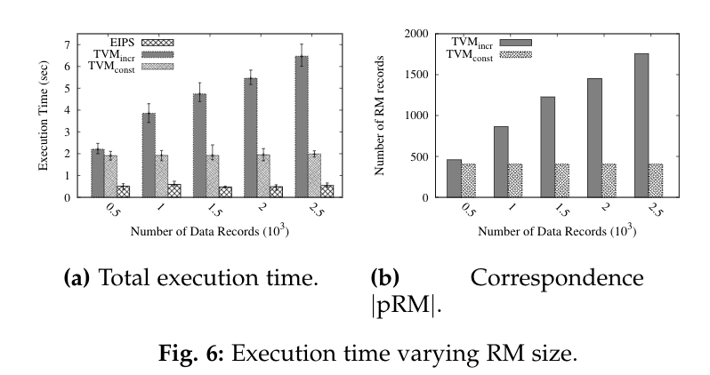
Experiments Cont.
Notes:
The RM size does not affect the execution time while TVM is affected.

Slide 21
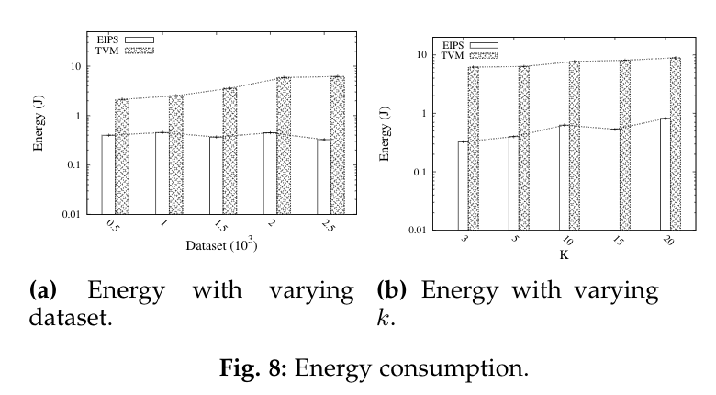
Experiments Cont.
Notes:
On the smartphones, TVM costs more energy consumption since EIPS conducts most of the workload on server side.

Slide 22
Conclusion
EIPS achieves
high accuracy
efficient execution time
low energy cost

Slide 23
Thank you!

