Slide 1
LShape Partitioning: Parallel Skyline Query Processing using MapReduce
Heri Wijayanto, Wenlu Wang, Wei-Shinn Ku, and Arbee Chen
Science & Engineering
Notes:
Hi, my name is Wenlu Wang. I am an assistant professor at Texas A&M University – corpus Christi.
Today I will talk about Lshape …
The skyline operator is very helpful with refining the data to be used in the subsequent analysis.
That is why we propose to address skyline query using an advanced Lshape partition.

Slide 2
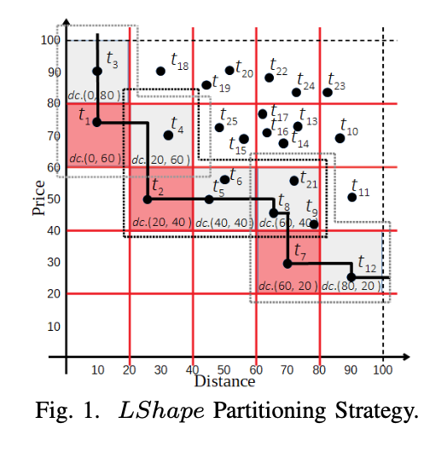

LShape Partitioning Strategy
Data Cell: A cell that contains data points.
dc(20,60)
Notes:
First of all, as shown in figure 1, we assume each dimension of the search space is partitioned to equal intervals,
[play]
Data cell is a cell that contained data points.
Data cell is uniquely identified by its minimum coordinate.
[play] [play]
For example, the yellow cell is a data cell, denote as dc(20, 60).

Slide 3
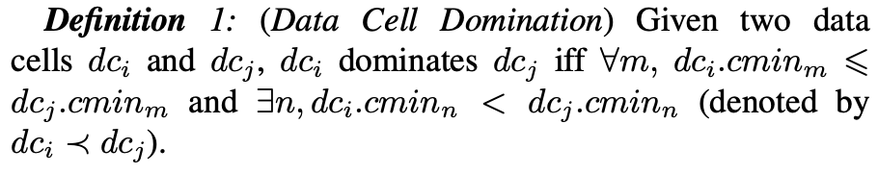
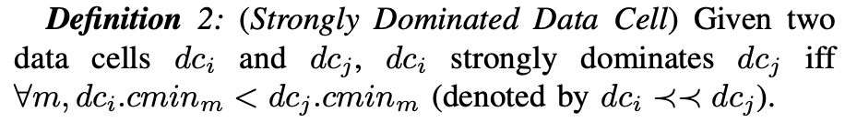
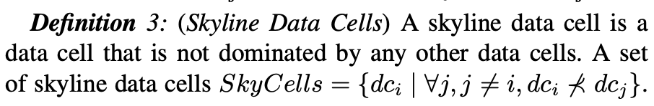
LShape Partitioning Strategy
Strongly
Dominate
Dominate
Dominate
Since strongly dominated data cells do not contain any skyline
data points, our main idea is to focus on dominated but not
strongly dominated data cells.
Notes:
First of all, I would like to introduce the concept of data cell domination.
[play]
Given a yellow data cell.
The yellow cell dominates this green cell
The yellow cell also dominate this green cell
[play]
We also have another concept of strongly dominated data cell.
The yellow cell strongly dominate this green cell.
[play]
Similarly, we have skyline data cells.
[play]
The reasons why we have those concepts is to focus on dominated but not strongly dominated data cells, since strongly dominated data cells do not contain any skyline data points.
[play]
Those are dominated but not strongly dominated data cells.

Slide 4

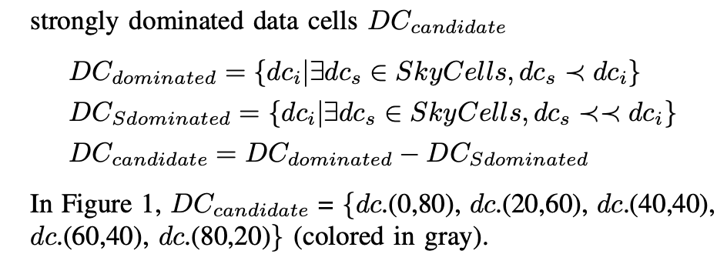
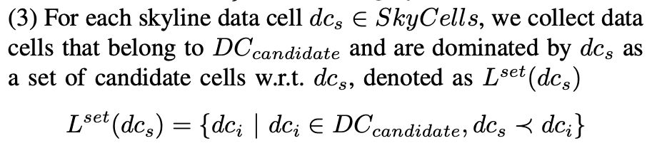
Notes:
Here I would like to introduce the steps of LShape partitioning.
At the first step, we identify skyline cells.
Second step, we search for candidate data cells, which are dominated but not strongly dominated data cells.
Third step, for each skyline data cell, we collect candidate cells that are dominated by the current skyline data cell.

Slide 5
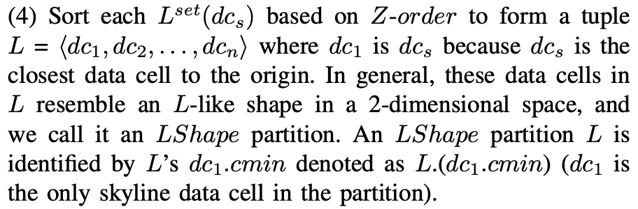
Notes:
This is for the first skyline data cell and the first LShape partition.
This is for the second skyline data cell.
This is for the third skyline data cell.
Last not not the least, we sort data cells in each Lshape partition in z-order.

Slide 6
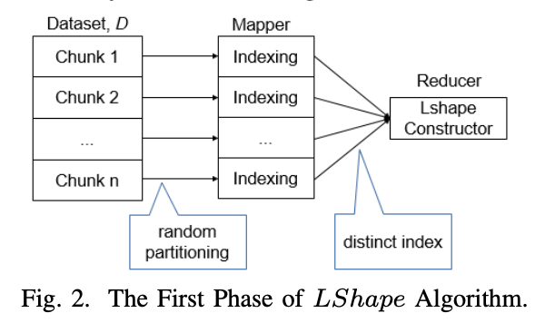
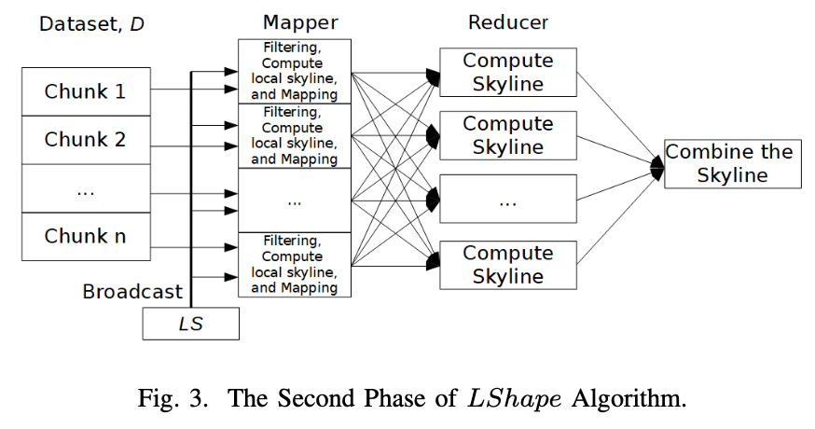
LShape Algorithm
Notes:
Figure 2 and 3 present the mapreduce process.

Slide 7
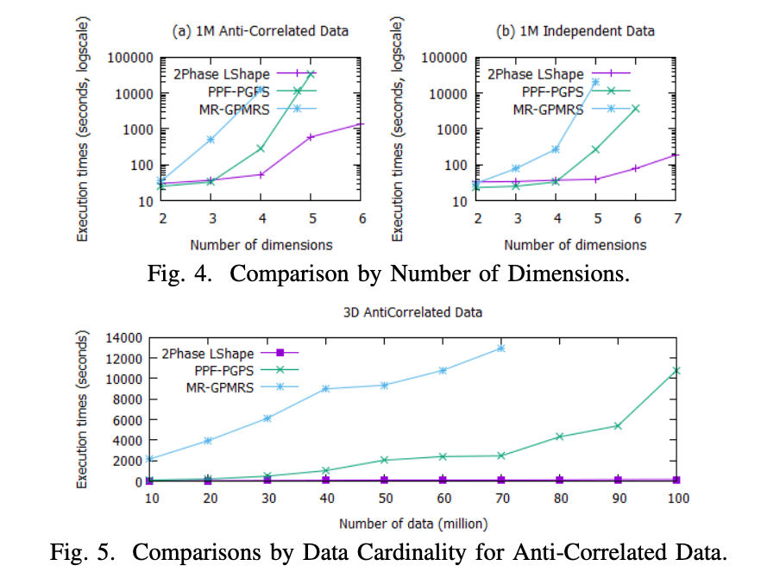
Experiments
Notes:
We experimentally validate the performance of our Lshape partitionoing.

Slide 8
Thank you!

