Slide 1
Efficient Parallel Spatial Skyline Evaluation Using Map-Reduce
Wenlu Wang¹, Ji Zhang¹,
Min-Te Sun², Wei-Shinn Ku¹
Dept. of Computer Science and Software Engineering, Auburn University
Dept. of Computer Science and Information Engineering, National Central University

Slide 2
Introduction-Spatial Skyline Query(SSQ)
Unlike skyline queries that only take static object attributes into account, the distance between objects is also calculated as dynamic attributes in the spatial skyline queries.
Given a set of data points P and a set of query points Q in a d-dimensional space, spatial skyline queries return a subset of P, in which data points are not spatially dominated by other data points in P.
The spatial dominance is defined by using the distance from data points to all query points.

Slide 3
Introduction-large scale SSQ
As data grows rapidly, addressing skyline queries on large-scale datasets in a single node becomes impractical.
The distance between moving objects may keep changing. Static indexing is not applicable.
Map-Reduce framework has been incorporated into parallel solutions for skyline computation
We address spatial skyline queries on large-scale datasets in this paper.

Slide 4
Background-SSQ solutions
Branch-and-Bound Spatial Skyline ( B²S² )
Voronoi-based Spatial Skyline (VS²)

Slide 5
Background-Parallel Skyline Solution
Map-Reduce based parallel solutions
Random data partitioning
Grid-based data partitioning
Angle-based data partitioning
However, none of them can be applied to SSQ.
Therefore, we propose
independent region-based partitioning

Slide 6
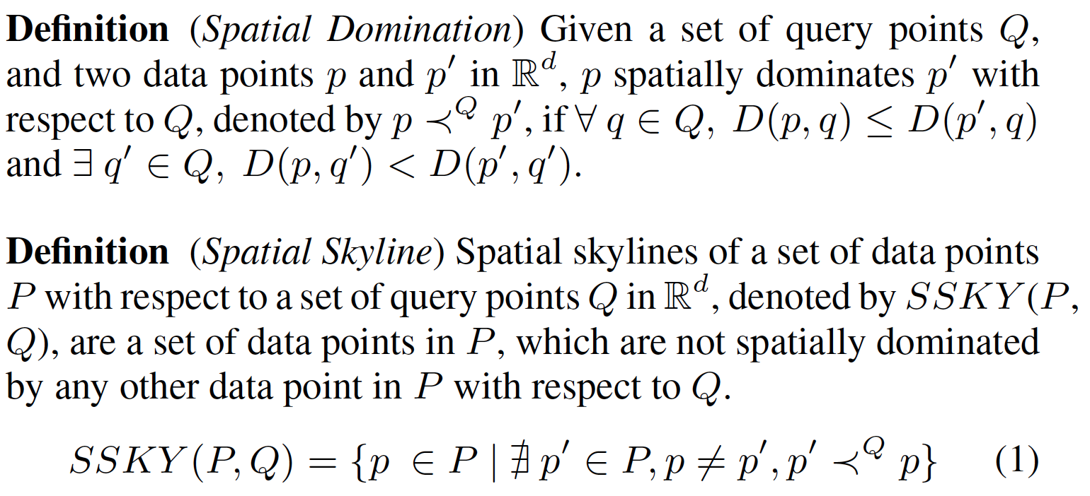
Preliminary

Slide 7
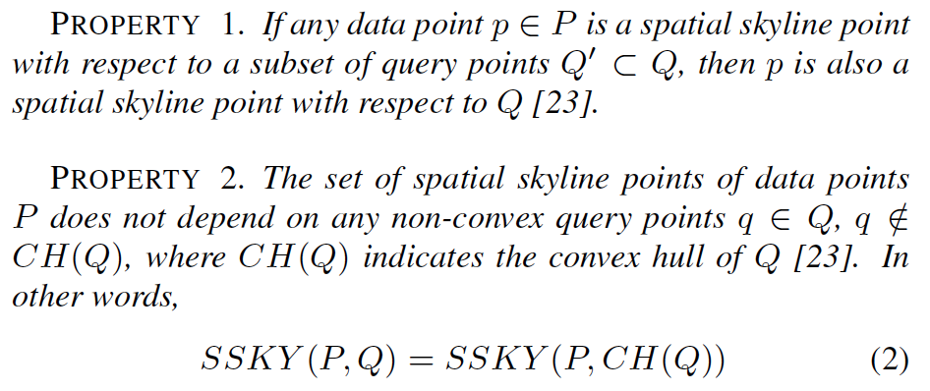
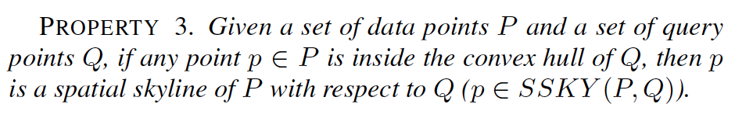
Preliminary

Slide 8
Design-System Framework

Slide 9
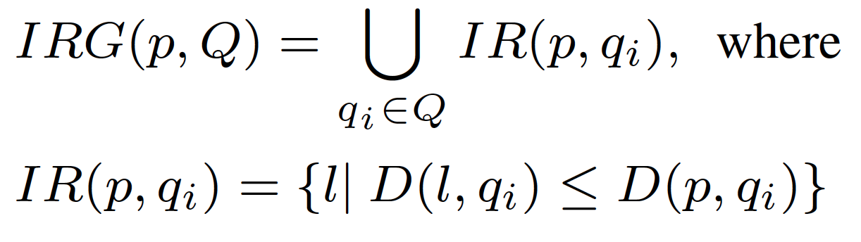
Design-Independent Region
Definition (Independent Region) Given a data point p and a set of query points Q in a d-dimensional space, we define an Independent Region of p and q_{i} ( q_{i} in Q ) as a sphere centered at q_{i} with radius D(p, q_{i}).
An Independent Region Group (IRG) of p with respect to Q is the union of the independent regions, as shown in Figure.

Slide 10
Design-Pruning Region
A pruning region using p and a visible facet L_{qx}
An example of PR(p, q_{i}）

Slide 11
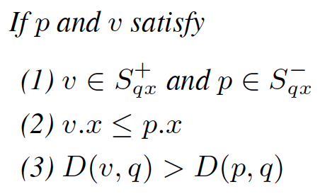
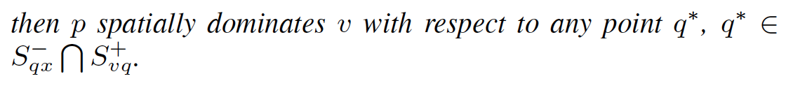
Design-Pruning Region

Slide 12
Design-Spatial Skyline Algorithm
Phase 1:
Calculate Convex Hull query points
Phase 2:
Map Locally optimal independent region pivot
Reduce Globally optimal independent region pivot
Phase 3:
Map Independent Region-based partitioning
Reduce Spatial Skyline calculation
within Independent Region

Slide 13
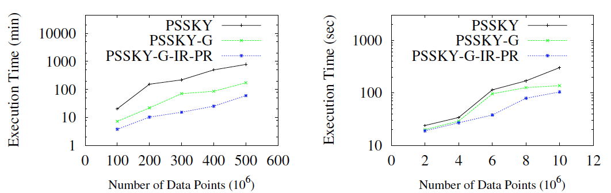
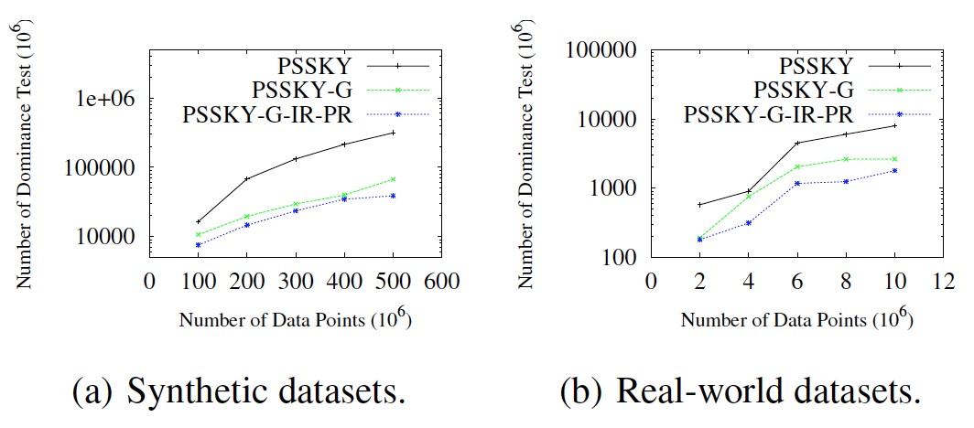
Experimental Validation
Scalability with Cardinality

Slide 14
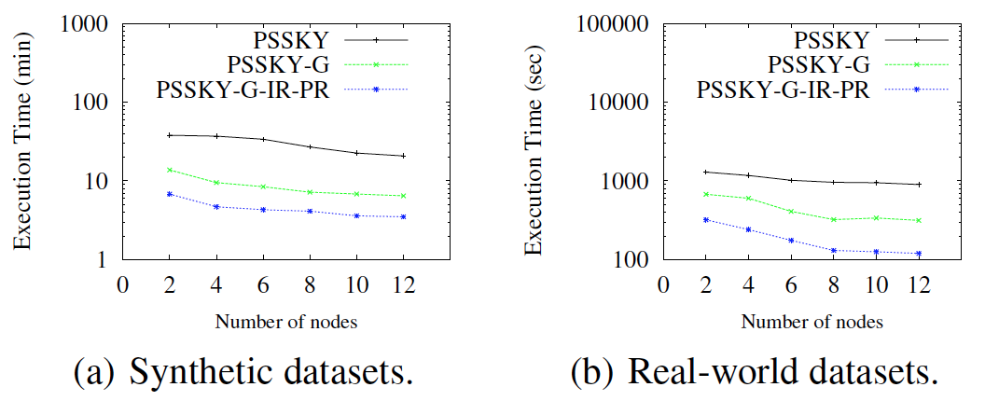
Experimental Validation
Effect of Number of Nodes

Slide 15
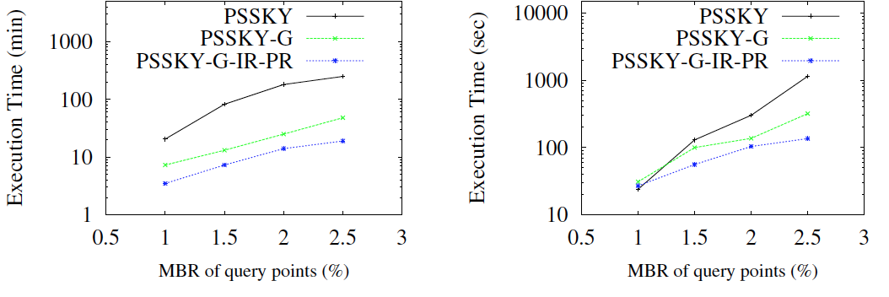
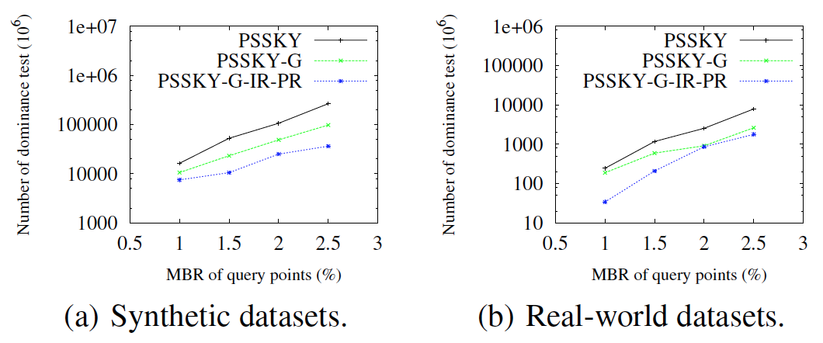
Experimental Validation
Effect of Query Points

Slide 16
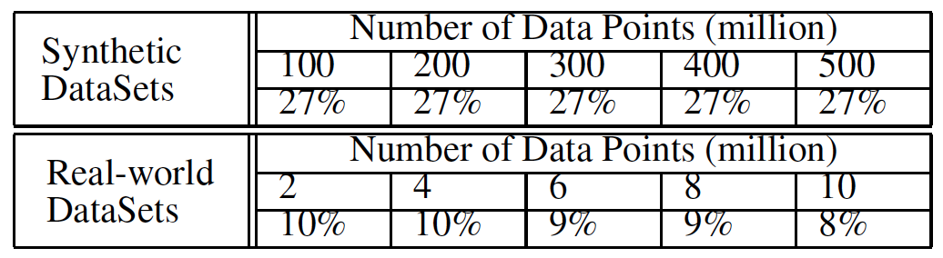
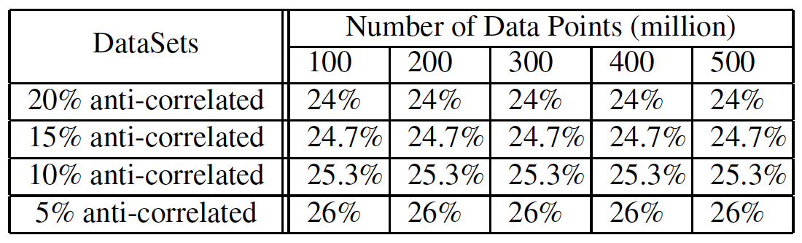
Experimental Validation
Effect of Pruning Regions
Effectiveness of pruning regions by varying dataset cardinality.
Effectiveness of pruning regions by varying dataset distribution.

Slide 17
Experimental Validation
Effect of Independent Region Pivot Selection

Slide 18
Conclusion
In this paper, we propose an advanced parallel spatial skyline solution utilizing Map-Reduce framework.
We propose a novel concept of independent regions; the input data points are partitioned by their associated independent regions. Unqualified data points outside independent regions can be eliminated without the dominance test.
All spatial skylines in independent regions are calculated in parallel, and the global spatial skylines are the union of local spatial skylines.
To avoid high cost of data point comparison, we propose a concept of pruning regions, in which objects can be discarded without comparing their distance to all convex hull query points.
We demonstrate the efficiency and effectiveness of the proposed solution through extensive experiments on large-scale real-world, and synthetic datasets.

Slide 19
Future Work
We plan to extend the proposed parallel solution to address spatial skyline queries on road networks. Theoretically, the concepts of independent regions and pruning regions can be applied in the space of road networks. However, more investigation is needed to evaluate the cost of calculating the independent regions and pruning regions. Due to variety of data distribution, it is also interesting to study the pruning power of pruning regions on road networks.

