Slide 1
DSD Final Project
Final Report
Hardware Implementation of Pipelined RISC-V
Group 7
B10901008 張禾牧
B10901016 邱巖盛
B10901078 歐信泓

Slide 2
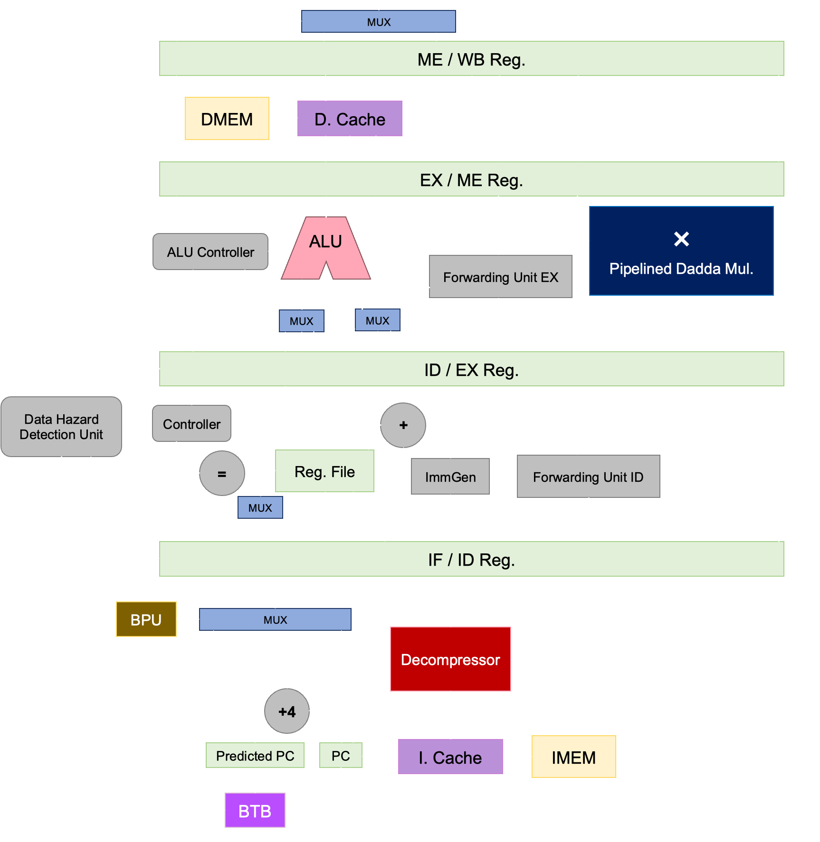
Current Results
Complete the whole architecture.
Conducted some experiments (covered later).
Best Performance for now:
t_{cycle} (ns) | 2.82
T_{BPred} (ns) | 1287.330
T_{QSort} (ns) | 361361.85
T_{Conv} (ns) | 75656.37
A_{cell} (µm²) | 313764.3873
A_{cell}T_{Conv}T_{QSort} | 8.58 × 10¹⁵
Notes:
1.因為有找到相關paper的關係，預計先以了解其原理和先生出能運作的程式為主
2.現在因為題目的例子和black box實際的運行成本還是未知，要是太大會需要減少計算的次數
3.

Slide 3
Extensions

Slide 4

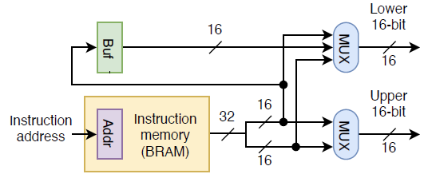
Decompressor
The instruction buffer will not always be valid (e.g. after jump).
When an invalid buffer is required (PC[1] && !inst_buffer_valid), fetch lower instruction and stall for one cycle
I cache addr. = PC[31:2] + (PC[1] & inst_buffer_valid)
Notes:
1.因為有找到相關paper的關係，預計先以了解其原理和先生出能運作的程式為主
2.現在因為題目的例子和black box實際的運行成本還是未知，要是太大會需要減少計算的次數
3.

Slide 5
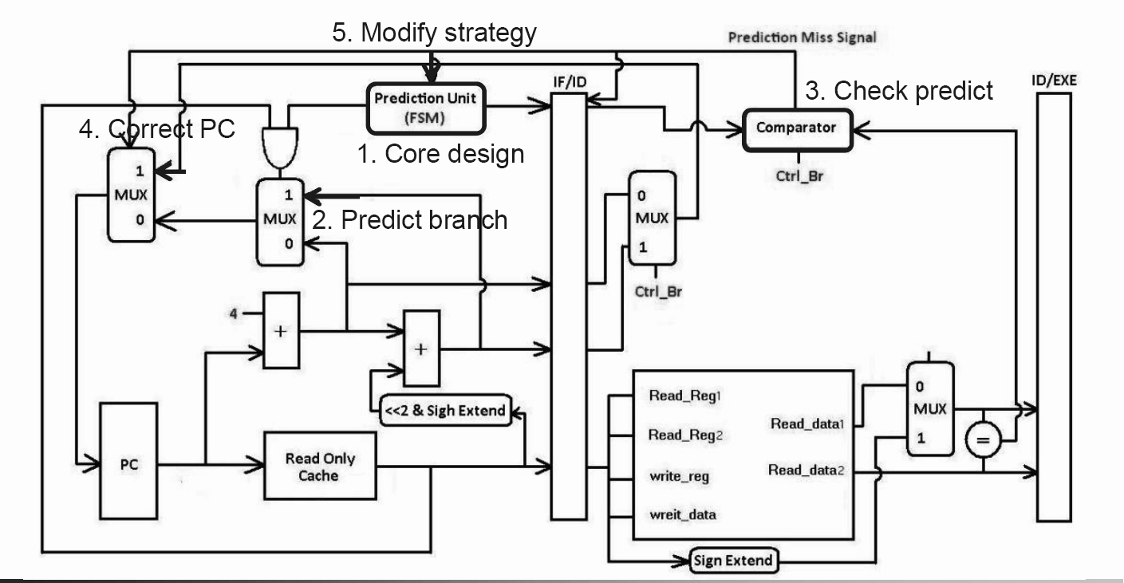
Branch Prediction
Use two-bit saturation counter
Save the last_not_taken_PC and use it if branch miss
Notes:
1.因為有找到相關paper的關係，預計先以了解其原理和先生出能運作的程式為主
2.現在因為題目的例子和black box實際的運行成本還是未知，要是太大會需要減少計算的次數
3.

Slide 6

Multiplier
Pipelined Multiplier
We care about
Observations:
mul operation only requires lower 32 bits (mulh)
Design
Verilog designware multiplier
Dadda multiplier with lower 32 bits
Use EX & MEM (& ID) for the pipelined multiplier
Hazard: MEM_calculation (&& ID_calculation)
Automatic Retiming
set_dont_retime [get_registers …] false
set_optimize_register -design [get_designs mul_design]
mid
Reg
out
Reg
res = A * B
Notes:
1.因為有找到相關paper的關係，預計先以了解其原理和先生出能運作的程式為主
2.現在因為題目的例子和black box實際的運行成本還是未知，要是太大會需要減少計算的次數
3.

Slide 7


Dadda Multiplier
First we consider the classic 8-bit multipliers:
dadda_8: basic 8-bit dadda multiplier
dadda_8_lower: last 8 bits of the product
Partial Product Compression Priority：
Data from older stage ＞ Data from newer stage
Temp. carry data > Temp. sum data
(critical path: and / or < xor )
Notes:
1.因為有找到相關paper的關係，預計先以了解其原理和先生出能運作的程式為主
2.現在因為題目的例子和black box實際的運行成本還是未知，要是太大會需要減少計算的次數
3.

Slide 8
Dadda Multiplier (cont’d)
Design a traditional 32-bit Dadda Multiplier is an extremely tough work.
We can seperate 32-bit a, b into concatenation of 8-bit {a₀, a₁, a₂, a₃} and {b₀, b₁, b₂, b₃}, thus
2³²
2³²
32
24
16
8
}
call dadda_8_lower_8
}
call dadda_8
Notes:
1.因為有找到相關paper的關係，預計先以了解其原理和先生出能運作的程式為主
2.現在因為題目的例子和black box實際的運行成本還是未知，要是太大會需要減少計算的次數
3.

Slide 9
Observations

Slide 10
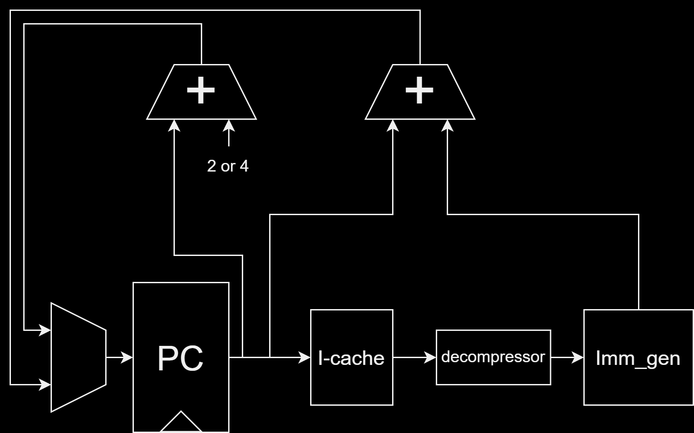
Issue about critical path
Calculating the branch target consumes lots of time
We use three different ways to reduce delay:
Instruction Cache optimization
Partial Immediate Generator
Branch Target Buffer

Slide 11
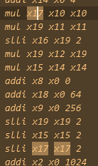
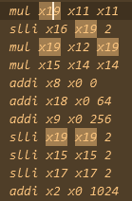
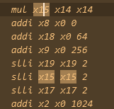
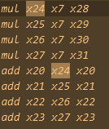
About the Convolution Testbench
Most mul results are not required immediately.
More cycles can be used for mul calculations.

Slide 12
Optimizations

Slide 13
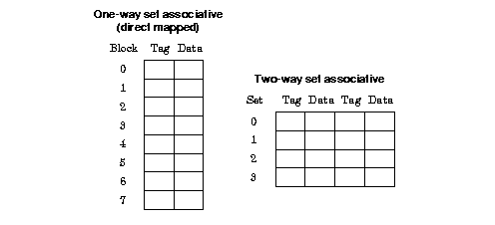
Cache Optimization
Direct-mapping helps reduce critical path than 2-way (about 0.3 ns).
Remove write-related function from I. Cache
area reduced (about 15000µm²)

Slide 14
Partial Immediate Generator
A lot of time is wasted on calculating immediate because of the decompressor. (decompressor → imm_gen)
Another unit Part_Imm_Gen for building a faster path for branch target
Use "decode" technique
Only provide correct immediate for (C.) beq, bne, jal
Immediate is 21 bits (partial imm is 20 bits)
IF
/
ID
decompressor
imm_gen
inst. cache
Part_Imm_Gen
PCaddImm
+
PC

Slide 15

Branch Target Buffer
Cache the target of branch instruction
If there is any miss, the target will be calculated in ID stage & store into the buffer
Cache Size: 2/4 block, 2-associative
IF
/
ID
I. Cache
decompressor
Imm_en
PC
PC
is_conditional
Branch Target Buffer
Branch Predictor
+
target
BTB_miss
IF_ID_BTB_miss

Slide 16
Out of order multiplication
It is for reducing the total area.
No significant improvement (since the multiplier design doesn’t changed).
mul hazard: [rs1 or rs2 ∈ any middle registers]
mul_stall = mul_out_rd && MEM_WB_RegWrite
IF
ID
EX
MEM
WB
if is_mul && mul_not_stall
if !MEM_WB_RegWrite
K-stages multiplier

Slide 17
Result Analysis

Slide 18
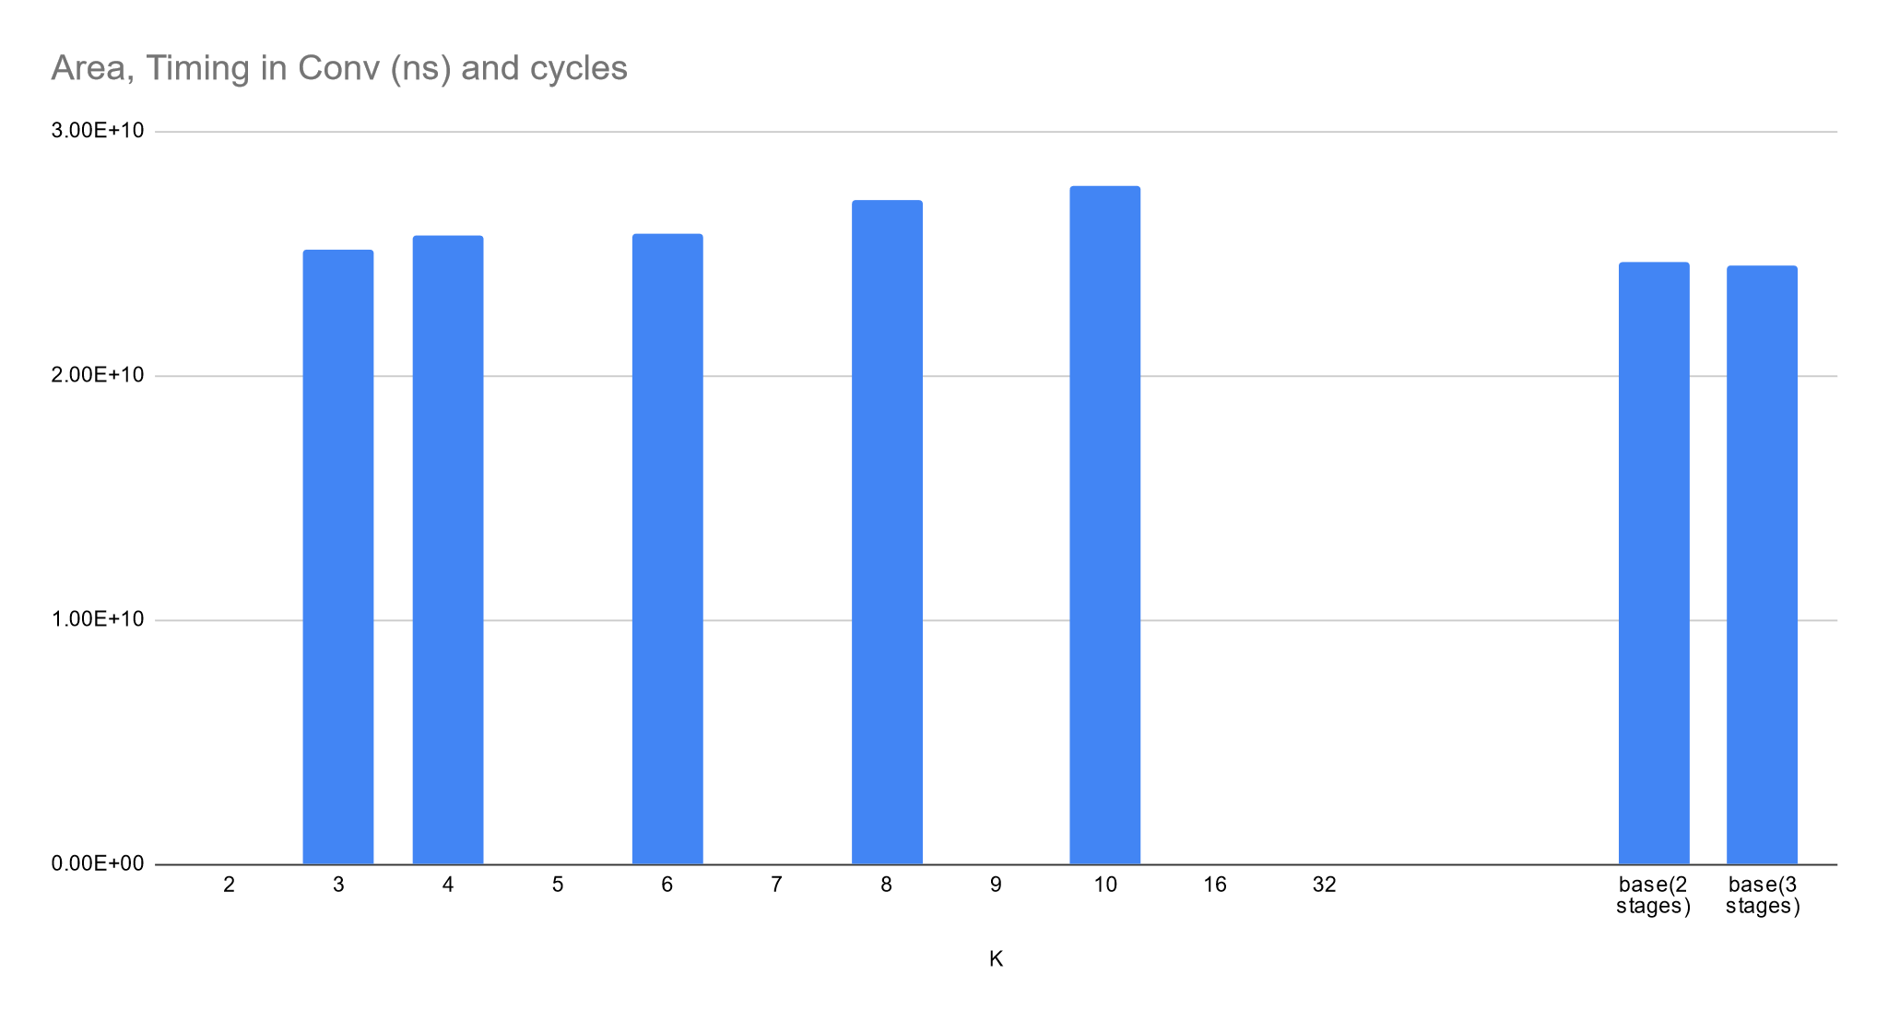
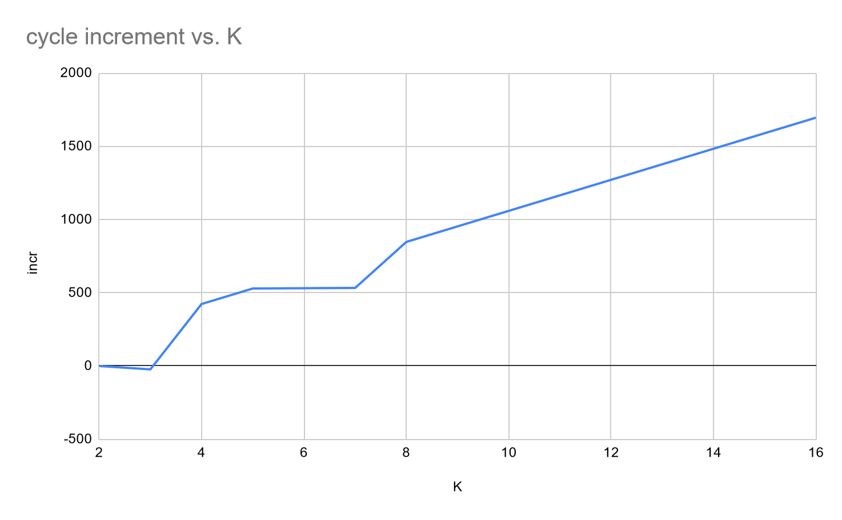
Out-Of-Order multiplier

Slide 19
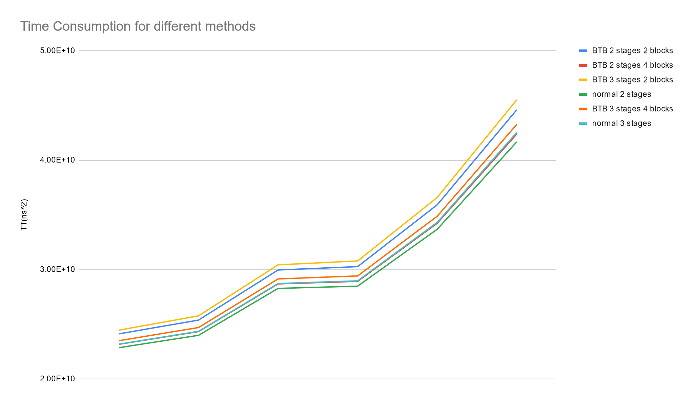
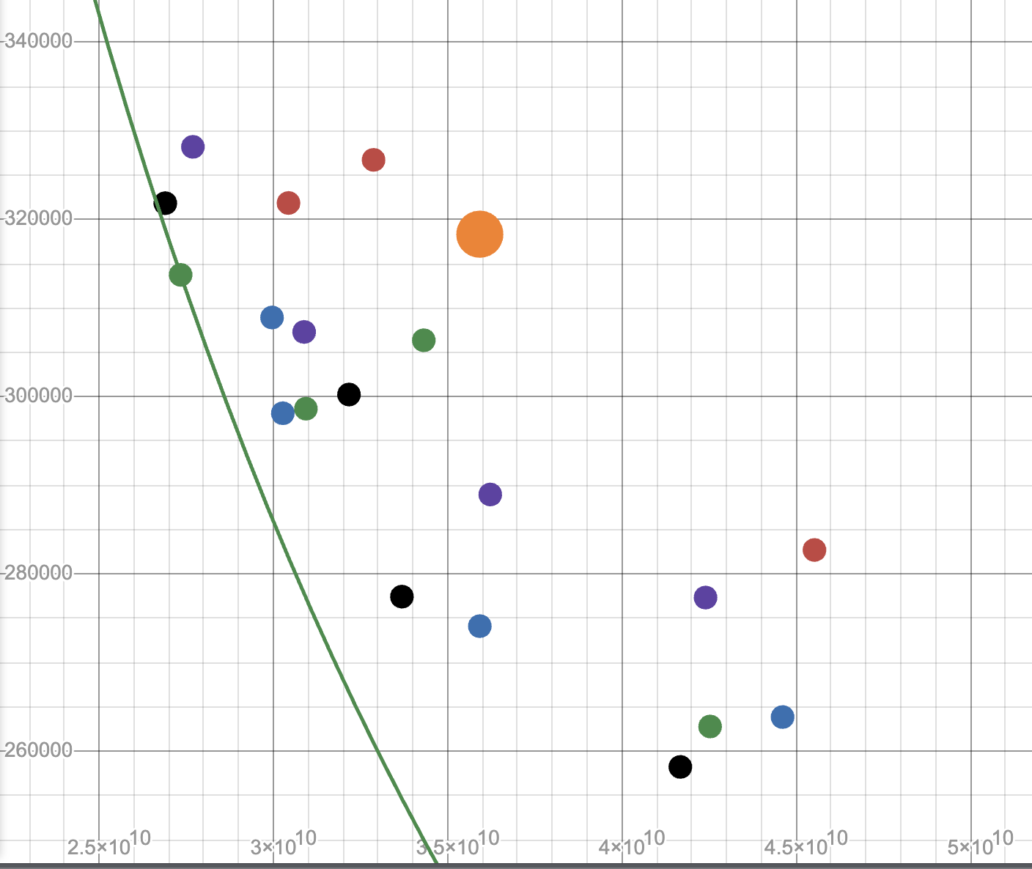
Performance
Blue Dot: BTB two stage(2 block)
Red Dot: BTB three stage(2 blocks)
Black Dot: normal two stage(2 block)
Green Dot: normal three stage(2 blocks)
Purple Dot: BTB two stage(4 blocks, 2 way)
Orange Dot: Dadda multiplier
Green Curve: AT² curve passing the Green Dot

Slide 20
Work Assignment Chart
張禾牧：
Decompressor & Other Units, Optimization, Conduct Experiments
邱巖盛：
Multiplier Connection, Optimization, Conduct Experiments
歐信泓：
Multiplier Connection, Synthesis Setup, Optimization, Conduct Experiments
Notes:
1.因為有找到相關paper的關係，預計先以了解其原理和先生出能運作的程式為主
2.現在因為題目的例子和black box實際的運行成本還是未知，要是太大會需要減少計算的次數
3.

