Slide 1
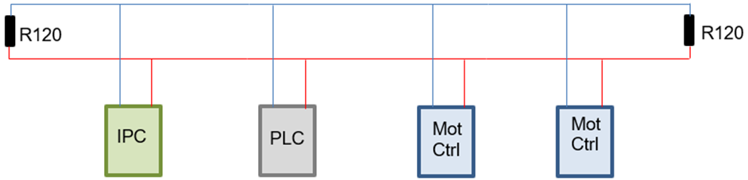
Bus topology
Trunk length
60ohm
Stub length
Twisted pair, shielded cable - rules
T-connector or pass through

Slide 2
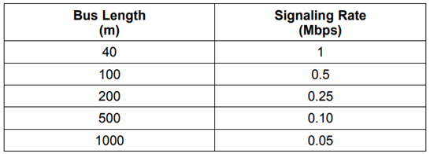
Maximum bus (trunk) lenght

Slide 3
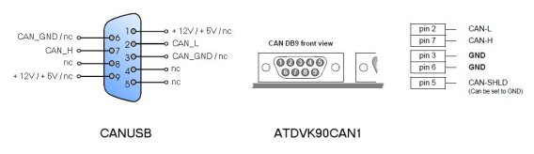
Physical connection & pins
PEAK
NOTE: IPC no power

Slide 4
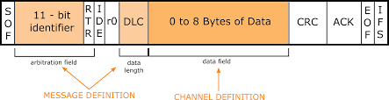
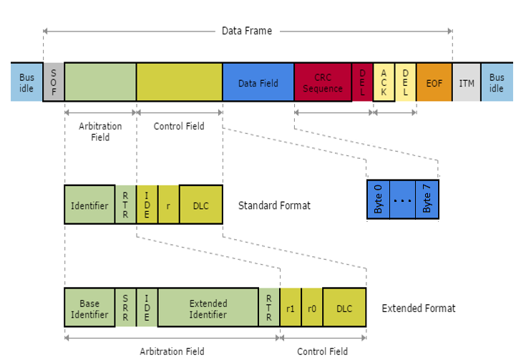
Bitrates
Up to 1Mbit/s
Typical 125k,250k,500k
SAME bitrate for all!
FD up to 5 Mbit/s
Message format
ID – 11bit/29bit (unique!)
DLC
Data
Issue w. bitrate/unique?
Two buses
Navitrol 2 ch
CAN bridge/gateway
Bit arbitration
Bit 0 is dominant
Collision prevention
Priority
1 for extended

Slide 5
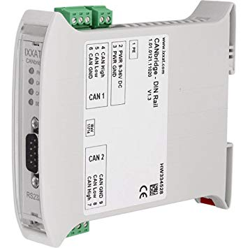
CAN bridge use cases
Different bitrates
?
Duplicate id’s
?
CANOpen
Non CANOpen dev
Tx msg id 0
Filters
ID translation
Non-working topology
!

Slide 6
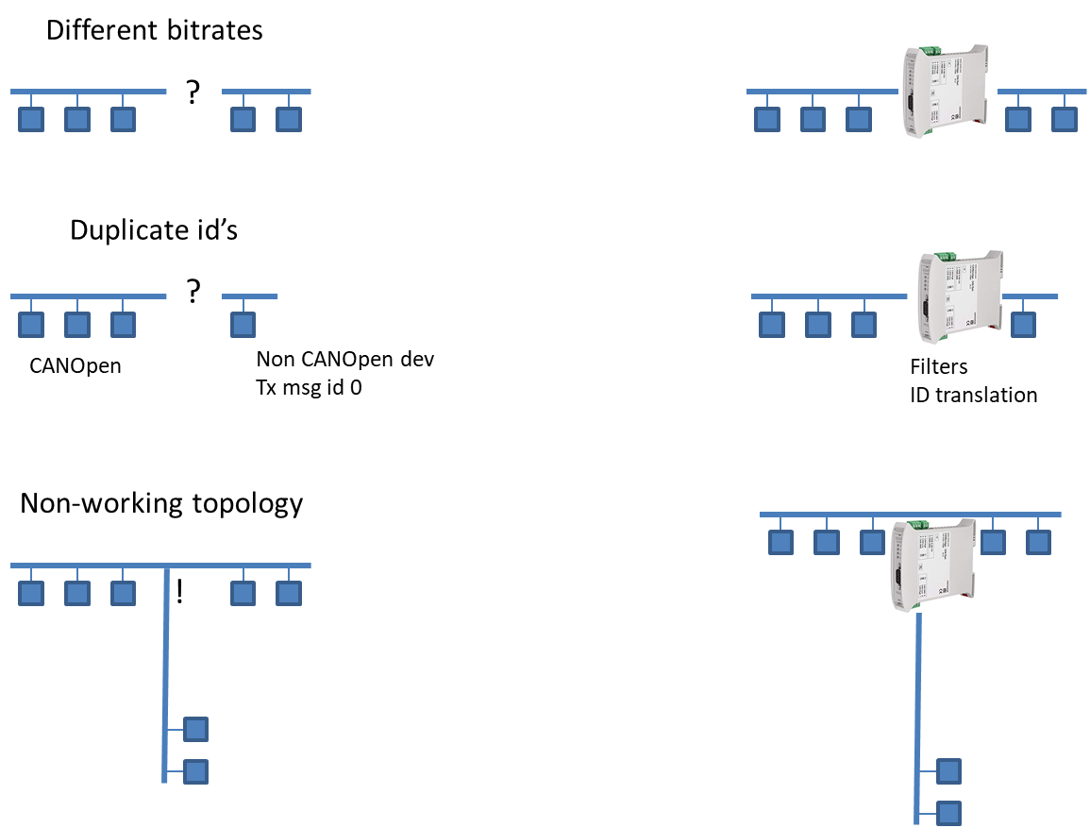

Slide 7
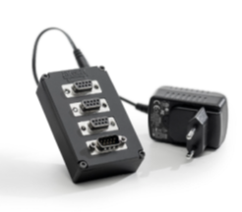

Slide 8
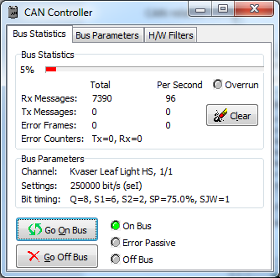
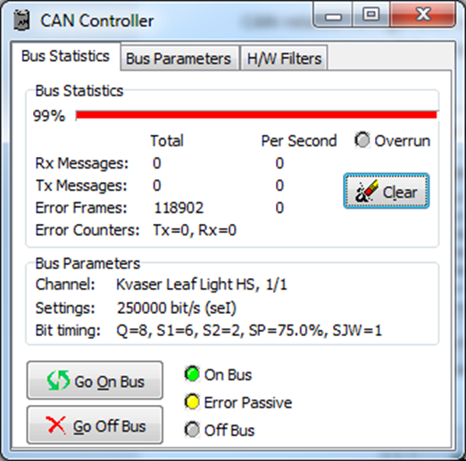
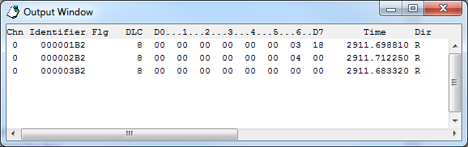
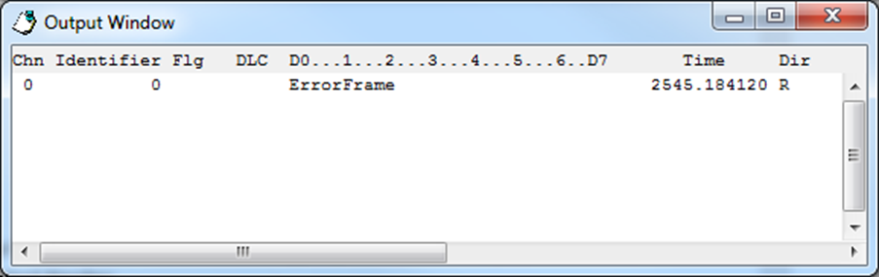
Troubleshooting - CANKing
B
A
C
D
E

Slide 9
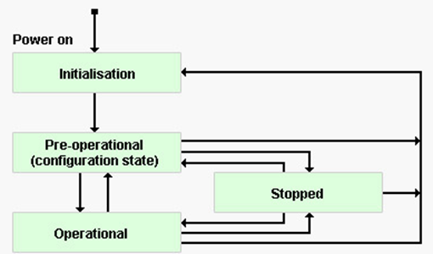

Slide 10
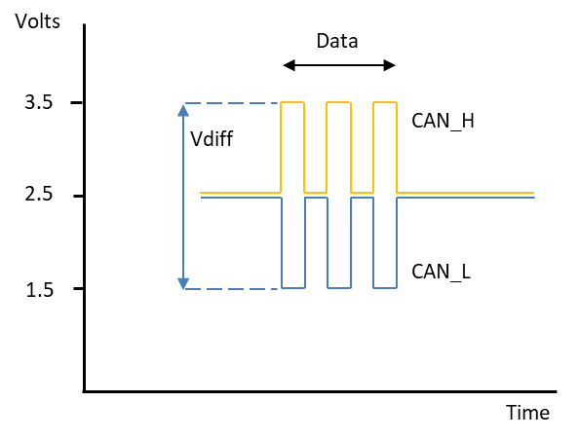
Volts
3.5
Data
Vdiff
CAN_H
2.5
1.5
CAN_L
Time

