Slide 1
LIA Automatization
-README-
GitHub link

Slide 2
Table of content
1 - Setting up environment
A – Folder structure……………………………………………..........................3
B – Requirements……………………..……………......................................4
C – Building environment…………………………………………………………….5
2 – Running scripts......................................................................................6
A – Downloading the data……………………………………..........................3
B – Running the analysis……………..……………......................................4

Slide 3




1 - Setting up the environment
A – Folder structure
LIA
data
ADM00
ADM00 shapefile
Dataframes
asset_info.csv, country_info.csv and enso.csv
Rasters
Table with ODC links + folder with zarr files
Shapefiles
Asset shapefiles
output
Output folder
utils
Python scripts
LIA.py
Main python script to execute to run the processing
LIA_download.py
Main python script to download the data
README.pptx
This README
LIA_ENV.yml
Yml file for creating the environment

Slide 4
1 - Setting up the environment
A – Folder structure
LIA
data
To change when processing a new country
ADM00
ADM00 shapefile
Dataframes
asset_info.csv, country_info.csv and enso.csv
Rasters
Table with ODC links + folder with zarr files
Shapefiles
Asset shapefiles
output
Output folder
utils
Python scripts
LIA.py
Main python script to execute to run the processing
LIA_download.py
Main python script to download the data
README.pptx
This README
LIA_ENV.yml
Yml file for creating the environment

Slide 5
B - Requirements
requirement 1: Anaconda
If not already installed (https://docs.anaconda.com/anaconda/install/)

Slide 6
C – Building environment
Step 1: Create the environment from the AIMS_env.yml file. In the Anaconda command prompt browse to the AIMS_env.yml file and type:
This step must only be done the first time. Once the environment has been created there is no need to do it again.
Note: The name of the environment is in the first line of the LIA_ENV.yml (in our case it is called LIA_ENV)
Step 2: Activate the environment:
The environment has now been activated. The python script must be executed inside this environment in order to work.
conda env create -f LIA_ENV.yml
conda activate LIA_ENV

Slide 7
1 – Running the scripts
A – Downloading the data
In the Anaconda command line (in the environment), browse to the LIA folder.
Run the LIA_download.py script:
python LIA_download.py
By default, he 3 datasets (NDVI.zarr, LST.zarr and CHIRPS.zarr) will be downloaded in the data/Rasters/zarr_files folder.

Slide 8
An optional flag can be added in order to see the start and end dates of each dataset (if the flag is added, the data is not downloaded)
python LIA_download.py –check_dates
An other optional flag can be added in order to select which datasets to download.
python LIA_download.py –select

Slide 9
B – Running the analysis
In the Anaconda command line (in the environment), browse to the LIA folder.
Run the LIA.py script:
python LIA.py
By default all of the analysis will be executed and the results will be saved in the output folder.
Note: The analysis is run using the local data stored in zarr_files.
So the LIA_download.py script must be run before the LIA.py script

Slide 10
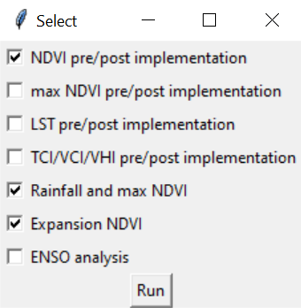
An optional flag can be added in order to select specific analysis:
python LIA.py --select
When doing so, the following window will open up.
Select the analysis to execute and click on Run

