Slide 1
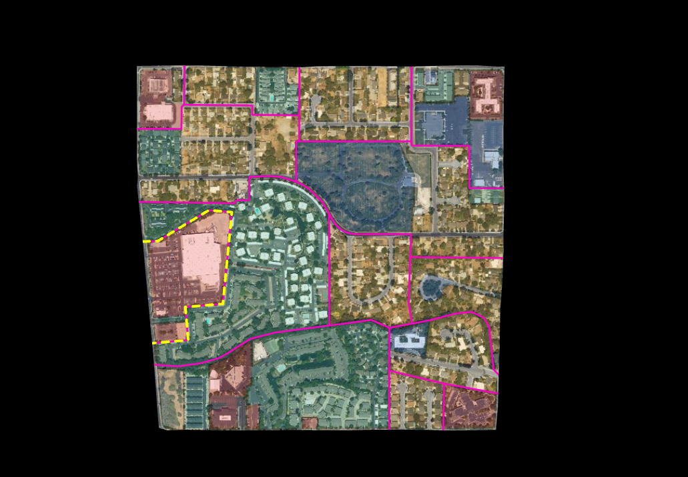
Commercial Area
Commercial Area
Wasatch Choice Center Boundary
sf neighborhood split by road access
Mixed use area, primarily mf

Slide 2
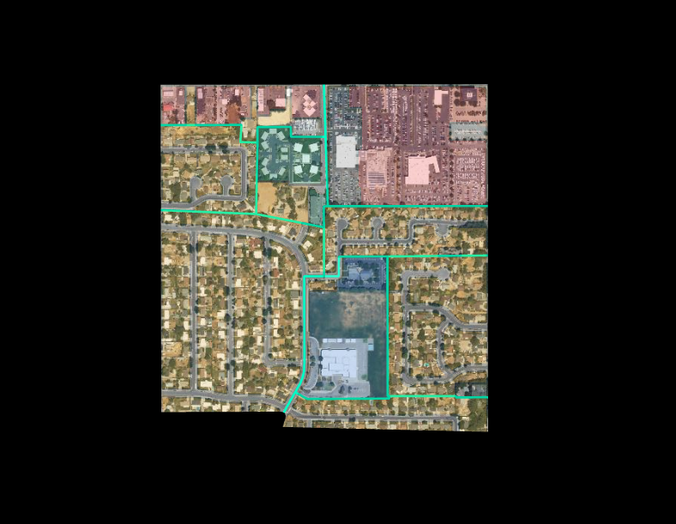
commercial properties
large commercial area
mf properties
sf neighborhood split by road access
sf neighborhood split by road access
parks/place of worship

