Slide 1
Part 6
Introduction to PHP

Slide 2
Contents
9.1 Origins and Uses of PHP
9.2 Overview of PHP
9.3 General Syntactic Characteristics
9.4 Primitives, Operations, and Expressions
9.5 Output
9.6 Control Statements
9.7 Arrays
9.8 Functions
9.10 Form handling

Slide 3
9.1 Origin and Uses of PHP
PHP is a server-side scripting language, embedded in HTML pages.
PHP has a good support for form processing.
PHP can interact with a wide variety of databases.
PHP is now developed, distributed and supported as an open source product.

Slide 4
9.2 Overview of PHP
Working principle
When a PHP document (with suffix .php) is requested of a server, the server sends the document first to a PHP processor.
The result of the processing is the response to the request.

Slide 5
9.2 Overview of PHP
Two modes of operation
Copy mode in which plain HTML is copied to the output.
Interpret mode in which PHP code is interpreted and the output from that code is sent to the output.
The client never sees PHP code, only the output produced by the code.

Slide 6
9.2 Overview of PHP
PHP has typical scripting language characteristics.
Dynamic typing, untyped variables
Associative arrays
Pattern matching
Extensive libraries

Slide 7
9.3 General Syntactic Characteristics
Code inclusion
Variable name
Comment style
Statements

Slide 8
9.3 General Syntactic Characteristics
Code inclusion style
PHP code is contained between the tags <?php and ?>
PHP code can also be included with the PHP:
include(“file_2.php”);
When a file is included, the PHP interpreter reverts to copy mode.
Note that the codes in an included file must be in <?php and ?> tags.

Slide 9
9.3 General Syntactic Characteristics
Variable name
All variable names in PHP begin with $ and continue as the variables in other programming languages.
Variable names are case sensitive.
However, reserved words and function names are not case sensitive. For example, while and While are the same.
Comment styles
One line comments can begin with // and continue to the end of a line.
Multi-line comments can begin with /* and end with */.

Slide 10
9.3 General Syntactic Characteristics
Statements
PHP statements are terminated with semicolons.
Braces are used to create compound statements.

Slide 11
9.4 Primitives, Operations, Expressions
Four scalar types: boolean, integer, double, string.
Two compound types: array, object.
Two special types: resource and NULL
Note that object and special types are not covered in this textbook.

Slide 12
9.4 Primitives, Operations, Expressions
Contents
Variables
Integer type
Double type
String type
Boolean type
Arithmetic operations and expressions
Sring operations
Scalar type conversions

Slide 13
9.4.1 Variables
Variables in PHP have no type declarations.
The type of a variable is set every time it is assigned a value.
<?php
$txt = "Hello World!";
$number = 16;
?>

Slide 14
9.4.1 Variables
A variable that has not been assigned a value is called an unbounded variable, and has the value NULL, which is the only value of the NULL type.
If an unbounded variable is used in an expression, NULL is coerced to a value according to the context.
NULL is coerced to 0 if a number is needed,
NULL is coerced to the empty string if a string is needed.
NULL is coerced to FALSE if a Boolean value is needed.

Slide 15
9.4.1 Variables
We can use the IsSet() function to test whether a variable has a value, which returns TRUE or FALSE.
Example: IsSet($fruit)

Slide 16
9.4.(2-3) Integer Type and Double Type
Integer is equivalent to long in C, that is, usually 32 bits.
Double type values are stored internally as floating point values.
Double literals can include a decimal point, an exponent, or both.
For example, 0.345E-3.

Slide 17
9.4.4 String Type
String literals are enclosed in single or double quotes.
Single quoted strings have neither escape sequence interpretation nor variable interpolation
Example: $sum=5;
‘The sum is: $sum’
Double quoted strings have escape sequences interpreted and variables interpolated.
Example: “The sum is: $sum”
A literal $ sign in a double quoted string must be escaped with a backslash \.
Characters in PHP are one byte string.

Slide 18
9.4.5 Boolean Type
The Boolean type has two values :TRUE and FALSE.
Non-boolean type values are coerced as needed by the context.
For integer values, it evaluates to FALSE if it is zero; otherwise, TRUE. For double values, only 0.0 is interpreted as FALSE.
For strings, the empty string and the literal string “0” all count as FALSE. Note string ‘0.0’ counts as TRUE.
NULL counts as FALSE.

Slide 19
9.4.6 Arithmetic Operators and Expressions
PHP supports the usual collection of arithmetic operators:
+, -, *, /, %, ++, --
A variety of numeric functions is available: floor, ceil, round, rand, abs, min, max (pp.363, table 9.2).

Slide 20
9.4.7 String Operations
String catenation is indicated with a period.
Example strTest.php
Characters are accessed in a string with a subscript enclosed in curly braces.
Example strTest.php

Slide 21
9.4.7 String Operations
Many useful string functions are provided.
strlen gives the length of a string.
strcmp compares two strings and returns a number.
chop removes whitespace from the end of a string.
See table 9.3 (pp.364)

Slide 22
9.4.8 Scalar Type Conversions
Types can be determined in two different ways.
use the gettype function, which takes a variable as its parameter and returns a string of the type name
use is_int (is_double, is_bool, is_string) function

Slide 23
9.4.8 Scalar Type Conversions
Implicit type conversion
Explicit type conversion

Slide 24
9.4.8 Scalar Type Conversions
Implicit type conversions are demanded by the context in which an expression appears.
For example:
A string which has only a sign followed by digits is converted to an integer if a numeric value is required.
A string which is a valid double literal (including either a period or e or E) converts to a double if a numeric value is required.

Slide 25
9.4.8 Scalar Type Conversions
Explicit type conversions can be forced in three ways. Suppose that $sum=4.777
(int)$sum in the C style
Using several conversion functions such as intval($sum) (intval, doubleval or strval)
settype($sum, “integer”)

Slide 26
9.4.9 Assignment Operators
PHP has the same set of assignment operators as C
PHP also includes the compound assignments such += and -=

Slide 27
9.5 Output
All ouput of PHP must be in the form of HTML
Three ways to create output: print and printf

Slide 28
9.5 Output
The print function is used to send data to output.
print takes string parameters, PHP coerces it as necessary.
Example:
print(“You are welcome”);
print “You are welcome”;
print(47);
Note:
It returns a value (1 if succeeded, 0 if it failed) to indicate whether the operation is completed.
It only accepts one parameter.

Slide 29
9.5 Output
The printf function is also available
Format:
printf(fat,arg1…)
The first argument fat is a format code with interspersed format codes.
The remaining parameters (such as arg1) are to be formatted.

Slide 30
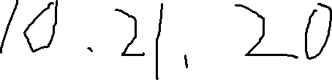
9.5 Output
A format code begins with % followed by a field width and a type specifier
Field width is a single integer to specify the number of characters (minimum) used to display the value or two integers separated by a period to indicate field width and decimal places for double values.
Type specifiers are s for string, d for integer and f for double.
read the textbook of pp. 366

Slide 31
9.5 Output
Example printf.php
printf("%s world. Day number %5d",$str,$number);
Note:
Displays $number as an integer and $str as a string

Slide 32
9.5 Output
The example today.php uses the date function to dynamically generate a page with the current date.
date function, whose first parameter is a string that specifies the part of the date you want to see.
l requires the day of the week
F requires the month
j represents the day of the month, and S suffix next to the j gets the correct suffix of the day (st,nd,rd or th)

Slide 33
Class exercise
Write a php document with the following features
There are three variables a, b and c. The value of a is “You are ”. The value of b is “welcome!”. The value of c is a double 45.6.
The concatenation of a and b is displayed with print function.
The value of c is displayed with print function.
tips
Variable name
echo without parentheses
Switch to next line

Slide 34
9.6 Control Statements
Relational operators
Boolean operators
Selection statements
Loop statements

Slide 35
9.6.1 Relational Operators
PHP has the usual comparison operators ( >, <, <=, >=, ==, and !=) of JavaScript.
PHP also has the identity operator ===
This operator does not force coercion.
It produces TRUE only if both operands are of the same type and have the same value.
Its opposite operator is !==

Slide 36
9.6.2 Boolean Operators
PHP supports &&, || and !
The lower precedence version and and or are also provided.
The xor operator is provided, too.
Note that all Boolean operators are evaluated as short-circuit operators.

Slide 37
9.6.3 Selection Statements
PHP provides an if with almost the same syntax as C/C++/Java
The only difference is that its statement can contain any number of elseif clauses.
The switch statement is provided with syntax and semantics similar to C/C++/Java
The case expressions are coerced before comparison.
break is necessary to prevent execution from flowing from one case to the next.
default case can be included.

Slide 38
9.6 Loop Statements
PHP provides the while, for and do-while as JavaScript does.
The for loop is illustrated in the example powers.php
This example also illustrates a number of mathematical functions such as sqrt()，pow() available in PHP.

Slide 39
Class exercise
Write a php script to displaly the weather of five days from Monday to Friday, using while statement.
The weather information is a centigrade degree ranging between (25-40). Tips: using rand(a,b) pp.363
Once the centigrade degree is greater than 35, show a message “It’s very hot”.

Slide 40
9.7 Arrays
9.7.1 Array creation
9.7.2 Accessing array elements
9.7.3 Dealing with arrays
9.7.4 Sequential access to array elements
9.7.5 Sorting arrays

Slide 41
9.7 Arrays
Arrays in PHP combine the characteristics of regular arrays and hashes.
An array can have elements indexed numerically. These elements are maintained in order.
An array, even the same array, can have elements indexed by string. These are not maintained in any particular order.
The elements of an array are, conceptually, key/value pairs.

Slide 42
9.7.1 Array Creation
Two ways of creating an array
Assigning a value to an element of an array
$list[0]=17;
$list[]=18

Slide 43
9.7.1 Array Creation
Using array construct
Create a numerically indexed array
$list=array(23, ‘xiv’, “bob”, 777);
It creates a traditional array of four elements, with the keys 0,1,2,3.
Create an array with string indexes
$ages=array(“Joe” => 42, “Mary” =>41, “Bif”=>17);

Slide 44
9.7.2 Accessing Array Elements
Array elements are accessed by using a subscript in square brackets.
The subscripts can be a string or an integer.
Example
print(“Mary is $ages[‘Mary’] years old <br/>”);
print(“Mary is $ages[1] years old <br/>”);

Slide 45
9.7.2 Accessing Array Elements
Multipe elements of an array can be assigned to scalar varaibles in one statement, using the list construct.
Example:
$trees=array(“oak”,”pine”,”binary”);
list($a,$b,$c)=$trees;

Slide 46
9.7.2 Accessing Array Elements
The array_keys function returns a list of the keys of an array.
The array_values returns a list of values in an array.
Example:
$highs=array(“Mon”=>74,”Tue”=>70,”Wed”=>67);
$days=array_keys($highs);
$nums=array_values($highs);
Now the value of $days is (“Mon”,”Tue”,”Wed”), and the value of $nums is (74,70,67). In both cases, the keys are (0,1,2).

Slide 47
9.7.3 Functions with Arrays
The number of elements in an array can be determined with the sizeof().
Example:
$words=array(“Are”,”you”,”lonesome”,”today”);
$len=sizeof($words);

Slide 48
9.7.3 Functions with Arrays
The unset function can be used to remove an array or an element of an array.
Example:
$list=array(2,4,6,8);
unset($list[2]);
is_array(arg) determines if its argument arg is an array.
The in_array(expr,arg) function returns TRUE if the expression expr is in the array arg.

Slide 49
9.7.3 Functions with Arrays
implode converts an array of strings to a single string, connecting the parts with a specified string.
Example:
$words=array(“Are”,”you”,”lonesome”,”today”);
$str=implode(“ ”,$words);
explode converts a string into a list of strings by separating the string at specified characters.
Example:
$str=“April in Paris, Texas is nice”;
$words=explode(“ ”,$str);

Slide 50
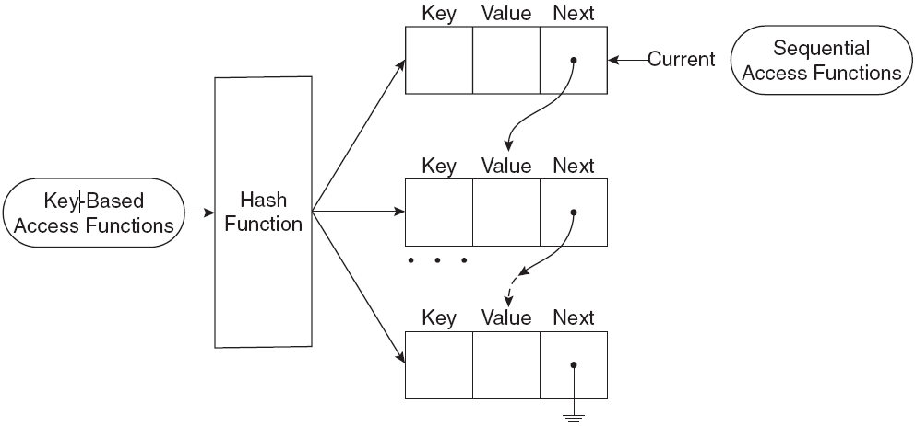
9.7.4 Sequential Access to Array Elements

Slide 51
9.7.4 Sequential Access to Array Elements
PHP maintains a marker in each array, called the “current” pointer.
The pointer starts at the first element when the array is created.
The element being referred to by the pointer can be obtained by the current() function.
Example:
$cities=array(“London”,”New York”);
$city=current($cities);
print(“the first city is $city”);

Slide 52
9.7.4 Sequential Access to Array Elements
The next function moves the pointer to the next element and returns the value (no key) there.
Example:
$city=current($cities);
print(“$city<br/>”);
while($city=next($cities)) print(“$city <br/>”);

Slide 53
9.7.4 Sequential Access to Array Elements
The each function returns the key/value pair and moves the pointer to the next element.
The key and value can be accessed using the keys “key” and “value” on the key/value pair.
Example:
$sal=array(“Mike”=>4000,”Tom”=>3000,”Robert”=>2000);
while($emp=each($sal))
{ $name=$emp[“key”];
$salary=$emp[“value”];
print(“The salary of $name is $salary <br/>”);}

Slide 54
9.7.4 Sequential Access to Array Elements
Both functions return false if no more elements are available.
prev ($sal) moves the pointer back towards the beginning of the array by one element.
reset($sal) moves the pointer to the beginning of the array.

Slide 55
9.7.4 Arrays as Stacks
PHP provides the array_push function that appends its arguments to a given array
It takes an array as its first parameter.
After the first parameter, there can be any number of additional parameters.
The values of all subsequent parameters are placed at the end of the array.
The function array_pop removes the last element of a given array and returns it
It takes an array as the single parameter.

Slide 56
9.7.4 Iterating Through an Array
The foreach statement has two forms for iterating through an array
foreach (array as scalar_variable) loop body
foreach (array as key => value) loop body

Slide 57
9.7.4 Iterating Through an Array
The first version assigns each value in the array to the scalar_variable in turn.
foreach ($list as $temp)
print("$temp <br />");

Slide 58
9.7.4 Iterating Through an Array
The second version assigns each key to key and the associated value to value in turn.
In the following example, each day and temperature is printed.
$lows = array("Mon" => 23, "Tue" => 18, "Wed" => 27);
foreach ($lows as $day => $temp)
print("The low temperature on $day was $temp <br />");

Slide 59
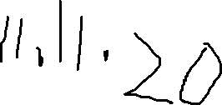
9.7.5 Sorting Arrays
The sort() function sorts the values in an array and makes a numerically subscripted array from the sorted list.
The function asort() sorts the values in an array but keeps the original key/value association.
The function ksort() is similar to asort() but sorts by keys.
The example sorting.php illustrates the various sort functions.

Slide 60
9.8 Functions
Function syntax
function name([parameters]) {
...
}
The parameters are optional, but not the parentheses.
Function names are not case sensitive.
A return statement causes the function to immediately terminate and return a value, if any.

Slide 61
9.8.2 Parameters
A formal parameter, specified in a function declaration, is simply a variable name.
If more actual parameters are supplied in a call than there are formal parameters, the extra values are ignored.
If more formal parameters are specified than there are actual parameters in a call, the extra formal parameters receive no value.

Slide 62
9.8.2 Parameters
PHP defaults to pass by value
Putting an ampersand in front of a formal parameter specifies that pass-by-reference.
Example addone.php

Slide 63
9.8.3 The Scope of Variables
A variable defined in a function is, by default, local to the function.
A global variable of the same name is not visible in the function.
Example summer.php
Declaring a variable in a function with the global keyword means that the function uses the global variable of that name which is defined outside the function.
Example big_sum.php

Slide 64
9.8.4 Lifetime of Variables
The default lifetime of a local variable is from the time the function begins to execute to the time the function returns.
Declaring a variable with the static keyword means that the lifetime is from the first use of the variable to the end of the execution of the entire script.
In this way a function can retain some ‘history’.
Example do_it.php

Slide 65
9.10 Form Handling
The values from forms can be accessed in PHP using the $_POST and $_GET arrays.
If a form has a text box named “phone” and the form method is POST, the value of the element is available in the PHP script as follows:
$_POST[“phone”]
The popcorn3.html and popcorn3.php implement the popcorn ordering using PHP.
The printf ()function is used to get two decimal places printed for currency values.

Slide 66
Class practice or homework
实验2的内容

Slide 67
End

