Slide 1
Part 8
Introduction to XML

Slide 2
contents (pp.277)
8.1 Introduction
8.2 The Syntax of XML
8.3 XML Document Structure
8.4 Document Type Definitions
8.7 Displaying Raw XML Documents
8.8 Displaying XML Documents with CSS
8.10 XML Processors

Slide 3
8.1 Introduction
eXtensible Markup Language (XML)
  A meta-markup language
    It is a language for defining markup language.

Slide 4
8.1 Introduction
Motivation for the development of XML
  Deficiencies of HTML
    HTML is defined to describe the layout of information without considering its meaning.
      For example: a list of used cars with color and price can be nested in paragraph element, but cannot be found.
    Lax syntactical rules

Slide 5
8.1 Introduction
Markup languages defined in XML are known as applications.
XML can be written by hand or generated by computer.
  Useful for data exchange
    Data stored in XML documents can be electronically distributed and processed by any number of different processing applications.
    Example first.xml

Slide 6
8.2 The Syntax of XML
Levels of syntax
  Well-formed documents conform to basic XML rules
  Valid documents are well-formed and also conform to a schema which defines details of the allowed content
    The first is Document Type Definitions(DTDs)
    The second is XML schema

Slide 7
8.2 The Syntax of XML
Well-formed XML documents
  Every beginning tag has a matching ending tag.
  If a beginning tag is inside an element, the matching ending tag is also inside the element.
  There is one root tag that contains all the other tags in a document.
  Attributes must have a value assigned, the value must be quoted.

Slide 8
8.2 The Syntax of XML
  The characters <, >, &，‘，” shoule be represented with entity(See next slide)
  Tag name is case-sensitive
  The processing instruction is included in <? and ?>
Validity is tested against a schema, discussed later.

Slide 9
8.2 The Syntax of XML
Tag | entity | meaning
< | &lt; | Less than
> | &gt; | Greater than
& | &amp; | and
‘ | &apos; | Single quote
“ | &quot; | Double quotes

Slide 10
8.3 XML Document Structure
Example entity.xml

Slide 11
8.3 XML Document Structure
An XML document often uses two auxiliary files
  Schema file: specifying its tag set and structural syntactic rules
    DTD or XML Schema
  Style file:describing how the content is printed or displayed
    Cascading Style Sheets (CSS)
    XSLT (extensible stylesheet language transformation)

Slide 12
8.4 Document Type Definitions(DTD)
A DTD is a set of structural rules called declarations, which specify a set of elements that can appear in the document as well as how and where these elements may appear.
  A set of declarations
    Define tags, attributes, entities
    Specify the order and nesting of tags
    Specify which attributes can be used with which tags

Slide 13
8.4 Document Type Definitions(DTD)
Declaration syntax
  <!keyword …. >
  Four possible keywords can be used:
    ElEMENT, used to define tags;
    ATTLIST, used to define tag attributes;
    ENTITY, used to define entities;
    NOTATION, used to define data type notations.
  Note: case sensitive

Slide 14
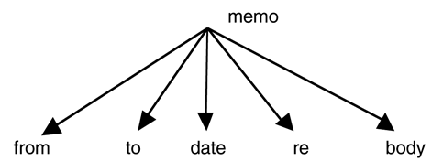
8.4.1 Declaring Elements
General syntax
  <!ELEMENT element-name (list of names of child elements)>
  For exmaple:
    <!ELEMENT memo(from,to,date,re,body)>

Slide 15
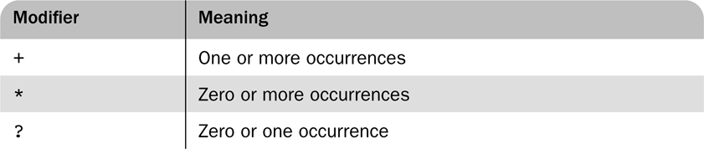
8.4.1 Declaring Elements
Multiplicity: Specifying the number of times that a child element may appear
For example:
  <!ELEMENT person(parent+,age,spouse?,sibling*)>

Slide 16
8.4.1 Declaring Elements
The leaf node of a DTD specifies the data type of the content of an element.
  In most cases, the type is PCDATA, for parsable character data.
  Two other content types can be specified with EMPTY and ANY
    EMPTY is to specify that the element has no content.
    ANY is to specify that the element may contain literally any content.
  Example:
      <!ELEMENT body(#PCDATA)>

Slide 17
8.4.2 Declaring Attributes
General syntax
  <!ATTLIST element-name
    (attribute-name attribute-type default-value?)+ >
  Explanation can be found in pp.307

Slide 18
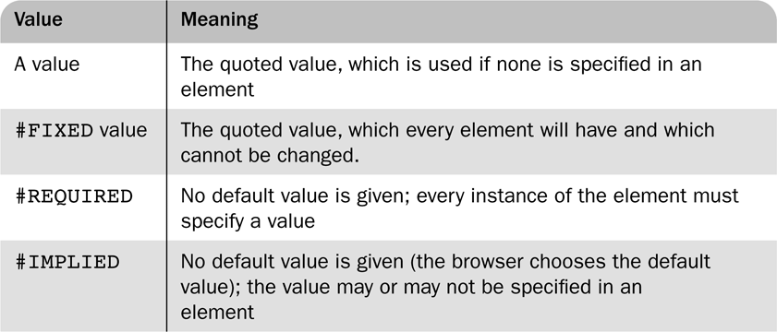
8.4.2 Declaring Attributes
Default value

Slide 19
8.4.2 Declaring Attributes
Supose the following specification.
  <!ATTLIST airplane places CDATA “4”>
  <!ATTLIST airplane engine_type CDATA #REQUIRED>
  <!ATTLIST airplane price CDATA #IMPLIED>
  <!ATTLIST airplane manufacturer CDATA #FIXED “Cessna”>
The following xml is valid for the DTD
<airplane places =”10” engine_type=”jet”> </airplane>
Note: for the #FIXED usage

Slide 20
8.4.3 Declaring Entities
Three commonly used entities: general entity, parameter entity and external text entity.
  General entity
    These entities can be referenced anywhere in the content of an XML document.
  Parameter entity
    These entities can be referenced only in DTD.
  External text entity
    When an entity is longer than a few words, such as a section of a technqical article, its text is defined outside the DTD.

Slide 21
8.4.3 Declaring Entities
General Syntax
  <!ENTITY [%] entity-name “entity-value”>
  With %: a parameter entity
  Without %: a general entity
Parameter entities may only be referenced in the DTD
External text entity
  <!ENTITY entity-name SYSTEM “file-location”>
  The replacement for the entity is the content of the file

Slide 22
8.4.3 Declaring Entities
Suppose that a document includes a large number of references to the full name of President Kennedy. We could define an entity as follows.
  <!ENTITY jfk “John Fitzgerald Kennedy”>
Any XML document can specify the name with just the reference &jfk

Slide 23
8.4.4 A sample DTD
See planes.dtd

Slide 24
8.4.5 Internal and External DTDs
A DTD can appear inside an XML document or in an external file, as is the case with plances.dtd.
If the DTD is included in the XML code, it must be introduced with <!DOCTYPE root-element [ and terminated with ]>

Slide 25
8.4.5 Internal and External DTDs
Internal
  <!DOCTYPE root-element [
    declarations
    ]>
External file
  <!DOCTYPE root-name SYSTEM “file-name”>
  For example:
    <!DOCTYPE planes_for_sale SYSTEM “planes.dtd”>

Slide 26
8.4.5 Internal and External DTDs
Example 1
  External DTD
  planes.xml and planes.dtd
Example 2
  planesdtd.xml

Slide 27
8.7 Displaying Raw XML Documents
Plain XML documents are generally displayed literally by browsers
  Some of the elements in the display are preceded with dash sign or plus sign, which can be interacted with.
  Demonstrate the planes.xml

Slide 28
8.8 Displaying XML Documents with CSS
An xml-stylesheet processing instruction can be used to associate a general XML document with a style sheet
  <?xml-stylesheet type=“text/css” href=“planes.css”>
The property of CSS
  The style sheet selectors will specify tags that appear in the XML document
  The display property
    It denotes whether an element is to be displayed inline or in a separate block

Slide 29
8.8 Displaying XML Documents with CSS
Demonstrate planescss.xml with planes.css

Slide 30
8.9 XSLT Style Sheets(自学)
eXtensible Stylesheet Language(XSL) is a family of specifications for transforming XML documents
  XSLT: specifies how to transform XML documents into different forms and formats, perhaps using different dtd.
  XPath: specifies how to select parts of a document and compute values
  XSL-FO: specifies a target XML language describing the printed page (not discuss)

Slide 31
8.9 Overview of XSLT
XSLT describes how to transform XML documents into other XML documents such as XHTML
  XSLT can be used to transform to non-XML documents as well
A functional style programming language
Basic syntax is XML
  There is some similarity to LISP and Scheme
An XSLT processor takes an XML document as input and produces output based on the specifications of an XSLT document

Slide 32
8.9 XSLT Processing
XSLT
Document
XSLT
Processor
XSL
Document
XML
Document

Slide 33
8.10 XML Processors
XML processors provide tools in programming languages to read in XML documents, manipulate them and to write them out
Four purposes
  Check the basic syntax of the input document
  Replace entities
  Insert default values specified by schemas or DTD’s
  If the parser is able and it is requested, validate the input document against the specified schemas or DTD’s

Slide 34
8.10 Purposes of XML Processors
The basic structure of XML is simple and repetitive, so providing library support is reasonable
Two different standards/models for processing
  SAX
  DOM

Slide 35
8.10 Parsing
The process of reading in a document and analyzing its structure is called parsing
The parser provides as output a structured view of the input document

Slide 36
8.10 The SAX Approach
In the SAX（Simple API for XML） approach, an XML document is read in serially
As certain conditions, called events, are recognized, event handlers are called
The program using this approach only sees part of the document at a time
This approach are suitable for processing large XML documents.

Slide 37
8.10 The SAX Approach (Example)
public void startElement(String uri, String localName, String qName, Attributes attributes) throws SAXException
{
if(qName.equals(“ad")){System.out.println(“ad”);
}
---------------------------------------------------------------------
public void endElement(String uri, String localName, String qName, Attributes attributes) throws SAXException
{
if(qName.equals(“ad")){ System.out.println(“ad ends”);
}

Slide 38
8.10 The DOM Approach
In the DOM(Document Object Model) approach, the parser produces an in-memory representation of the input document
  Because of the well-formedness rules of XML, the structure is a tree

Slide 39
8.10 The DOM Approach (Example)
publicvoid parseXml(String fileName) {
…..
// 获得文档根元素对对象;
Element root = document.getDocumentElement();
// 获得文档根元素下一级子元素所有元素;
NodeList nodeList = root.getChildNodes();
……
}

Slide 40
8.10 The DOM Approach
Advantages over DOM
  Parts of the document can be accessed more than once
  The document can be restructured
  Access can be made to any part of the document at any time
  Processing is delayed until the entire document is checked for proper structure and, perhaps, validity
One major disadvantage is that a very large document may not fit in memory entirely

Slide 41
End!

