Slide 1

Purpose-oriented Study on Commits For Better Software Quality
— A Research Agenda
CSCI 699 Project Presentation, 04/2021
Presenter: Jincheng He
jinchenh@usc.edu

Slide 2
Outline
1. Motivation
2. Context
3. Data Set
4. Literature and Challenge
5. Plan and Goals

Slide 3
1. Motivation
Open-source software quality monitoring and control is important
Developers commit their changes to repositories with certain purposes
Different types (purposes) of commits have different impact on software.
How, and how to control
Notes:
Abstract:
Developing software with the source code open to the public is very common; however, similar to its closed counterpart, open-source has quality problems, which cause functional failures, such as unsatisfying user experience, and non-functional, such as long responding time.
Previous researchers have revealed when, where, how and what the developers contribute to projects and how these aspects impact software quality.
However, there has been little work on how different categories of commits impact software quality.
To improve the quality of open-source software, we propose this research agenda to investigate how it is impacted by commits of different purposes.
By identifying these impacts, we will establish a new set of guidelines for committing changes, thus improving the quality.

Slide 4
2. Context
Open-source software and Version Control System
Commits, Purpose and Message
Code Change Pattern
Software Quality and Metrics
Notes:
Outline for this section.

Slide 5
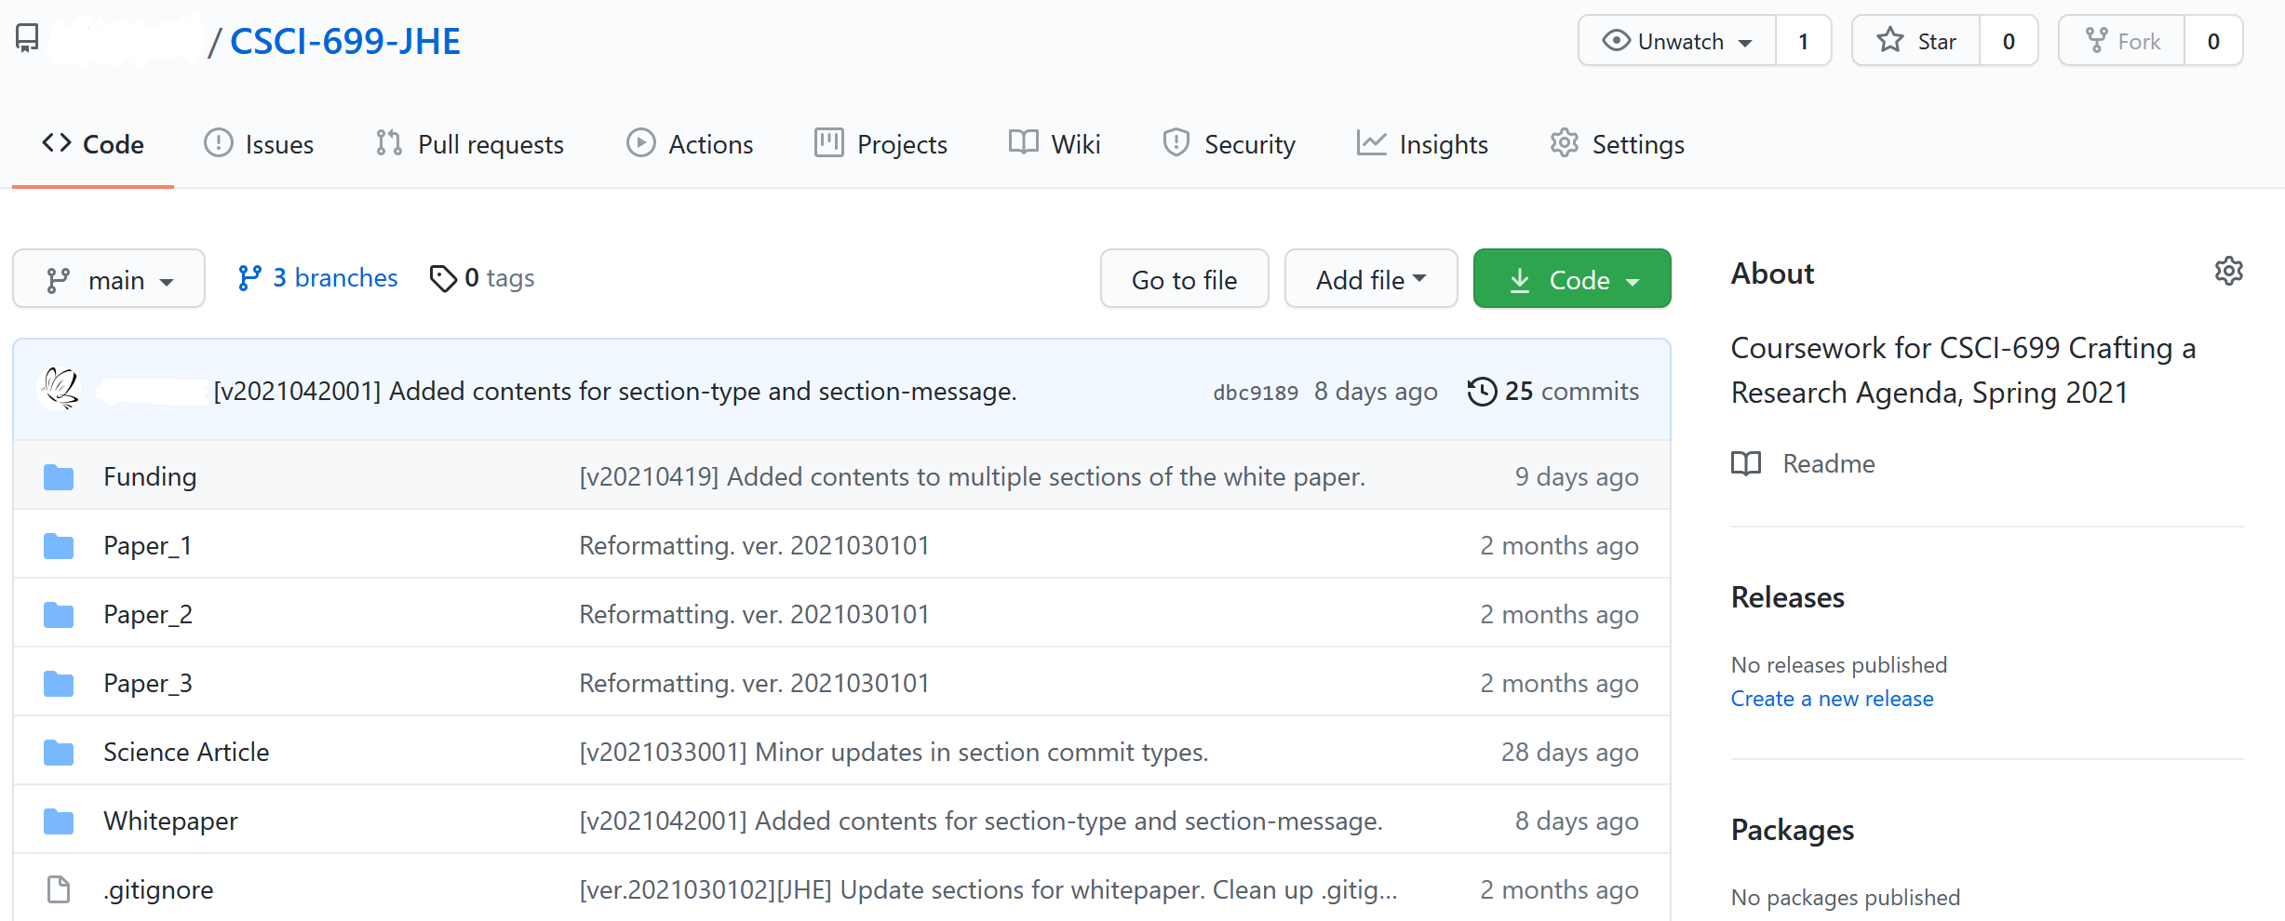
2.1 OSS and VCS
Notes:
Briefly introduce open-source software and version control system. The figure is from GitHub.

Slide 6
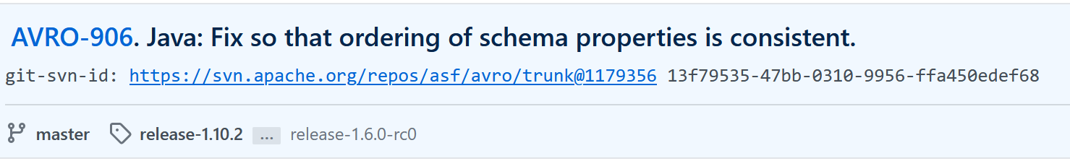
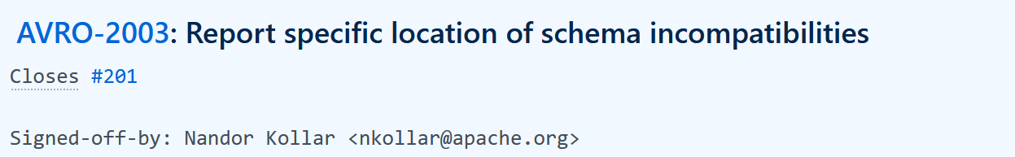
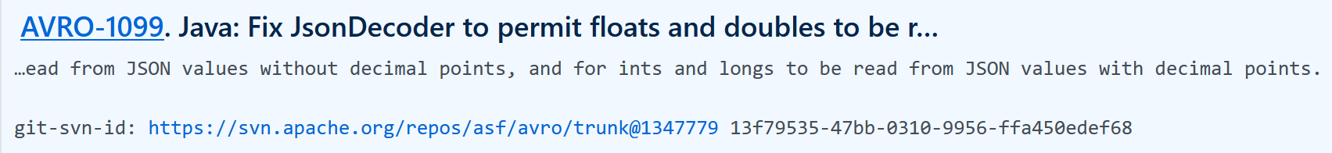
2.2 Commits, Purpose and Message
Notes:
Explain what is a commit, what is commit message and what is the purpose of a commit.
The figures are from Apache-Avro, examples of commits and commit messages.

Slide 7
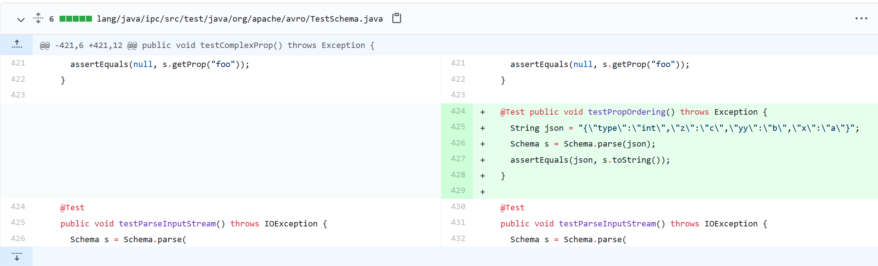
2.3 Code Change Pattern
Notes:
Explain what is “code change” in a commit and the potential patterns behind it.
The figure is one minor change in testing file.

Slide 8
3. Data Set
Projects: 68 open-source Java projects from Apache, Google, and Netflix GitHub Repositories
Commits: 314 breakers and 1600 neutrals
Data: Project meta-data from GitHub and quality metrics from static analysis tools: PMD, SonarQube, FindBugs
Notes:
Overview of Current Data Set

Slide 9
3.1 Breaker and Neutral
Before
Impact
After
Neutral
Breaker
Uncompilable (Broken)
Compilable (Solid)
Notes:
Introduce Breakers and Neutrals in this page. Compilability is one of the software quality aspects we will investigate.

Slide 10
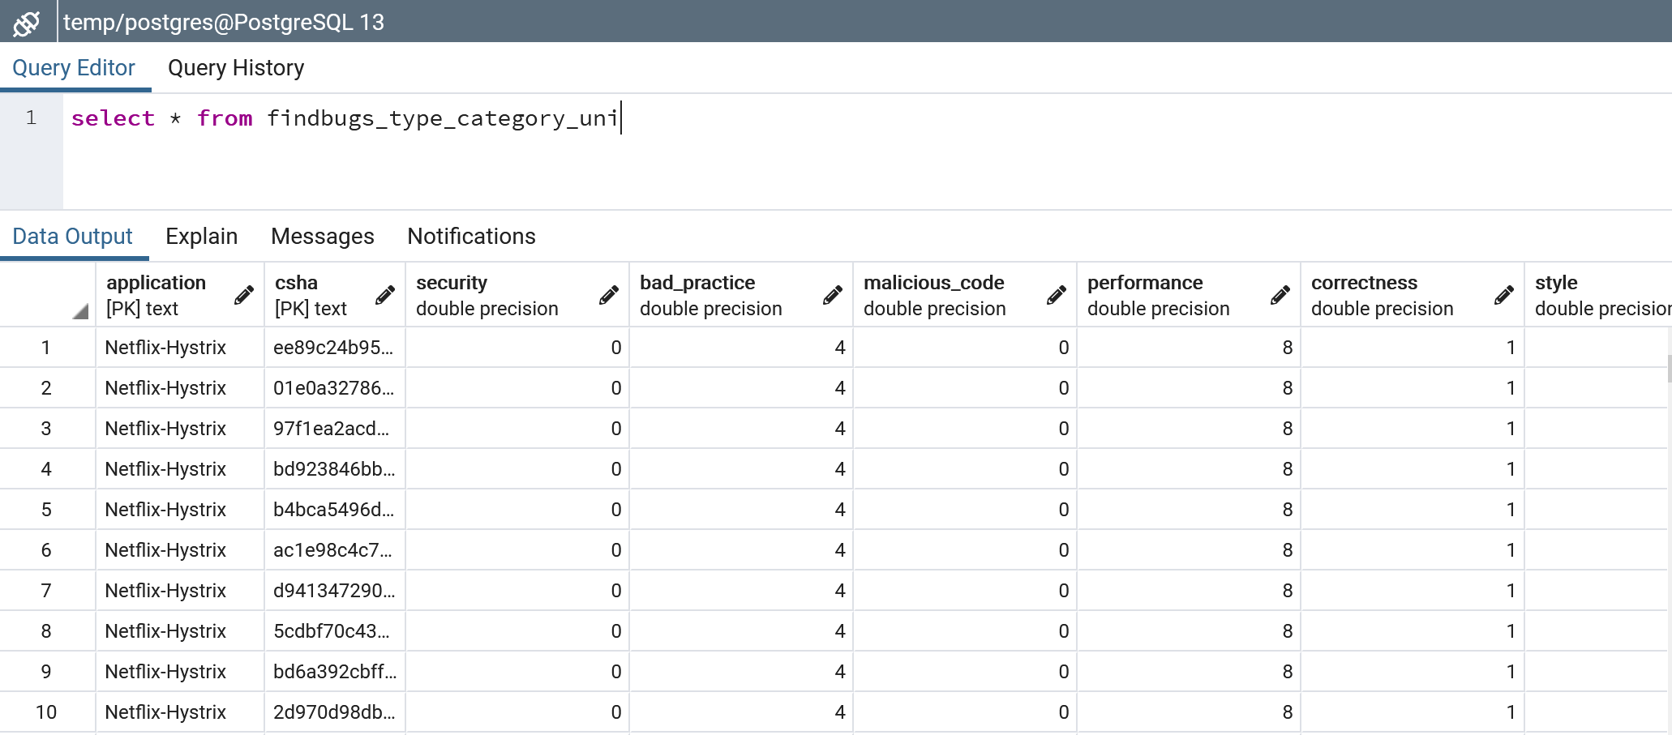
3.2 Software Metrics
Basic statistics: line of code, number of classes, etc
Quality metrics: vulnerability, code smell, etc
Tools: PMD, SonarQube, FindBugs, CAST, etc.
Notes:
Briefly introduce software quality and metrics. The figure is an example showing metrics from FindBugs.

Slide 11
3.2 Software Metrics
Basic statistics: line of code, number of classes, etc
Quality metrics: vulnerability, code smell, etc
Tools: PMD, SonarQube, FindBugs, CAST, etc.
Notes:
Briefly introduce software quality and metrics. The figure is an example showing metrics fr
om FindBugs.

Slide 12
3.3 Plan to Extend Data Set
Limitations:
The current data set only contains projects from three large corporations, which are from Google, Netflix and Apache.
We focus on impactful commits in current data set.
Notes:
Choosing the data set is a critical issue for a software repository mining research, since if the chosen data set is not representative, the conclusions won't be generally applicable.
The intention of extending our current data set is to avoid this situation.
We identify limitations of our current data set and how we plan to extend it as following:
The current data set only contains projects from three large corporations, which are from Google, Netflix and Apache. We plan to collect data from other corporations with the expectation of obtaining software data from different corporation conventions.
We focus on impactful commits in current data set. To resolve this limitation, we plan to investigate non-impactful commits and evaluate whether it is necessary to extend this research to those commits.

Slide 13
4. Literature and Challenges
Commit Types and Automated Tagging
Commit Message and Automated Generation
Relation Between Code and Commit Purpose
Software Quality and Metrics
Notes:
Outline for this section.

Slide 14
4.1 Commit Types
Previous Taxonomies for Commits
Purpose-oriented Categorization
Automated Tagging
Notes:
Show previous works in this sub-direction that do the categorizations and automated classification and why we choose purpose-oriented categorization.
Refer to the white paper for further details.
Introduce research challenges:
Work has been done to categorize commits in different ways and apply the categorizations to train prediction models.
However, there is a problem left unresolved in categorization.
The major one is the ambiguity of the concepts.
For example, the term ``bug'', used in some of the categorizations we mentioned, was first used by Grace Hopper, used to describe a failure in an early electromechanical computer back in 1946.
Later, the term ``bug'', is widely used in software engineering, used to describe an error, flaw or fault in a computer program or system that leads to an incorrect or unexpected result, or to behave in unintended ways.
The reason why it is a failure is that the concept itself is vague and sometimes misleading.
It aims at a clear boundary but ends up without getting one.
The word ``bug'' may be divorced from a sense that a human being caused the problem, and instead implies that the defect arose on its own.
Sometimes, it is better to describe a ``mistake'' in software more accurately using other terms in software mistake metamorphism to avoid ambiguity.
This problem also happen in other categorizations, like ``maintenance'', used in Hindle's categorization, which is the most ambiguous one even for manual classification.
Thus, as the core of our research, we plan to resolve this problem by create a more fine-grained categorization.
Instead of relying majorly on commit messages, we will characterize code changes and use them as major source for categorization, while also using commit messages and meta-data as supporting materials.
After the creation of our categorization, it will be necessary to investigate how to automate classification in a novel way, since we have a new and more fine-grained categorization.

Slide 15
4.2 Commit Message
Use Commit Messages to support categorization
Automated Message Generation
Notes:
Explain how we can use commits message to support categorization.
Show previous works related to this sub-direction.
Explain how we can apply our work into application (message generation).
Refer to the white paper for further details.
Introduce research challenges:
We will use code as our major source for categorization.
But we will also make use of commits messages to support it.
One of the major challenges in this step will be removing the useless information in commit messages.
We plan to apply natural language processing techniques to support this step.
Previous works don't have a core, well-grained categorization to support message generation.
Our categorization will provide support for it.

Slide 16
4.3 Code
Inconsistency between code changes and commit message.
The necessity of establishing a good categorization, linking it to every single code change, and supporting the development and maintenance.
Notes:
Explain why it is necessary to investigate code to help categorizing commits and the importance of the categorization.
While commit messages provide information about the initiatives of developers, the code changes provide direct information about what they exactly do.
There is a gap between the initiatives and the exact work done.
When we review the commits during manual categorizing, we find inconsistency between the code changes and what they report in their commit messages.
For example, a developer may make a small change and a major change but only report the major change.
However, the unexpected small one may introduce a defect in the software.
But as it is not included in the commit message, it will be hard for maintainers to track this kind of changes.
We will investigate into this as an important step in our research to demonstrate the importance of our categorization work, thus the importance of establishing a good categorization, linking it to every single code change, and supporting the development and maintenance.

Slide 17
4.4 Quality and Metrics
Tool-based Quality Metrics
Compilability and Other Quality Aspects
Notes:
Explain how we evaluate software quality in this research (two main approaches).
Refer to the white paper for further details.
Tool-based Quality Metrics
Researchers use static analysis tools and other tools to assess the quality of software.
For example, PMD, SonarQube and FindBugs give basic statistics of software, such as the lines of code, the number of functions, as well as quality-related metrics, such as vulnerability and code smell.
CAST software provide additional architecture evaluation.
We will evaluate software quality by using these metrics.
Other Independently Defined Quality Aspects
The software quality and quality metrics are not completely shown by the tools.
For example, they can't evaluate the quality when the software are not compilable.
And the compilability is one of the most basic quality software should possess.

Slide 18
5. Plan and Goals
Stage One: Categorization
Stage Two: Calibration and Investigation
Stage Three: Application
Goals
Benefits and Intellectual Advancement
Notes:
In previous sections, we present the data set and tools we will use in this research, investigate the sub-areas related to this research topic, and identify the corresponding research challenges.
To resolve the challenges, we come up with the following research plan and explain the benefits of this research:
Stage One
Few researchers have studied the correlation between the change type and the code, or how change type impacts quality.
In this stage, we start by refining the existing categorization of commit changes in open source software repositories.
We evaluate the quality of those changes by obtaining quality metrics from static analysis tools, to demonstrate the importance of this research.
To assess the correlation between the quality and the categories, we will train a machine learning model, in addition to applying standard mathematical correlation analyses.
Stage Two
In this stage, although we have categorized the commit changes, further work distinguishing between different categories is required.
This is because high-level categories overlap.
In this stage, we will remove the ambiguity of the categories by analyzing the code changes within the commits rather than the commit messages and manual categorizing.
Once this is done, we will investigate the correlation between the categories and changes in code to reveal whether they correlate and how those changes impact software quality.
Stage Three
In the final stage, we will apply our contributions in different ways.
We will construct guidelines which will help developers develop software as well as automate commit message generation and automate classification to support development and maintenance.
In addition, we will create an index which explains how different code patterns impact the quality.
We will conclude this research by releasing them.
Benefits
We will be able to provide guidelines on how open-source software developers, when contributing to projects, can improve quality.
In addition, the results of the second stage will allow us to provide more reliable coding standards and will improve overall code quality.
Improved quality will help to reduce cost and improve software service quality.
Intellectual Advancement
The first goal of this research is to make concrete improvements in the quality of open-software by providing guidelines for developers and, thus, to improve code quality.
We believe this will also change the way people think, code and develop software.

Slide 19
Acknowledgement
SERC
Dr. Abram Hindle, from Universityof Alberta,
Dr. BarathRaghavan, Chuizheng Meng et al., from CSCI-699 Class
Pooyan Behnamghader, Elaine Venson, from CSSE
Mary Ann Murphy, from USC ALI

Slide 20
Thank you.

Slide 21
Q&A

