Slide 1
Languages for the Semantic Web
Heiner Stuckenschmidt
Vrije Universiteit Amsterdam
heiner@cs.vu.nl

Slide 2
Overview
Semantic Web Languages
  XML / XML Schema
  RDF / RDF Schema
  Ontology Web Language
Advanced Topics
  OWL and UML
  Families of Languages
  Modularization

Slide 3
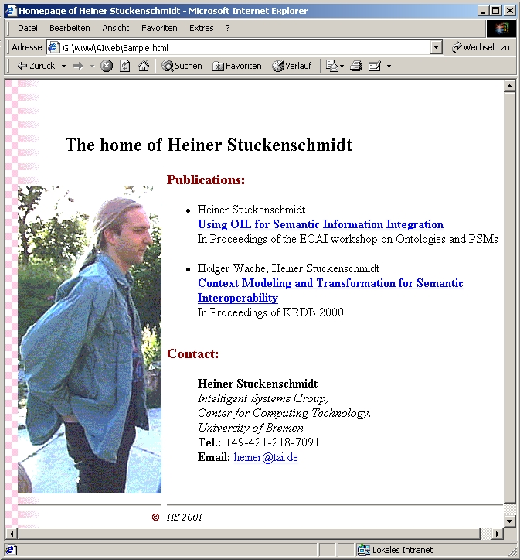
Separation of Form and Content
/www/home.html
heiner.gif
papers.dbf

Slide 4
The Glue: Annotations
  Information is annotated with type information
<document>
<title>A Problem and its Solution</title>
<abstract>
We describe a serious problem and
propose a solution to it.
</abstract>
<section>
<header>The Problem</header>
<text>...</text>
</section>
<section>
<header>Our Solution</header>
<text>...</text>
</section>
<reference>
Someone (sometimes): The real Problem.
</reference>
<reference>
Another one (later): No Solutions Yet !
</refernce>
</document>
Types are structured using labeled trees as data model
document
title
reference
abstract
section
header
text

Slide 5
Human Readable Information
HTML Annotations:
  fixed markup language
  presentational and linking Information
  Very little definitional strenghts
<b> Heiner Stuckenschmidt </b> <br>
<i> Intelligent Systems Group,<br>
Center for Computing Technology,<br>
University of Bremen <br> </i>
<b>Tel.:</b> +49-421-218-7091 <br>
<b> Email: </b> <a href="mailto:heiner@tzi.uni-bremen.de">heiner@tzi.de</a>

Slide 6
Machine-Understandable Information
Language
  Encoding: valid Characters
  Lexicon: valid Words
  Syntax: valid Sentences
Ontology
  Vocabulary: Known Terms
  Terminology: Intended Meaning
  Conceptualization: Valid Structures
{
XML
XML Schema
RDF
{
RDF Schema
OWL

Slide 7
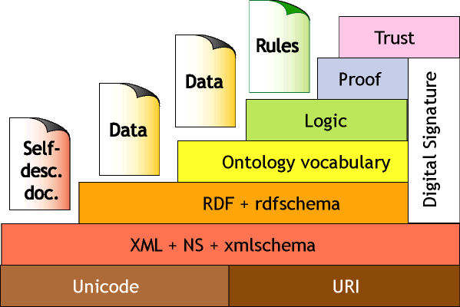
The Semantic Web Layer Cake

Slide 8
XML-Structuring Information
XML-Annotations:
<researcher>
<name> Heiner Stuckenschmidt </name>
<affiliation>
<group> Intelligent Systems Group</group>
<institute> Center for Computing Technology</institute>
<university> University of Bremen </university>
</affiliation>
<phone>+49-421-218-7091</phone>
<email> heiner@tzi.uni-bremen.de </email>
</researcher>
- Definable Annotation Language

Slide 9
XML Schema – Data Models for the Web
Name
Group
has
n
1
Phone
Researcher
Affiliation
Institute
eMail
<xsd:element name="reseracher">
<xsd:complexType>
<xsd:element name="name" type="xsd:String"/>
<xsd:element name="affiliation" type="affil"
minOccurs="1" maxOccurs="unbounded"/>
<xsd:element name="phone" type="xsd:String"/>
<xsd:element name="eMail" type="xsd:String"/>
</xsd:complexType>
</xsd:element>
<xsd:complexType name="affil">
<xsd:element name="group" type="xsd:String"/>
<xsd:element name="institute" type="xsd:String"/>
<xsd:element name="university" type="xsd:String"/>
</xsd:complexType>
University
Cardinalities
Complex-Types
Ordering
Data-Types

Slide 10
RDF – A Data Model for Metadata
„Metadata is machine understandable information about web resources or
anything that has an URI, it is represented as a set of independent assertions:“
Triple: T(subject, attribute, values)
Creator
Heiner
http://www.tzi.de/~heiner/public/KRDB00.pdf
Creator
Holger
<rdf:Description about="http://www.tzi.de/~heiner/public/KRDB00.pdf">
<dc:Creator rdf:ressource="http://www.tzi.de/~heiner#me"/>
<dc:Creator rdf:ressource="mailto:wache@tzi.de"/>
</rdf:Description>

Slide 11
Annotating Metadata
<rdf:Description rdf:about="http://.../dc/datamodel/WD-dc-rdf/">
<dc:title>
Guidance on expressing the Dublin Core within the Resource
Description Framework (RDF)
</dc:title>
<dc:creator> Eric Miller </dc:creator>
<dc:creator> Paul Miller </dc:creator>
<dc:creator> Dan Brickley </dc:creator>
<dc:subject> Dublin Core; RDF; XML </dc:subject>
<dc:publisher> Dublin Core Metadata Initiative </dc:publisher>
<dc:contributor> Dublin Core Data Model Working Group </dc:contributor>
<dc:date> 1999-07-01 </dc:date>
<dc:format> text/html </dc:format>
<dc:language> en </dc:language>
</rdf:Description>

Slide 12
No Semantics Yet !
The following descripition is valid in RDF:
A stronger typing model is needed !
<rdf:RDF>
<lib:Book about="War and Peace">
<lib:creator rdf:resource="Anna Karenina"/>
<lib:pages>1.376*10³</lib:pages>
</lib:Book>
<lib:Book about="Anna Karenina">
<lib:creator rdf:resource="LT"/>
<lib:pages>864</lib:pages>
</lib:Book>
</rdf:RDF>

Slide 13
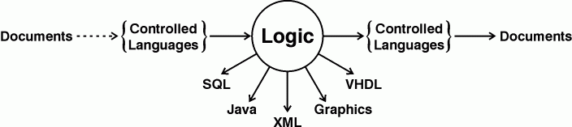
Interfacing to Logic
Possible Representation of Complex Knowledge
  Natural languages. Anything observed by humans can be expressed in natural language.
  Logic. Anything to be implemented on a digital computer can be specified in logic
Controlled Languages are used to mediate between Logic and natural languages.

Slide 14
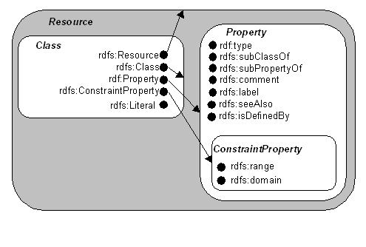
RDFS – Adding a Type System

Slide 15
An Example:
Relations:
Class Hierarchy:
<rdf:Property ID="Author">
<rdfs:domain rdf:resource="#Publications"/>
<rdfs:range rdf:resource="#Researcher"/>
</rdf:Property>
<rdf:Property ID="FirstAuthor">
<rdfs:subPropertyOf rdf:resource="#Author"/>
</rdf:Property>
<rdfs:Class ID="Person"/>
<rdfs:Class ID="Document"/>
<rdfs:Class ID="Researcher">
<rdfs:subClassOf rdf:resource="#Person"/>
</rdfs:Class>
<rdfs:Class ID="Publication">
<rdfs:subClassOf rdf:resource="#Document"/>
</rdfs:Class>
Assertions:
<rdf:Description about="http:/www.tzi.de/~heiner/public/KRDB00.pdf">
<rdf:type rdf:resource="#Publication"/>
<FirstAuthor rdf:resource="http://www.tzi.de/~heiner#me"/>
<Author rdf:resource="mailto:wache@tzi.de"/>
</rdf:Description>

Slide 16
Investigating RDF Meaning
RDF consists of Triples (do you see them ?)
Simplified Syntax:
<lib:Book about="War and Peace">
<lib:creator rdf:resource="LT"/>
<lib:pages>1.376*10³</lib:pages>
</lib:Book>
(:"War and Peace" rdf:type lib:Book)
(:"War and Peace" lib:creator "Leo Tolstoy")
(:"War and Peace" lib:pages 1.376*10³)

Slide 17
Basic Types
rdf:Resource
  Everything that can be refered to using an URI
rdf:Property
  A binary relation between two resources
rdf:Statement
  A triple consisting of an rdf:subject, an rdf:predicate and an rdf:object

Slide 18
Intended Semantics
An RDF Statement consists of a resource, a property and a second resource:
If M contains | then add
(:s :p :o) | (:s rdf:type rdf:Resource) (:p rdf:type rdf:Property) (:o rdf:type rdf:Resource)

Slide 19
Example
doris
(:alice :has-child :betty)
(:alice :has-child :charles)
(:betty :has-child :doris)
(:betty :has-child :eve)
(:charles : has-sibling :betty)
(:doris :has-sister :eve)
(:eve :has-sister :doris)
betty
alice
eve
charles
:has-child
:has-sister
:has-sibling

Slide 20
Specialized Properties
rdfs:subPropertyOf
applies to properties and must be interpreted as the subset relation between the relations they denote.
  For example, rdf:type is rdfs:subPropertyOf rdf:Property
The spezialization is introduced to structure Relations by introducing specializations

Slide 21
Intended Semantics
If M contains | Then add
(:s rdfs:subPropertyOf :o) | (:s rdf:type rdf:Property) (:o rdf:type rdf:Property)
(:s :p :o) (:p rdfs:subPropertyOf :q) | (:s :q :o)
(:p rdfs:subPropertyOf :q) (:q rdfs:subPropertyOf :r) | (:p rdfs:subPropertyOf :r)

Slide 22
Example
(:has-sister rdfs:subPropertyOf :has-sibling)
(:has-brother rdfs:subPropertyOf :has-sibling)
(:has-child rdfs:subPropertyOf :has-descendant)
Using the intended semantics, we can infer:
(:alice :has-descendant :betty)
(:alice :has-descendant :charles)
(:betty :has-descendant :doris)
(:betty :has-descendant :eve)
(:doris :has-sibling :eve)
(:eve :has-sibling :doris)

Slide 23
Constraints on Properties
rdfs:domain
  restrict the set of resources that may have a given property (i.e. its domain)
rdfs:range
  Restricts the set of values for a given Property (i.e. ist range)

Slide 24
Intended Semantics
Domain and range force subjects and objects of a Property to be of a certain type
If M contains | Then add
(:s :p :o) (:p rdfs:domain :t) | (:s rdf:type :t)
(:s :p :o) (:p rdfs:domain :t) | (:o rdf:type :t)

Slide 25
Example
(:has-child rdfs:domain parent)
(:has-child rdfs:range person)
(:has-sibling rdfs:domain person)
(:has-brother rdfs:range :male-person)
(:has-sister rdfs:range :female-person)
Using the intended semantics, we can infer:
(:alice rdf:type parent)
(:betty rdf:type parent)
(:doris rdf:type :female-person)
(:eve rdf:type :female-person)
(:charles rdf:type :person)

Slide 26
Class Hierarchies
rdfs:Class
  Classes are resources denoting a set of resources, by the mean of the property rdf:type
rdfs:subClassOf
  Classes are structured the same way as properties, in a subset hierarchy denoted by the property rdfs:subClassOf

Slide 27
Intended Semantics
If M contains | Then add
(:s rdf:type :o) | (:o rdf:type rdfs:Class)
(:s rdf:type :o) (:o rdfs:subClassOf :c) | (:s rdf:type :c)
(:s rdfs:subClassOf :o) (:o rdfs:subClassOf :c) | (:s rdfs:subClassOf :c)
(:s rdfs:subClassOf :o) | (:s rdf:type rdfs:Class) (:o rdf:type rdfs:Class)
(:s rdf:type rdfs:Class) | (:s rdfs:subClassOf rdf:Resource)

Slide 28
Example
(:parent rdfs:subClassOf :person)
(:male-person rdfs:subClassOf :person)
(:female-person rdfs:subClassOf :person)
(:mother rdfs:subClassOf :parent)
(:mother rdfs:subClassOf :female-person)
Using the intended semantics, we can infer:
(:alice rdf:type person)
(:betty rdf:type person)
(:doris rdf:type :person)
(:eve rdf:type :person)

Slide 29
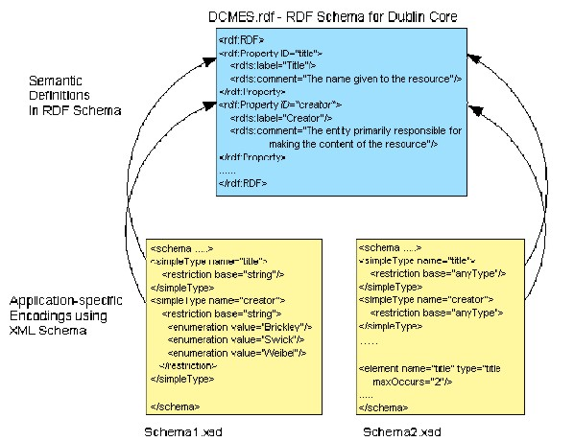
RDFS vs. XML Schema
Encapsulation of Data sources with metadata about
  Encoding
  Structure
  Contents
  Semantics
RDF Schema can provide a common basis for special purpose models
  Encode Application Data with XML
  Map schema to common RDF/S model
}
XML Schema
}
RDF(Schema)
[Hunter & Lagoza 2001]

Slide 30
OWL - Beyond RDF Schema
RDF(S)
DAML+OIL
class-def
subclass-of
slot-def
subslot-of
domain
range
class-expressions
  AND, OR, NOT
slot-constraints
  has-value, value-type
  cardinality
slot-properties
  trans, symm

Slide 31
DAML+OIL: Classes
<daml:Class rdf:ID="Male">
<rdfs:subClassOf rdf:resource="#Animal"/>
</daml:Class>
<daml:Class rdf:ID="Female">
<rdfs:subClassOf rdf:resource="#Animal"/>
<daml:disjointWith rdf:resource="#Male"/>
</daml:Class>
<daml:Class rdf:ID="Man">
<rdfs:subClassOf rdf:resource="#Person"/>
<rdfs:subClassOf rdf:resource="#Male"/>
</daml:Class>

Slide 32
Class-Building Operations
Relation to other Classes
  rdfs:subClassOf
  daml:disjointWith
  daml:disjointUnionOf
  daml:sameClassAs
  (daml:equivalentTo)
Contained Elements:
  daml:oneOf
Boolean combinations:
  daml:intersectionOf
  daml:unionOf
  daml:complementOf

Slide 33
DAML+OIL: Properties
<daml:ObjectProperty rdf:ID="hasParent">
<rdfs:domain rdf:resource="#Animal"/>
<rdfs:range rdf:resource="#Animal"/>
</daml:ObjectProperty>
<daml:ObjectProperty rdf:ID="hasChild">
<daml:inverseOf rdf:resource="#hasParent"/>
</daml:ObjectProperty>
<daml:UniqueProperty rdf:ID="hasMother">
<rdfs:subPropertyOf rdf:resource="#hasParent"/>
<rdfs:range rdf:resource="#Female"/>
</daml:UniqueProperty>

Slide 34
Property-Building Operations
Basic Types:
  daml:ObjectProperty
  daml:DataTypeProperty
Special Types
  daml:TransitiveProperty
  daml:UniqueProperty
  daml:UnambigousProperty
Further Restrictions:
  rdfs:subPropertyOf
  rdfs:domain
  rdfs:range
  daml:samePropertyAs
  daml:inverseOf

Slide 35
DAML+OIL: Property Restrictions
<daml:Class rdf:ID="Person">
<rdfs:subClassOf rdf:resource="#Animal"/>
<rdfs:subClassOf>
<daml:Restriction>
<daml:onProperty rdf:resource="#hasFather"/>
<daml:toClass rdf:resource=„#Man“/>
</daml:Restriction>
<daml:Restriction daml:cardinality="1">
<daml:onProperty rdf:resource="#hasFather"/>
</daml:Restriction>
</rdfs:subClassOf>
</daml:Class>

Slide 36
DAML+OIL: Property Restrictions
<daml:Class rdf:ID="Person">
<rdfs:subClassOf rdf:resource="#Animal"/>
<rdfs:subClassOf>
<daml:Restriction daml:cardinalityQ="1"> <daml:onProperty rdf:resource="#hasFather"/>
<daml:hasClassQ rdf:resource=„#Man“/>
</daml:Restriction>
</rdfs:subClassOf>
</daml:Class>

Slide 37
Restrictions
General:
  daml:Restriction
  daml:onProperty
Value and Type Restrictions
  daml:toClass
  daml:hasValue
  daml:hasClass
Number Restrictions
  daml:cardinality
  daml:maxCardinality
  daml:minCardinality
Combinations:
  daml:cardinalityQ
  daml:maxCardinalityQ
  daml:minCardinalityQ

Slide 38
DAML+OIL: Individuals
<rdf:Description rdf:ID="Asia">
<rdf:type>
<rdfs:Class rdf:about="#continent"/>
</rdf:type>
<daml:differnetIndividualFrom rdf:resource="#Europe"/>
</rdf:Description>
<continent rdf:ID="Asia"/>
<rdf:Description ID:about="India">
<is_part_of rdf:resource="#Asia"/>
<daml:sameIndividual rdf:resource="#IndianSubcontinent"/>
<inhabitants><xsd:integer rdf:value="700.000.000"/></inhabitants>
</rdf:Description>

Slide 39
DAML+OIL: Defined Datatypes
<xsd:simpleType name="over17">
<xsd:restriction base="xsd:positiveInteger">
<xsd:minInclusive value="18"/>
</xsd:restriction>
</xsd:simpleType>
<daml:Class rdf:ID="Adult">
<daml:intersectionOf rdf:parseType="daml:collection">
<daml:Class rdf:about="#Person"/>
<daml:Restriction>
<daml:onProperty rdf:resource="#age"/>
<daml:hasClass rdf:resource=„...#over17"/>
</daml:Restriction>
</daml:intersectionOf>
</daml:Class>

Slide 40
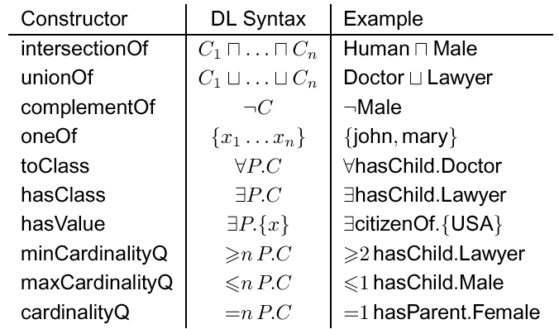
DAML+OIL Constructors

Slide 41
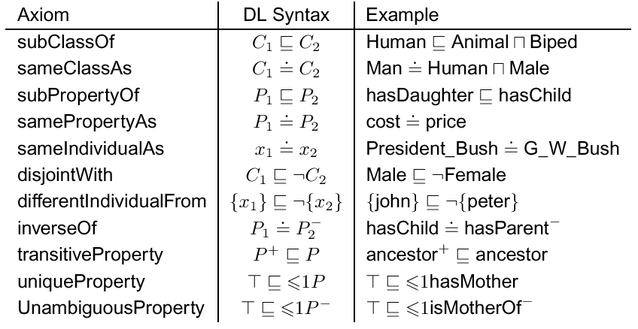
DAML+OIL Axioms

Slide 42
The Good News about OWL
OWL is well supported
  W3C Working Group
  European Network OntoWeb
  IST Project WonderWeb
OWL is compatible with Web Standards
  Information can be included on web pages
  Existing tools can be used for processing
OWL has a clear semantics
  Reasoning support is provided
  Formal properties are well known

Slide 43
Even better news: Reasoning Support
At Development Time:
  Consistency checking (also possible in UML)
  Automatic generation of class hierarchies
At Use Time:
  Classification of new objects
  Querying property values (not unlike a database)
  Retrieval of objects and classes

Slide 44
The Bad News about OWL (and XML)
<daml:Class rdf:ID="file:C:\Programme\OILEd2.2\ontologies\Animals.rdfs#Domestic-Animal">
<rdfs:label>Domestic-Animal</rdfs:label>
<rdfs:comment/>
<oiled:creationDate>09:21:58 27.03.2002</oiled:creationDate>
<daml:sameClassAs>
<rdfs:Class>
<daml:intersectionOf>
<daml:List>
<daml:first>
<daml:Class rdf:about="file:C:\Programme\OILEd2.2\ontologies\Animals.rdfs#Animal"/>
</daml:first>
<daml:rest>
<daml:List>
<daml:first>
<daml:Restriction>
<daml:onProperty rdf:resource="file:C:\Programme\OILEd2.2\ontologies\Animals.rdfs#origin"/>
<daml:hasClass>
<daml:Class>
<daml:oneOf>
<daml:List>
<daml:first>
<daml:Thing rdf:about="file:C:\Programme\OILEd2.2\ontologies\Animals.rdfs#domestic"/>
</daml:first>
<daml:rest>
<daml:nil/>
</daml:rest>
</daml:List>
</daml:oneOf>
</daml:Class>
....
OWL and XML are meant for machines, not for humans !

Slide 45
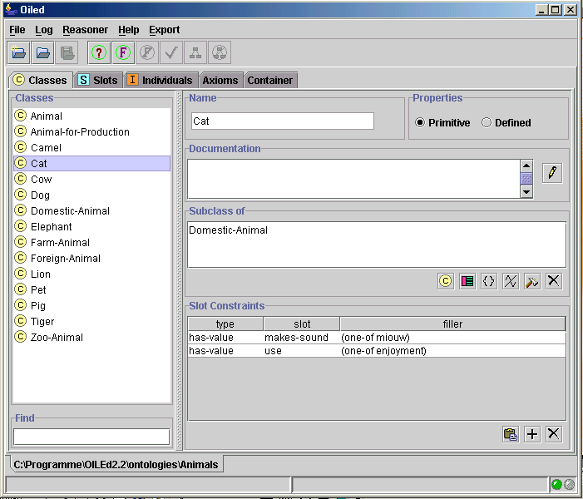
A little bit better, but still...
Available Ontology Editors
provide little support for
graphical modelling !

Slide 46
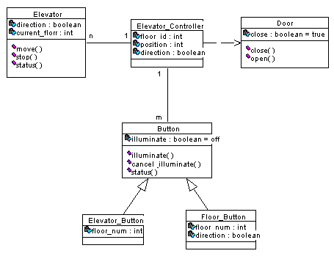
A Solution: Specifying Ontologies in UML
Why UML ?
  It is the de facto standard in Software Engineering
  It supports other kinds of knowlegde (e.g. Processes)
  It has a graphical notation
  It is meant for Human consumption !
  It has very good tool support:
  http://www.objectsbydesign.com/tools/umltools/umltools_byCompany.html

Slide 47
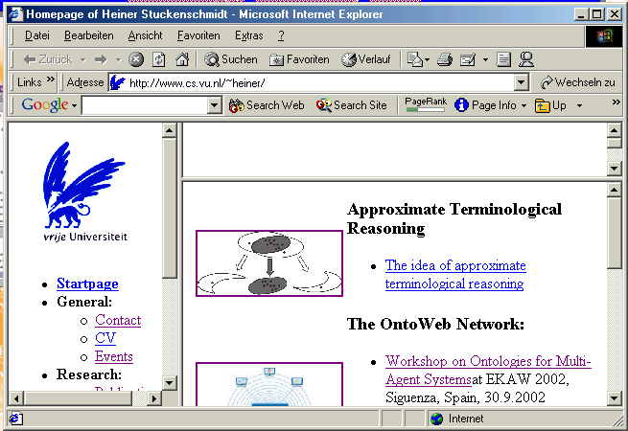
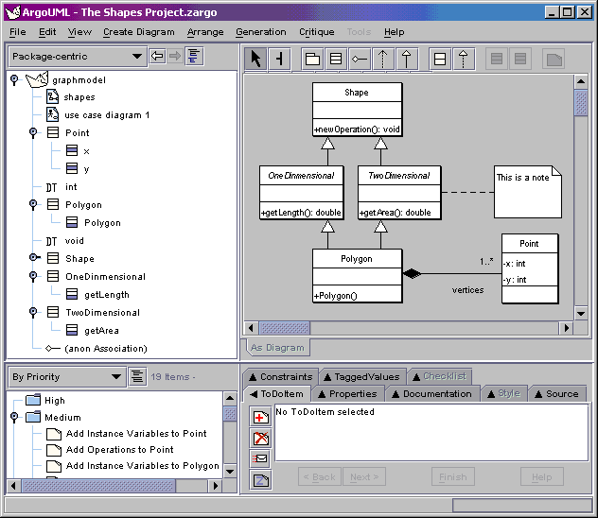
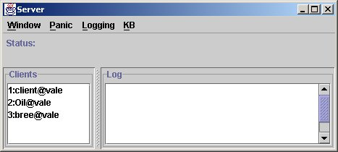
Current Plan: Ontology Building with UML
Information System:
XML-based encoding
UML Editor:
RDF/S
XMI
OWL Reasoner:
OWL
Ongoing Master‘s Thesis (Kateryna Falkovych)

Slide 48
Ontology Extraction from UML Diagrams
Ontologies are hidden in existing UML Models
Extract it by partial mappings to OWL
  Straightforward for Class Diagram
  Not obvious for other Diagrams !
  Meta-Models needed:
    Actors
    Activities
    Processes
    ...

Slide 49
Language Layering
Logical Operators
Full Cardinalities
Class Expressions
OWL – Logic Version
OWL – ‚Frame‘ Version
Disjointness and Equality
Local Properties, Transitivity
Simple Cardinalities
Defined and Enumerated Classes
RDF Schema
Classes / Inheritance
Properties / Subproperties
Global Type Restrictions
Individuals

Slide 50
Families of Langauges
FL-
L’
L’’
FL
AL
FLN
ALU
ALC
ALE
ALN
ALUE
ALEN
ALUR
SHF
SHIQ
L
[Euzenat and Stuckenschmidt 2002]

Slide 51
Defining Logical Operators
<dl:INV parent-of/>
DTD: Document Type Definition
<!ELEMENT dl:INV (%dl:RDESC;)>
DSD: Document Semantics Definition
<dsd:denotation match="dl:INV">
<mml:eq/>
<mml:apply>
<mml:inverse/>
<dsd:apply-interpretation select="*[1]"/>
</mml:apply>
</dsd:denotation>
[Euzenat 2001]

Slide 52
Assembling Logics
<dlml:logic name="shiq">
<dlml:atoms/>
<dlml:cop name="anything"/>
<dlml:cop name="nothing"/>
<dlml:cop name="and"/>
<dlml:cop name="or"/>
<dlml:cop name="not"/>
<dlml:cop name="all"/>
<dlml:cop name="some"/>
<dlml:cop name="csome"/>
<dlml:cop name="catleast"/>
<dlml:cop name="catmost"/>
<dlml:rop name="inv"/>
<dlml:rop name="trans"/>
<dlml:cint name="cprim"/>
</dlml:logic>
max
min
inv
not
some
SHIQ
all
or
and
[Euzenat 2001]

Slide 53
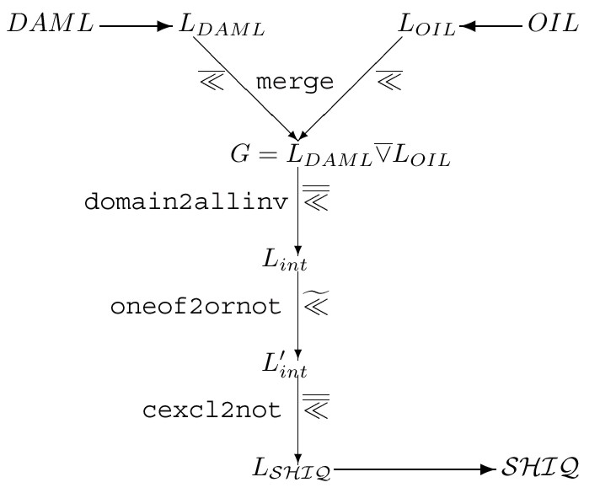
Transformations by Local Change
Ontologies are mapped
  From DAML to DLML
  From OIL to DLML
G is the union of both representations
G is mapped to SHIQ
  domain restrictions
  enumerations
[Stuckenschmidt and Euzenat 2001]

Slide 54
Prooving Formal Properties
Domain restrictions of the form (domain r C) is equivalent with the following SHIQ expression
Using General Concept Implication, we can even translate the expression into SHF:
(implies top (all (inv r) C))
(implies (some r :top) C)

Slide 55
Modularization
Aims
  Improve Transparency
  Support Re-Use
  Increase Efficiency
Requirements
  Clear Semantics
  Maximal Cohesion
  Localized Reasoning

Slide 56
Semantics of Modular Ontologies
Requirements:
  Classical semantics for single modules
    Ability to use existing methods
  Unique notion of module membership
    Avoid Naming and reference conflicts
  Global notion of logical consequence
    Ability to reason across modules
  Local containment of inconsistencies
    Avoid error propagation

Slide 57
Distributed Description Logics
A DDL consists of
  A set T_{i} of T-Boxes
  Sets B_{i} of bridge rules of the form
    i:C -⊆-> j:D
    i:C -⊇-> j:D
Semantics of a DDL:
  Abstract domains Δ_{i}
  Local Interpretations I_{i} over domains Δ_{i}
  Binary relations r_{ij} ⊆ Δ_{i} x Δ_{j}
[Borgida and Serafini 2002]

Slide 58
Properties of DDL
Classical Semantics for Modules
  Local Interpretations
Local containment of inconsistency
  Inconsistency in linked theories does not influence local reasoning (in SHIQ)
Global notion of logical consequence
  Distributed model can be translated into a single global model if the logic supports qualified existential restrictions and global axioms

Slide 59
Reasoning with Modular Ontologies
Reasoning on a global model does not scale up !
Alternative approach:
  Perform reasoning within subtheories
  Providing minimal interaction interfaces for results
  Results exchange by message passing
C ⊆ D

Slide 60
Partition-Based Logical Reasoning
Partitioned Logical Theories:
  Partitions Ai with signature L(Ai)
  Organized in a partition Graph (Ai,E,l)
  Connected by a link, if L(Ai) ∩ L(Aj) ≠ ∅
  The intersection l(i,j) is called communication language
Reasoning in Partitioned Theories
  Local reasoning determines interpretation of communication languages
  Result is passed to connected partition as prior knowledge for local reasoning
  Sound and complete for SAT and for Resolution
[Amir and McIlraith 2000]

Slide 61
Conclusion
Some achievements have been reached
  Standardization of languages for data, data structures and metadata
  Languages for interfacing markup with logical theories to support reasoning
But there is still a lot of work to do
  to ease the use of existing languages
  to meet the requirements for representing and using formal knowledge in a distributed setting

