Slide 1
Metadata, the art of adding signposts
Workshop “Metadata or not?”
WGI, Tilburg
May 19, 2004

Slide 2
Why do we add metadata?
To find information back
To investigate the source
To see what is related
To have an overview AND see what is relevant

Slide 3
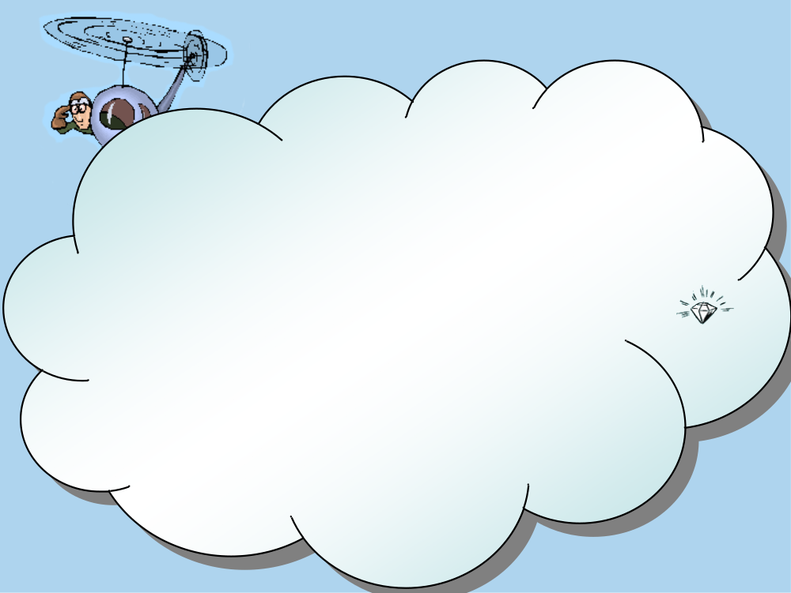
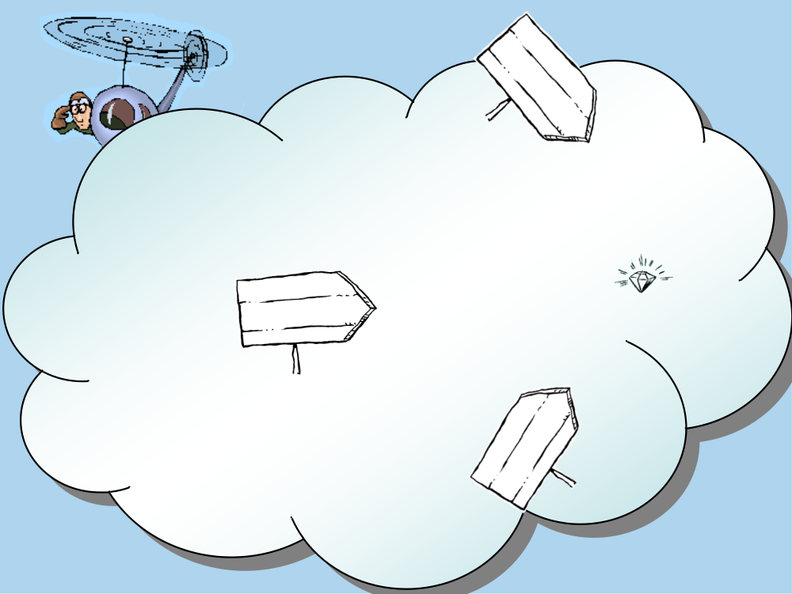
Metadata to have an overview AND see what is relevant

Slide 4



Experts use metadata to communicate with users
1
2
3

Slide 5
Metadata to have an overview AND see what is relevant
Must show what the information is about
NOT “to what other subjects it is also related”
The essence, the message, the intention
Quality 1: Aboutness

Slide 6
Metadata to have an overview AND see what is relevant
Index only useful information, not all information
Why do we have and Google and the Open Directory Project?
Quality 2: only useful information

Slide 7
Metadata to have an overview AND see what is relevant
Must show the relevance of that information:
  For whom?
  To achieve what goal?
  In which circumstances? (conditions)
Called “User Scenario” in User Centered Design
Especially supports students
Quality 3: The relevance of information

Slide 8
Metadata to have an overview AND see what is relevant
Metadata must be clear
“Women, Fire and Dangerous Things” (Lakoff):
Basic-levelness: The optimal abstraction
Contains all relevant characteristics and leaves out unnecessary detail
Example: optimal is ‘car’, not optimal is ‘vehicle’, also not optimal is ‘BMW 323’
Depends on the user (role, experience) and culture
Quality 4: clear

Slide 9
Metadata to have an overview AND see what is relevant
Summary
Metadata have 4 quality aspects:
show what the information is about
point to useful information only
describe the relevance of information
are clear (basic-levelness)

Slide 10
How do machines fulfill the different quality aspects of metadata?
Show what the information is about | Linguistic analysis of text
Point to useful information only | Machines record behavior
Describe the relevance of the information | Machines cannot answer “For whom?”, “What goal?” nor “In which conditions?”
Are clear (basic-levelness) | How can a machine tell that “car” is better than “vehicle”?

Slide 11
What is the quality of metadata generated by machines?
100%
50%
show what the
information is
about
point to useful
information
only
describe the
relevance of
information
are clear
(basic-
levelness)

Slide 12
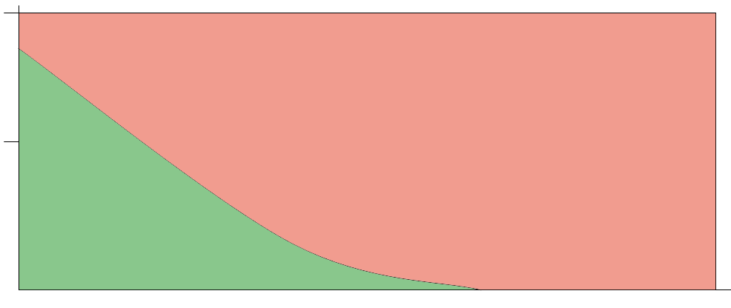
What is the quality of metadata generated by machines?
100%
50%
show what the
information is
about
point to useful
information
only
describe the
relevance of
information
are clear
(basic-
levelness)

Slide 13
So why is the quality of metadata not appreciated?
The costs of ‘not finding’ are not visible
  Information Retrieval is hardly ever tested
The benefits of ‘efficiently finding’ are hard to measure
Good user interfaces for information retrieval are lacking

Slide 14
Question:
Answer:
What interface can show:
The author AND
The subject AND
The target audience AND
The task AND
The conditions AND
The date AND
The information lifecycle?
Faceted interfaces

Slide 15
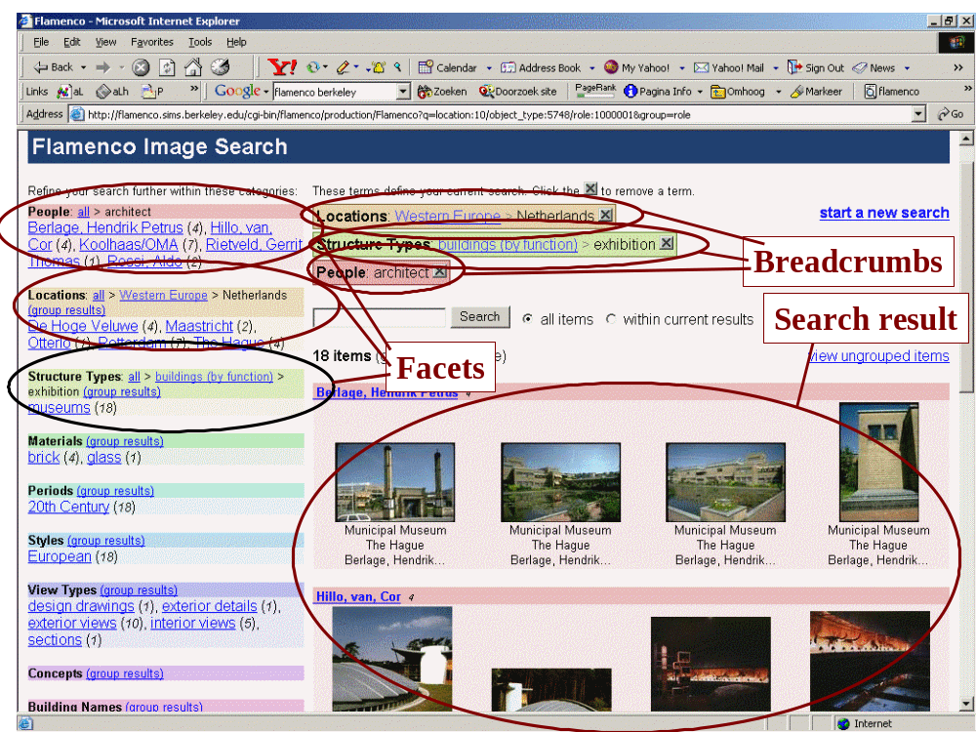
Notes:
9
Start: 1:35
Questions:
What is the consistent order in this case?
Why is a consistent order needed?
How are the terms chosen in this case?
Stopword lists eliminate terms that only convey meaning through word order
Observations:
No need to keep a position for terms that never occur

Slide 16
Information Retrieval Test
Give a representative of the target audience a real life task and observe
Train think-out-loud
Never interfere except: “what are you trying to do now?”
Forget complicated recordings, take notes
Look for questions, confusions and assumptions
Evaluate together with the subject of experiment

Slide 17
Summary
Faceted interfaces show multiple classifications at the same time
Metadata can be tested

