Slide 1
The Web is not Well-Formed
Issues in Developing a Web Ontology Language
Guus Schreiber
University of Amsterdam
Social Science Informatics
W3C’s Web Ontology Working Group
(contributions from many colleagues)

Slide 2
Overview
The vision of a semantic web
Why worry: use cases
Requirements arising from use cases
What does RDF (Schema) already offer?
What should a web ontology language offer?
Issues

Slide 3
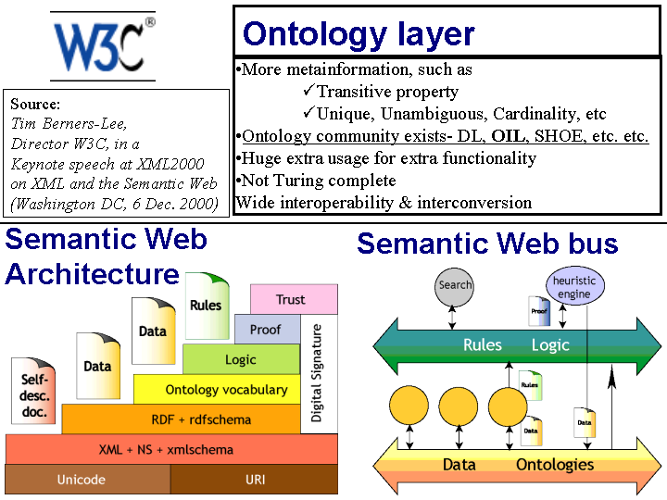

Slide 4
A web ontology language?
Current W3C activity
Goal: define ontology language with formal semantics for “semantic web”
Tentative name: “the web ontology language OWL”
Basis: description logic?!
Initial proposal: DAML+OIL (van Harmelen et al.)
Struggle between neats and scruffies
Web Ontology
Language OWL
RDF (Schema)
XML (Schema)

Slide 5
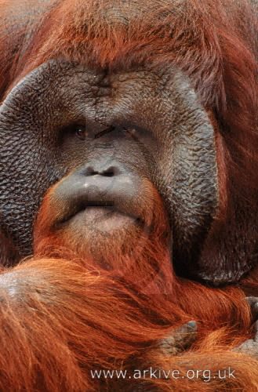
Typical semantic search scenario
A person searches for photos of an “orange ape”
An image collection of animal photographs contains snapshots of orang-utans.
The search engine finds the photos, despite the fact that the words “orange” and “ape” do not appear in annotations

Slide 6
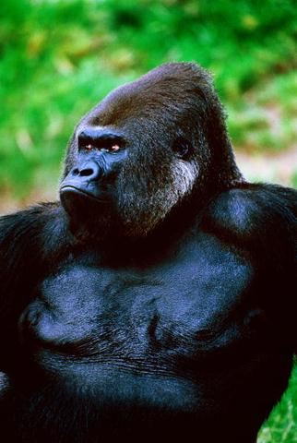

Use case: index & search of image collections
Protégé
ontology editor
Annotation ontology
Domain ontology
RDF(S) generator
(ontology specs)
RDFS file
RDF(S) parser
Annotation
tool
RDF file
(annotations)

Slide 7
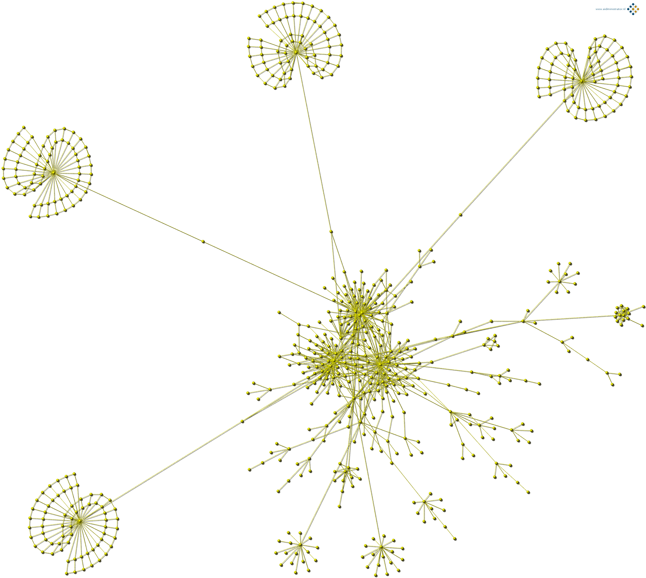
Use case:
Providing structure of a website

Slide 8
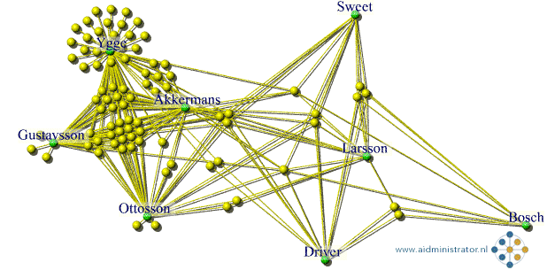
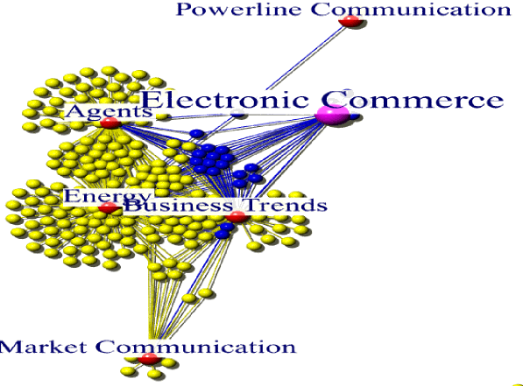
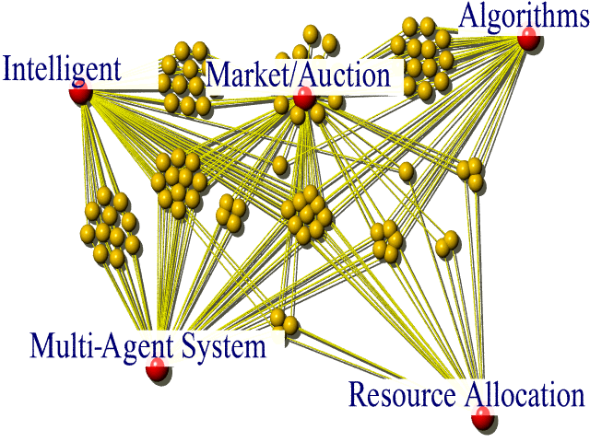
Use case (cntd.):
Semantic Website Access
Key idea: use ontology to markup and cluster hyperlinks
Author relations
Agent subtopic structure
Interactive generation
of subtype intersections
(here, e-commerce)

Slide 9
Other use cases
Web portal
  Website for getting information about some topic (city, interest area)
  Typical problems: documents/links submitted from very diverse sources
Design documentation
  Intranet of documents about design of large artefacts, such as airplanes
  Typical problems: awareness of part-pf structure
Web services
  Offering task support, such as travel planning
  Typical problems: interoperability, does everybody use the same terms for the same concepts?

Slide 10
Requirements for a Web Ontology Language
Derived from uses cases
W3C working draft
  http://w3.org
  go to Web Ontology in the index

Slide 11
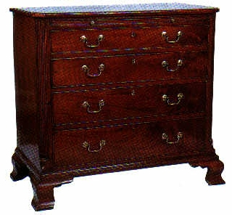
Expressivity requirement: part-whole relation
Examples:
  a wing spar is part of a wing assembly
  chests of drawers have feet with their own style
Most items in collections have some internal structure

Slide 12
Expressivity requirement: definitional and default rules
IF style/period = “Late Georgian”
THEN (by definition)
culture = “British” AND
date.created between 1760-1811
IF type = “chest of drawers”
style/period = “Late Georgian”
THEN (this typically suggests)
material.main = “mahogany”

Slide 13
Expressivity requirement: classes as instances
Aircraft
no-of-seats: positive integer
owner: Airline
Fokker-50
subclass of Aircraft
no-of-seats: 40-50
PH-851
instance of Fokker-50
no-of-seats = 45
owner = KLM
Aircraft-type
no-of-engines: integer >0
propulsion: {propeller, jet}
Fokker-50
instance of Aircraft-type
no-of-engines = 2
propulsion = jet

Slide 14
Classes as instances: the ape example
Orang-utan
Latin name: Pongo pygmaeus
kingdom: Animalia
phylum: Chordate
class: Mammalia
order: Primates
family: Hominidae
genus: Pongo
An orang utan (as animal type) is an instance of species (see left)
An individual orang utan is an instance of the animal type orang utan with its own features (lives in Artis, 30 years old)
Note: an individual orang utan is NOT an instance of species

Slide 15
Expressivity requirement: using existing hierarchies
<color>
<chromatic color>
pink
vivid pink
strong pink
<intermediate pink>
purplish pink
brilliant purplish pink
yellowish pink
<neutral color>

Slide 16
Expressivity of RDF Schema
Class
  Describes collection of resources
Property
  Links class to another class or to a “literal” (data value)
  Domain and range restrictions
Subclass relation
  Property inheritance
Subproperty relation
Classes and properties are themselves also resources
  Cf. “classes as instances”

Slide 17
Strength and limitations of
RDF Schema
Limitations:
  No cardinality specification
  No formal features of subclass relation
    Disjointness, completeness
  No formal features of properties
    Inverse, transitive, symmetric
Strengths
  Simple basic scheme
    Relatively easy to learn
  Built-in extensibility mechanism (metaclass notion)

Slide 18
Issues: description logic basis for OWL?
Description logic (DL) is descendant of early concept languages such as KL-ONE
  Well researched, associated theorem provers
Classes are defined in distributed manner
  not one class definition
Classes do not need to have a name
Expressivity is limited by decidability of subsumption reasoning
Non-intuitive modeling for non-DL people

Slide 19
Example: DL specification of definitional knowledge
Earlier example in DL terms:
All Late-Georgian things are subclasses of the intersection of all British things and all things created between 1760-1811
Syntax is also a problem, see DAML+OIL example on the right
<daml:Restriction>
<daml:onProperty rdf:resource="some-URL#style"/>
<daml:hasClass>
<daml:Class rdf:about="some-URL#Late Georgian"/>
</daml:hasClass>
<rdfs:subClassOf>
<daml:Class>
<daml:intersectionOf rdf:parseType="daml:collection"/>
<daml:Restriction>
<daml:onProperty rdf:resource="some-URL#date"/>
<daml:hasClass>
<daml:Class rdf:about="some-URL#1760-1811"/>
</daml:hasClass>
</daml:Restriction>
<daml:Restriction>
<daml:onProperty rdf:resource="some-URL#culture"/>
<daml:hasClass>
<daml:Class rdf:about="some-URL#British"/>
</daml:hasClass>
</daml:Restriction>
</daml:intersectionOf>
</daml:Class>
</rdf:subClassOf>
</daml:Restriction>

Slide 20
Proposed OWL language features
RDF basis (?!)
Basic features (OWL Lite/Core):
  Cardinality restrictions
  Local range constraints
  Unique properties
  Disjointness and completeness
  Equality of resources
  Inverse and transitive properties
  Datatypes (reference to XML Schema)
DL extensions for expert language users
  Boolean combinations
  Nameless classes
Based on experiences with DAML+OIL

Slide 21
Language syntax
Exchange syntax: RDF/XML based
  “ugly”
Non-normative presentation syntaxes
  XML
    For the full OWL language
  UML
    For the core language features
    Development of a UML profile in cooperation with OMG is being considered

Slide 22
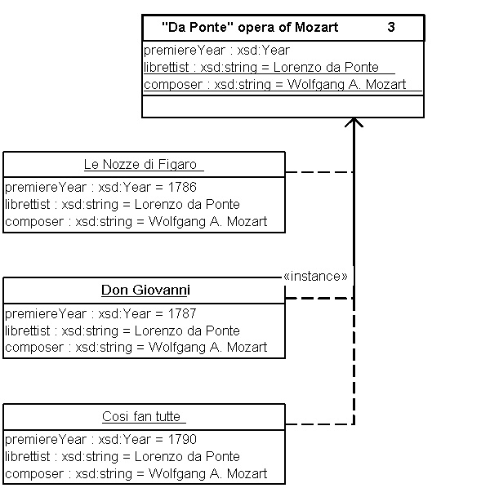
Example UML presentation of OWL

Slide 23
Metaclass mechanism for extending expressivity
Metaclasses can be used to attach additional meaning to classes/properties
Can be used to express many of the requirements
Possible can of worms if used in an unbounded way
  Scruffies could say: “Who cares? The web is not a well-formed logical world.”
OWL should provide methodological guidelines for using a limited set of metaclasses
User groups are likely to create additional (more specific) ones
If widely used, special language idiom may be needed (will not be in OWL 1.0)

Slide 24
Modelling part-whole relations
Create a subclass ”part-whole” property as a subclass the “property” metaclass
State for each property denoting an part-whole relation that it is an instance of the “part-whole” metaclass
  E.g. parts such as feet of a piece of antique furniture
Attach the appropriate semantics to the part-whole metaclass
  Transitivity, asymmetry, weak supplementary
Subclasses of the part-whole metaclass may be introduced in the future
  Complex – component, area, - place, mass - portion

Slide 25
Modelling default knowledge
Metaclasses used to model different types of subclass relations
Such metaclasses are common in object taxonomies
  Mammals
  Apes
  Orang utan
  Typical orang utan
    colour =orange/red)
Exploited for search, e.g.:
  Query generalization up to level of natural category
  Given me all atypical orang-utans / LG chests-of-drawers
<storage furniture>
abstract class
chest-of-drawers
natural category
Late-Georgian chest-of-drawers
art-historic category
typical LG chest-of-drawers
archetype not complete
material = mahogany

Slide 26
Some final observations
Semantic web forces the need for real-life, non-ideal ontologies
Language is unlikely to be used if does not support the modelling requirements of the user
  Either by first-class language features
  Or by well-defined guidelines or idioms
Participation in W3C standardization efforts is an interesting experience for a researcher

