Slide 1
Bluetooth API
For Android Programming
CSC-6360 Graduate Project – Spring 2021
William Dobson

Slide 2
Introduction and Goals
Technology overview
Network architecture
Protocol stack
Programming requirements
Android Implementation
Simple demonstration

Slide 3
What is Bluetooth?
It is a standardized short range wireless Radio Frequency (RF) Data Interface that operates in the 2.4GHz ISM Frequency Band.
Allows computing devices to connect and share data and resources at relatively low speeds.
Can function as a “Personal” Area Network for up to 8 devices.

Slide 4
History
Developed at Ericsson Mobile by Dr Nils Rydbeck and Dr Johan Ullman starting in 1989.
First Prototype in 1994 (Dr Jaap Haartsen)
Intel, Ericsson, and Nokia formed a consortium to develop a wireless interface standard.
First adopted standard IEEE 802.15.1 in 1999
Five major versions of the standard (> 3200 pgs)

Slide 5
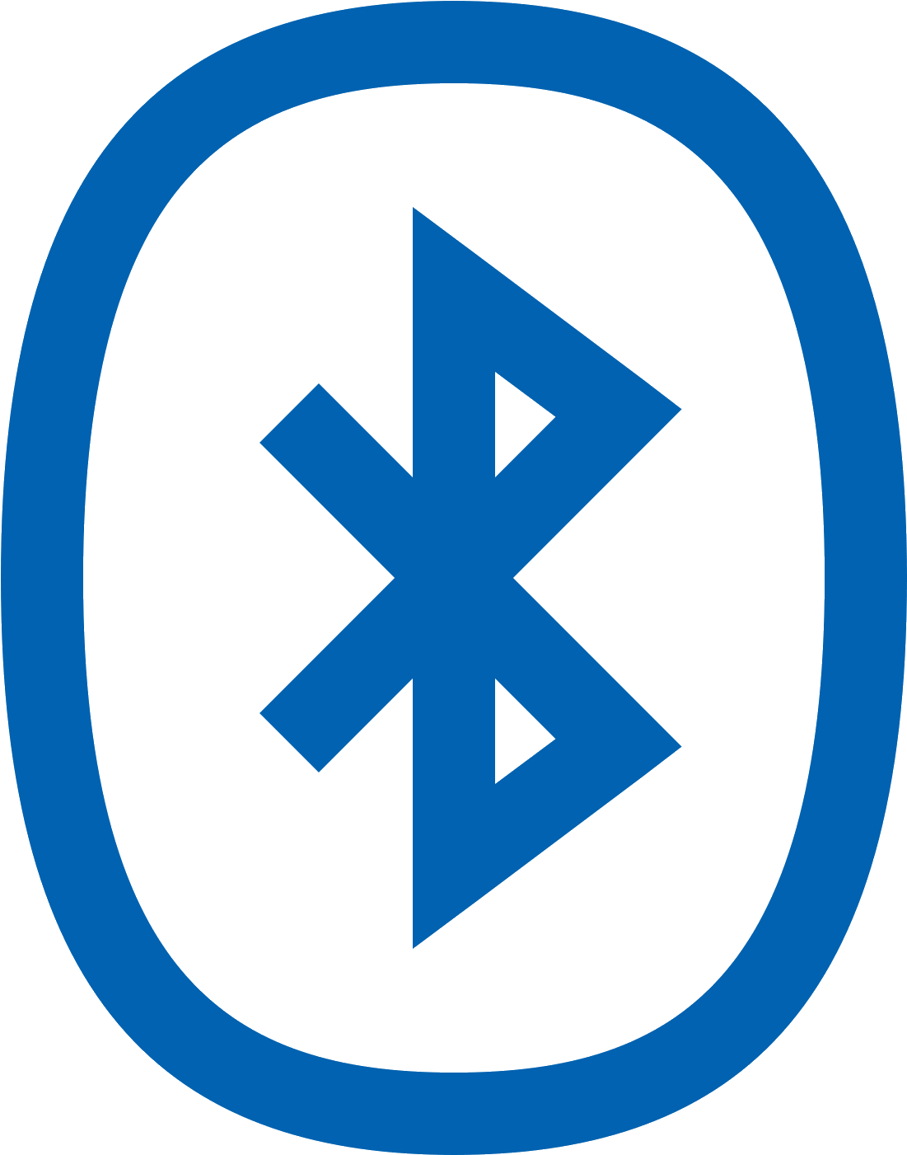
The Bluetooth name
During development of the standard Intel engineer Jim Kardach was reading a book about the 10th Century Viking King Harald “Bluetooth” Gormsson who united the warring tribes of Denmark and Norway. Kardach suggested the name which was adopted. The symbol for Bluetooth is a a combination of the old Nordic letters for ‘H’ and ‘B’

Slide 6
Bluetooth IEEE 802.15.1 versions
V1.0 (1999) Data rate ~ 1 Mbps, higher power
V2.0 (2004) Data rate ~ 3 Mbps, higher power
V3.0 (2009) Data rate ~ 24 Mbps, higher power
V4.0 (2010) data rate ~ 24 Mbps, low power (BLE)
V5.0 (2016) data rate ~ 50 Mbps, low power (BLE)

Slide 7
Bluetooth Low Energy (BLE)
With V4.0 a lower energy method was introduced using short bursts of RF signals to send smaller packets of data.
This results in a substantial reduction in power usage (longer battery life).
This method is not backward compatible with previous versions. but has become a standard in modern mobile devices.
BLE is used for medical implants that can be monitored by mobile devices.

Slide 8
2. Bluetooth networks
Short range “personal” area network for devices within 10 meters of each other.
Up to 8 devices can interconnect in a “Piconet” configuration with one Primary (Client) device and up to 7 Secondary (Server) devices.
The Primary device acts as a hub controlling all network traffic.
Each Secondary device only connects to one Primary device (point to point) for a given Piconet.
A Piconet may be extended to multiple Piconets that when grouped is called a “Scatternet”.

Slide 9
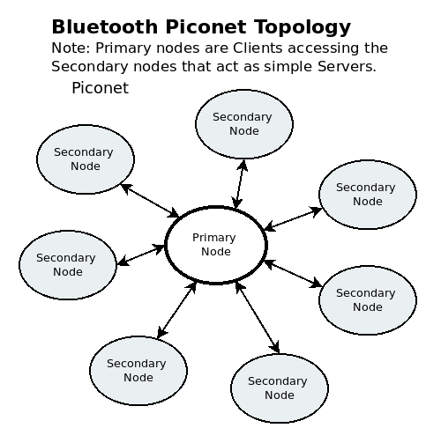
Piconet Example
All Secondary nodes must communicate through the Primary node.
Secondary nodes cannot communicate directly.

Slide 10
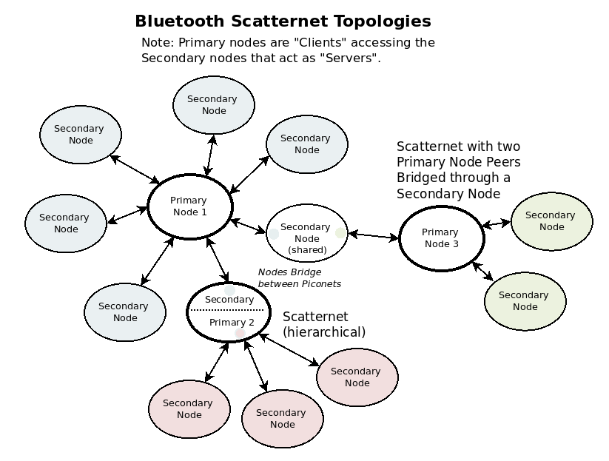
Scatternet Example
An extended Piconet is called a “Scatternet” where nodes with multiple interfaces can act as “Bridges” to interconnect multiple Piconets.

Slide 11
Scatternet Issues
Speed decreases as network size increases
Collisions become more likely due to limited number of frequencies available for hopping.
Nodes that bridge Piconets may require special programming and usage.

Slide 12
3. Bluetooth Protocol Stack
Bluetooth employs a protocol stack that is similar to the OSI network model.
The original Bluetooth (classic) was oriented around replacing wired connections with wireless connections by offering APIs that were compatible with those interfaces.
The BLE stack is more streamlined using UUIDs rather than addresses and port numbers to make connections

Slide 13
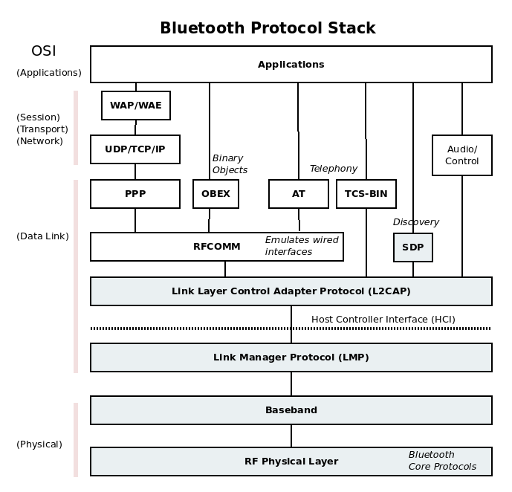
Bluetooth (classic) Protocol Stack

Slide 14
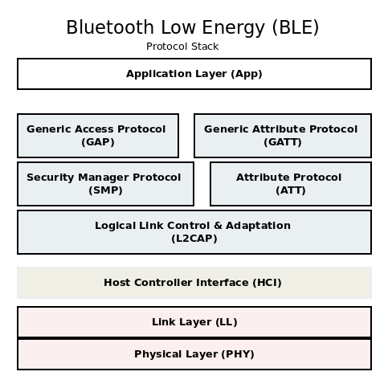
Bluetooth Low Energy (BLE) Protocol Stack

Slide 15
BLE – API
Devices are termed: “Centrals” (clients) or “Peripherals” (servers)
GAP (Generic Access Protocol) is used by Peripherals for “Advertisement” of availability and handles the subsequent connection (pairing) to Centrals.
GATT (Generic Attribute Protocol) controls how data is presented and structured to the Client device. The roles of the interfaces are transaction dependent.
Ex: Client sends Request -> Server will send a Response.
Server sends Indication -> Client will send a Confirmation

Slide 16
API Attribute Operations
Commands Client->Server no response required
Requests Client->Server response required
Responses Server-Client *response to request
Notifications Server->Client no response required
Indication Server->Client notification requires response
Confirmation Client->Server *response to indication

Slide 17
API Data Attribute Operations
Read (request) Client->Server response required
Request Write Client->Server *response required
Write Client->Server no response required
*Request Write is generally safer since it acknowledges the write to the server completed successfully.

Slide 18
UUIDs
Universally Unique Identifier (UUID) is a 128-bit hexadecimal value that is used in the API direct remote communications to the correct destination.
For Client devices the UUID should be unique and most systems provide a method to randomly generate these.
For Server devices there are standard SIG-Adopted UUIDs that have the form:
0000xxxx-0000-1000-8000-00805F9B34FB
where xxxx is a 16-bit field defined for a given device type.

Slide 19
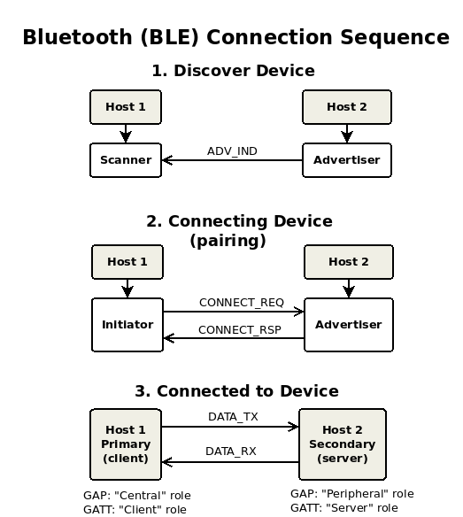
BLE Device Connection Sequence
For Discovery the Peripheral device launches an “Advertiser” process to broadcast availability.
The Central launches a “Scanner” process to detect available devices.
If selected the Central connects with the Peripheral with an “Initiator” process.
Once connected both devices store their “Paired” state for future connections.

Slide 20
4. Bluetooth Programming Requirements
Bluetooth like any other network application involves Asynchronous events for receiving data from remote devices.
This means that to receive messages in a timely manner network applications must use a separate process Thread to monitor and handle incoming data.
Threads are also needed when implementing the device Scanner process which may take significant amount of time to complete.
Threads allow the App to continue to function normally while monitoring for these events.

Slide 21
Android Java – Two methods of spawning threads
1. Threads may be spawned for an inline block of code using the Thread object type:
(Thread) run(){
// inline code segment
// Note: a Handler is required to pass data from this process
}.start();
2. A java class that extends Thread will have a method called run(){ … } that is executed upon the .start() call:
MyThreadClass my_thread_object;
my_thread_object.start(); // invokes internal run() method
In both cases a message Handler is required pass data to other processes.

Slide 22
Notes on Bluetooth in Android Studio
The AVD emulators in Android Studio do not support Bluetooth operations.
This means all code must be run on a Physical Android device.
This makes debugging a bit more challenging and should be factored into your schedule for these types of projects.

Slide 23
5. Setup of Client Device – Coding Steps
1. Set Permissions in the Manifest
2. Create a BluetoothAdapter
3. Enable Bluetooth (verify enabled)
4. Find Device and create BluetoothDevice instance for use
-Select a paired device (get UUID)
-Discover and connect to a new device (get UUID)
5. Create a BluetoothSocket to connect to a UUID
6. Implement Transmit and Receive data methods.

Slide 24
Bluetooth Setup - Permissions
Step 1: Add Permissions to Manifest file before the application entries.
<manifest xmlns:android=http://schemas.android.com/apk/res/android
:
<uses-permission android:name="android.permission.BLUETOOTH" />
<uses-permission android:name="android.permission.BLUETOOTH_ADMIN" />
<uses-permission android:name="android.permission.ACCESS_FINE_LOCATION" />
:
<application

Slide 25
Bluetooth Setup – Create Bluetooth Adapter
Example of creating a default adapter instance and confirming its existence:
BluetoothAdapter bluetoothAdapter = BluetoothAdapter.getDefaultAdapter();
if (bluetoothAdapter == null) { // Device doesn't support Bluetooth }

Slide 26
Bluetooth Setup – Enable Bluetooth
Example of checking Bluetooth status and requesting if not enabled.
if (!bluetoothAdapter.isEnabled()) { Intent enableBtIntent = new Intent(BluetoothAdapter.ACTION_REQUEST_ENABLE); startActivityForResult(enableBtIntent, REQUEST_ENABLE_BT); }
Note: REQUEST_ENABLE_BT is a locally defined integer > 0.

Slide 27
Bluetooth Setup – Finding Paired Devices
Example code that queries the adapter to get a Set of paired BluetoothDevices that can be used for selection and connection..
Set<BluetoothDevice> pairedDevices = bluetoothAdapter.getBondedDevices(); if (pairedDevices.size() > 0) { // There are paired devices. Get the name and address of each paired device.
for (BluetoothDevice device : pairedDevices) { String deviceName = device.getName(); String deviceHardwareAddress = device.getAddress(); // MAC address
// Do something with deviceName and deviceHardwareAddress
}
}
Note: this was used to populate a ListView for device selection in this project.

Slide 28
Bluetooth Setup – Discovering Devices
Example code for a BroadcastReceiver to get results from the startDiscovery() process that runs as an asynchronous thread to the main code body.
// Create a BroadcastReceiver instance for ACTION_FOUND in main class code body private final BroadcastReceiver receiver = new BroadcastReceiver() { public void onReceive(Context context, Intent intent) { String action = intent.getAction(); if (BluetoothDevice.ACTION_FOUND.equals(action)) { // Discovery has found a device. Get the BluetoothDevice // object and its info from the Intent. BluetoothDevice device = intent.getParcelableExtra(BluetoothDevice.EXTRA_DEVICE); String deviceName = device.getName(); String deviceHardwareAddress = device.getAddress(); // MAC address } } };
@Override protected void onCreate(Bundle savedInstanceState) { // Register for broadcasts when a device is discovered. IntentFilter filter = new IntentFilter(BluetoothDevice.ACTION_FOUND); registerReceiver(receiver, filter); // Register receiver }
Note: always register the receiver in OnCreate().

Slide 29
Bluetooth Setup – Discovering Devices (cont)
Once a BroadcastReceiver has been instantiated the discovery process can now be invoked by calling:
btAdapter.startDiscovery();
It is recommended to unregister the receiver before closing the app as shown in the OnDestroy() method below.
@Override protected void onDestroy() { super.onDestroy(); ... // Don't forget to unregister the ACTION_FOUND receiver. unregisterReceiver(receiver); }

Slide 30
Bluetooth Setup – Create Bluetooth Socket
Once connected to a remote Bluetooth device the Client can now open a Socket through which data may be transmitted and received. Below is a helper method used to create an insecure socket for this project.
// create socket helper
private BluetoothSocket createBTSocket(BluetoothDevice device) throws IOException {
try {
final Method m = device.getClass().getMethod("createInsecureRfcommSocketToServiceRecord", UUID.class);
return (BluetoothSocket) m.invoke(device, BTUUID);
} catch (Exception e) {
Log.e(TAG, "Could not create Insecure RFComm Connection",e);
}
return device.createRfcommSocketToServiceRecord(BTUUID);
}

Slide 31
Bluetooth – Message Handler
We need to create a thread to handle the asynchronous operations to transmit and receive data through the BluetoothSocket. To do this a message Handler is needed in the main code body to receive messages from this thread.
// setup message handler that is called by the receive data thread and displays it in a textview
btHandler = new Handler(Looper.getMainLooper()){
// handleMessage called when thread returns received data from go() in ConnectionThread
@Override
public void handleMessage(Message msg){
if(msg.what == MESSAGE_READ){
String readMessage = null;
try {
readMessage = new String((byte[]) msg.obj, "UTF-8");
} catch (UnsupportedEncodingException e) {
e.printStackTrace();
}
// update display and add any message processing here
btreadMsgTV.setText(readMessage);
}
(cont)

Slide 32
Bluetooth – Message Handler (cont)
We need to create a thread to handle the asynchronous operations to transmit and receive data through the BluetoothSocket. To do this a message Handler is needed in the main code body to receive messages from this thread.
(cont)
// update status textview on connection status
if(msg.what == CONNECTING_STATUS){
if(msg.arg1 == 1)
btStatusTV.setText("Connected to Device: " + msg.obj);
else
btStatusTV.setText("Connection Failed");
}
}
};

Slide 33
Bluetooth – Transmit and Receive Thread
ConnectionThread class definition and constructor:
// constructor sets up local socket streams
public ConnectionThread(BluetoothSocket socket, Handler handler) {
btSocket = socket;
btHandler = handler;
// use temporary stream objects to get them from socket before first assignment to real streams
InputStream tempIn = null;
OutputStream tempOut = null;
try {
tempIn = socket.getInputStream();
tempOut = socket.getOutputStream();
} catch (IOException e) { } // needs a break here?
btInStream = tempIn; // assigns steams to actual final streams
btOutStream = tempOut;
}

Slide 34
Bluetooth – Transmit and Receive Thread (cont)
ConnectionThread Receive run() method:
@Override // run thread to receive data starts upon .start() call on instance of this class
public void run() {
byte[] buffer = new byte[RCV_BUFFERSIZE]; // buffer store rcv data
int bytecnt; // bytes returned from read()
while (true) { // Receive loop listens to btInStream until break on ioexception
try {
// Check for data in InStream
bytecnt = btInStream.available();
if(bytecnt != 0) {
buffer = new byte[RCV_BUFFERSIZE];
SystemClock.sleep(RCV_LATENCY); // wait for rest of data.
bytecnt = btInStream.available(); // get bytes available to read
bytecnt = btInStream.read(buffer, 0, bytecnt); // rcv data and update number of bytes actually read
// pass rcv data to message handler for processing and display
btHandler.obtainMessage(MESSAGE_READ, bytecnt, -1, buffer).sendToTarget();
}
} catch (IOException e) {
e.printStackTrace();
break; // breaks out of rcv loop
}
}
}

Slide 35
Bluetooth – Transmit and Receive Thread (cont)
ConnectionThread write() and cancel() methods:
// Method to transmit data
public void write(String input) {
byte[] bytes = input.getBytes(); //converts entered String into bytes
try {
btOutStream.write(bytes);
} catch (IOException e) { }
}
/* Call this from the main activity to shutdown the connection */
public void cancel() {
try {
btSocket.close();
} catch (IOException e) { }
}

Slide 36
6. Project Demonstration
For demonstration purposes simple Android App was implemented to connect and communicate with a Raspberry Pi 4 (RPi4) device via Bluetooth.
The physical mobile device used was a Motorola G6 phone
Python code was implemented on the RPi4 device to echo back received messages and respond to numeric command codes issued in the data to toggle 3 LEDs and report their status.
Another command was implemented to report the temperature of the CPU core back to the Android Client via this interface to demonstrate its use for telemetry.

Slide 37
Project Demonstration Notes
The Bluetooth interface on the RPi4 was implemented using the RFCOMM legacy Serial Port API so the Android client was required to use a SIG-Adopted UUID:
00001101-0000-1000-8000-00805F9B34FB
When using the remote request for UUIDs an index=7 was required when getting the UUID from the remote device:
BTUUID = device.getUuids()[7].getUuid();
*This was required in this specific case but will likely use a different index for other devices.

Slide 38
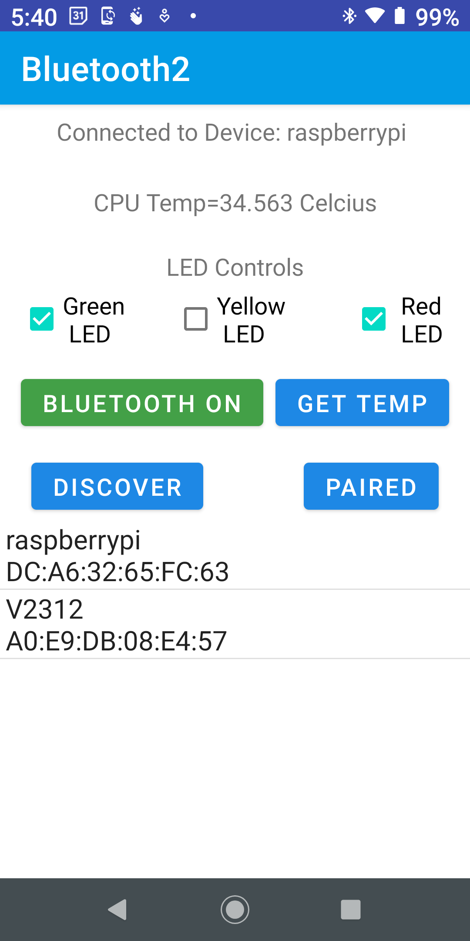
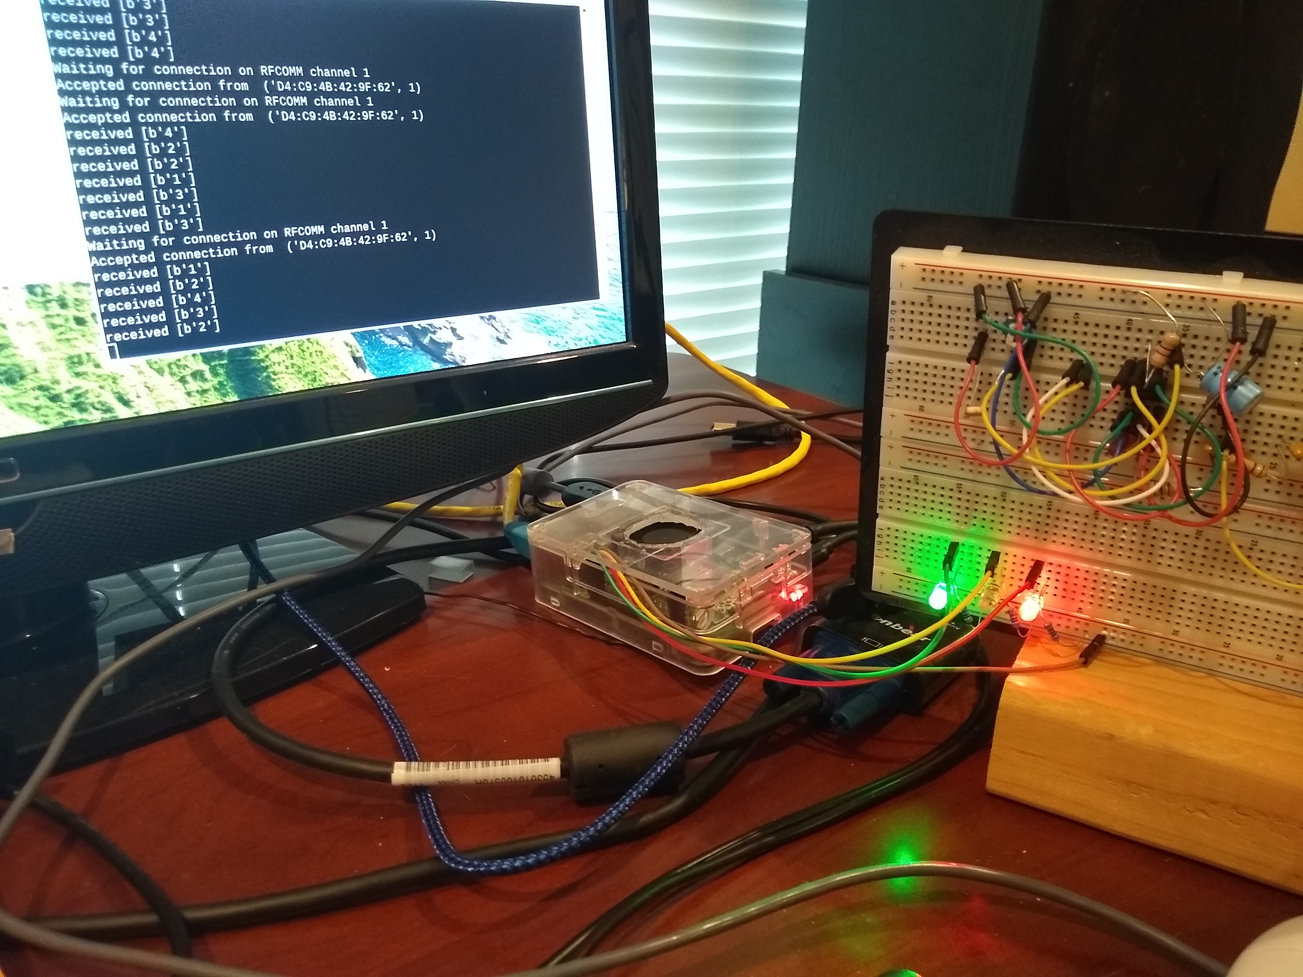
Bluetooth Demonstration Images
These images show the Android app and RPi4 status during testing of the code.

Slide 39
References:
https://developer.android.com/guide/topics/connectivity/bluetooth
https://standards.ieee.org/standard/802_15_6-2012.html
https://www.bluetooth.com/specifications/specs/core-specification/
https://www.bluetooth.com/blog/a-developers-guide-to-bluetooth/
https://circuitdigest.com/microcontroller-projects/controlling-raspberry-pi-gpio-using-android-app-over-bluetooth/
https://github.com/bauerjj/Android-Simple-Bluetooth-Example
https://www.rfwireless-world.com/Tutorials/Bluetooth-protocol-stack.html

