Slide 1
Annotation of genetic variants using ANNOVAR
BAIFW 2019 class
Li Fang, Ph.D.
University of Pennsylvania
12/06/2019

Slide 2
Annotation of genetic variants using ANNOVAR
By the end of this lecture, you will learn
Some basic concepts in variant annotation
Gene-based annotation using ANNOVAR
Filter-based annotation using ANNOVAR
Notes:
I will explain the concepts in the following slides.

Slide 3
Annotation of genetic variants using ANNOVAR
By the end of this lecture, you will learn
Some basic concepts in variant annotation
Gene-based annotation using ANNOVAR
Filter-based annotation using ANNOVAR
Notes:
I will explain the concepts in the following slides.

Slide 4
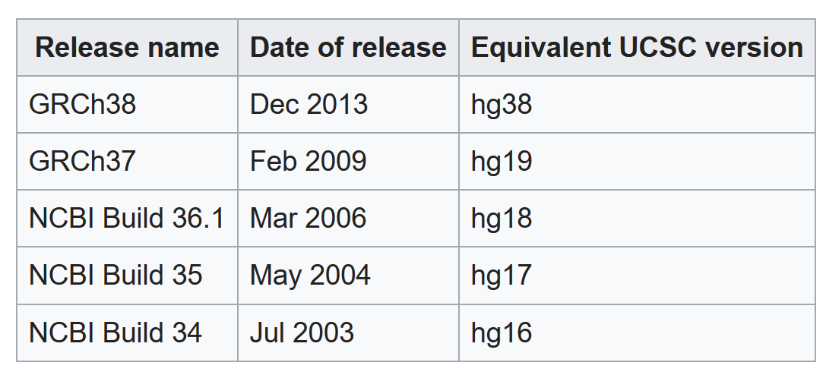
The reference genome
A reference genome is a representative genome sequence of a species.
Human reference genomes: originally sequenced and assembled by the Human Genome Project. The latest version is GRCh38, also known as hg38.

Slide 5
The reference genome
The human reference genome is haploid (contains one set of chromosomes).
DNA is double stranded (+ and -). The reference sequence contains only one strand because the sequence of the complementary stand can be inferred using the complementary base pairing rule (A-T; G-C).
reference sequence
5’-AGGTCACGTCCAC-3’ (+)
3’-GTGGACGTGACCT-5’ (-)
allele 1
diploid genome
5’-AGGTCACGTCCAC-3’ (+)
3’-GTGGACGTGACCT-5’ (-)
allele 2

Slide 6
Variant calling
In a variant calling process, we align the reads of an individual genome to the reference genome and compare them.
A variant is a difference between a individual genome and the reference genome.
We usually only compare one strand (the strand of the reference genome)
reference sequence
5’-AGGTCACGTCCAC-3’ (+)
3’-TCCAGTGCAGGTG-5’ (-)
imagined complementary of reference sequence
5’-AGGTCACGTCCAC-3’ (+)
heterogygous SNV
5’-AGGTCATGTCCAC-3’ (+)
5’-AGGTCATGTCCAC-3’ (+)
3’-TCCAGTACAGGTG-5’ (-)
5’-AGGTCACGTCCAC-3’ (+)
allele 1
individual sequence
(diploid)
C -->T mutation
5’-AGGTCACGTCCAC-3’ (+)
3’-TCCAGTGCAGGTG-5’ (-)
allele 2

Slide 7
Types of genetic variants
SNV: A single-nucleotide variant is a substitution of a single nucleotide that occurs at a specific position in the genome.
SNP: single-nucleotide polymorphism is an SNV that is relatively common in a population (>1%).
Sometimes SNV and SNP are used interchangeably.
For example, SNP detection and SNV detection usually have the same meaning. A SNP caller will output all SNVs regardless of their population frequency. Users and use ANNOVAR to get the population frequency of each variant.

Slide 8
Types of genetic variants
An examples of SNV:
5’-AGGTCACC-3’
3’-TCCAGTGG-5’
5’-AGATCACC-3’
3’-TCTAGTGG-5’
Reference sequence:
AGGTCACC
|| |||||
AGATCACC
Alternative sequence of an individual:

Slide 9
Types of genetic variants
Indel: A indel usually refers to a insertion or a deletion that is < 50 bp. Large insertions and deletions are classified as structural variants.
Examples of Indels:
alignment gap
Reference sequence:
AG-TCAACGT
|| |||||||
AGATCAACGT
AGTCAACGT
|||||| ||
AGTCAA-GT
Alternative sequence of an individual:
alignment gap

Slide 10
Functional consequences of genetic variants
synonymous SNV:
an SNV that does not alter the amino acid sequence of a protein.
non-synonymous SNV:
an SNV that alters the amino acid sequence of a protein.
DNA
protein
DNA
protein
non-synonymous SNV
synonymous SNV

Slide 11
Functional consequences of genetic variants
non-frameshift insertion/deletion:
an insertion/deletion that does not cause frameshift changes in protein coding sequence. (i.e. length = multiples of 3, as one amino acid corresponds to 3 nucleotides)
frameshift insertion/deletion:
an insertion of one or more nucleotides that cause frameshift changes in protein coding sequence
DNA
protein
DNA
protein

Slide 12
Functional consequences of genetic variants
stop-gain SNV/Indel: An SNV/Indel that leads to the immediate creation of a stop codon at the variant site.
stop-loss SNV/Indel: An SNV/Indel that leads to the immediate elimination of a stop codon at the variant site.
DNA
protein
DNA
protein
Stop-gain insertion

Slide 13
Annotation of genetic variants using ANNOVAR
By the end of this lecture, you will learn
Some basic concepts in variant annotation
Gene-based annotation using ANNOVAR
Filter-based annotation using ANNOVAR
Notes:
I will explain the concepts in the following slides.

Slide 14
Gene-based annotation
Gene-based annotation is the annotation of the consequence of a variant on genes.
1) Variant_function: intergenic / intronic / exonic / UTR3/ UTR5, etc
2) Exonic_variant_function: synonymous SNV / non-synonymous SVN/non-frameshift indels / frameshift / stop-gain / stop-loss / splicing, etc

Slide 15
Gene-based annotation
Commonly used gene databases:
RefSeq gene
ENSEMBL gene (also known as GENCODE)
UCSC known gene
Differences:
RefSeq gene: non-redundant
GENCODE gene: includes computational predicted genes and isoforms

Slide 16
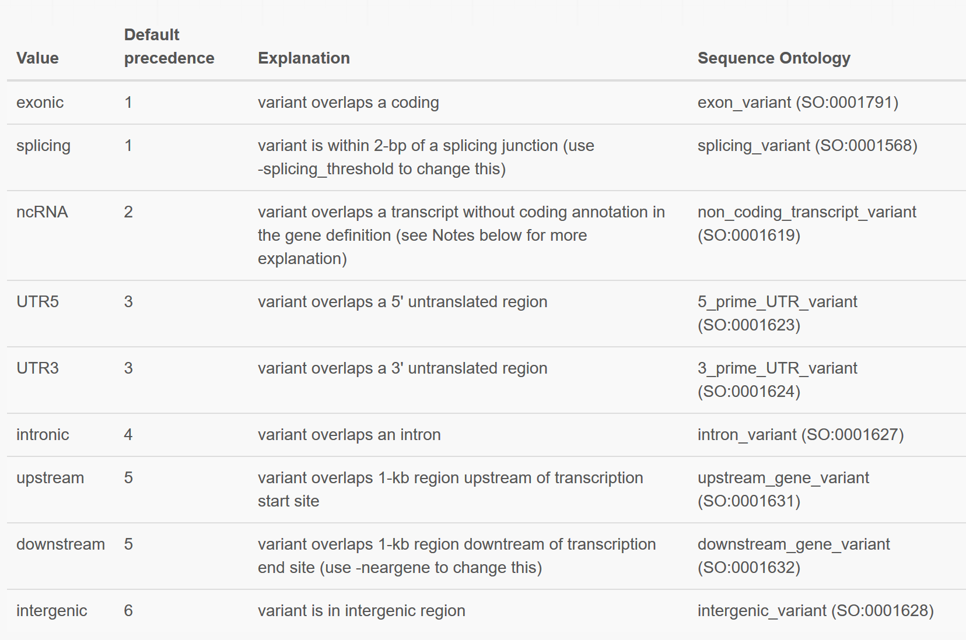
Location of the variant (variant_function)

Slide 17
Examples of SNVs
SNP1 is an intergenic variant, as it is > 1 kb away from any gene
SNP2 is a downstream variant, as it is 1 kb from the 3'end of the NADK gene
SNP3 is a UTR3 variant
SNP4 is an intronic variant
SNP5 is an exonic variant
The arrows indicate that the gene goes from right to left.

Slide 18
Examples of indels
Deletion 1 is an intergenic variant;
Deletion 2 is a downstream variant;
Deletion 3 is a UTR3 variant;
Deletion 4 overlaps both with UTR3 and intron, and based on the precedence rule, it is a UTR3 variant;
Deletion 5 is an intronic variant;
Deletion 6 overlaps with both an exon and an intron, and based on the precedence rule, it is an exonic variant.

Slide 19
Annotation of genetic variants using ANNOVAR
By the end of this lecture, you will learn
Some basic concepts in variant annotation
Gene-based annotation using ANNOVAR
Filter-based annotation using ANNOVAR
Notes:
I will explain the concepts in the following slides.

Slide 20
Filter-based annotation
Usually, we use filter-based annotation to get:
Allele frequency (in a population) of an variant
Known disease associations
Predicted (pathogenic) scores of different variant-scoring tools.
dbSNP ID

Slide 21
Filter-based annotation
Usually, we use filter-based annotation to get:
Allele frequency (in a population) of an variant
Known disease associations
Predicted (pathogenic) scores of different variant-scoring tools.
dbSNP ID

Slide 22
Widely used allele frequency databases
1000 Genomes Project: about 2,500 WGS data sets
ExAC (exome aggregation consortium): about 65,000 WES data sets
gnomAD (genome aggregation consortium): 125,748 WES data sets and 15,708 WGS data sets.
…
WGS: Whole-genome sequencing.
WES: Whole-exome sequencing, a technology that can fragment the DNA, capture the exon fragments, and then sequence them.

Slide 23
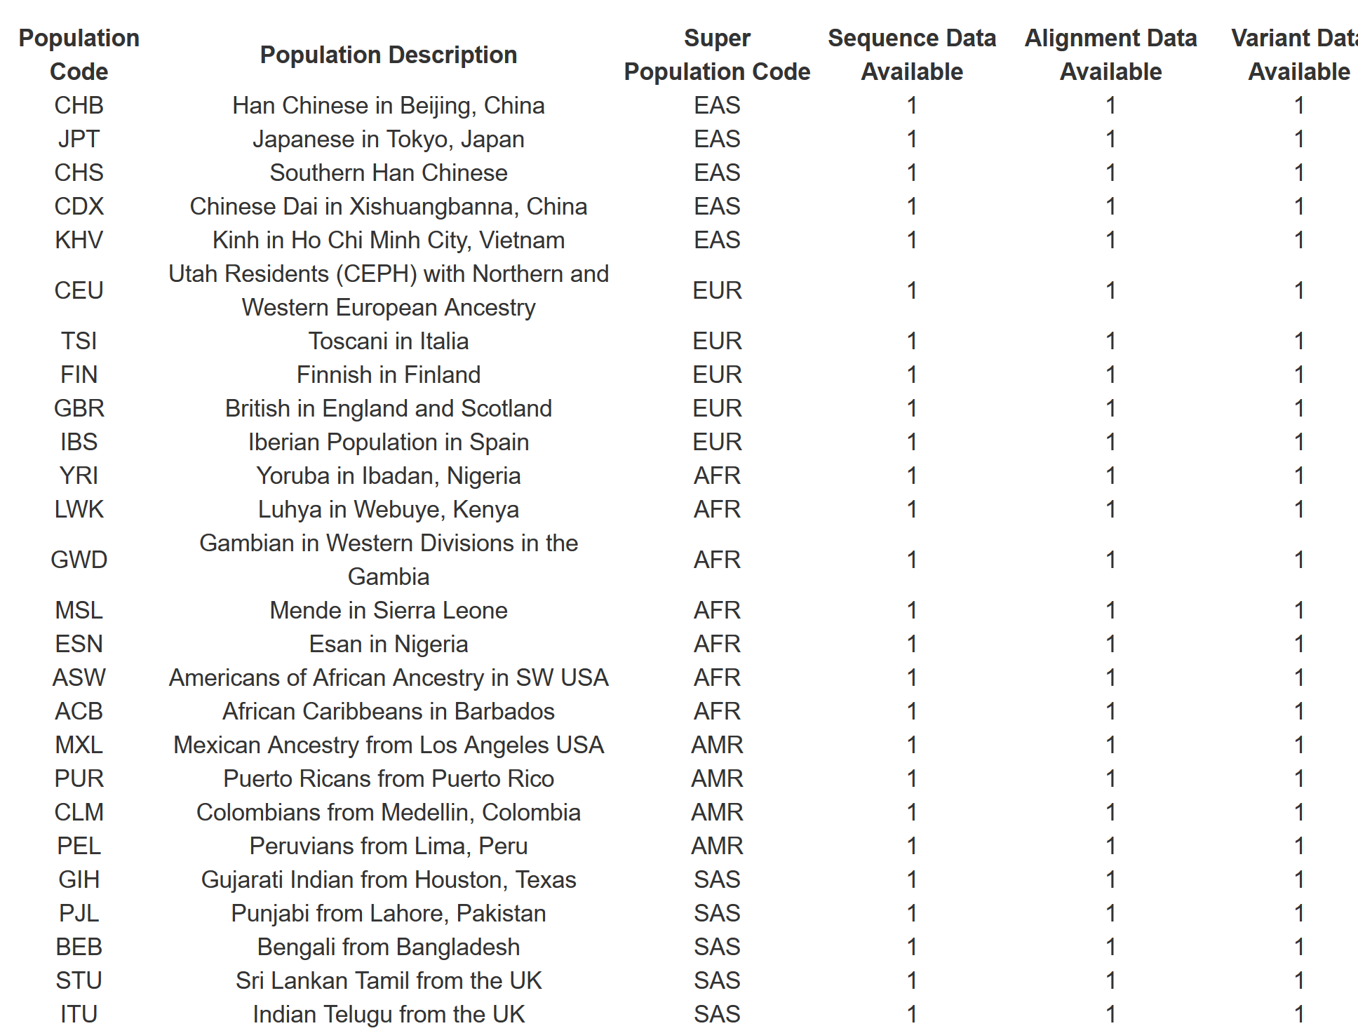
Different ethnicity groups in the databases
1000 Genomes Project:
5 super populations
AFR, African
AMR, Ad Mixed American
EAS, East Asian
EUR, European
SAS, South Asian

Slide 24
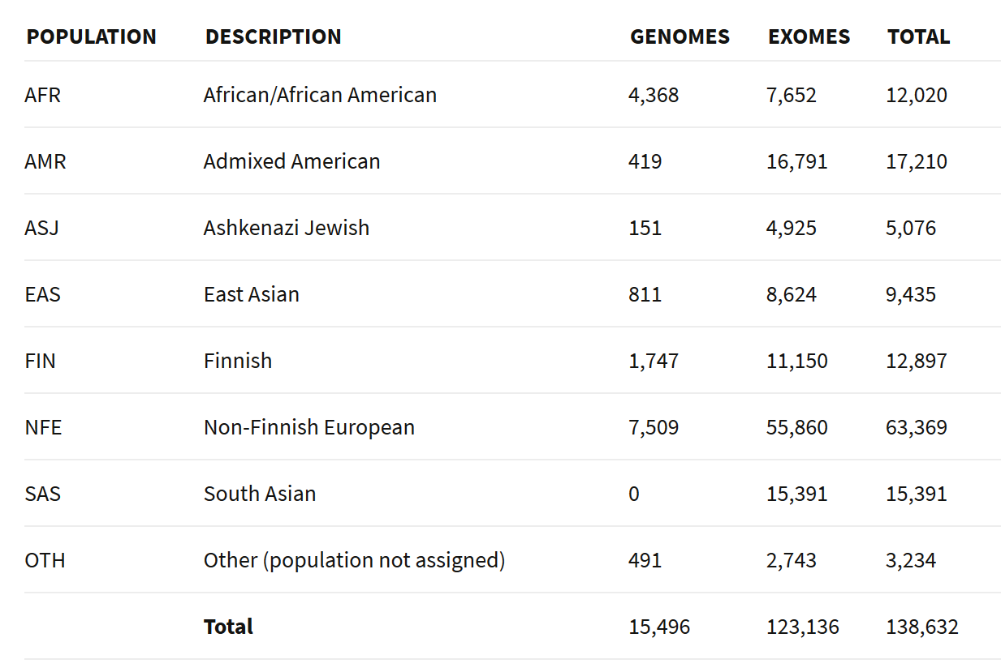
Different ethnicity groups in the databases
GnomAD database

Slide 25
Disease association databases
ClinVar: relationship between genetic variants and human health (https://www.ncbi.nlm.nih.gov/clinvar/)
COSMIC: somatic mutations in cancers (https://cancer.sanger.ac.uk/cosmic)
And others (e.g. HGMD, human gene mutation database)

Slide 26
Predicted (pathogenic) scores of different variant-scoring tools
Exome scores:
SIFT
PolyPhen
LRT
MutationTaster
MutationAssessor
MetaSVM, etc.
Genome scores:
GERP++,
CADD,
DANN,
FATHMM,
GWAVA,
FunSeq2, etc.

Slide 27
dbSNP ID (rs number)
rs201219564
rs2691305
rs190717287
rs200676709
rs2691303
rs375850923
rs62642130
rs374499151
rs370858051
rs375289924

Slide 28
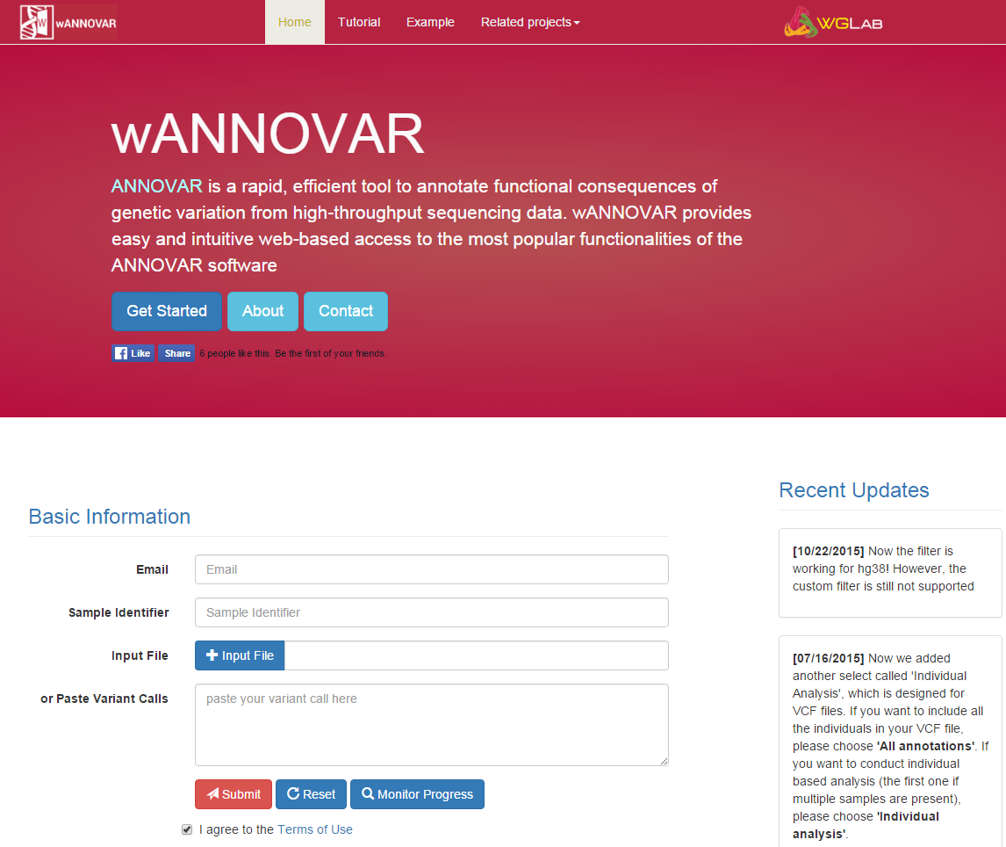
wANNOVAR is the online version of ANNOVAR
URL:
http://wannovar.wglab.org

Slide 29
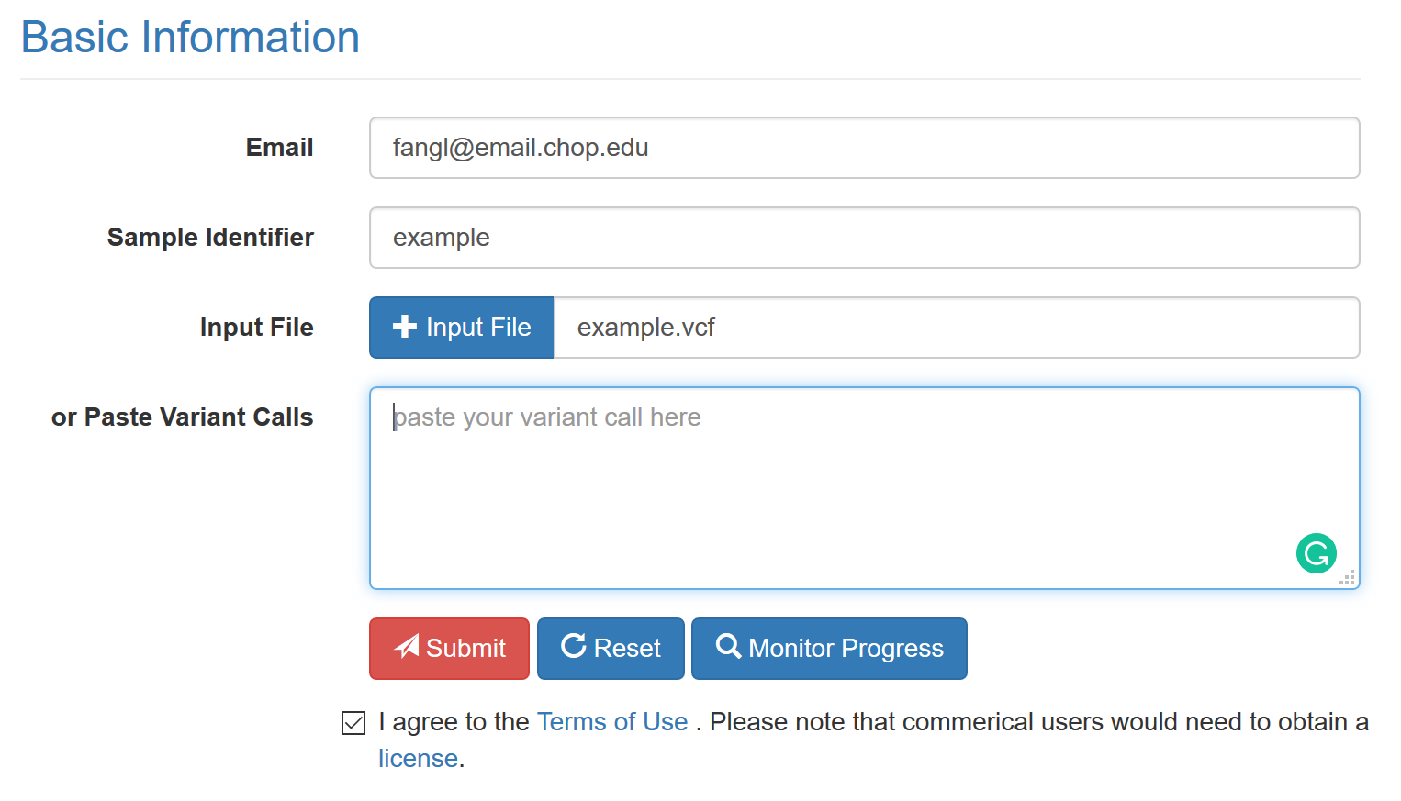
Demo

Slide 30
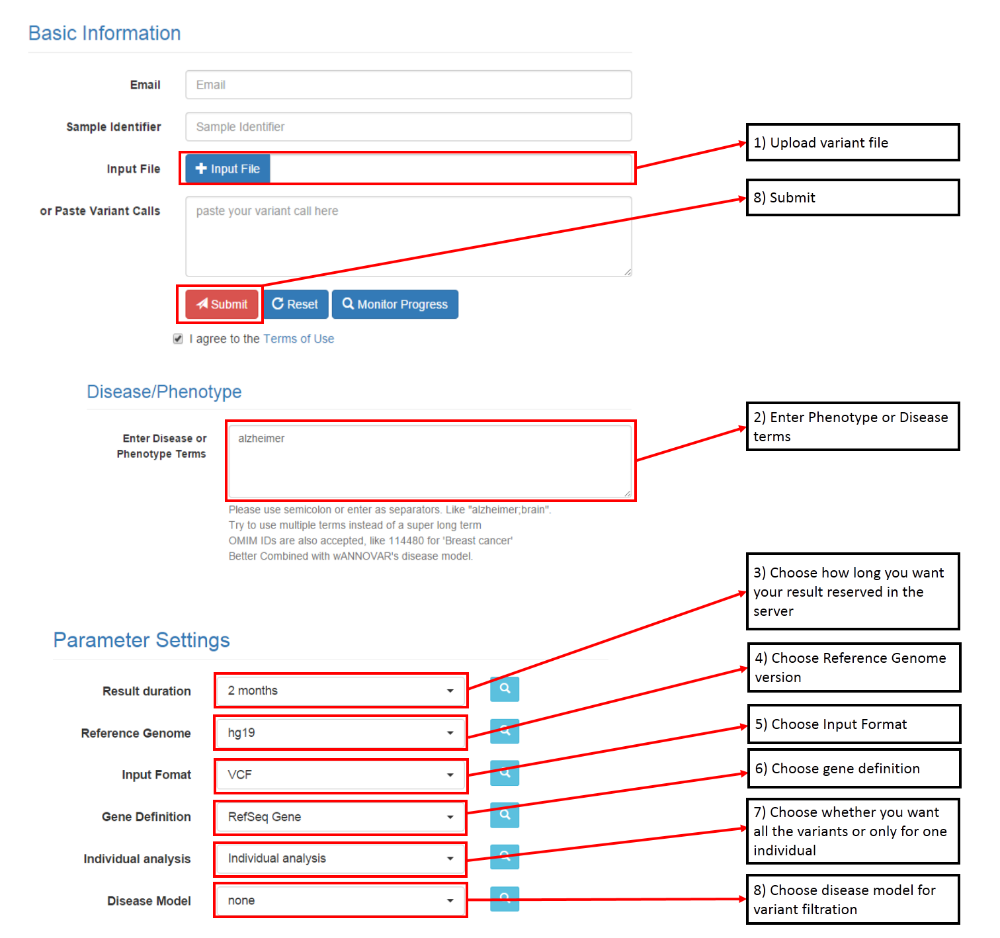
Job submission

Slide 31
Results page

Slide 32
Results page

