Slide 1

WGPlaner
Midterm Presentation

Slide 2
Presentation procedure
Vision
Technologies
Project Management
Demo
Architecture
Automation
Testing
Your Questions

Slide 3
Vision

Slide 4






Motivation - Simplify your shared flat life
Students, couples, families, etc…
Manage your shared flat
Organize group events
Control your Shopping List
Simplify your Accounting
Manage your group related tasks

Slide 5
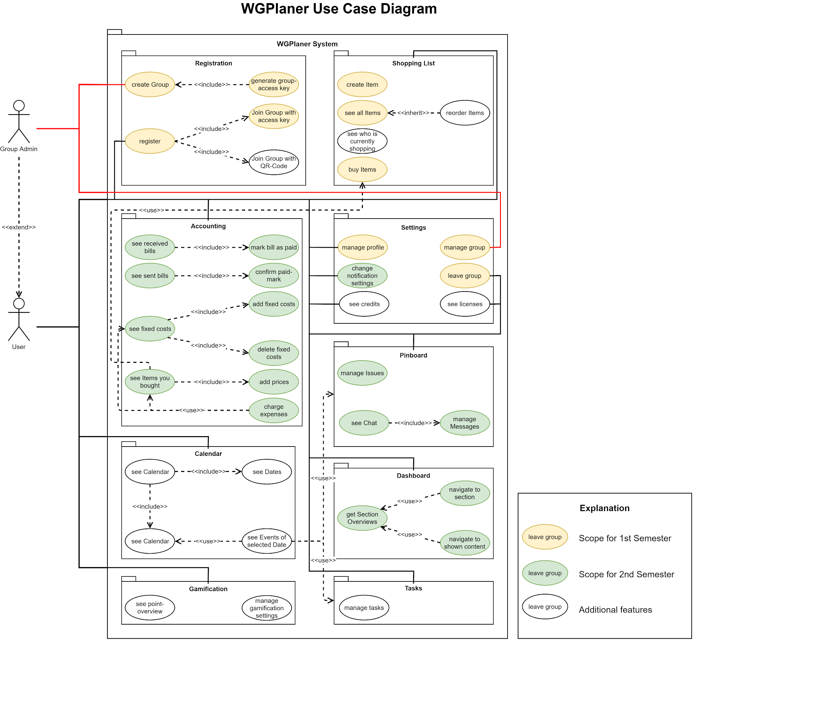
Components
Current Scope
Registration
Register
Create Group
Join Group
Shopping List
Add products
Buy products
Settings
Manage Profile
Manage Group

Slide 6

Technologies

Slide 7
Project Management

Slide 8
Scrum
Project Management method: Spiral
Sprints of one week
Requirements and Use Cases

Slide 9
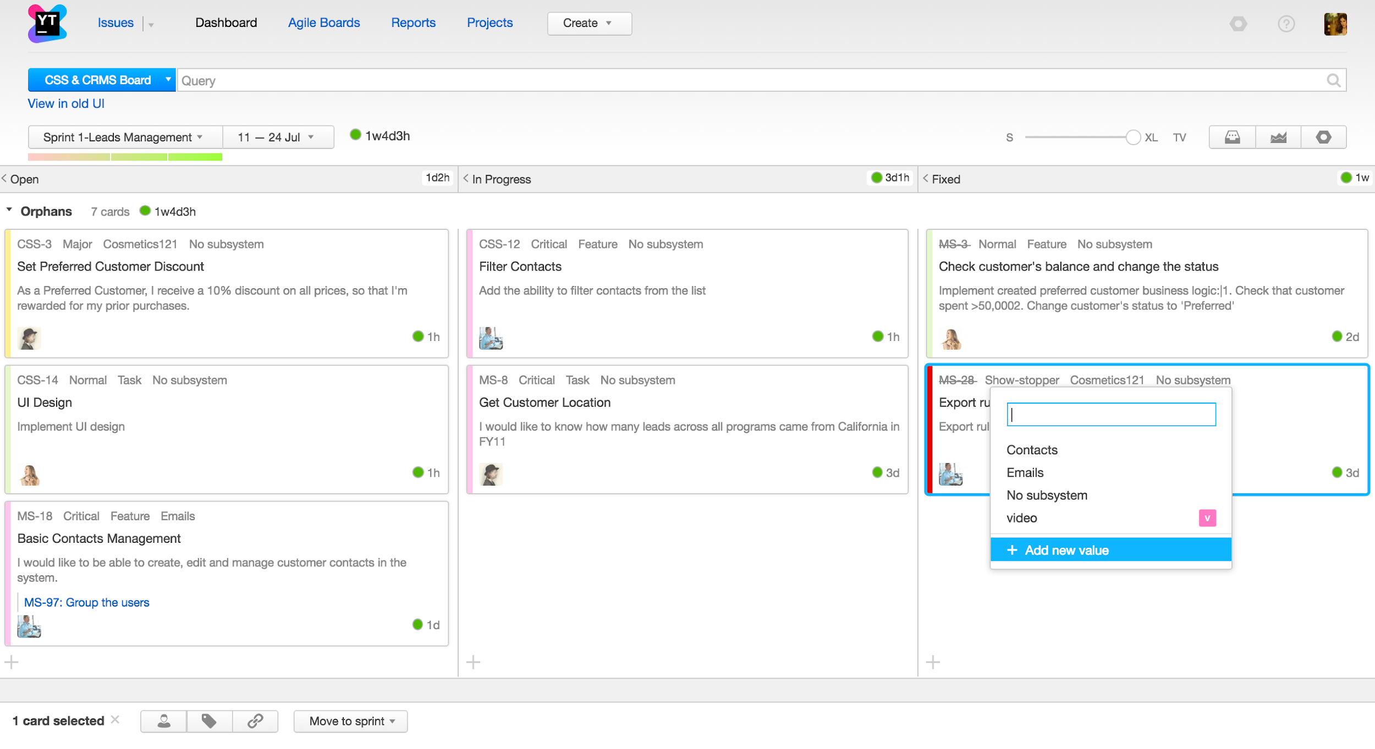
Platform
YouTrack

Slide 10
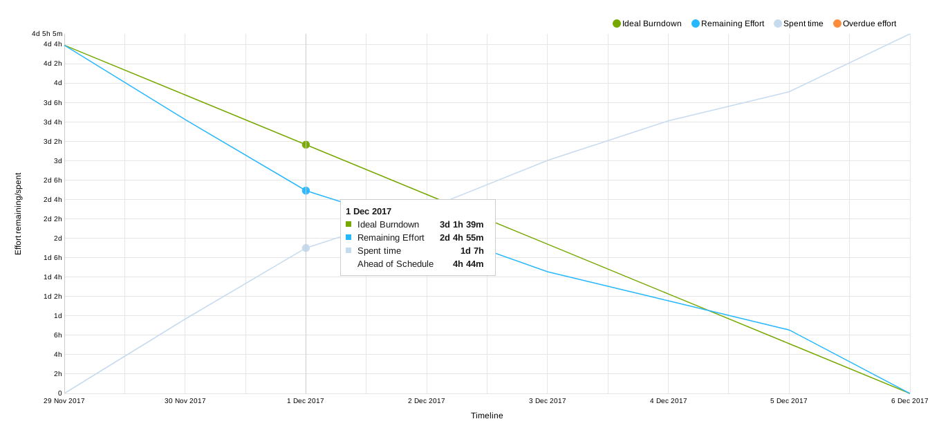
Burndown Diagram

Slide 11
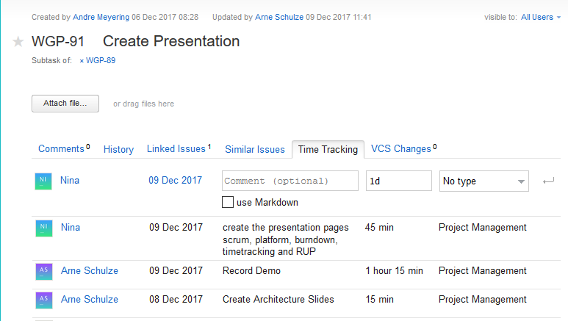
Time tracking

Slide 12
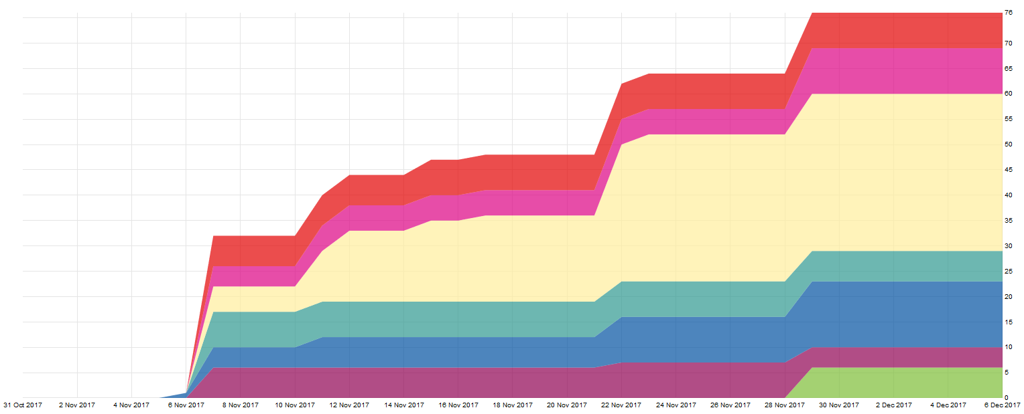
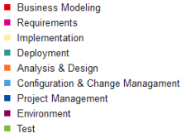
Cumulative Flow (RUP)
Legend

Slide 13


Demo

Slide 14
Demo Video

Slide 15
Architecture

Slide 16
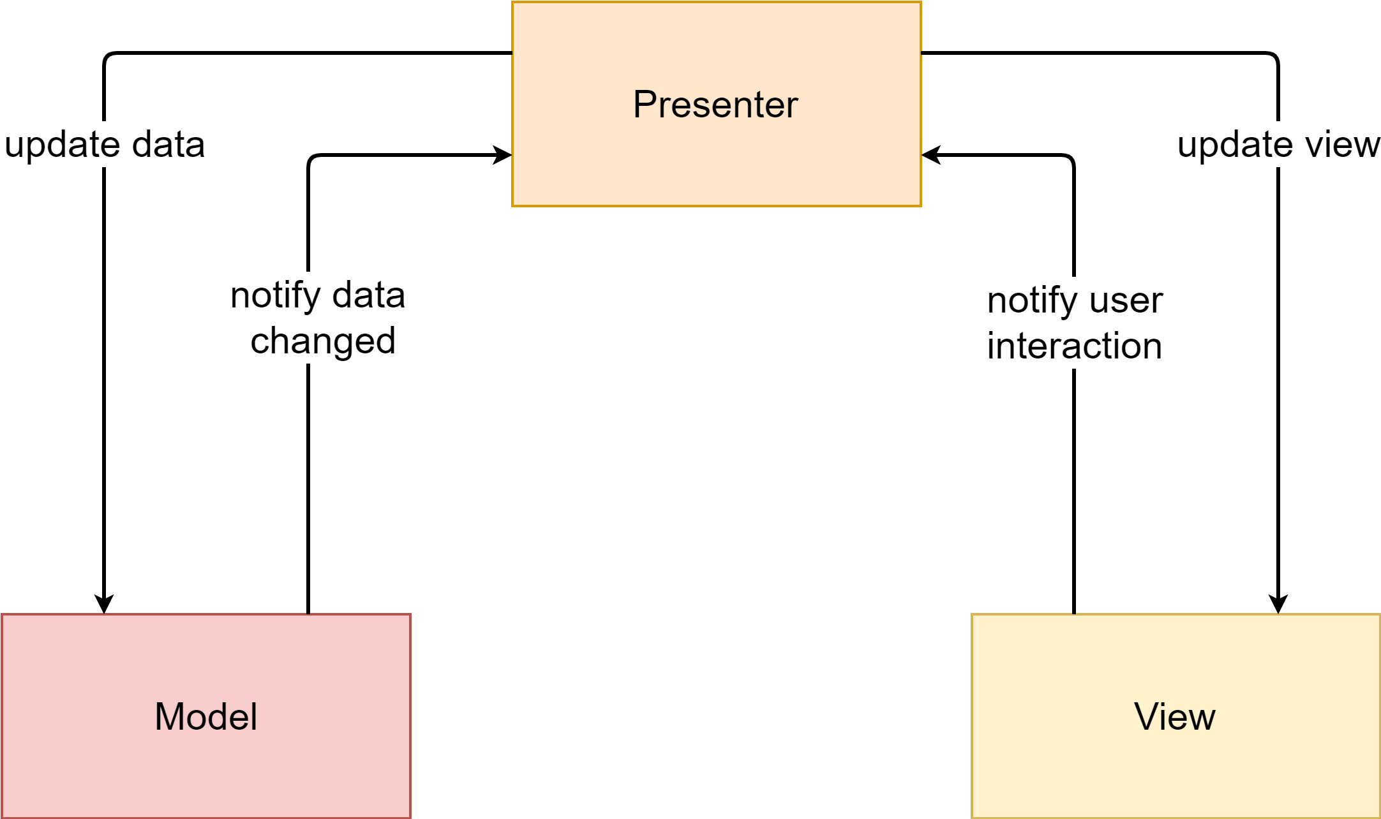
Android MVP Pattern

Slide 17
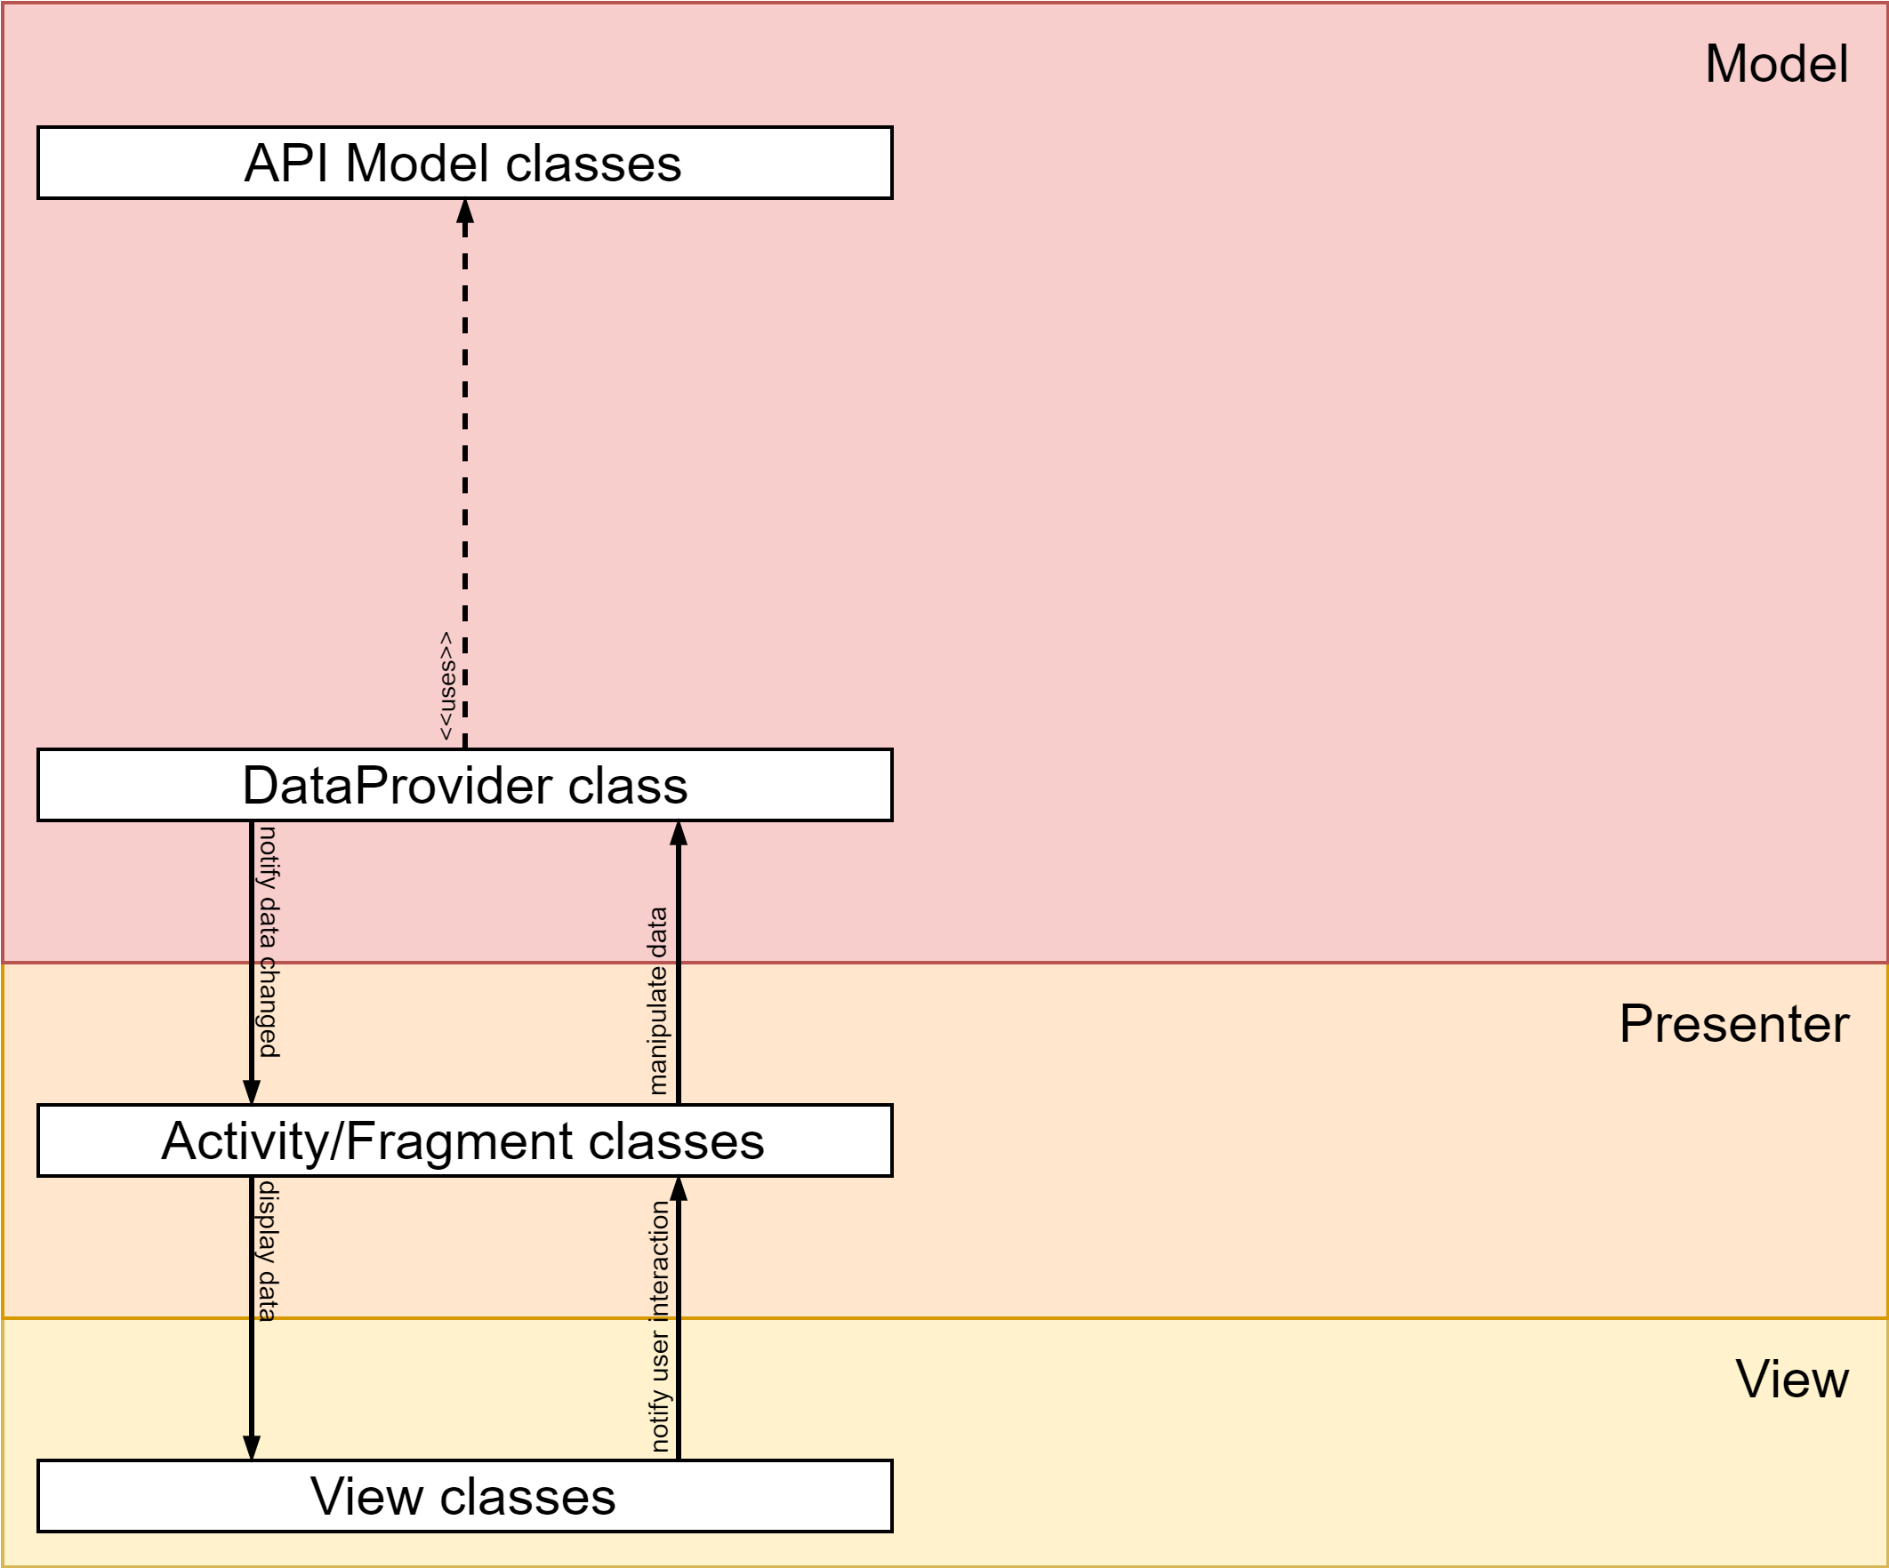
MVP Implementation

Slide 18
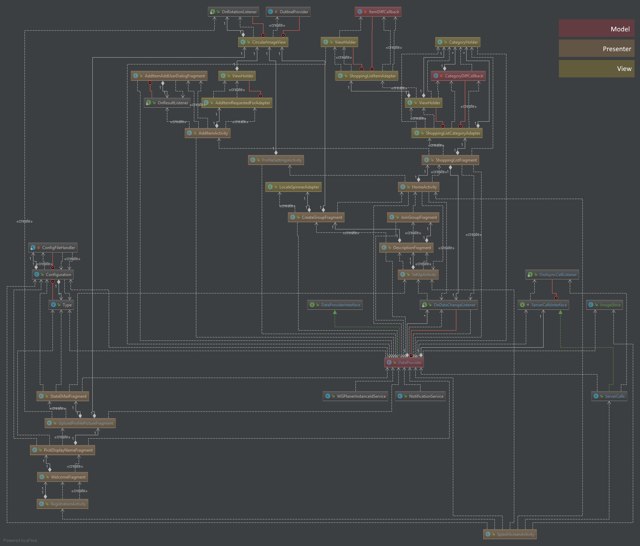
Class Diagrams - MVP Pattern marked

Slide 19
Automation

Slide 20
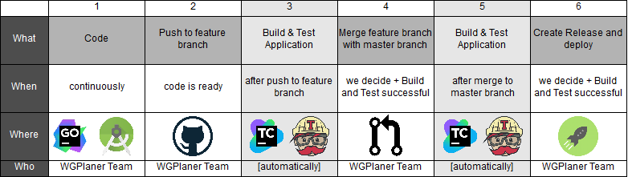
Deployment Procedure

Slide 21
Testing
Android
Cucumber UI Tests
Unit tests with JUnit
Server
Unit and integration tests with go test

Slide 22
Your Questions

Slide 23
Thank you for your Attention!

