Slide 1
Automated binary exploitation
By wil gibbs

Slide 2
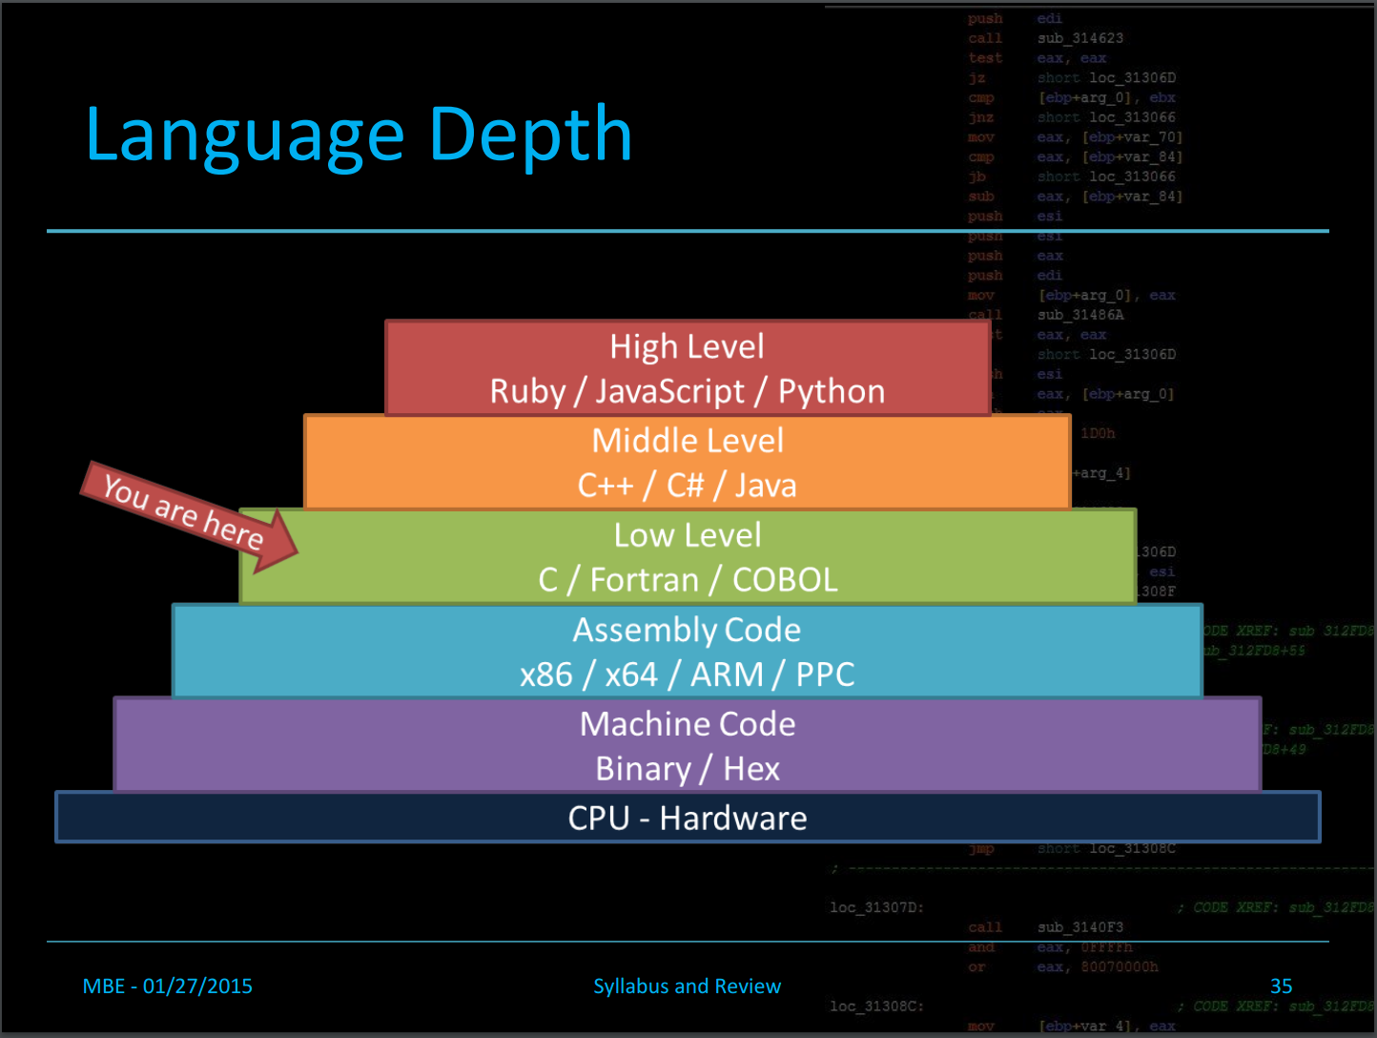
What is binary exploitation?
Where does this occur?
Whose fault is it?
How can I prevent it?

Slide 3

Why do you care?
How does this affect you?
  Engineer vs Consumer
Has this happened before?
What are the potential applications?

Slide 4
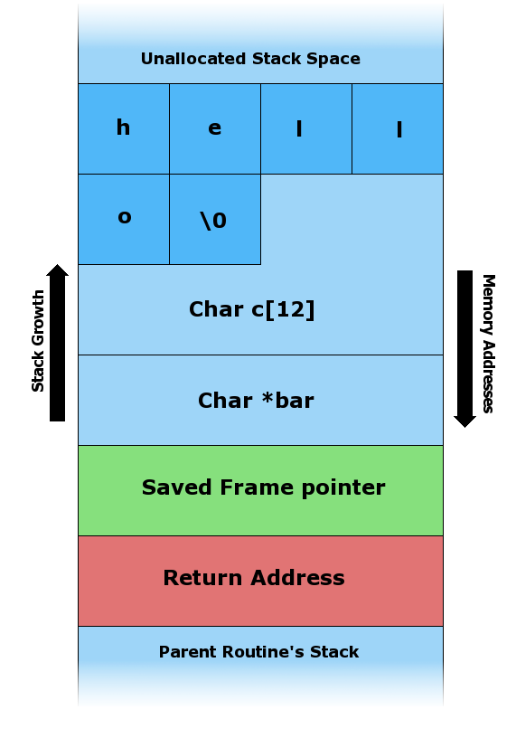
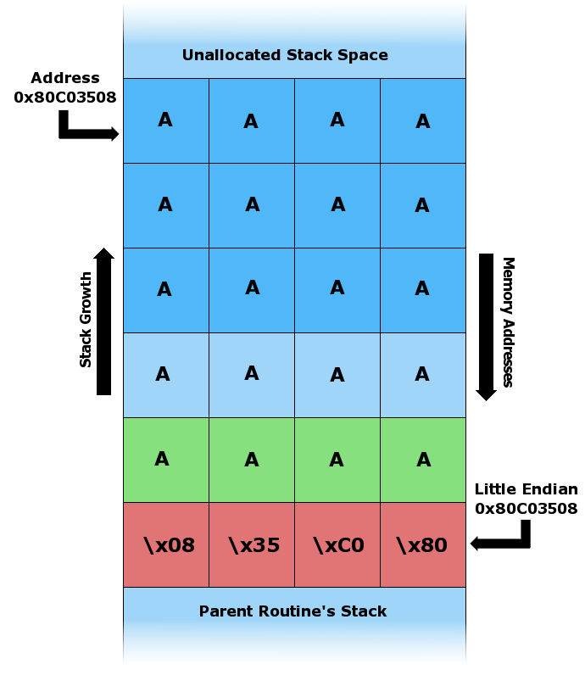
Where/How does this occur?

Slide 5
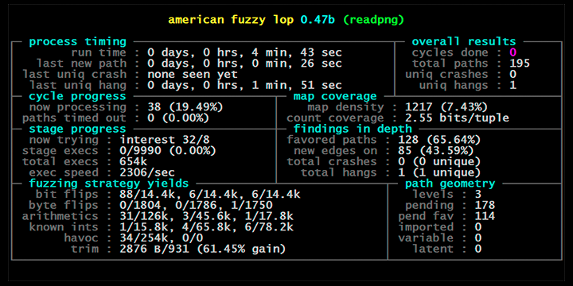
What is fuzzing?
American Fuzzy Lop (AFL)
Code Blocks
Code Coverage
Segfaults

Slide 6


ANGR
AFL
Constraint Solvers
Semi-Automated
Flaws

Slide 7
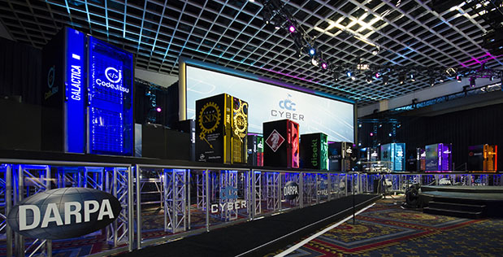
Cyber Grand Challenge
Competition
Mechanical Phish
Automation
limitations

Slide 8
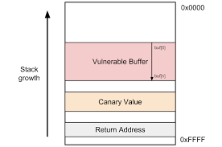
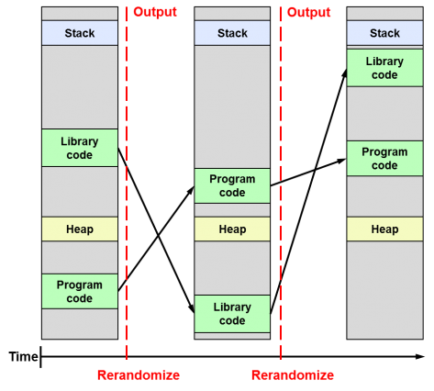
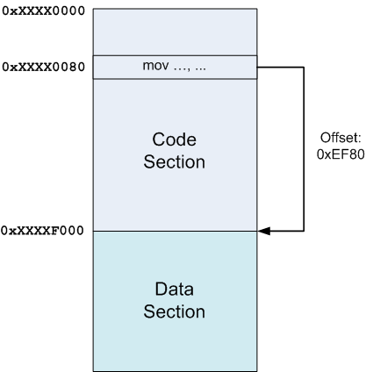
Is there a way to prevent Attacks?
ASLR: Address Space Layout Randomization
PIE: Position Independent Executable
Canary

Slide 9

What do I do now?
Exploitation Today
Current Research
Affected Areas

Slide 10
Citations
1. Shoshitaishvili Yan, “Mechanical Phish: Resilient Autonomous Hacking” 2018

