Slide 1

ROS - Lecture 1
October 2016
ROS Introduction
Main concepts
Basic commands
Lecturer: Roi Yehoshua
roiyeho@gmail.com

Slide 2
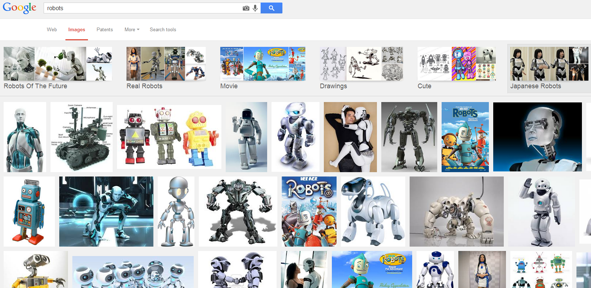
The Problem
Lack of standards for robotics

Slide 3

What is ROS?
ROS is an open-source robot operating system
A set of software libraries and tools that help you build robot applications that work across a wide variety of robotic platforms
Originally developed in 2007 at the Stanford Artificial Intelligence Laboratory and development continued at Willow Garage
Since 2013 managed by OSRF (Open Source Robotics Foundation)

Slide 4
ROS Main Features
ROS has two "sides"
The operating system side, which provides standard operating system services such as:
hardware abstraction
low-level device control
implementation of commonly used functionality
message-passing between processes
package management
A suite of user contributed packages that implement common robot functionality such as SLAM, planning, perception, vision, manipulation, etc.

Slide 5
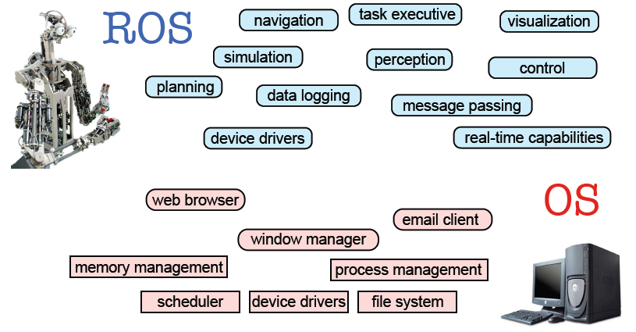
ROS Main Features
Taken from Sachin Chitta and Radu Rusu (Willow Garage)

Slide 6
ROS Philosophy
Peer to Peer
ROS systems consist of numerous small computer programs which connect to each other and continuously exchange messages
Tools-based
There are many small, generic programs that perform tasks such as visualization, logging, plotting data streams, etc.
Multi-Lingual
ROS software modules can be written in any language for which a client library has been written. Currently client libraries exist for C++, Python, LISP, Java, JavaScript, MATLAB, Ruby, and more.
Thin
The ROS conventions encourage contributors to create stand-alone libraries and then wrap those libraries so they send and receive messages to/from other ROS modules.
Free and open source

Slide 7
ROS Wiki
http://wiki.ros.org/
Installation: http://wiki.ros.org/ROS/Installation
Tutorials: http://wiki.ros.org/ROS/Tutorials
ROS Tutorial Videos
http://www.youtube.com/playlist?list=PLDC89965A56E6A8D6
ROS Cheat Sheet
http://www.tedusar.eu/files/summerschool2013/ROScheatsheet.pdf

Slide 8
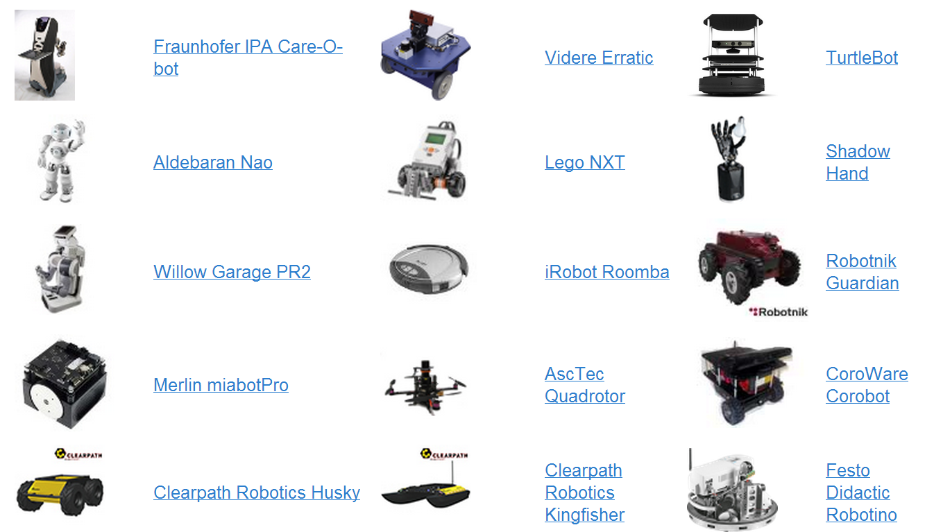
Robots using ROS
http://wiki.ros.org/Robots

Slide 9
ROS Core Concepts
Nodes
Messages and Topics
Services
ROS Master
Parameters
Stacks and packages

Slide 10
ROS Nodes
Single-purposed executable programs
e.g. sensor driver(s), actuator driver(s), mapper, planner, UI, etc.
Individually compiled, executed, and managed
Nodes are written using a ROS client library
roscpp – C++ client library
rospy – python client library
Nodes can publish or subscribe to a Topic
Nodes can also provide or use a Service

Slide 11
ROS Topics
A topic is a name for a stream of messages with a defined type
e.g., data from a laser range-finder might be sent on a topic called scan, with a message type of LaserScan
Nodes communicate with each other by publishing messages to topics
Publish/Subscribe model: 1-to-N broadcasting

Slide 12
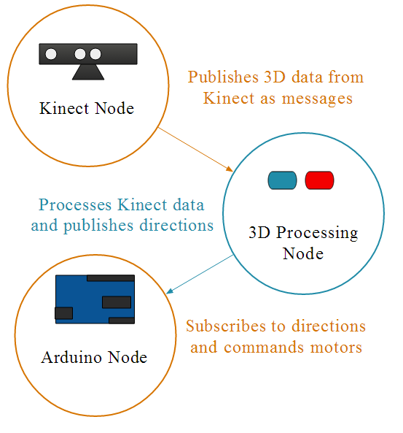
ROS Topics

Slide 13
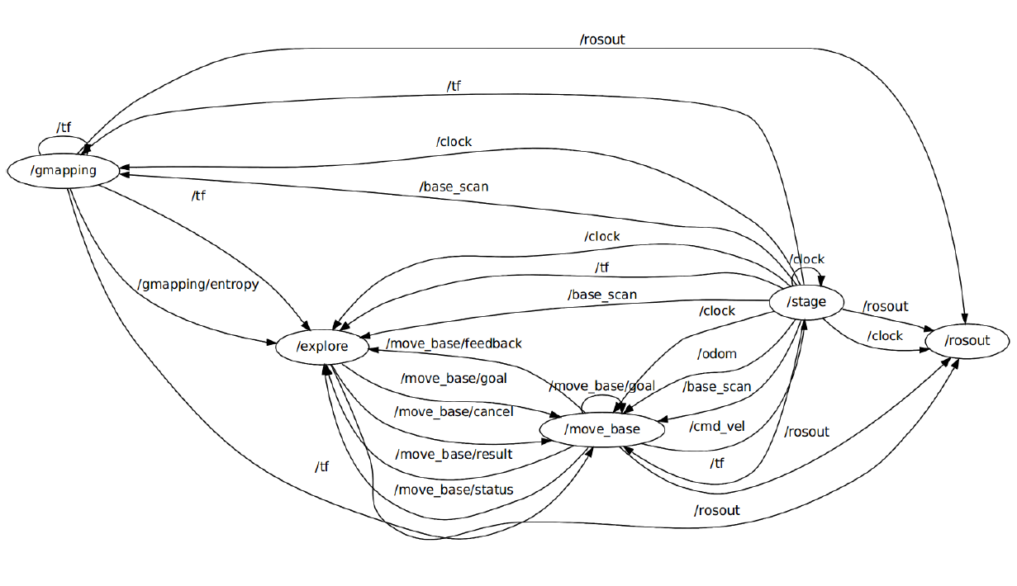
The ROS Graph

Slide 14
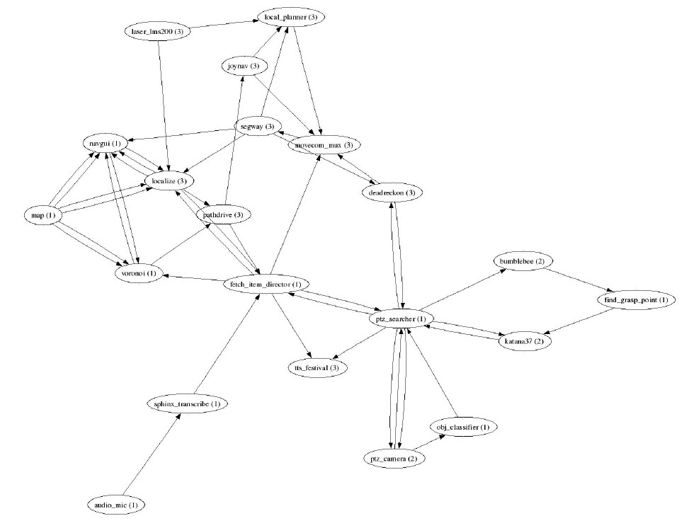
Fetch an Item Graph
Taken from Programming Robots with ROS (Quigley et al.)

Slide 15
ROS Messages
Strictly-typed data structures for inter-node communication
For example, geometry_msgs/Twist is used to express velocity commands:
Vector3 is another message type composed of:
Vector3 linear
Vector3 angular
float64 x
float64 y
float64 z

Slide 16
ROS Services
Synchronous inter-node transactions / RPC
Service/Client model: 1-to-1 request-response
Service roles:
carry out remote computation
trigger functionality / behavior
Example:
map_server/static_map – retrieves the current grid map used by the robot for navigation

Slide 17
ROS Master
Provides connection information to nodes so that they can transmit messages to each other
Every node connects to a master at startup to register details of the message streams they publish, and the streams to which that they to subscribe
When a new node appears, the master provides it with the information that it needs to form a direct peer-to-peer connection with other nodes publishing and subscribing to the same message topics

Slide 18
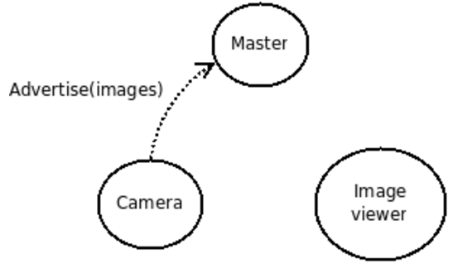
ROS Master
Let’s say we have two nodes: a Camera node and an Image_viewer node
Typically the camera node would start first notifying the master that it wants to publish images on the topic "images":

Slide 19
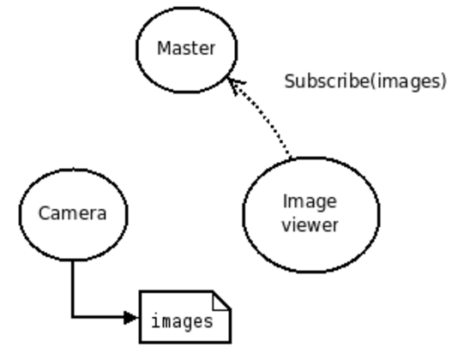
ROS Master
Now, Image_viewer wants to subscribe to the topic "images" to see if there's maybe some images there:

Slide 20
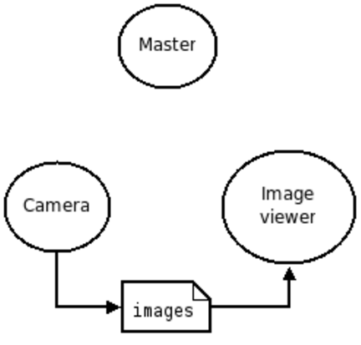
ROS Master
Now that the topic "images" has both a publisher and a subscriber, the master node notifies Camera and Image_viewer about each others existence, so that they can start transferring images to one another:

Slide 21
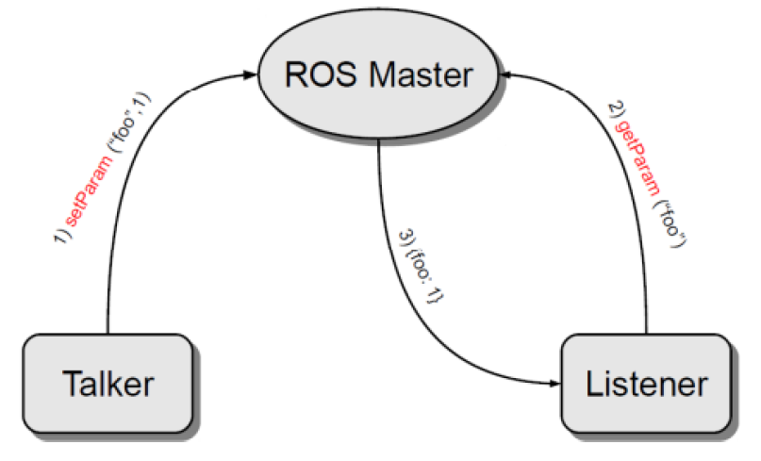
Parameter Server
A shared, multi-variate dictionary that is accessible via network APIs
Best used for static, non-binary data such as configuration parameters
Runs inside the ROS master

Slide 22
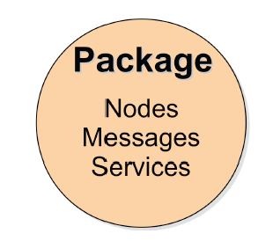
ROS Packages
Software in ROS is organized in packages.
A package contains one or more nodes and provides a ROS interface
Most of ROS packages are hosted in GitHub

Slide 23
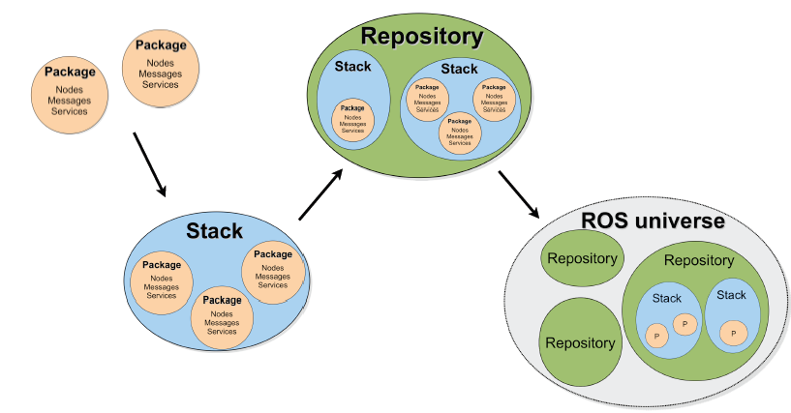
ROS Package System
Taken from Sachin Chitta and Radu Rusu (Willow Garage)

Slide 24
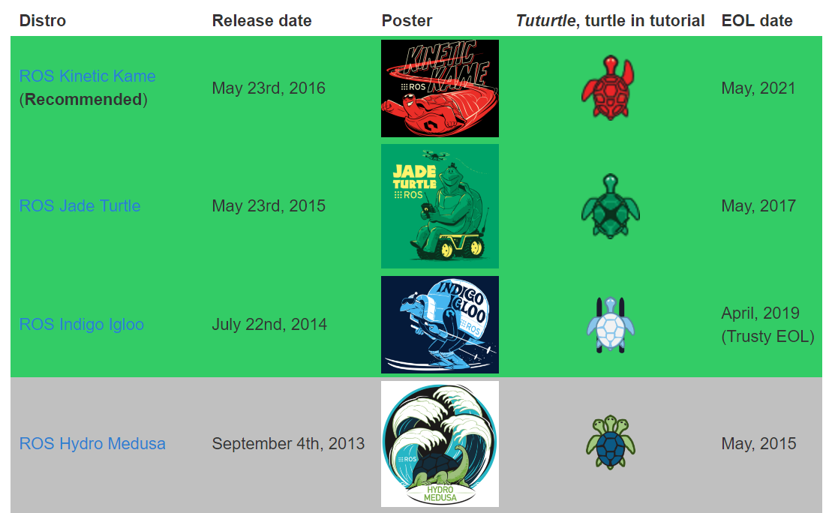
ROS Distribution Releases

Slide 25
ROS Supported Platforms
ROS is currently supported only on Ubuntu
other variants such as Windows and Mac OS X are considered experimental (will be supported on ROS 2.0)
ROS distribution supported is limited to <=3 latest Ubuntu versions
ROS Jade supports the following Ubuntu versions:
Vivid (15.04)
Utopic (14.04)
Trusty (14.04 LTS)
ROS Indigo supports the following Ubuntu versions:
Trusty (14.04 LTS)
Saucy (13.10)

Slide 26
ROS Installation
If you already have Ubuntu installed, follow the instructions at:
http://wiki.ros.org/indigo/Installation/Ubuntu
You can also download a VM with ROS Indigo Pre-installed from here:
http://nootrix.com/downloads/#RosVM
Two VMs are available: one with Ubuntu 32Bits and the other with Ubuntu 64Bits (.ova files)
You can import this file into VirtualBox or VMWare

Slide 27
ROS Environment
ROS relies on the notion of combining spaces using the shell environment
This makes developing against different versions of ROS or against different sets of packages easier
After you install ROS you will have setup.*sh files in '/opt/ros/<distro>/', and you could source them like so:
You will need to run this command on every new shell you open to have access to the ros commands, unless you add this line to your bash startup file (~/.bashrc)
If you used the pre-installed VM it’s already done for you
$ source /opt/ros/indigo/setup.bash

Slide 28
ROS Basic Commands
roscore
rosrun
rosnode
rostopic

Slide 29
roscore
roscore is the first thing you should run when using ROS
roscore will start up:
a ROS Master
a ROS Parameter Server
a rosout logging node
$ roscore

Slide 30
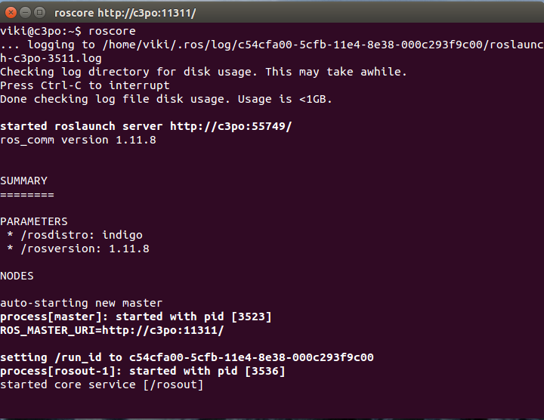
roscore

Slide 31
rosrun
rosrun allows you to run a node
Usage:
Example:
$ rosrun <package> <executable>
$ rosrun turtlesim turtlesim_node

Slide 32
Demo - Turtlesim
In separate terminal windows run:
roscore
rosrun turtlesim turtlesim_node
rosrun turtlesim turtle_teleop_key

Slide 33
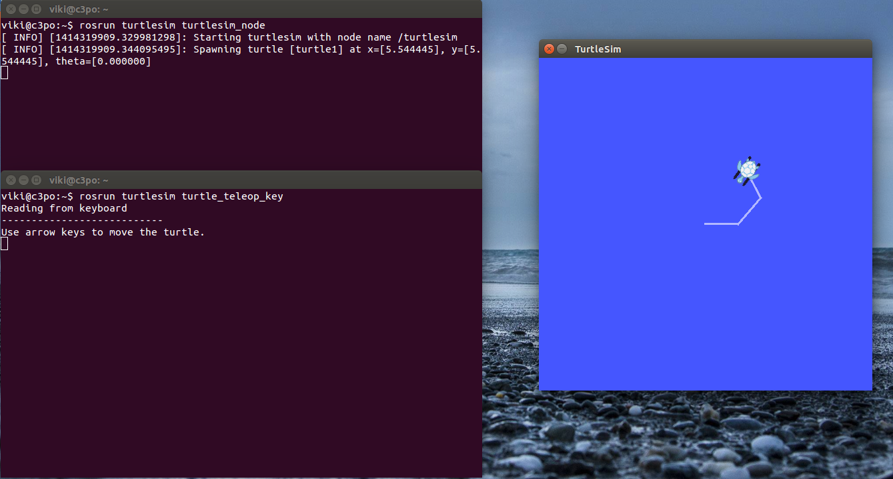
Demo - Turtlesim

Slide 34
rosnode
Displays debugging information about ROS nodes, including publications, subscriptions and connections
 | Command
List active nodes | $rosnode list
Test connectivity to node | $rosnode ping
Print information about a node | $rosnode info
Kill a running node | $rosnode kill
List nodes running on a particular machine | $rosnode machine

Slide 35
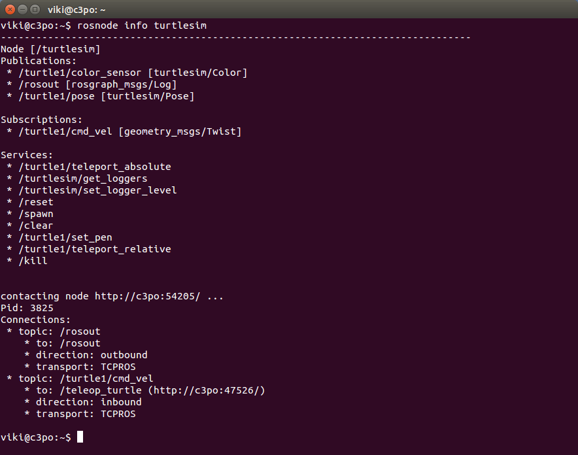
rosnode info

Slide 36
rostopic
Gives information about a topic and allows to publish messages on a topic
 | Command
List active topics | $rostopic list
Prints messages of the topic to the screen | $rosnode echo /topic
Print information about a topic | $rostopic info /topic
Prints the type of messages the topic publishes | $rostopic type /topic
Publishes data to a topic | $rostopic pub /topic type args

Slide 37
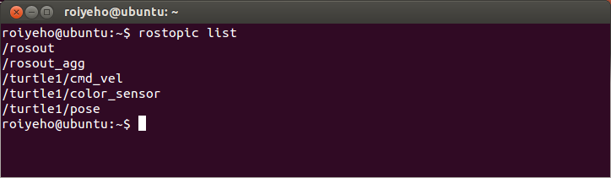
rostopic list
Displays the list of current topics:

Slide 38
Publish to ROS Topic
Use the rostopic pub command to publish messages to a topic
For example, to make the turtle move forward at a 0.2m/s speed, you can publish a cmd_vel message to the topic /turtle1/cmd_vel:
To specify only the linear x velocity:
$ rostopic pub /turtle1/cmd_vel geometry_msgs/Twist '{linear: {x: 0.2, y: 0, z: 0}, angular: {x: 0, y: 0, z: 0}}'
$ rostopic pub /turtle1/cmd_vel geometry_msgs/Twist '{linear: {x: 0.2}}'

Slide 39
Publish to ROS Topic
Some of the messages like cmd_vel have a predefined timeout
If you want to publish a message continuously use the argument -r with the loop rate in Hz
For example, to make the turtle turn in circles continuously, type:
$ rostopic pub /turtle1/cmd_vel -r 10 geometry_msgs/Twist ‘{angular: {z: 0.5}}'

Slide 40
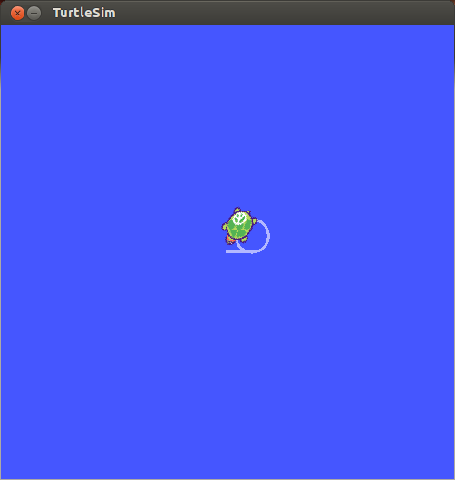
Publish to ROS Topic

Slide 41
Ex. 1
Run the turtlesim node
Send a command to turtlesim to move backwards continuously at 5Hz rate

