Slide 1

How to Setup LAMP on Ubuntu
by Yothin Muangsommuk Computer System Administrator Group
King Mongkut’s Institute of Technology Ladkrabang

Slide 2




What is LAMP ?
A solution stack of software components to build a general purpose web server.
L = Linux
A = Apache HTTP Server
M = MySQL
P = Perl/Python/PHP
Notes:
อธิบายแต่ละตัวให้ละเอียดๆด้วย !!!
อย่าลืมบอกลินุกซ์คร่าวๆ
Apache ทำงานโปรโตคอลอะไร พอร์ตไหน
mySQL ย่อมาจากอะไร บอกด้วย
P อธิบายการใช้งานควบกับภาษาอื่นๆ

Slide 3
Why LAMP ?
Easy to Code
Easy to Deploy
Develop Locally
Cheap hosting
Notes:
Easy to code: Novices can build something and get it up and running very quickly with PHP and MySQL.
Easy to deploy: Since PHP is a standard Apache module, it is easy to deploy LAMP web applications by uploading .php files to an Apache server and connecting to a MySQL database.
Develop locally: LAMP can be set up so an app can be built locally, then deployed to the Web.
Cheap and ubiquitous hosting: Many inexpensive web hosts provide PHP and MySQL services.^{[citation needed}

Slide 4
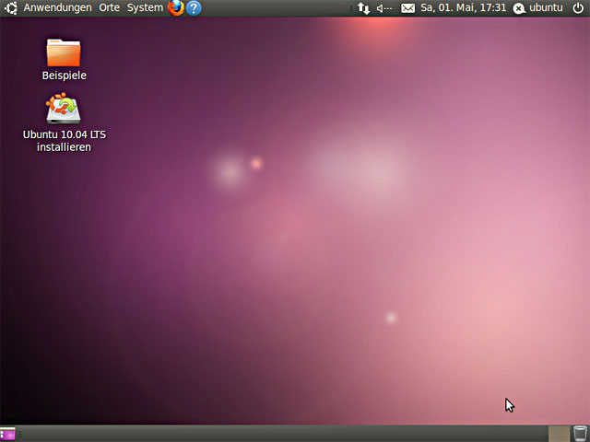
What we need ?
Just Ubuntu 11.04 desktop or server with an internet connection

Slide 5
Installing Apache
Open terminal by press Alt+F2 and enter “gnome-terminal”
Installing apache by enter “sudo apt-get install apache2”
When installing process finish restart apache service by enter “sudo /etc/init.d/apache2 restart”

Slide 6
Installing Apache
Checking that apache server run correctly by open browser and enter “http://localhost” on URL bar.
if you read "It works!", which is the content of the file /var/www/index.html , this proves Apache works.

Slide 7
Installing PHP 5
Open terminal and enter “sudo apt-get install php5”
then restart apache by enter “sudo /etc/init.d/apache2 restart”

Slide 8
Testing PHP
Open terminal and enter “sudo gedit /var/www/testphp.php”
On gedit Copy/Paste this line into the phptest file: <?php phpinfo(); ?>

Slide 9
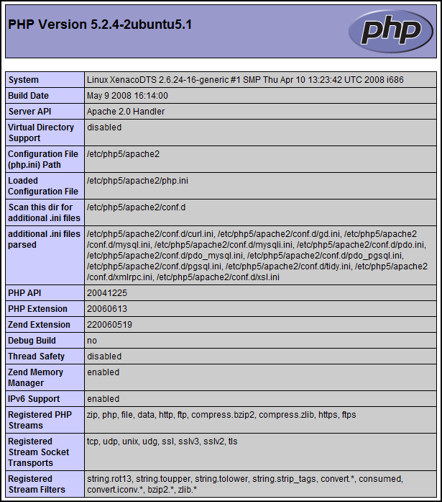
Testing PHP
Save and open browser enter “http://localhost/testphp.php”

Slide 10
Installing MySQL
Open terminal and type “sudo apt-get install mysql-server”
Installer will ask for root password type press enter
Configurate php.ini in order to get PHP work with MySQL by type “gksudo gedit /etc/php5/apache2/php.ini”

Slide 11
Installing MySQL
Change this line: ;extension=msql.so To look like this: extension=mysql.so
restart apache again by enter “sudo /etc/init.d/apache2 restart”

Slide 12
It’s Ready !

Slide 13
but

Slide 14
Is it easier to configurate MySQL in Graphic Mode ?

Slide 15
The answer is phpMyAdmin.

Slide 16
Installing phpMyAdmin
Open terminal and enter “sudo apt-get install libapache2-mod-auth-mysql php5-mysql phpmyadmin”
Installer will ask for web server choose apache2 and enter ok
Then it will ask for database’s administrative password , MySQL application password enter the same as root password.

Slide 17
Installing phpMyAdmin
Checking that phpMyAdmin run correctly by open browser and type “http://localhost/phpmyadmin” on URL bar.

Slide 18
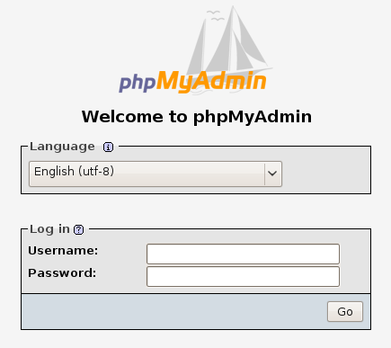
Installing phpMyAdmin
It’s gonna be like this
You can access mySQL configuration by log in with user “root” and password as you set

Slide 19
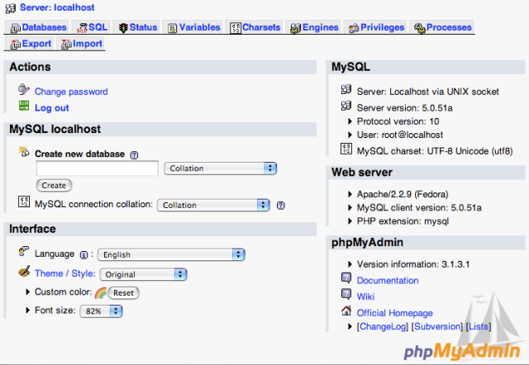
Installing phpMyAdmin
You can create , edit and monitor your SQL database on this page.

Slide 20
Question ?

Slide 21
Thanks for coming today

Slide 22
Reference
https://help.ubuntu.com/community/ApacheMySQLPHP
http://www.howtoforge.com/ubuntu_lamp_for_newbies
http://en.wikipedia.org/wiki/LAMP_(software_bundle)

