Slide 1
Network Configuration
& SSH

Slide 2
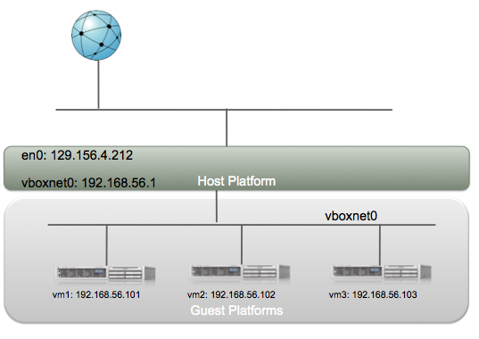
Host-only Networking

Slide 3
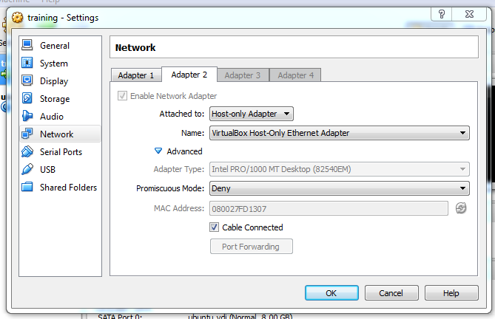

Slide 4
Interface Configuration

Slide 5
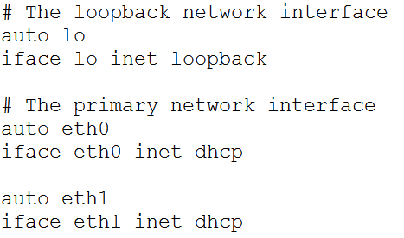

Slide 6
DHCP request

Slide 7
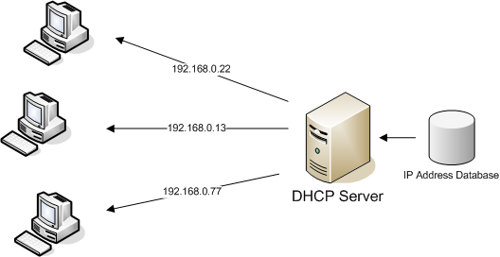

Slide 8


Slide 10
