Slide 1
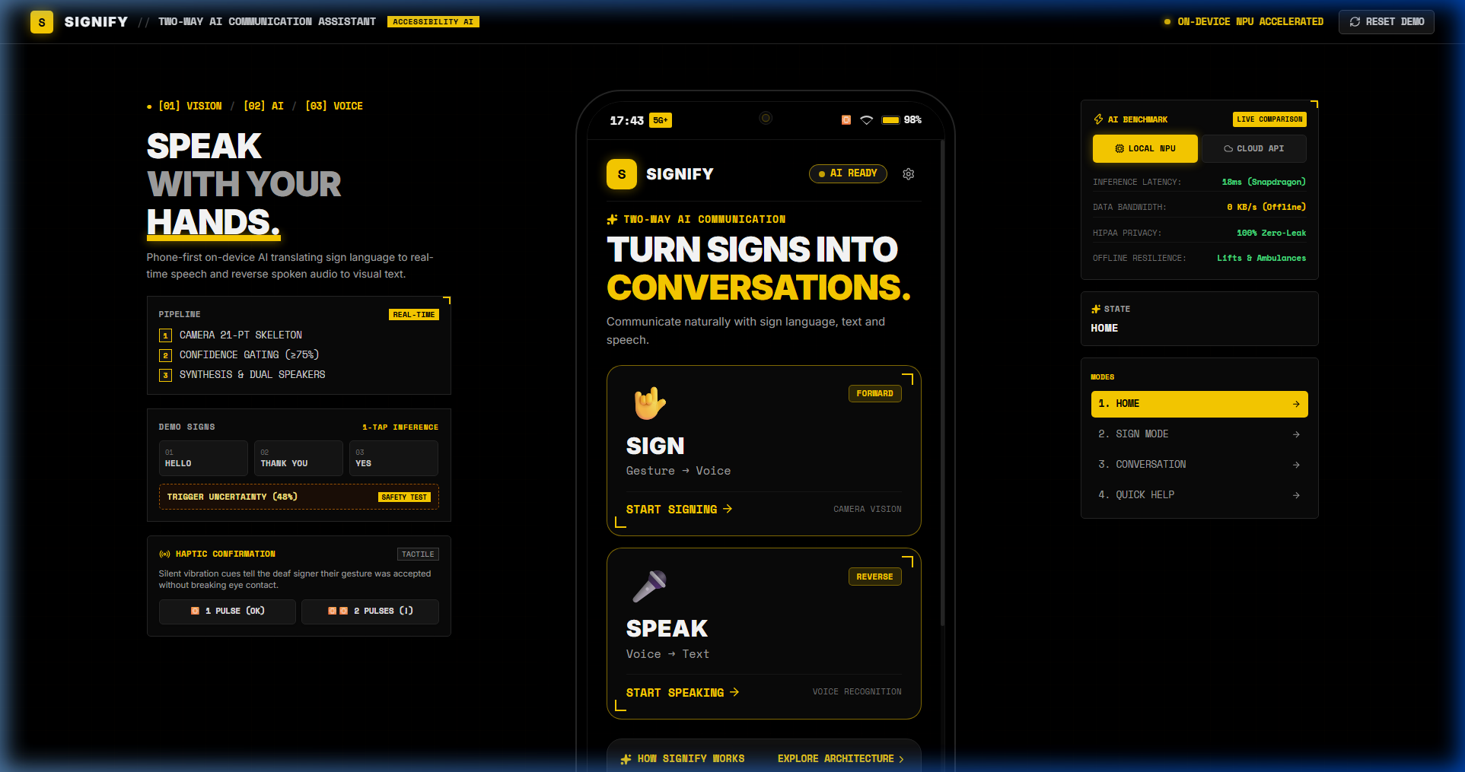
iQOO HACKATHON 2026 // HEALTHTECH
SIGNIFY
LET THE SILENCE
BE HEARD.
A phone-first on-device AI bidirectional communication assistant for sign-language users.
PHONE-FIRST
ON-DEVICE AI
BIDIRECTIONAL
SIGNIFY
iQOO HACKATHON 2026

Slide 2
01 // THE GAP
WHEN COMMUNICATION
BREAKS, EVERY SECOND MATTERS.
Sign language can be a complete language — but the surrounding conversation may not understand it.
SIGN
?
UNDERSTANDING
01
→
→
THE REAL PROBLEM
✋
A classifier can identify a sign.
A communication tool must help two people understand each other.
THE GAP
The challenge is not simply recognizing a hand shape.
It is turning a gesture into usable, human communication.
SIGNIFY
iQOO HACKATHON 2026

Slide 3
02 // THE INSIGHT
SIGN RECOGNITION
ISN'T THE END GOAL.
Individual signs become valuable when context turns them into a natural message.
04
01
02
03
MEANING
HELP
→
DOCTOR
→
PAIN
→
"I need a doctor.
I'm in pain."
96% CONFIDENCE
94% CONFIDENCE
91% CONFIDENCE
FROM GESTURE → MEANING
Signify is designed around the conversation, not just the prediction.
SIGNIFY
iQOO HACKATHON 2026

Slide 4
03 // THE PRODUCT
MEET SIGNIFY.
A phone-first communication bridge: see the sign, understand the context, speak the message.
01
02
03
SEE
UNDERSTAND
SPEAK
Camera-based
gesture input.
Confidence +
context.
Natural voice
output.
COMMUNICATION WITHOUT BARRIERS.
SIGNIFY
iQOO HACKATHON 2026

Slide 5
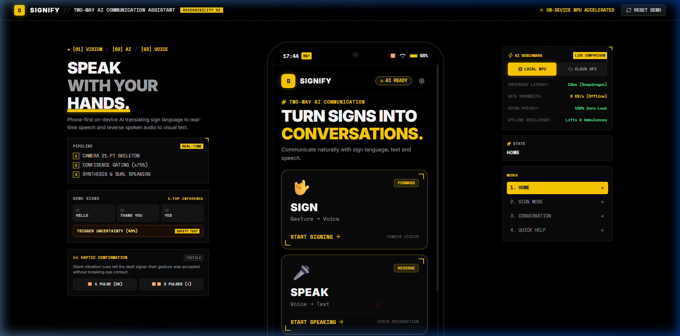
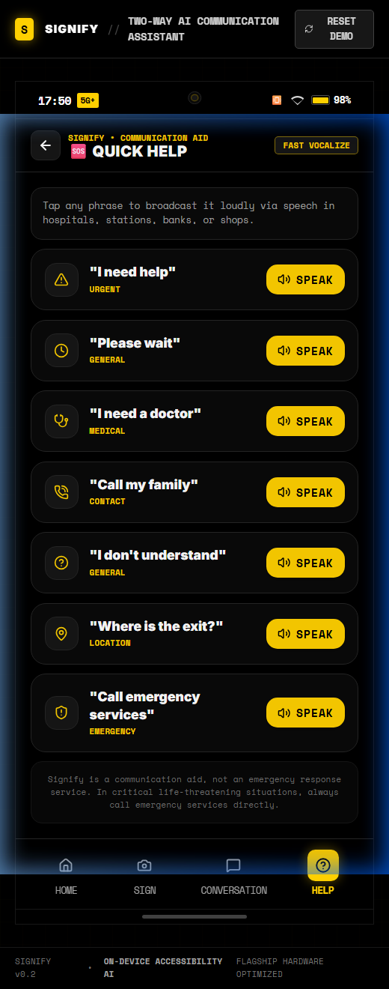
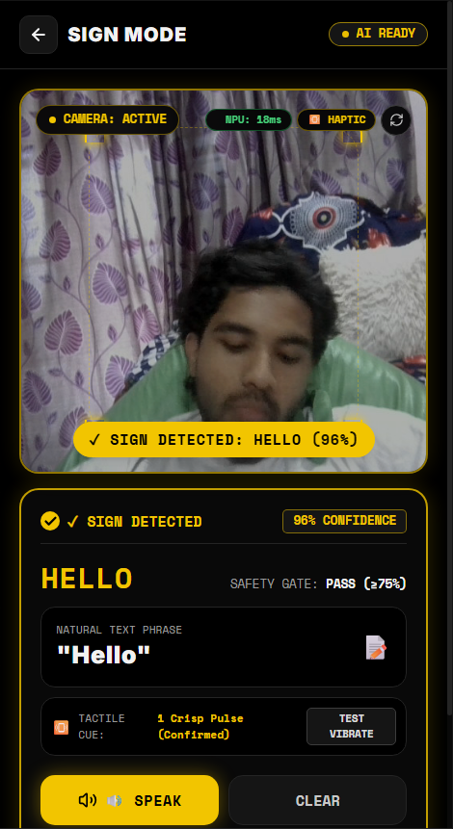
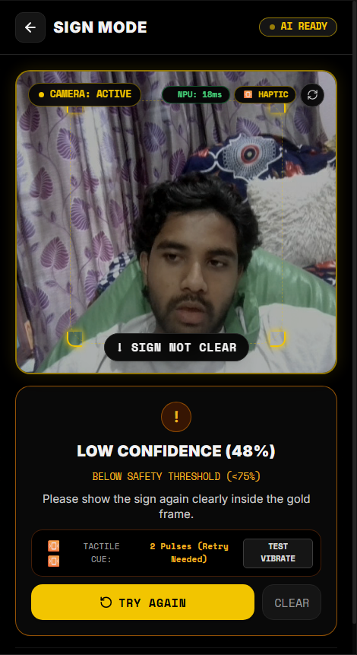
04 // THE EXPERIENCE
ONE PHONE.
ONE CONVERSATION.
The product flow is intentionally simple enough to understand at a glance.
01 / CHOOSE
02 / CONTEXT
03 / RECOGNIZE
04 / COMPOSE
SIGNIFY
iQOO HACKATHON 2026

Slide 6
05 // DEMO MODE
BUILT FOR
REAL MOMENTS.
A focused vocabulary makes the demo predictable, meaningful, and easy to evaluate.
01
HOSPITAL
Essential healthcare
HELP • DOCTOR • PAIN
02
EMERGENCY
Fast critical communication
HELP • AMBULANCE • DANGER
03
DAILY
Everyday conversation
HELLO • THANK YOU • YES
SIGNIFY
iQOO HACKATHON 2026

Slide 7
06 // LIVE INTERPRETER
SEE → RECOGNIZE → RESPOND.
Camera captures 21-point hand skeleton with Snapdragon NPU 18ms inference and silent haptic vibration confirmation.
01
02
03
CAMERA
AI
GATE
Gesture tracked
in frame.
Sign candidate
identified.
96%
accepted.
DETECTED SIGN
HELP
HIGH CONFIDENCE // SAFE FOR AUTO-ASSEMBLY
SIGNIFY
iQOO HACKATHON 2026

Slide 8
07 // TRUST
NOT EVERY PREDICTION
SHOULD BECOME A SENTENCE.
Signify treats uncertainty as a product state: 2 quick haptic pulses tell the deaf signer to repeat without breaking eye contact.
01
02
03
HELP
DOCTOR
WATER
96% / HIGH CONFIDENCE
AUTO-ASSEMBLE
94% / HIGH CONFIDENCE
AUTO-ASSEMBLE
58% / NOT CONFIDENT
TRY AGAIN
GATING THRESHOLD
HIGH CONFIDENCE → ACCEPT | LOW CONFIDENCE → RETRY / CONFIRM
SIGNIFY
iQOO HACKATHON 2026

Slide 9
08 // CONTEXT
RECOGNITION
BECOMES CONVERSATION.
The sentence builder combines recognized signs into a message a person can actually use.
3 SIGNS
HELP + DOCTOR + PAIN
1 NATURAL MESSAGE
"I NEED A DOCTOR.
I'M IN PAIN."
CONTEXT BUILDER // HIGH CONFIDENCE
SIGNIFY
iQOO HACKATHON 2026

Slide 10
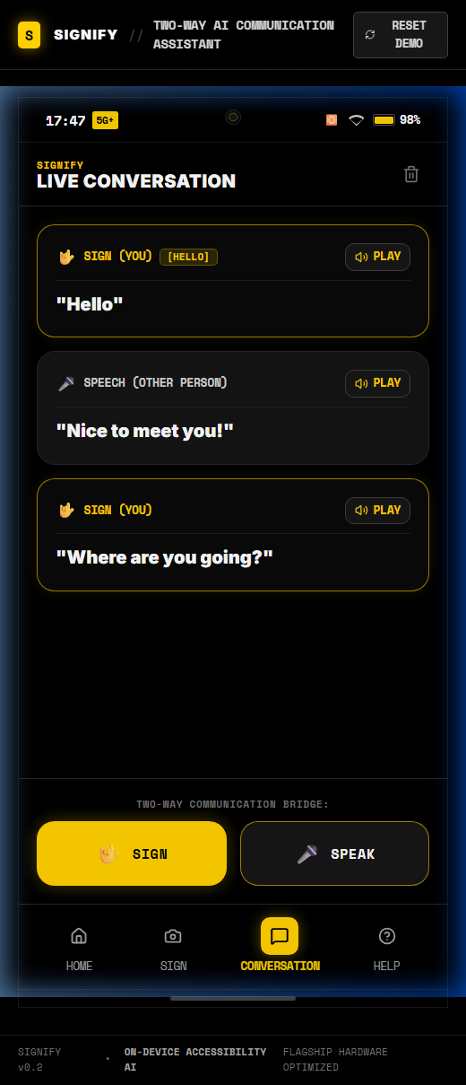
09 // BIDIRECTIONAL
COMMUNICATION
GOES BOTH WAYS.
A true bidirectional bridge: forward sign-to-speech for the listener, and reverse speech-to-text with oversized visual text for the signer.
01
02
SIGN → SPEECH
SPEECH → TEXT
Gesture
↓
AI interpretation
↓
Natural speech
Spoken audio
↓
Transcription
↓
Readable text
SIGNIFY
iQOO HACKATHON 2026

Slide 11
10 // ON-DEVICE AI
THE NPU IS THE
FAST PATH TO SIGNIFY.
Local model inference keeps camera input close to the device and is aligned with the hackathon's phone-first architecture.
01
02
03
04
05
CAMERA
→
PREPROCESS
→
NPU
→
GATE
→
OUTPUT
frames
crop / normalize
local model inference
confidence
text + speech
LOW LATENCY
PRIVACY
EFFICIENCY
PHONE-FIRST
Targeting < 18ms inference latency directly on Snapdragon NPU.
100% offline HIPAA privacy — zero video frames leave device (0 KB/s data).
< 45MB INT8 quantized
model for mobile NPU.
Instant real-time loop with
zero network dependency.
IMPLEMENTATION TARGET: LOCAL / OPEN-SOURCE MODEL → SNAPDRAGON NPU
* Prototype UI currently simulates recognition; the NPU layer is the real-device integration target.
SIGNIFY
iQOO HACKATHON 2026

Slide 12
11 // WHY THE PHONE
THE PHONE
ISN'T THE SCREEN.
IT'S THE SYSTEM.
Signify is designed around the capabilities that make a phone the natural communication bridge.
CAMERA
MICROPHONE
SEE
LISTEN
ON-DEVICE AI
SPEAKER
UNDERSTAND
SPEAK
PHONE-FIRST / MOBILE / PRIVACY-AWARE
SIGNIFY
iQOO HACKATHON 2026

Slide 13
12 // SYSTEM
FROM CAMERA
TO COMMUNICATION.
A modular pipeline keeps recognition, confidence, context, and output as distinct stages.
01
02
03
04
05
CAMERA
→
RECOGNITION
→
CONFIDENCE
→
CONTEXT
→
OUTPUT
gesture input
sign candidate
gate
sentence
text + speech
OFFLINE-FIRST
PRIVACY-AWARE
CONFIDENCE-GATED
HUMAN-FRIENDLY
REAL-TIME READY
SIGNIFY
iQOO HACKATHON 2026

Slide 14
13 // TEAM
WE'VE BUILT BEFORE.
WE'VE CONTRIBUTED BEFORE.
Relevant experience gives us a shorter path from idea → prototype → real build.
01
02
03
HACKATHON EXPERIENCE
OPEN-SOURCE
BUILDING MINDSET
YStart-AI — AI-powered startup idea validation/evaluation
platform.
Built during The Hive / ApplyBee AI hackathon.
Contributor experience through GirlScript
Summer of Code (GSSoC) 2026.
Real collaborative development beyond classroom
projects.
Full-stack + ML experience across computer vision,
APIs, AI prototypes and product-focused builds.
TEAM CREDIBILITY
IDEATE → SHIP → ITERATE
Proven track record in rapid prototyping, AI product evaluation, and collaborative open-source shipping.
SIGNIFY
iQOO HACKATHON 2026

Slide 15
14 // ROADMAP
FROM PROTOTYPE
TO EVERYDAY COMMUNICATION.
The current build establishes the interaction model; the next steps deepen real-time recognition and personalization.
NOW
NEXT
NEXT
VISION
01
02
03
04
INTERACTIVE
PROTOTYPE
REAL-TIME
MODEL
PERSONALIZED
VOCABULARY
EVERYDAY
ASSISTANT
→
→
→
Interactive prototype, confidence safety-gate, NPU benchmark & triage (Completed)
MediaPipe 21-point tracking + quantized TFLite on Snapdragon Hexagon NPU
Regional sign vocabulary (ISL & ASL) + contextual sentence builder
Foldable dual-screen mode + wearable silent haptic confirmation alerts
SIGNIFY
iQOO HACKATHON 2026

Slide 16
15 // CLOSING
EVERYONE
DESERVES
TO BE HEARD.
LET THE SILENCE
BE HEARD.
SIGNIFY
COMMUNICATION WITHOUT BARRIERS.
SIGNIFY // LET THE SILENCE BE HEARD
iQOO HACKATHON 2026

