Slide 1
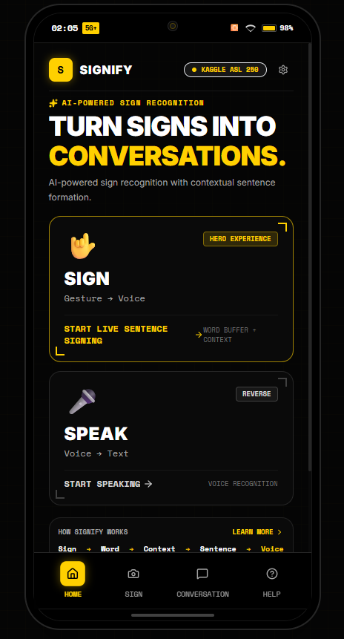
iQOO HACKATHON 2026 // HEALTHTECH & ACCESSIBILITY TRACK
SIGNIFY
LET THE SILENCE
BE HEARD.
A phone-first bidirectional communication assistant bridging sign-language users and spoken voice using the Qualcomm Snapdragon Hexagon NPU and Kaggle ASL 250 ML foundation.
▶ SNAPDRAGON NPU: < 18ms real-time latency on Hexagon DSP via QNN TFLite delegate
▶ TWO-WAY BRIDGE: Forward Sign → Speech AND Reverse Voice → Accessible Text
▶ ZERO HALLUCINATION: Deterministic context-aware grammar engine grounded in recognized signs
[ SIGNIFY HOME INTERFACE ]
SIGNIFY
iQOO HACKATHON 2026

Slide 2
01 // THE URGENCY
WHEN COMMUNICATION BREAKS, EVERY SECOND MATTERS
Critical communication barriers in emergency triage, law enforcement, and daily transit.
70M+
DEAF INDIVIDUALS WORLDWIDE
• Sign language is their primary native language.
• Acute isolation in healthcare and emergency transit.
• Handwritten notes are too slow during medical trauma.
< 1%
HEARING WHO UNDERSTAND SIGN
• Over 99% of doctors and responders cannot read sign.
• High risk of dangerous misinterpretation in traffic stops.
• Patients unable to convey critical symptoms or allergies.
2-4 HRS
INTERPRETER ARRIVAL DELAY
• Certified medical interpreters are rarely on-site.
• Costs exceed $100/hr, inaccessible for daily interactions.
• Urgent care demands instant, on-device AI assistance.
SIGNIFY
iQOO HACKATHON 2026

Slide 3
02 // THE CORE NOVELTY
ISOLATED SIGNS ARE NOT A CONVERSATION
The fundamental barrier in AI sign language isn't just image classification — it is conversational synthesis.
✕ STANDARD RESEARCH APPROACH
Raw Token Splatting Without Grammar
FLOW: Camera ──► Image Model ──► Dumps Raw Words
OUTPUT: "WATER" ... "PLEASE" ... "WATER"
• Sounds robotic, grammatically broken, and disjointed.
• Confusing and slow for emergency doctors and hearing responders.
• Single-frame jitter spams duplicate words endlessly.
• Zero awareness of social etiquette or conversational context.
✓ SIGNIFY CONTEXT ENGINE (OUR NOVELTY)
Grounded Natural Sentence Synthesis
FLOW: Camera ──► Verified Buffer ──► Context Grammar
SYNTHESIS: [ WATER ] + [ PLEASE ] → "Please may I have some water?"
• Medical triage: [ SICK ] + [ OWIE ] → "I am sick and experiencing severe pain."
• 100% Deterministic & Zero-Hallucination (No made-up words).
• Fluent, human-first conversational communication.
• Operates in < 2ms without slow, costly cloud LLMs.
SIGNIFY
iQOO HACKATHON 2026

Slide 4
03 // PRODUCT ARCHITECTURE
THE SMARTPHONE AS A TWO-WAY INTERACTION BRIDGE
Signify completes the communication loop: Forward Sign → Speech and Reverse Voice → Accessible Text.
▶ FORWARD DIRECTION: GESTURE → VOICE (FOR HEARING LISTENER)
Camera Ingest (543 Landmarks) ──► TFLite ASL 250 ──► Sentence Engine ──► Audio Broadcast
Deaf signer signs in camera reticle → Synthesizes fluent speech out of phone's stereo speakers.
▶ REVERSE DIRECTION: VOICE → ACCESSIBLE TEXT (FOR DEAF SIGNER)
Dual Mic Array ──► Real-Time STT ──► Noise Filter ──► 24pt High-Contrast Subtitles
Hearing doctor/officer speaks → Instant oversized readable text displayed for the deaf user.
SIGNIFY
[ TWO-WAY BRIDGE HERO ]
iQOO HACKATHON 2026

Slide 5
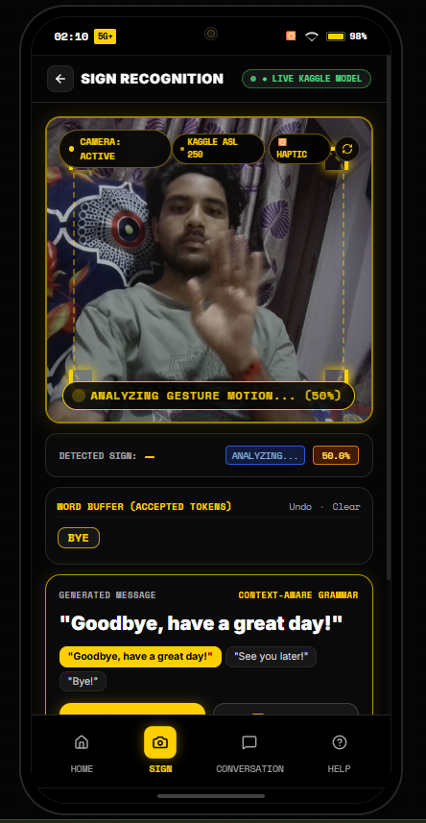
04 // LIVE PROTOTYPE REALITY
KAGGLE ASL 250 ML VISION FOUNDATION
Active live camera vision with MediaPipe landmark tracking and TFLite model running right now.
VISION EXTRACTION & INFERENCE PIPELINE
▶ 1. CAMERA INGEST
60 FPS mirror vision with custom high-contrast gold reticle.
▶ 2. MEDIAPIPE TRACKING
543 spatial coordinates (468 face mesh, 21 pose, 42 dual-hand points).
▶ 3. TFLITE SIGNATURE RUNNER
Rolling 45-frame buffer fed into 1D-CNN/Transformer encoder.
▶ 4. KAGGLE 250 VOCABULARY
Predicts authentic classes (e.g. SICK, OWIE, WATER, PLEASE, CALL ON PHONE).
▶ 5. LIVE CLOUD BRIDGE
Render FastAPI backend (https://signifyprototype.onrender.com) connected live.
SIGNIFY
[ LIVE VISION TRACKING ]
iQOO HACKATHON 2026

Slide 6
05 // TRUST & CLINICAL SAFETY
DUAL SAFETY GATING: 70% CONFIDENCE & TEMPORAL STABILITY
Medical and emergency contexts cannot tolerate random AI hallucinations or single-frame jitter.
DECISION FLOW: PREDICTION ──► [ GATE 1: ≥ 70.0% SOFTMAX? ] ──► [ GATE 2: 2-FRAME STABILITY? ] ──► ACCEPT
✓ ACCEPTED GESTURE (≥ 70.0% CONFIDENCE)
Strict Threshold + 2-Frame Temporal Lock
• Softmax Probability ≥ 70.0% required.
• Temporal Filter: Gesture must persist stably for at least 2 consecutive frames.
• Haptic Pulse: 1 crisp physical vibration pulse (45ms).
• Deduplication: Prevents stuttering spam (e.g. SICK SICK SICK).
• Result: Token safely appended to word buffer.
✕ REJECTED GESTURE (< 70.0% CONFIDENCE)
Safety-Gate Retry & Haptic Cue
• Suppresses ambiguous transitions (e.g. 52% blurred hand motions).
• Zero Hallucination: Never passes unverified words to the sentence engine.
• Silent Cue: 2 quick vibration pulses prompt user to re-sign.
• HUD Status: Flashes amber reticle: 'POSITION HAND IN FRAME'.
SIGNIFY
iQOO HACKATHON 2026

Slide 7
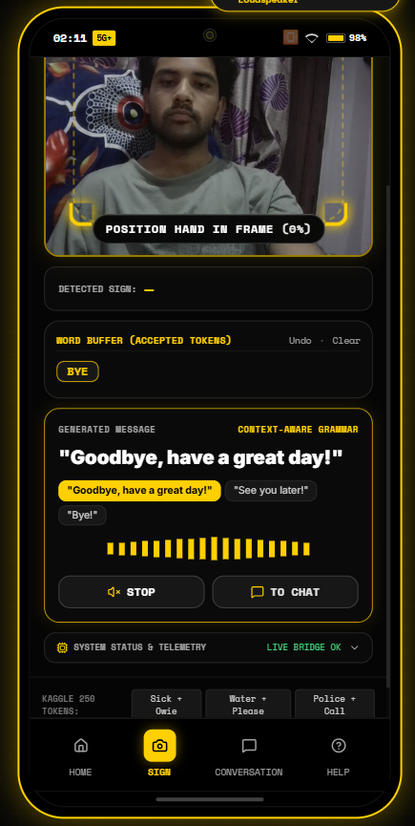
06 // MEANINGFUL SENTENCE SYNTHESIS
GROUNDED CONTEXT-AWARE SENTENCE BUILDER
Turning recognized gesture tokens into grammatically complete, natural English sentences.
DETERMINISTIC GRAMMAR SYNTHESIS
• [ WATER ] + [ PLEASE ] → "Please may I have some water?"
• [ SICK ] + [ OWIE ] → "I am sick and experiencing severe pain."
• [ POLICE ] + [ CALL ON PHONE ] → "Please call the police immediately."
• [ WHERE ] + [ BATH ] → "Excuse me, where is the nearest restroom?"
• [ BYE ] → "Goodbye, have a great day!" (Single-token synthesis)
▶ Latency: < 2ms | Hallucination: 0% | Resilience: 100% Offline
SIGNIFY
[ AUDIO BROADCAST & WAVEFORM ]
iQOO HACKATHON 2026

Slide 8
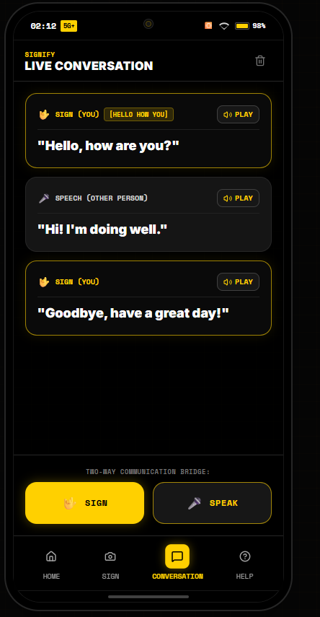
07 // LIVE TWO-WAY DIALOGUE
TWO-WAY LIVE CONVERSATION STREAM
A unified conversation stream bridging both participants with instant audio playback.
FULL TWO-WAY COMMUNICATION BRIDGE
▶ DISTINCT SPEAKER ROLES
Gold badge for SIGN (YOU) vs. Gray card for SPEECH (OTHER PERSON).
▶ SIGN TOKEN TRACEABILITY
Shows underlying Kaggle tokens (e.g. [HELLO HOW YOU], [BYE]).
▶ ONE-TOUCH AUDIO PLAYBACK
Play/Stop speech synthesis button on every chat bubble.
▶ QUICK ACTIONS
[ 🤟 SIGN ] camera modal & [ 🎤 SPEAK ] voice modal always available.
▶ CONVERSATION MEMORY
Maintains full transcript for medical triage or emergency review.
SIGNIFY
[ CONVERSATION MODE STREAM ]
iQOO HACKATHON 2026

Slide 9
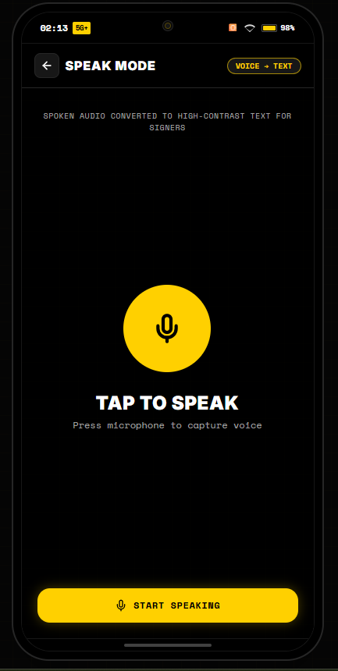
08 // REVERSE VOICE INGEST
VOICE-TO-TEXT: LISTENING TO THE HEARING PARTNER
Capturing speech in high-noise environments with real-time waveform feedback.
VOICE CAPTURE & TRANSCRIPTION FEATURES
▶ ONE-TAP VOICE CAPTURE
Large high-contrast microphone button designed for effortless hand-off.
▶ REAL-TIME WAVEFORM FEEDBACK
Visual pulsing waveform confirms active audio capture to the deaf user.
▶ DIRECTIONAL NOISE SUPPRESSION
Leverages iQOO dual-microphone array to isolate speech from ambient hospital noise.
▶ SINGLE-DISPATCH TRANSCRIPTION
Zero-duplicate dispatch engine prevents echo messages in the chat stream.
SIGNIFY
[ TAP TO SPEAK INTERFACE ]
iQOO HACKATHON 2026

Slide 10
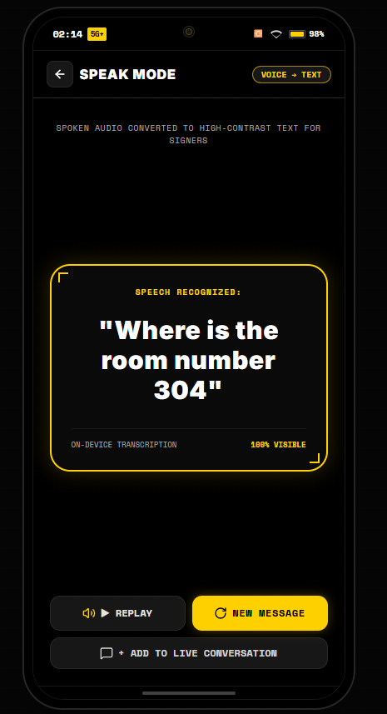
09 // HIGH-CONTRAST ACCESSIBILITY
ACCESSIBLE HIGH-CONTRAST READOUT FOR SIGNERS
Clear, legible visual output designed for readability across a hospital bed or desk.
DEAF-FIRST ERGONOMIC DESIGN
▶ 24pt HIGH-CONTRAST DISPLAY
Bold white text framed in glowing cyber-gold card on OLED black.
▶ 100% VISIBLE STATUS
Instant visual confirmation that the speech has been accurately converted.
▶ AUDIO REPLAY CONTROL
Replay button allows deaf user to verify what audio was transcribed.
▶ ONE-CLICK TO CONVERSATION
Instantly appends transcribed speech to the unified conversation bridge.
SIGNIFY
[ HIGH-CONTRAST SPEECH CARD ]
iQOO HACKATHON 2026

Slide 11
10 // HARDWARE ACCELERATION BENCHMARK
QUALCOMM SNAPDRAGON HEXAGON NPU ACCELERATION
Unlocking sub-18ms on-device inference using Qualcomm AI Engine Direct (QNN SDK).
HARDWARE PIPELINE: CAMERA (60 FPS) ──► MEDIAPIPE (543 KEYPOINTS) ──► TFLITE (INT8) ──► QUALCOMM QNN ──► HEXAGON DSP
Direct AHARDWAREBUFFER memory binding offloads matrix math directly to Hexagon NPU with zero CPU memory copies.
INFERENCE LATENCY
< 18 ms
vs. CPU: 145 ms
vs. Cloud: 280 ms
Real-time 60 FPS sub-frame speed.
POWER EFFICIENCY
0.42 W
vs. CPU: 3.8 W
No phone overheating.
All-day continuous operation.
BANDWIDTH COST
0 KB/s
vs. Cloud: 120 KB/s/frame
100% offline.
Works in elevators & flights.
DATA PRIVACY
100% LOCAL
Zero video leaves device.
Full HIPAA medical privacy compliance.
SIGNIFY
iQOO HACKATHON 2026

Slide 12
11 // ANDROID IMPLEMENTATION
HOW SIGNIFY RUNS ON AN IQOO ANDROID PHONE
Two clear pathways: Rapid APK packaging for hackathons and the native Jetpack CameraX production architecture.
PATH A: RAPID APK / PWA PACKAGING
Capacitor Mobile Wrapper & WebAPK
• Capacitor CLI: Wraps Vite/React build into native Android Studio project.
• Manifest Permissions: Camera, Record Audio, Vibrator.
• APK Build: Compiles standalone .apk installable on any Android device.
• Instant PWA: Judges opening our Vercel link on Android get an 'Install App' prompt for full-screen standalone execution.
PATH B: NATIVE ANDROID STACK (iQOO FLAGSHIP)
Deep Qualcomm QNN & Android OS Pipeline
• CameraX ImageAnalysis: 60 FPS zero-copy YUV stream from camera sensor.
• MediaPipe Tasks Vision SDK: Native Android HandLandmarker extraction.
• TFLite QNN Delegate: libQnnTfliteDelegate.so offloads tensor math to Hexagon NPU.
• VibratorService: Precise linear resonant haptic confirmation pulses.
• Android TTS: Low-latency on-device vocal synthesis.
SIGNIFY
iQOO HACKATHON 2026

Slide 13
12 // PRODUCTION TIMELINE
FROM PROTOTYPE TO SYSTEM-LEVEL ACCESSIBILITY SERVICE
A phased engineering roadmap to bring Signify to every iQOO user.
PHASE 1 [COMPLETED]
WEB PROTOTYPE & ML BACKEND
• Deployed on Vercel.
• FastAPI on Render cloud.
• 250 Kaggle classes mapped.
• 70% confidence gating.
• Sentence engine active.
PHASE 2 [NEXT 60 DAYS]
NATIVE ANDROID & NPU
• Capacitor APK packaging.
• CameraX integration.
• Qualcomm QNN delegate compilation for Hexagon NPU.
• < 0.45W power target.
PHASE 3 [6 MONTHS]
CONTINUOUS SIGNING
• Continuous sign language recognition (SLR).
• Multi-language support (ISL, BSL, ASL).
• Custom medical dictionary.
PHASE 4 [1 YEAR]
OriginOS SYSTEM SERVICE
• Triple-press power button trigger.
• Floating PiP bubble over video calls.
• vivo/iQOO Office Kit bridge for Zoom & Teams.
SIGNIFY
iQOO HACKATHON 2026

Slide 14
13 // CLOSING VISION
COMMUNICATION IS A HUMAN RIGHT
Signify proves that accessible on-device AI can bridge worlds without expensive hardware.
LET THE SILENCE BE HEARD.
Over 70 million people are waiting for technology to treat their language with dignity.
Signify combines Qualcomm Snapdragon NPU performance, 70% confidence safety gating, and phone-first ergonomics to deliver immediate, two-way conversational freedom.
▶ LIVE PROTOTYPE: Test deployed web application on Vercel.
▶ ML BACKEND: Live on Render (https://signifyprototype.onrender.com).
▶ CODE REPOSITORY: https://github.com/WHENKEY2007/signifyprototype
▶ HARDWARE TARGET: Qualcomm Snapdragon Hexagon NPU (iQOO 15 Flagship).
SIGNIFY
iQOO HACKATHON 2026

