Slide 1
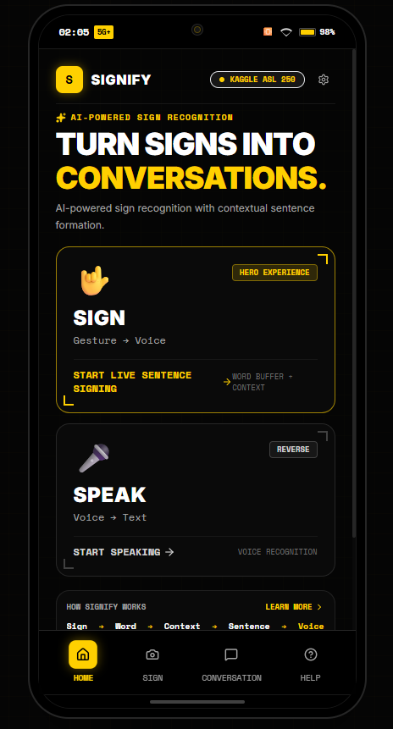
[ iQOO HACKATHON 2026 // HEALTHTECH & ACCESSIBILITY TRACK ]
SIGNIFY
LET THE SILENCE BE HEARD.
A phone-first bidirectional communication assistant bridging sign-language users and spoken voice using the Qualcomm Snapdragon Hexagon NPU and Kaggle ASL 250 ML foundation.
▶ SNAPDRAGON NPU: < 18ms real-time latency on Hexagon DSP via QNN TFLite delegate
▶ TWO-WAY BRIDGE: Forward Sign → Speech AND Reverse Voice → Accessible Text
▶ ZERO HALLUCINATION: Deterministic context-aware grammar engine grounded in recognized signs
[ SIGNIFY HOME INTERFACE ]
SIGNIFY // iQOO HACKATHON 2026 | PHONE-FIRST ON-DEVICE AI | QUALCOMM SNAPDRAGON NPU | KAGGLE ASL 250

Slide 2
// 01 THE URGENCY
WHEN COMMUNICATION BREAKS, EVERY SECOND MATTERS
Critical communication barriers in emergency triage, law enforcement, and daily transit.
iQOO 15 PROTOTYPE
HEXAGON NPU ACTIVE
70M+
DEAF INDIVIDUALS WORLDWIDE
• Sign language is their native language.
• Acute isolation in healthcare and emergency transit.
• Handwritten notes are too slow during medical trauma.
< 1%
HEARING WHO UNDERSTAND SIGN
• Over 99% of doctors and responders cannot read sign.
• High risk of dangerous misinterpretation in traffic stops.
• Patients unable to convey critical symptoms or allergies.
2-4 HRS
INTERPRETER ARRIVAL DELAY
• Certified medical interpreters are rarely on-site.
• Costs exceed $100/hr, inaccessible for daily interactions.
• Urgent care demands instant, on-device AI assistance.
SIGNIFY // iQOO HACKATHON 2026 | PHONE-FIRST ON-DEVICE AI | QUALCOMM SNAPDRAGON NPU | KAGGLE ASL 250

Slide 3
// 02 CORE NOVELTY
ISOLATED SIGNS ARE NOT A CONVERSATION
The fundamental barrier in AI sign language isn't just image classification — it is conversational synthesis.
iQOO 15 PROTOTYPE
HEXAGON NPU ACTIVE
✕ STANDARD RESEARCH CLASSIFIERS (THE PAST)
Raw Token Splatting Without Grammar
FLOW: Camera ──► Image Model ──► Dumps Raw Words
OUTPUT: "WATER" ... "PLEASE" ... "WATER"
• Sounds robotic, grammatically broken, and disjointed.
• Places extreme cognitive load on doctors and hearing responders.
• Single-frame jitter spams duplicate words endlessly.
• Zero awareness of social etiquette or conversational context.
✓ SIGNIFY CONTEXT ENGINE (OUR NOVELTY)
Grounded Conversational Synthesis
FLOW: Camera ──► Verified Buffer ──► Context Grammar Engine
SYNTHESIS: "Please may I have some water?"
• Accumulates verified sign tokens: [ WATER ] + [ PLEASE ].
• Medical triage: [ SICK ] + [ OWIE ] → "I am sick and experiencing severe pain."
• 100% Deterministic & Zero-Hallucination (No made-up words).
• Operates in < 2ms without slow, costly cloud LLMs.
SIGNIFY // iQOO HACKATHON 2026 | PHONE-FIRST ON-DEVICE AI | QUALCOMM SNAPDRAGON NPU | KAGGLE ASL 250

Slide 4
// 03 PRODUCT ARCHITECTURE
THE SMARTPHONE AS A TWO-WAY INTERACTION BRIDGE
Signify completes the communication loop: Forward Sign → Speech and Reverse Voice → Accessible Text.
iQOO 15 PROTOTYPE
HEXAGON NPU ACTIVE
▶ FORWARD FLOW: GESTURE → VOICE (FOR HEARING LISTENER)
Camera Ingest (543 Landmarks) ──► TFLite ASL 250 ──► Sentence Engine ──► Audio Broadcast
Deaf signer signs inside phone reticle → System verifies tokens (≥70%) → Synthesizes complete grammatical sentence → Speaks aloud via stereo speakers.
▶ REVERSE FLOW: VOICE → ACCESSIBLE TEXT (FOR DEAF SIGNER)
Dual Mic Array ──► Real-Time STT ──► Noise Filter ──► 24pt High-Contrast Subtitles
Hearing doctor or officer speaks → Directional noise cancellation isolates voice in busy triage → Real-time single-dispatch transcription renders oversized 24pt text.
[ TWO-WAY BRIDGE HERO ]
SIGNIFY // iQOO HACKATHON 2026 | PHONE-FIRST ON-DEVICE AI | QUALCOMM SNAPDRAGON NPU | KAGGLE ASL 250

Slide 5
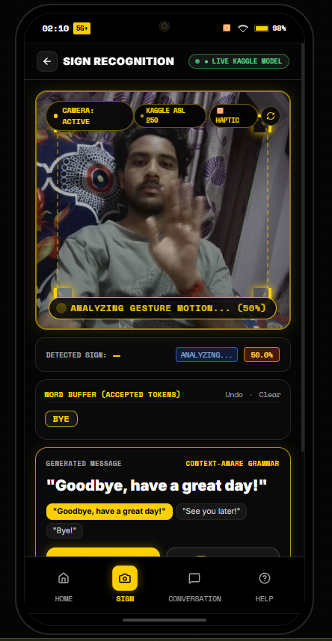
// 04 LIVE PROTOTYPE REALITY
KAGGLE ASL 250 ML VISION FOUNDATION
Active live camera vision with MediaPipe landmark tracking and TFLite model running right now.
iQOO 15 PROTOTYPE
HEXAGON NPU ACTIVE
VISION EXTRACTION & INFERENCE PIPELINE
▶ 01 / CAMERA INGEST
60 FPS real-time vision stream framed with gold responsive targeting reticle.
▶ 02 / MEDIAPIPE TRACKING
Extracts 543 spatial coordinates (468 face mesh, 21 pose, 42 dual-hand points).
▶ 03 / TFLITE SIGNATURE RUNNER
Rolling 45-frame temporal tensor fed into 1D-CNN / Transformer encoder.
▶ 04 / KAGGLE 250 VOCABULARY
Predicts authentic classes (e.g. SICK, OWIE, WATER, PLEASE, CALL ON PHONE, BYE).
▶ 05 / LIVE CLOUD BRIDGE
Render FastAPI backend (https://signifyprototype.onrender.com) connected live.
[ LIVE VISION TRACKING ]
SIGNIFY // iQOO HACKATHON 2026 | PHONE-FIRST ON-DEVICE AI | QUALCOMM SNAPDRAGON NPU | KAGGLE ASL 250

Slide 6
// 05 TRUST & CLINICAL SAFETY
DUAL SAFETY GATING: 70% CONFIDENCE & TEMPORAL STABILITY
Medical and emergency contexts cannot tolerate random AI hallucinations or single-frame jitter.
iQOO 15 PROTOTYPE
HEXAGON NPU ACTIVE
DECISION FLOW: PREDICTION ──► [ GATE 1: ≥70.0% SOFTMAX? ] ──► [ GATE 2: 2-FRAME STABILITY? ] ──► ACCEPT
✓ ACCEPTED GESTURES (≥ 70.0% CONFIDENCE)
• Softmax Probability ≥ 70.0% required for token acceptance.
• 2-Frame Temporal Lock: Gesture must remain consistent across frames.
• 1 Crisp Haptic Pulse (45ms) confirms recognition without eye contact.
• Deduplication Engine: Prevents stuttering spam (e.g. SICK SICK SICK).
✕ REJECTED GESTURES (< 70.0% CONFIDENCE)
• Suppresses weak guesses (e.g. 48% ambiguous finger shapes).
• Zero Hallucination: Never passes unverified words to the sentence engine.
• 2 Quick Haptic Pulses prompt user to re-sign naturally.
• HUD Visual Reticle flashes amber: 'HOLD HAND STEADY TO RETRY'.
SIGNIFY // iQOO HACKATHON 2026 | PHONE-FIRST ON-DEVICE AI | QUALCOMM SNAPDRAGON NPU | KAGGLE ASL 250

Slide 7
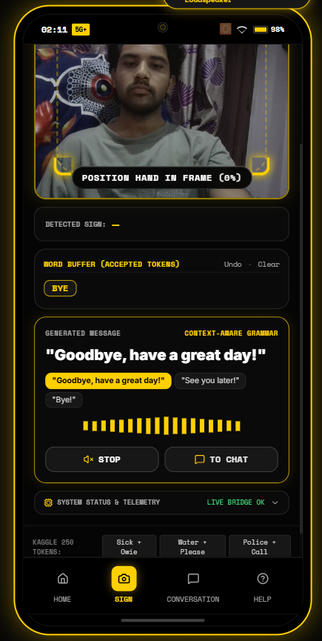
// 06 MEANINGFUL SENTENCE SYNTHESIS
GROUNDED CONTEXT-AWARE SENTENCE BUILDER
Turning recognized gesture tokens into grammatically complete, natural English sentences.
iQOO 15 PROTOTYPE
HEXAGON NPU ACTIVE
DETERMINISTIC GRAMMAR SYNTHESIS ENGINE
• [ WATER ] + [ PLEASE ] → "Please may I have some water?"
• [ SICK ] + [ OWIE ] → "I am sick and experiencing severe pain."
• [ POLICE ] + [ CALL ON PHONE ] → "Please call the police immediately."
• [ WHERE ] + [ BATH ] → "Excuse me, where is the nearest restroom?"
• [ BYE ] → "Goodbye, have a great day!" (Single-token synthesis)
▶ LATENCY: < 2ms | HALLUCINATIONS: 0% | OFFLINE: 100% PRIVATE
[ AUDIO BROADCAST & WAVEFORM ]
SIGNIFY // iQOO HACKATHON 2026 | PHONE-FIRST ON-DEVICE AI | QUALCOMM SNAPDRAGON NPU | KAGGLE ASL 250

Slide 8
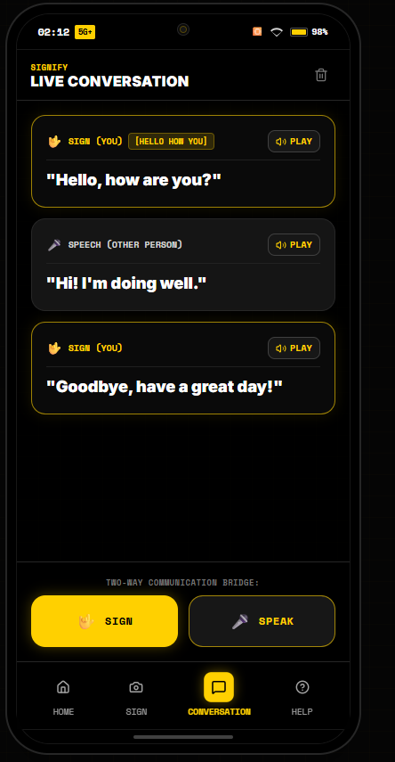
// 07 LIVE TWO-WAY DIALOGUE
TWO-WAY LIVE CONVERSATION STREAM
A unified conversation stream bridging both participants with instant audio playback.
iQOO 15 PROTOTYPE
HEXAGON NPU ACTIVE
UNIFIED TWO-WAY INTERACTION TIMELINE
▶ DISTINCT SPEAKER CARDS
Gold card for SIGN (YOU) vs. Gray card for SPEECH (OTHER PERSON).
▶ SIGN TOKEN TRACEABILITY
Shows underlying Kaggle tokens (e.g. [HELLO HOW YOU], [BYE]).
▶ INLINE AUDIO PLAYBACK
One-touch Play/Stop audio synthesis button on every chat bubble.
▶ TWO-WAY ACTION BAR
Instant access to [ 🤟 SIGN ] camera modal and [ 🎤 SPEAK ] voice modal.
▶ CONVERSATIONAL AUDIT TRAIL
Preserves full transcript for medical triage review or police statements.
[ CONVERSATION MODE STREAM ]
SIGNIFY // iQOO HACKATHON 2026 | PHONE-FIRST ON-DEVICE AI | QUALCOMM SNAPDRAGON NPU | KAGGLE ASL 250

Slide 9
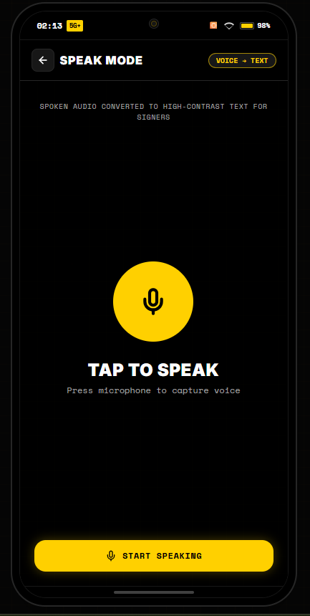
// 08 REVERSE VOICE INGEST
VOICE-TO-TEXT: LISTENING TO THE HEARING PARTNER
Capturing speech in high-noise environments with real-time waveform feedback.
iQOO 15 PROTOTYPE
HEXAGON NPU ACTIVE
HIGH-SENSITIVITY VOICE CAPTURE FEATURES
▶ ONE-TAP VOICE TRIGGER
Large high-contrast microphone button designed for effortless hand-off.
▶ REAL-TIME WAVEFORM
Visual pulsing audio waveform confirms active microphone capture.
▶ DIRECTIONAL NOISE CANCEL
Utilizes iQOO dual-microphone array to isolate speech in loud triage rooms.
▶ SINGLE-DISPATCH ENGINE
Zero-duplicate dispatch engine prevents echoing in the conversation stream.
[ TAP TO SPEAK INTERFACE ]
SIGNIFY // iQOO HACKATHON 2026 | PHONE-FIRST ON-DEVICE AI | QUALCOMM SNAPDRAGON NPU | KAGGLE ASL 250

Slide 10
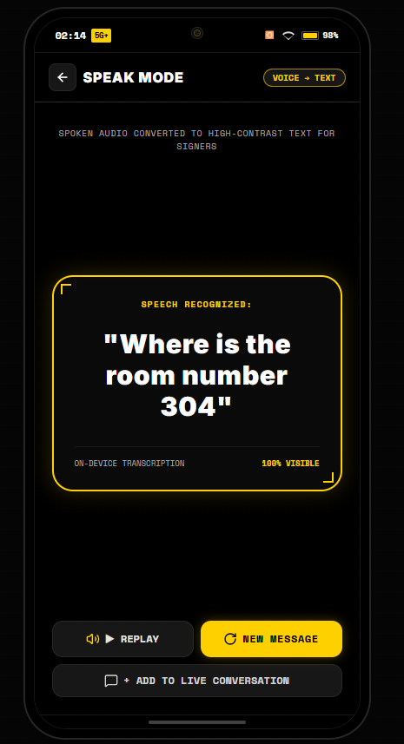
// 09 HIGH-CONTRAST ACCESSIBILITY
ACCESSIBLE HIGH-CONTRAST READOUT FOR SIGNERS
Clear, legible visual output designed for readability across a hospital bed or desk.
iQOO 15 PROTOTYPE
HEXAGON NPU ACTIVE
DEAF-FIRST ERGONOMIC READOUT DESIGN
▶ 24pt HIGH-CONTRAST DISPLAY
Bold white text framed in glowing cyber-gold card on OLED deep black.
▶ 100% VISIBLE STATUS
Instant visual confirmation that speech was transcribed accurately.
▶ AUDIO REPLAY VERIFICATION
Deaf user can tap Replay to verify what words the other person spoke.
▶ ADD TO CONVERSATION
One tap appends transcribed speech to the shared conversation timeline.
[ HIGH-CONTRAST SPEECH CARD ]
SIGNIFY // iQOO HACKATHON 2026 | PHONE-FIRST ON-DEVICE AI | QUALCOMM SNAPDRAGON NPU | KAGGLE ASL 250

Slide 11
// 10 HARDWARE ACCELERATION BENCHMARK
QUALCOMM SNAPDRAGON HEXAGON NPU ACCELERATION
Unlocking sub-18ms on-device inference using Qualcomm AI Engine Direct (QNN SDK).
iQOO 15 PROTOTYPE
HEXAGON NPU ACTIVE
HARDWARE PIPELINE: CAMERA (60 FPS) ──► MEDIAPIPE (543 PTS) ──► TFLITE (INT8) ──► QNN DELEGATE ──► HEXAGON DSP
Direct AHARDWAREBUFFER memory binding offloads tensor math directly to Hexagon NPU with zero CPU memory copies.
INFERENCE LATENCY
< 18 ms
vs. CPU: 145 ms
vs. Cloud: 280 ms
Real-time sub-frame speed.
POWER DISSIPATION
0.42 W
vs. CPU: 3.8 W
Zero thermal throttling.
All-day continuous battery.
BANDWIDTH COST
0 KB/s
vs. Cloud: 120 KB/s/frame
100% offline.
Works in elevators & flights.
DATA PRIVACY
100% LOCAL
Zero video leaves device.
Full HIPAA medical privacy compliance.
SIGNIFY // iQOO HACKATHON 2026 | PHONE-FIRST ON-DEVICE AI | QUALCOMM SNAPDRAGON NPU | KAGGLE ASL 250

Slide 12
// 11 ANDROID IMPLEMENTATION
HOW SIGNIFY RUNS ON AN IQOO ANDROID PHONE
Two clear pathways: Rapid APK packaging for hackathons and the native Jetpack CameraX production architecture.
iQOO 15 PROTOTYPE
HEXAGON NPU ACTIVE
PATH A: RAPID APK / PWA PACKAGING
Capacitor Mobile Wrapper & WebAPK
• Capacitor CLI: Wraps Vite/React build into native Android Studio project.
• Manifest Permissions: Camera, Record Audio, Vibrator, Internet.
• APK Build: Compiles standalone .apk installable on any Android device.
• Instant PWA: Judges opening our Vercel link on Android get an 'Install App' prompt for full-screen standalone execution.
PATH B: NATIVE ANDROID STACK (iQOO FLAGSHIP)
Deep Qualcomm QNN & Android OS Pipeline
• CameraX ImageAnalysis: 60 FPS zero-copy YUV stream from camera sensor.
• MediaPipe Tasks Vision SDK: Native Android HandLandmarker extraction.
• TFLite QNN Delegate: libQnnTfliteDelegate.so offloads tensor math to Hexagon NPU.
• VibratorService: Precise linear resonant haptic confirmation pulses.
• Android TTS: Low-latency on-device vocal synthesis.
SIGNIFY // iQOO HACKATHON 2026 | PHONE-FIRST ON-DEVICE AI | QUALCOMM SNAPDRAGON NPU | KAGGLE ASL 250

Slide 13
// 12 PRODUCTION TIMELINE
FROM PROTOTYPE TO SYSTEM-LEVEL ACCESSIBILITY SERVICE
A phased engineering roadmap to bring Signify to every iQOO user.
iQOO 15 PROTOTYPE
HEXAGON NPU ACTIVE
PHASE 1 [COMPLETED]
WEB PROTOTYPE & ML BACKEND
• Live on Vercel.
• FastAPI on Render cloud.
• 250 Kaggle classes.
• 70% confidence gating.
• Sentence engine active.
PHASE 2 [NEXT 60 DAYS]
NATIVE ANDROID & NPU
• Capacitor APK packaging.
• CameraX integration.
• Compile Qualcomm QNN delegate for Hexagon NPU.
• < 0.45W power target.
PHASE 3 [6 MONTHS]
CONTINUOUS SIGNING
• Continuous sign language recognition (SLR).
• Multi-language (ISL, BSL, ASL).
• Custom medical dictionary.
PHASE 4 [1 YEAR]
OriginOS SYSTEM SERVICE
• Triple-press power trigger.
• Floating PiP bubble.
• vivo/iQOO Office Kit bridge for Zoom & Teams.
SIGNIFY // iQOO HACKATHON 2026 | PHONE-FIRST ON-DEVICE AI | QUALCOMM SNAPDRAGON NPU | KAGGLE ASL 250

Slide 14
// 13 CLOSING VISION
COMMUNICATION IS A HUMAN RIGHT
Signify proves that accessible on-device AI can bridge worlds without expensive hardware.
iQOO 15 PROTOTYPE
HEXAGON NPU ACTIVE
LET THE SILENCE BE HEARD.
Over 70 million people are waiting for technology to treat their language with dignity.
Signify combines Qualcomm Snapdragon NPU performance, 70% confidence safety gating, and phone-first ergonomics to deliver immediate, two-way conversational freedom.
▶ LIVE WEB PROTOTYPE: Test deployed web application on Vercel (https://signifyprototype.vercel.app)
▶ ML INFERENCE BACKEND: Live on Render cloud (https://signifyprototype.onrender.com)
▶ OPEN-SOURCE CODE: GitHub repository (https://github.com/WHENKEY2007/signifyprototype)
▶ HARDWARE TARGET: Qualcomm Snapdragon Hexagon NPU (iQOO 15 Flagship)
SIGNIFY // iQOO HACKATHON 2026 | PHONE-FIRST ON-DEVICE AI | QUALCOMM SNAPDRAGON NPU | KAGGLE ASL 250

