Slide 1
Hospital Learning Game for Disaster Simulation
MCARE
Architecture and RoadMap
September 3rd, 2021 Rob Rowe <rrowe@who.int>

Slide 2
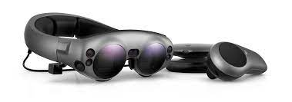


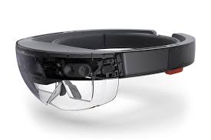
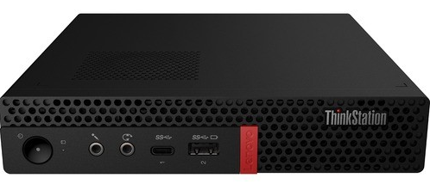
MCARE Architecture
Magic Leap ML1
LXP Credentials Server
Hololens HL2
On-prem MCARE Game Server
(Can Be Any PC, Installs on Laptop)
International MCARE Guide Server

Slide 3
MCARE Roadmap
1. Hire Core Game Makers Team
Game Client Programmer: Miguel, Hired in March
Game Producer: Rob, Hired in June
Sound Producer: Will, Hiring Sept 27th
Game Server Programmer: TBD, Future Hire Artist-Programmer to Be Trained, Meanwhile Rob Covering
Graphics Artist: TBD, Lost Emmy-winning Candidate in June, Future Hire Artist-Programmer, Meanwhile Miguel and Rob Covering
2. Card Game Mock-up [Preliminary Work Done by Kat before Canceled by Nelson]
3. Game Client [Developing Miguel’s PoC Code into Game Product, Ongoing]
4. Game Trailer [Rob Crash Cut 1-minute Video, Will on Sound, Ongoing]
5. Game Server [Rob Started Coding, Ongoing]

Slide 4
MCARE Collaborations
1. Quality & Standards – ISO 21001 Draft Doc Under Evaluation by Q&S
2. LXP Integration – Paused, Project Reorganization Underway under CTO
3. Comms – Rob Is Producing Game Trailer
4. Translations – Standing by to Do French Translation (Can Do in 24 Hours)
5. Birmingham NHS – SME JJ Documenting MoLA Algorithm
5. WHO Ship Sanitation VR Group – May Reuse Assets from ARG
6. Open3D Foundation (Amazon) – Waiting for WHOA Approval
7. Facebook – Rob Submitted Draft SOW, Making Revisions Requested
8. MPA ASWF (Disney) – Waiting for MCARE Public Website (Rob)

Slide 5
MCARE Deadlines
September 24th, 2021, Birmingham, UK, live exercise with NHS Doctors [Has NHS Received Headsets from Microsoft, Supply Chain Shortage?]
September 27th, 2021, Lyon, France, VIP Cornerstone Presentation [Headsets Will Not Available in Time from WHOA Procurement]
October 11th, 2021, Athens, Greece, Live Exercise
October 12th to 14th, 2021, Lyon, Trainer of Trainers Event
November 11th, 2021, Paris Peace Forum Presentation
March 10th, 2022, Detroit Peace Conference Presentation

Slide 6
Thank You
Rob Rowe <rrowe@who.int>

