Slide 1

Building Shiny Apps

Slide 2
This presentation has a hand-on element
Follow along on the github markdown document:
https://github.com/WHOIGit/Rshinypresentation/blob/master/worksheet.md
<number>

Slide 3
What is Shiny?
R package from RStudio
Web application framework for R
R code → interactive web page
No HTML/CSS/JavaScript knowledge required
Great for sharing R analysis with someone with no R experience
<number>

Slide 4
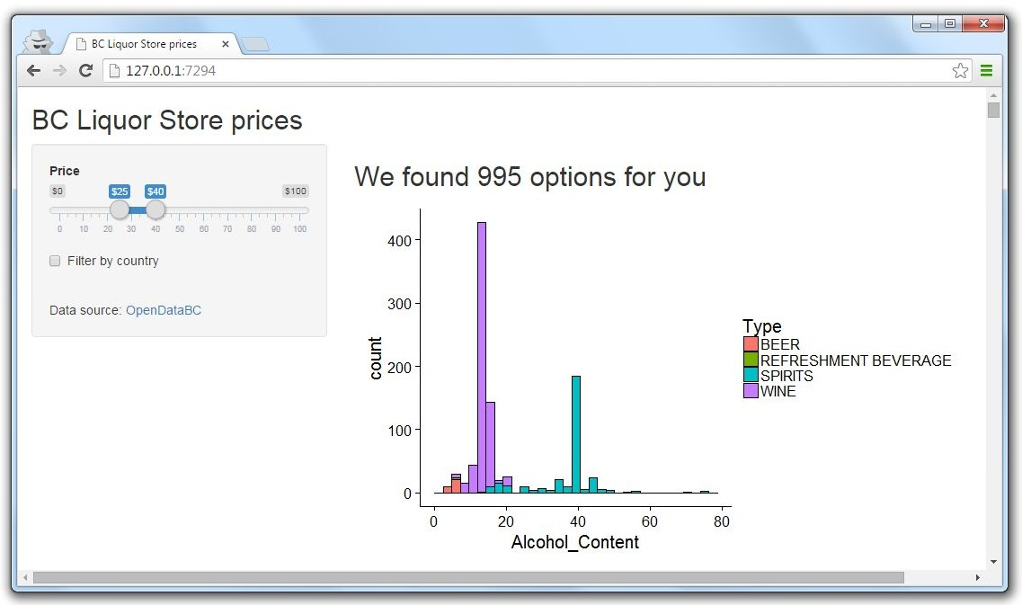

What is a Shiny app?
Computer running R
Web page
<number>

Slide 5


What is a Shiny app?
Server code
User interface (UI)
6

Slide 6
Shiny app template
library(shiny)
ui <- fluidPage()
server <- function(input, output) {} shinyApp(ui = ui, server = server)
<number>

Slide 7
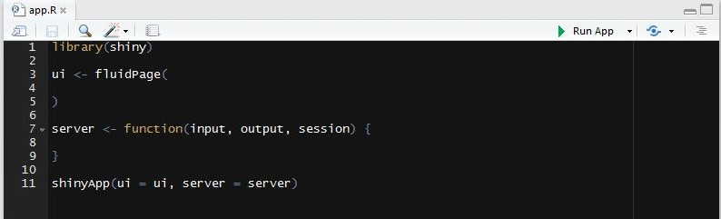
Run Shiny app in RStudio, method 1
Save file as “app.R” → “Run” button turns to “Run App”
Good for creating Shiny apps quickly, all code in one file
<number>

Slide 8
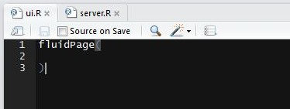
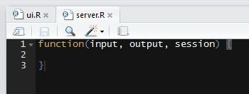
Run Shiny app in RStudio, method 2
Save UI as “ui.R” and server as “server.R” in same directory
Good for complex Shiny apps, separates view vs logic
9

Slide 9
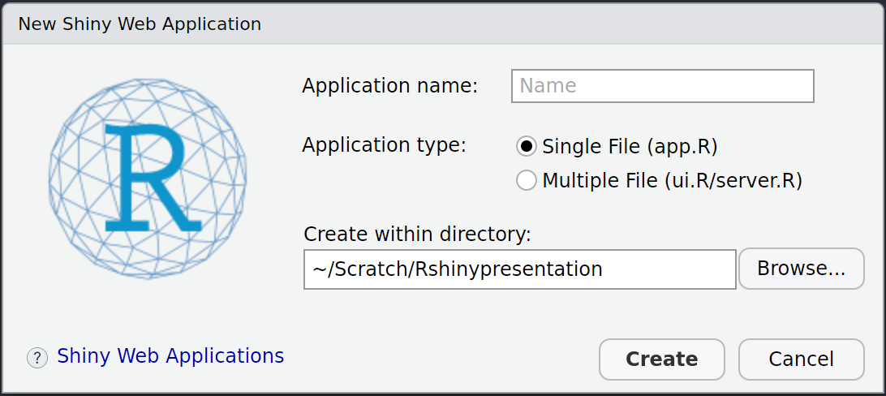
Run Shiny app in RStudio, method 3
File > New File > Shiny Web App...
Generates the template for you
<number>

Slide 10
Work through the tutorial until the end of Section 4
<number>

Slide 11
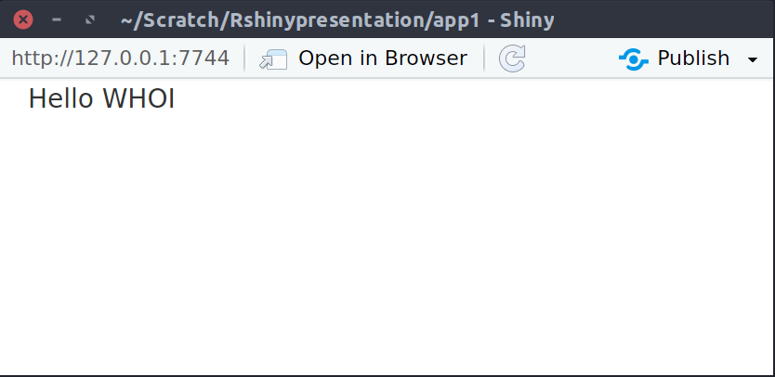
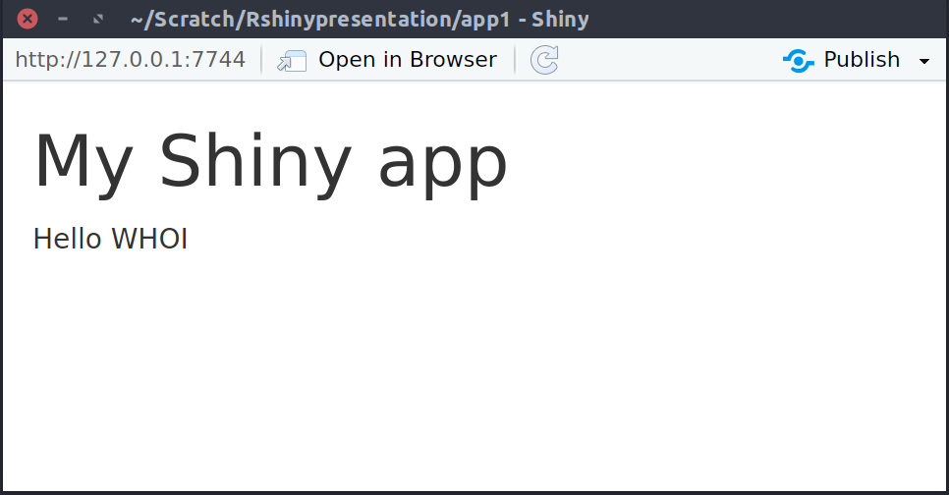
Add elements to app inside fluidPage()
library(shiny)
ui <- fluidPage( "Hello WHOI") server <- function(input, output) {} shinyApp(ui = ui, server = server)
fluidPage(
ui
h1("My Shiny app"), "Hello WHOI"
)
<number>

Slide 12
Add HTML to fluidPage()
Remember the UI simply creates HTML
Can use any HTML tags http://shiny.rstudio.com/articles/tag-glossary.html
h1() = header1, br() = line break, strong() = bold text
Any HTML tag can be accessed using `tags` object
h1 = tags$h1(), br = tags$br()
Common tags can be accessed without `tags`
<number>

Slide 13
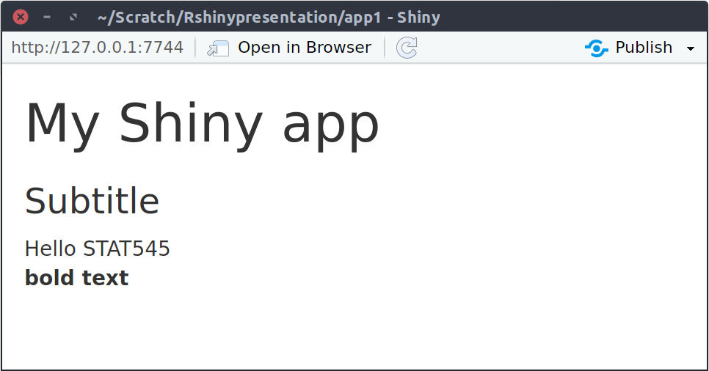
Add HTML to fluidPage()
fluidPage(
ui
h1("My Shiny app" ), h3("Subtitle" ), "Hello",
"STAT545",
br(),
strong("bold text" )
)
<number>

Slide 14
Use a layout
By default, all elements stack up one after the other
Can use different layouts http://shiny.rstudio.com/articles/layout-guide.html
We’ll use sidebarLayout()
<number>

Slide 15
Use a layout - sidebarLayout()
fluidPage(
ui
titlePanel("My Shiny app"),
sidebarLayout( sidebarPanel(
"This is a side panel"
),
mainPanel(
"And this is the main stuff"
)
)
)
<number>

Slide 16
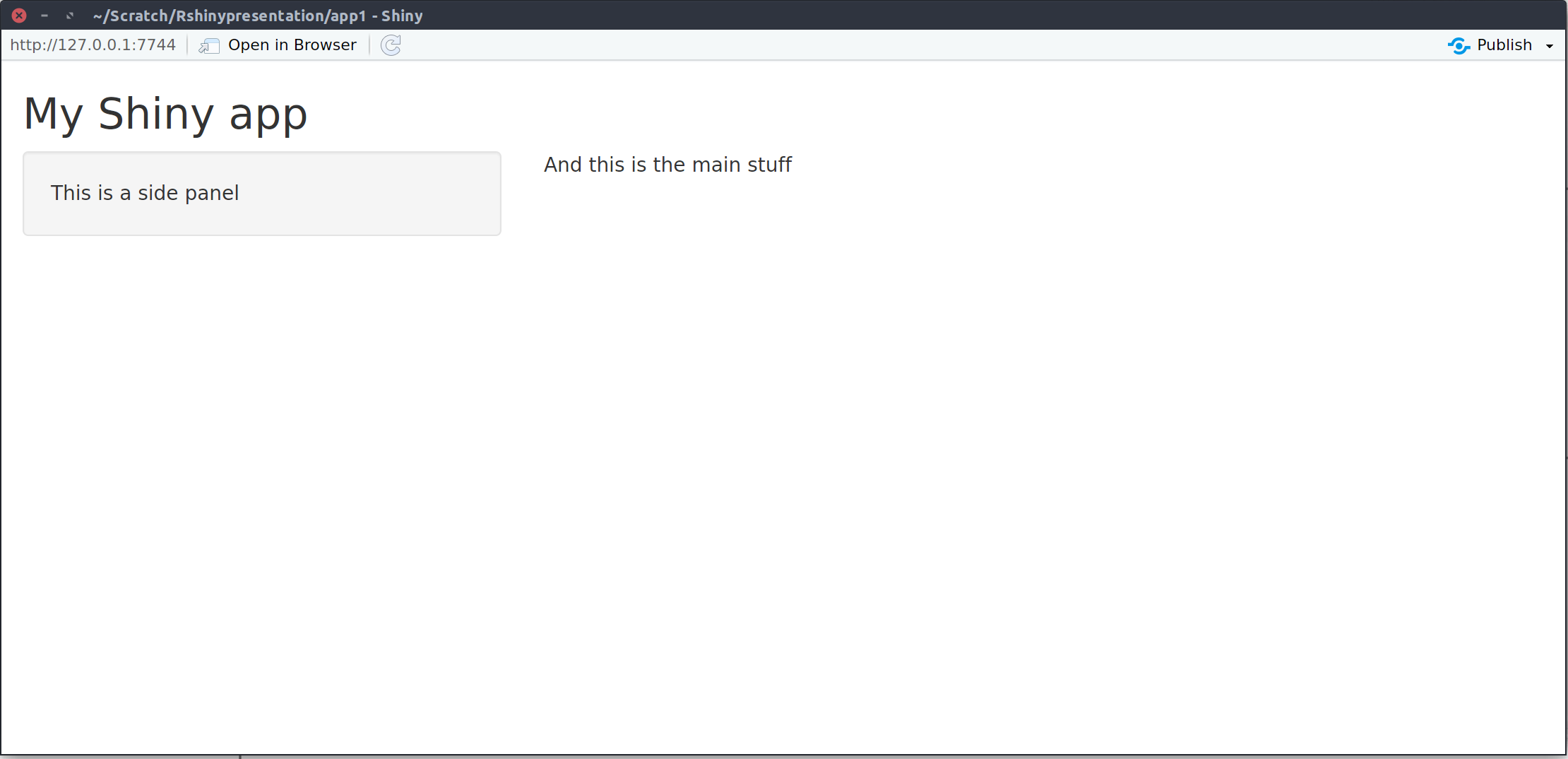
Use a layout - sidebarLayout()
titlePanel()
mainPanel()
sidebarPanel()
<number>

Slide 17
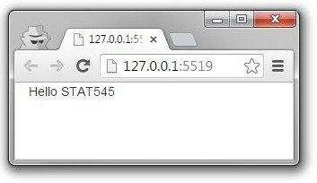
Summary
library(shiny) ui <- fluidPage()
server <- function(input, output) {} shinyApp(ui = ui, server = server)
3) Begin app with template
5 ) Add elements as arguments to
fluidPage()
<number>

Slide 18
Work through the tutorial until the end of Section 5
<number>

Slide 19
Inputs and outputs
For interactivity, app needs inputs and outputs
ui
fluidPage(
# *Input() functions, # *Output() functions
)
●
Inputs
- things user can
toggle
●
Output
- R objects user
can see, often depend on inputs
<number>

Slide 20
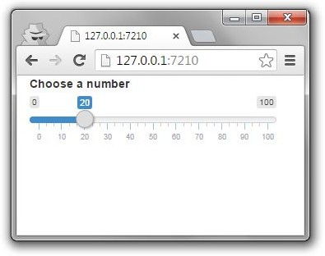
Inputs
library(shiny)
ui <- fluidPage(
sliderInput(
"num", "Choose a number", min = 0, max = 100,
value = 20)
)
server <- function(input, output) {} shinyApp(ui = ui, server = server)
<number>

Slide 21
Inputs
sliderInput("num", "Choose a number",
min = 0, max = 100, value = 20)
<div class="form-group shiny-input-container">
<label class="control-label" for="num">Choose a number</label>
<input class="js-range-slider" id="num" data-min="0"
data-max="100" data-from="20" data-step="1" data-grid="true" data-grid-num="10" data-grid-snap="false"
data-prettify-separator="," data-keyboard="true"
data-keyboard-step="1" data-drag-interval="true" data-data-type="number"/>
</div>
<number>

Slide 22
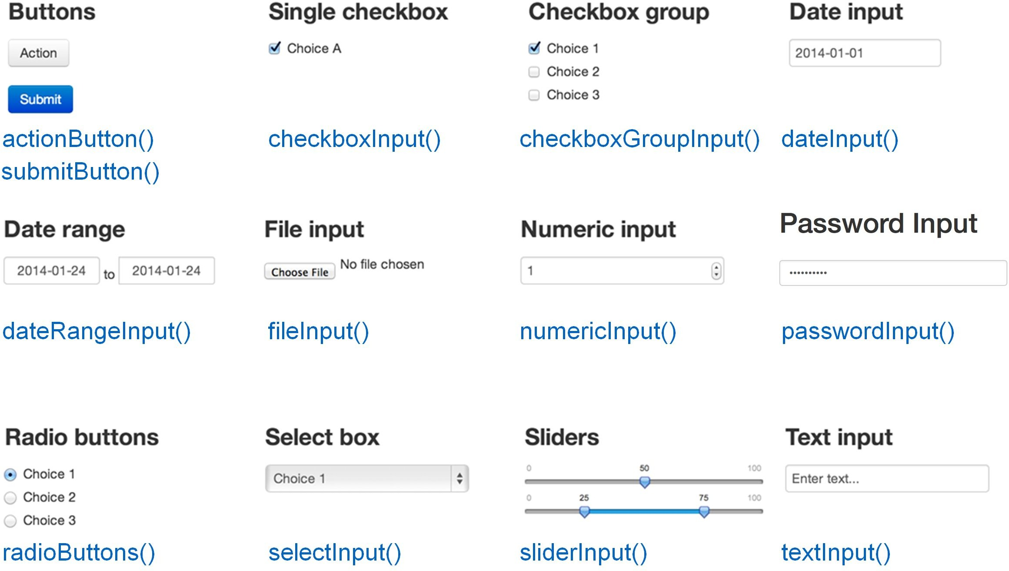
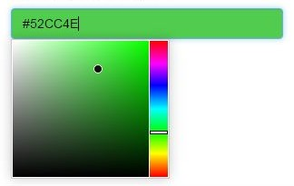
Inputs
Colour input
shinyjs::colourInput()
<number>

Slide 23
Inputs
Input-specific arguments
Input name
Label to display
sliderInput("num", "Choose a number", min = 0, max = 100, value = 20)
*Input( inputId, label, ... )
What arguments can I pass to an input function?
?sliderInput
<number>

Slide 24
Work through the tutorial until the end of Section 6
<number>

Slide 25
Outputs
Plots, tables, text - anything that R creates and users see
Initialize as empty placeholder space until object is created
Function | Outputs
plotOutput() | plot
tableOutput() | table
uiOutput() | Shiny UI element
textOutput() | text
<number>

Slide 26
Outputs
Output-specific arguments
Output name
plotOutput("myplot", width = "300px")
*Output( outputId, ... )
What arguments can I pass to an output function?
?plotOutput
<number>

Slide 27
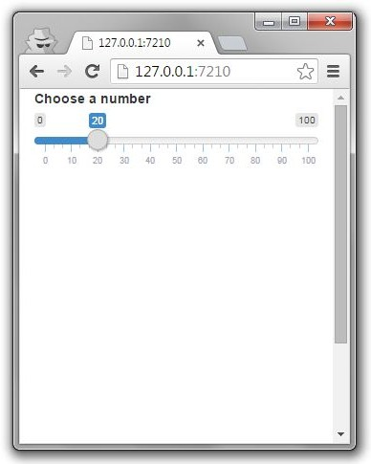
Outputs
library(shiny)
ui <- fluidPage(
sliderInput("num", "Choose a number",
0, 100, 20),
plotOutput("myplot")
)
server <- function(input, output) {} shinyApp(ui = ui, server = server)
*Output() adds space for UI object
You need to build the object in server
<number>

Slide 28
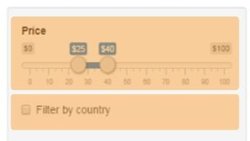
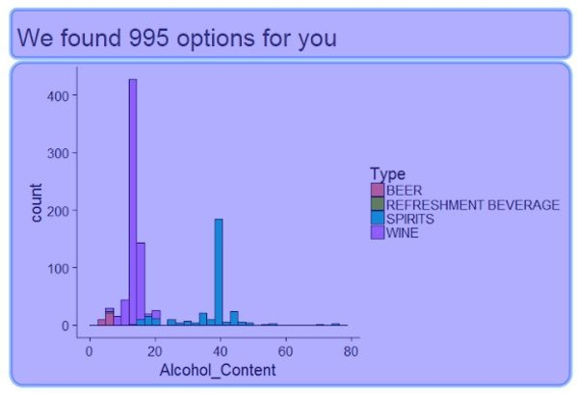

Summary
library(shiny) ui <- fluidPage()
server <- function(input, output) {} shinyApp(ui = ui, server = server)
3) Begin app with template
5 ) Add elements as arguments to
fluidPage()
6)Create inputs with *Input() functions
7)Create outputs with *Output() functions
8)Use server to assemble inputs into outputs
<number>

Slide 29
Work through the tutorial until the end of Section 8
<number>

Slide 30
Most common “why isn’t my app running?!” problems
Remember to:
comma-separate all the elements!
not add comma to the last element!
Count your brackets and parentheses!
<number>

Slide 31
Server: assemble input into outputs with 3 rules
server <- function(input, output) {
output$myplot <- renderPlot({ plot(rnorm(input$num))
})
}
<number>

Slide 32
Building outputs 1 - Save objects into output$
server <- function(input, output) {
output$myplot <- renderPlot({ plot(rnorm(input$num))
})
# in UI: plotOutput("myplot")
}
<number>

Slide 33
Building outputs 2 - Build objects with render*
server <- function(input, output) {
output$myplot <- renderPlot({ plot(rnorm(input$num))
})
}
<number>

Slide 34
*Output() → render*()
Output function | Render function
plotOutput() | renderPlot({})
tableOutput() | renderTable({})
uiOutput() | renderUI({})
textOutput() | renderText({})
<number>

Slide 35
render*() functions build reactive output to display in UI
renderPlot({ plot(rnorm(100)) })
Type of object to build
Code to build the object
<number>

Slide 36
Building outputs 3 - Access input values with input$
server <- function(input, output) { output$myplot <- renderPlot({
plot(rnorm(input$num))
# in UI:sliderInput("num", ...)
})
}
<number>

Slide 37
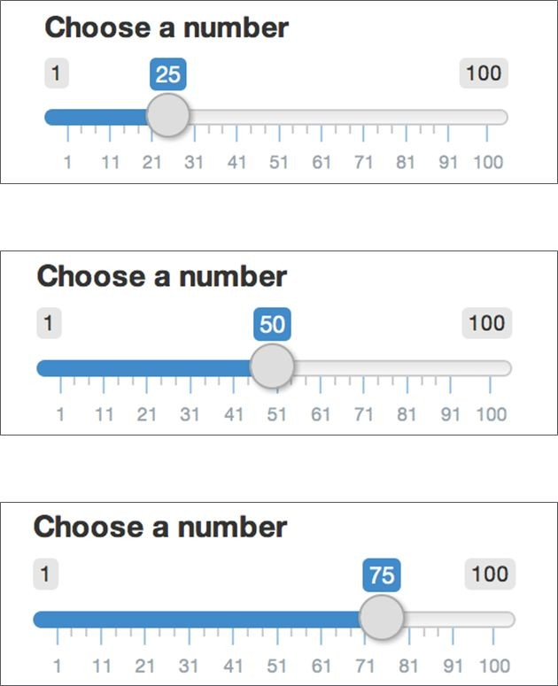
Using input$
input$num returns 25
input$num returns 50
input$num returns 75
<number>

Slide 38
Work through the tutorial until the end of Section 9
<number>

Slide 39
Reactivity
Shiny uses reactive programming
Supports reactive variables
When value of variable x changes, anything that relies on x is re-evaluated
Contrast with regular R:
x <- 5
y <- x + 1 x <- 10
# y is still 6
<number>

Slide 40
Reactivity
input$num is a reactive value
output$myplot <- renderPlot({ plot(rnorm(input$num))
})
output$myplot depends on input$num
input$num changes → output$myplot reacts
All inputs are automatically reactive, so if you use any input inside a render* function, the output will re-render any time input changes
<number>

Slide 41
Reactive contexts
You can define your own reactive variables
Reactive values can only be used inside reactive contexts
Any render* function is a reactive context
Use reactive({...}) to assign a reactive variable
Use observe({...}) to access a reactive variable
Remember: reactive variable means anything that depends
on it gets re-executed automatically
<number>

Slide 42
Reactive contexts
Assign variable |  |  |  | Access variable
server <- function(input, output) | { |  |  | server <- function(input, output) | {
x <- input$num + 1 |  |  |  | print(input$num)
} |  |  |  | }
# error |  |  |  | # error
server <- function(input, output) | { |  |  | server <- function(input, output) | {
x <- reactive({ |  |  |  | observe({
input$num + 1 |  |  |  | print(input$num)
}) |  |  |  | })
} |  |  |  | }
# OK |  |  |  | # OK
<number>

Slide 43
Simple Shiny app using basic reactivity
Single file Two files
library(shiny)
app.R
library(shiny)
ui.R
ui <- fluidPage(
sliderInput("num", "Choose a number", 0, 100, 20),
plotOutput("myplot")
)
server <- function(input, output) { output$myplot <- renderPlot({
plot(seq(input$num))
})
x <- reactive({ input$num + 1
})
observe({ print(x())
})
}
shinyApp(ui = ui, server = server)
fluidPage(
sliderInput("num", "Choose a number", 0, 100, 20),
plotOutput("myplot")
)
library(shiny)
server.R
function(input, output) { output$myplot <- renderPlot({
plot(seq(input$num))
})
x <- reactive({ input$num + 1
})
observe({ print(x())
})
}
44

Slide 44
Work through the tutorial until the end of Section 10
<number>

Slide 45
Using buttons in the UI
Different from other inputs: you usually don’t care about the "value" of the button, you care when it’s clicked
ui <- fluidPage( actionButton("btn", "Click me")
)
server <- function(input, output, session) { observe({
cat(input$btn)
})
}
shinyApp(ui = ui, server = server)
<number>

Slide 46
Work through the tutorial until the end of Section 12
<number>

Slide 47
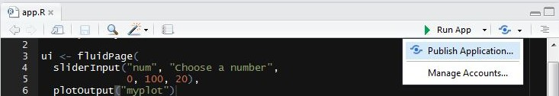
Share your app: shinyapps.io
Go to http://www.shinyapps.io/ and make an account
Make sure all your app files are in an isolated folder
Click “Publish Application” in RStudio
You might be asked to install a couple packages
Follow instructions from RStudio
<number>

Slide 48
Work through the tutorial until the end of Section 13
<number>

Slide 49
PS. Shiny in Rmarkdown
Set output: html_document
Set runtime: shiny
You can now use interactive inputs/outputs in Rmarkdown!
---
output: html_document runtime: shiny
---
```{r echo=FALSE}
sliderInput("num", "Choose a number",
0, 100, 20)
renderPlot({
plot(seq(input$num))
})
```
50

Slide 50
PPS. More things to check out
?conditionalPanel - conditionally show UI elements
global.R - objects here are available to both ui.R and server.R
Use navbarPage() or tabsetPanel() for multiple tabs in UI
Use DT::dataTableOutput() instead of tableOutput() for an interactive table instead of ugly static table
Add images by placing image under “www/image.png” and using UI function img(src = "image.png")
Use update*Input() functions to update input values from R
Know JavaScript/CSS? Use includeScript() or includeCSS()
<number>

Slide 51
Recommended add-on packages to Shiny
leaflet (http://rstudio.github.io/leaflet/)
Add interactive maps to your apps
shinyjs (https://github.com/daattali/shinyjs)
Enhance user experience in Shiny apps
shinythemes (http://rstudio.github.io/shinythemes/)
Easily alter the appearance of your app
ggvis (http://ggvis.rstudio.com/)
Similar to ggplot2 but plots are web-based and more interactive
shinydashboard (https://rstudio.github.io/shinydashboard/)
Gives you tools to create “dashboards”
<number>

Slide 52
Awesome non-intimidating resources
Shiny official tutorial http://shiny.rstudio.com/tutorial
Shiny cheatsheet http://shiny.rstudio.com/images/shiny-cheatsheet.pdf
Lots of short useful topics http://shiny.rstudio.com/articles
Shiny in Rmarkdown http://rmarkdown.rstudio.com/authoring_shiny.html
Get help from https://groups.google.com/forum/#!forum/shiny-discuss or http://stackoverflow.com/questions/tagged/shiny
Publish your app free with RStudio http://www.shinyapps.io
Host your app on your own Shiny server
http://deanattali.com/2015/05/09/setup-rstudio-shiny-server-digital-ocean/
<number>

