Slide 1

Building Shiny Apps

Slide 2
#1 Prerequisites
This presentation has a hand-on element
Follow along on the github markdown document:
https://github.com/WHOIGit/Rshinypresentation/blob/master/worksheet.md

Slide 3
#1 Prerequisites
You will require these on a laptop to follow along:
R-base 3.4.4
R-Studio 1.1.02
The following R packages installed
  Shiny
  Dplyr
  ggplot2

Slide 4
#2What is Shiny?
R package from RStudio
Web application framework for R
R code → interactive web page
No HTML/CSS/JavaScript knowledge required
Great for sharing R analysis with someone with no R experience

Slide 5
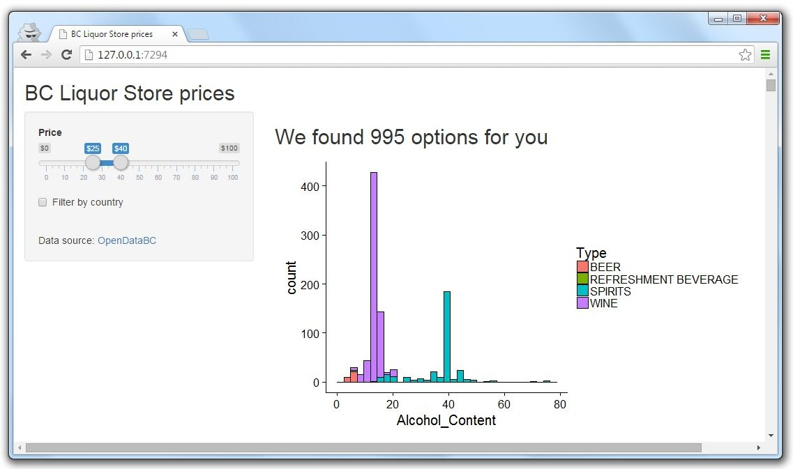

What is a Shiny app?
Computer running R
Web page

Slide 6


What is a Shiny app?
Server code
User interface (UI)
6

Slide 7
#3 Create an empty shiny template
library(shiny)
ui <- fluidPage()
server <- function(input, output) {} shinyApp(ui = ui, server = server)

Slide 8
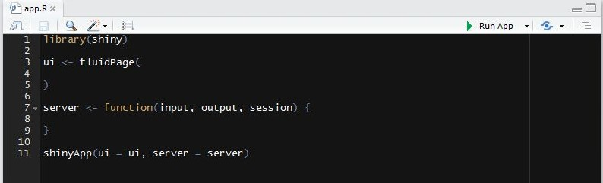
#3.1 Run Shiny app in Rstudio part1
Save file as “app.R” → “Run” button turns to “Run App”
Good for creating Shiny apps quickly, all code in one file

Slide 9
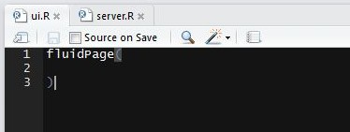
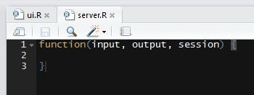
3.2# Run Shiny app in Rstudio part2
Save UI as “ui.R” and server as “server.R” in same directory
Good for complex Shiny apps, separates view vs logic
9

Slide 10
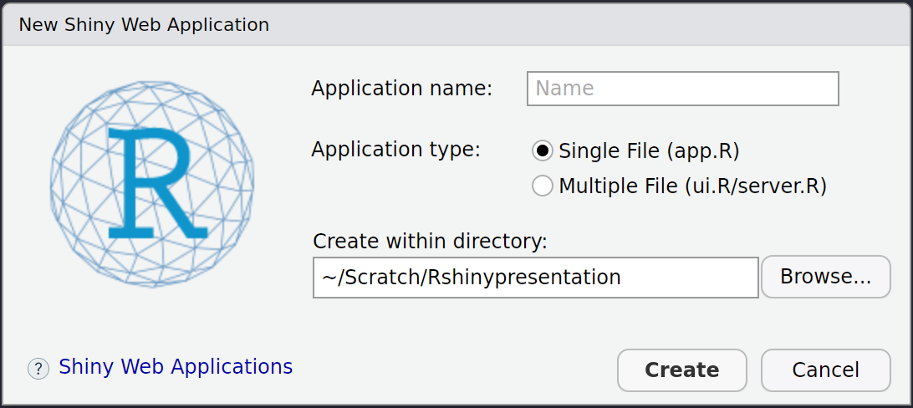
#3.3Run Shiny app in Rstudio part3
File > New File > Shiny Web App...
Generates a template for you
Note that this creates a subfolder in the directory with “application name” and a script called “app.R”

Slide 11
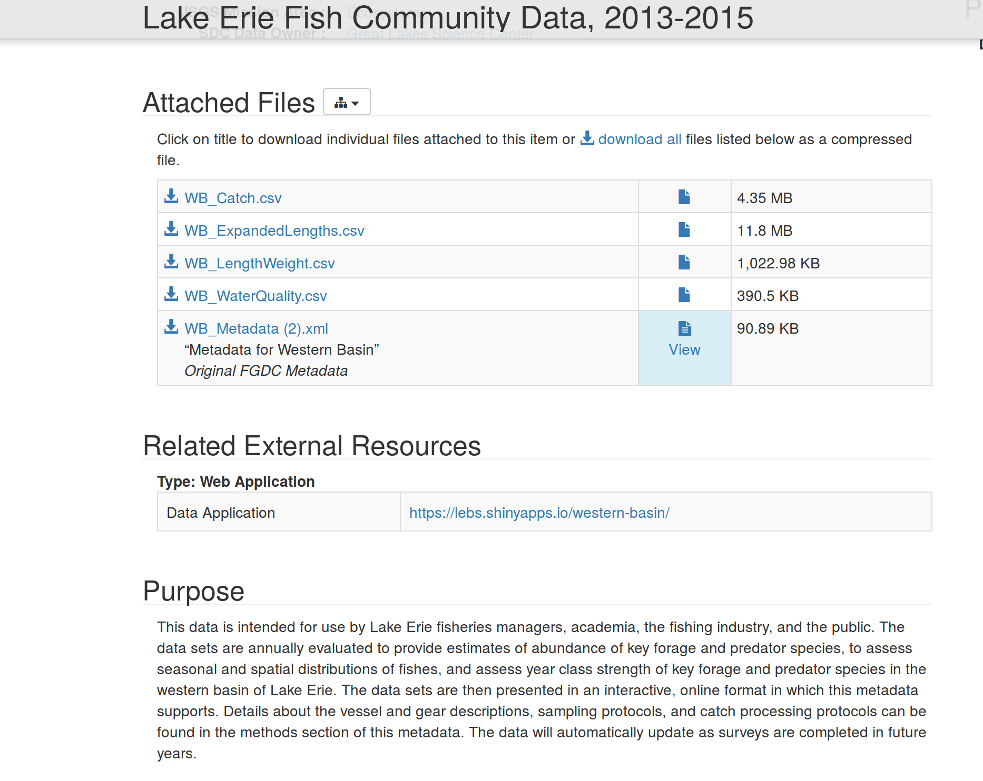
4# Load the dataset
9

Slide 12
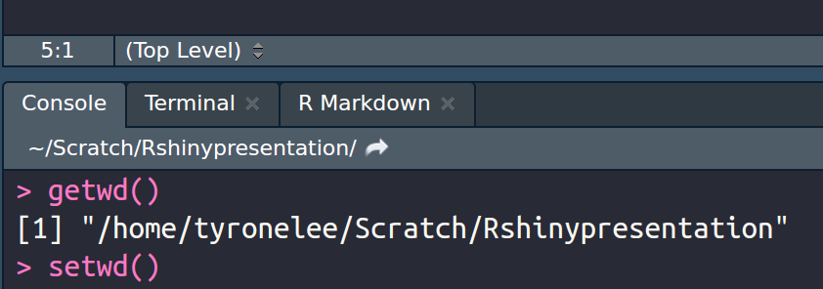
#4 Load the Dataset
Download the dataset to your working directory
Use “getwd()” in the console to find your current working dir
Use “setwd()” to change working dir
9

Slide 13
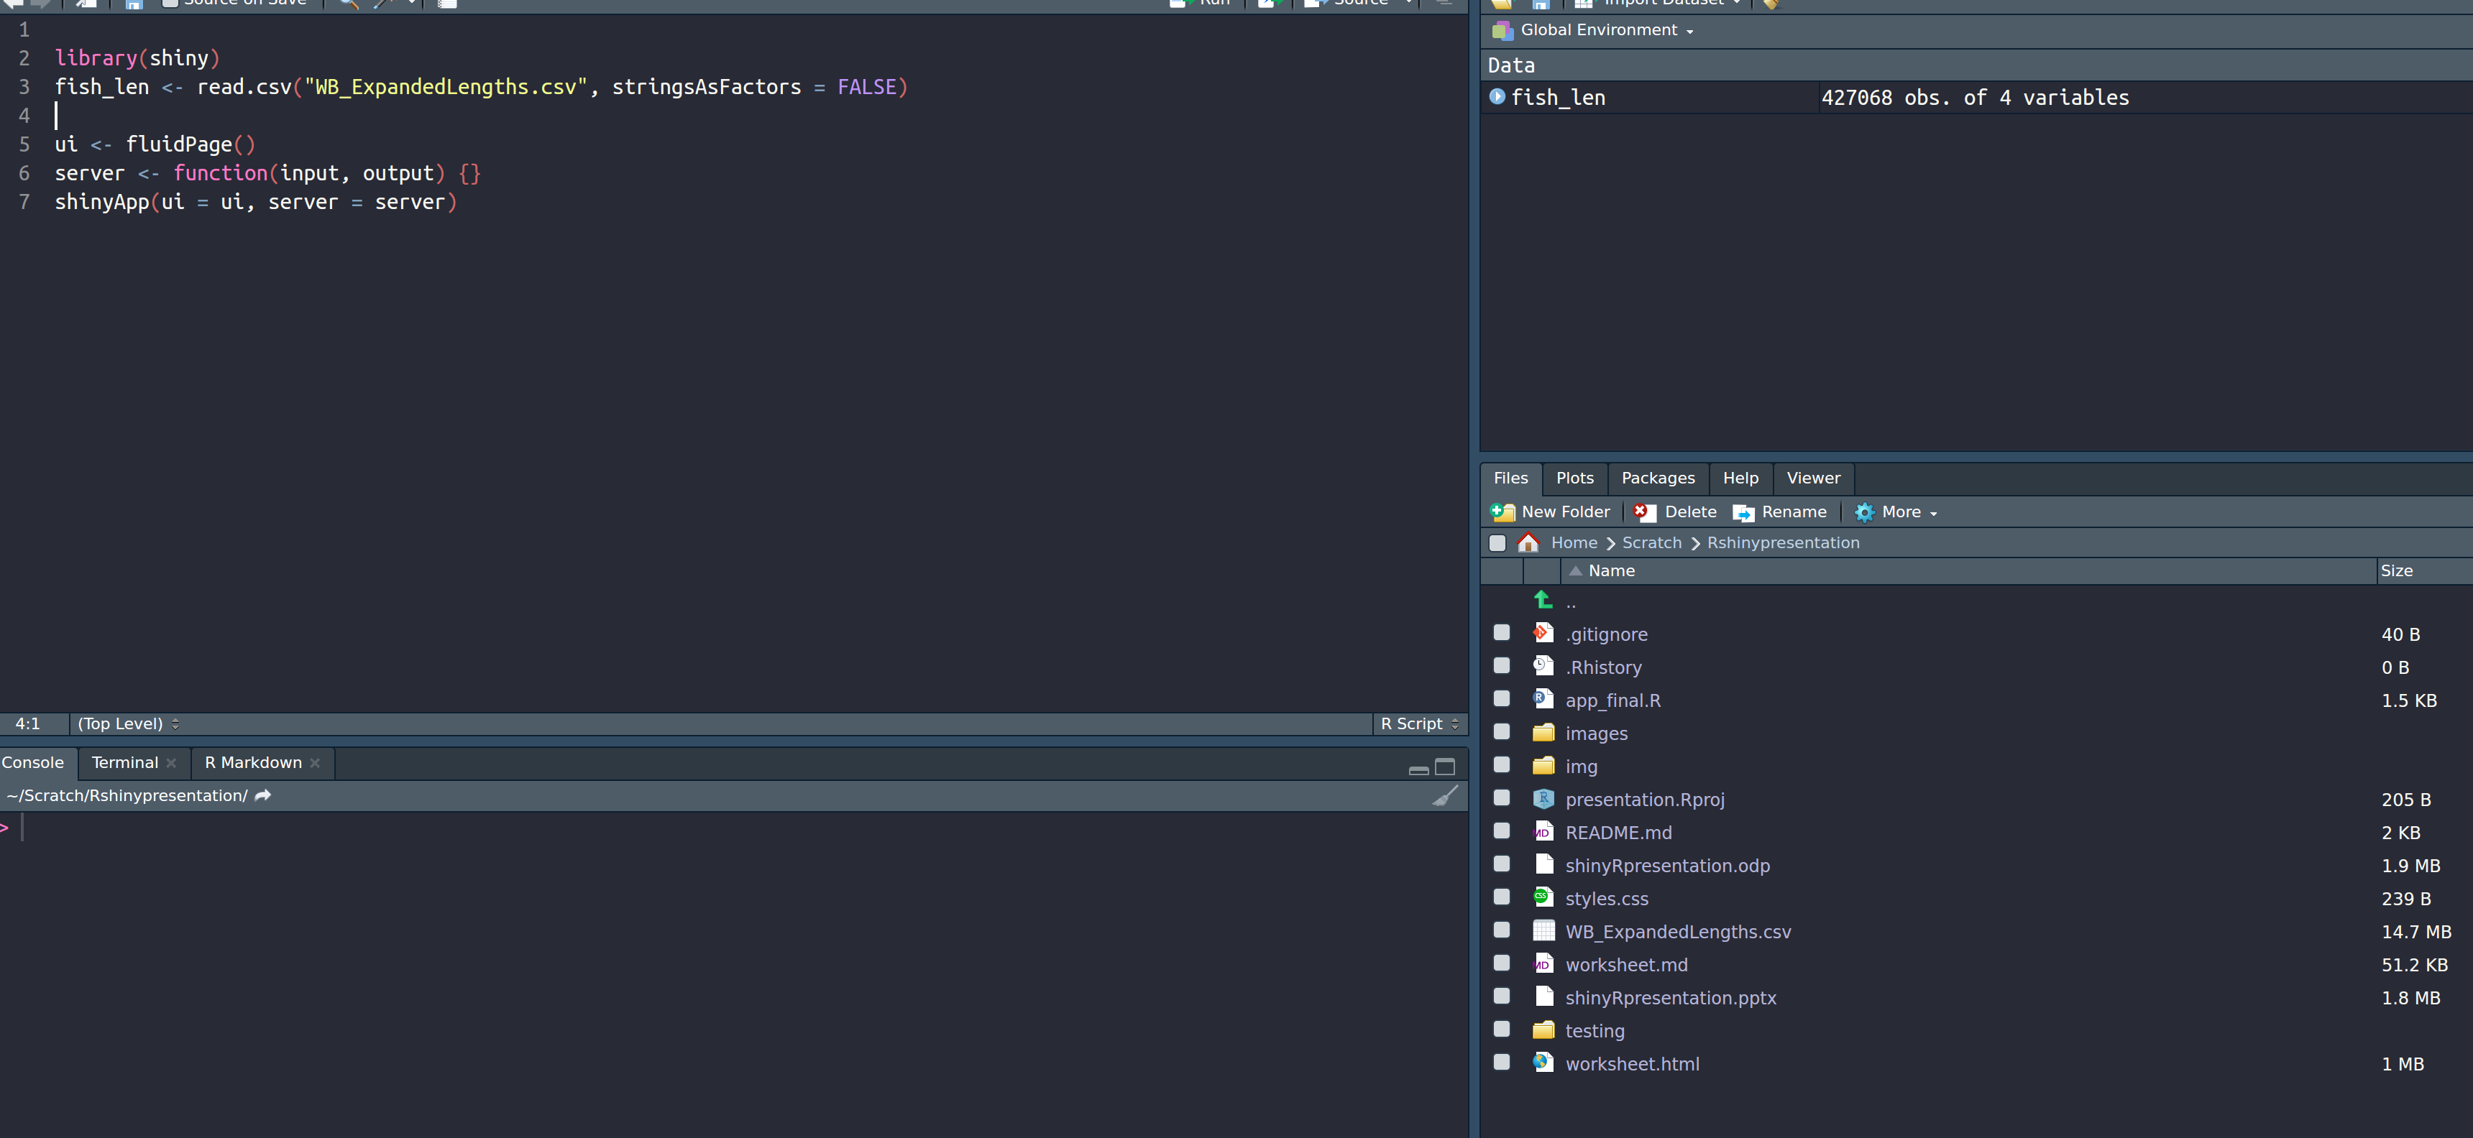
4# Load the dataset
9

Slide 14
Work through the tutorial until the end of Section 4

Slide 15
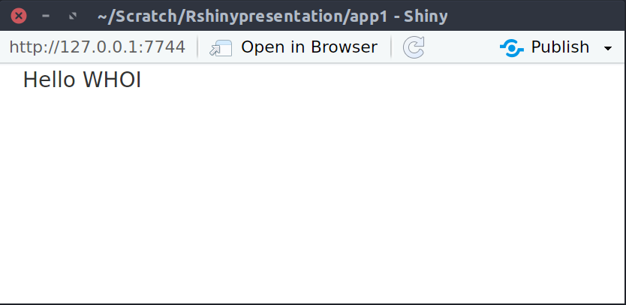
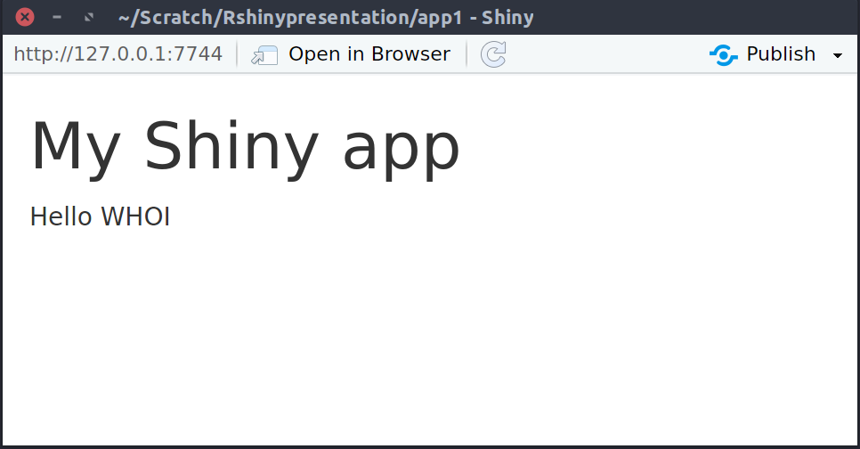
#5.1 Add text to app inside fluidPage()
library(shiny)
ui <- fluidPage( "Hello WHOI") server <- function(input, output) {} shinyApp(ui = ui, server = server)
fluidPage(
ui
h1("My Shiny app"), "Hello WHOI"
)

Slide 16
#5.2 Add HTML to fluidPage()
Remember the UI simply creates HTML
Can use any HTML tags http://shiny.rstudio.com/articles/tag-glossary.html
h1() = header1, br() = line break, strong() = bold text
Any HTML tag can be accessed using `tags` object
  h1 = tags$h1(), br = tags$br()
Common tags can be accessed without `tags`

Slide 17
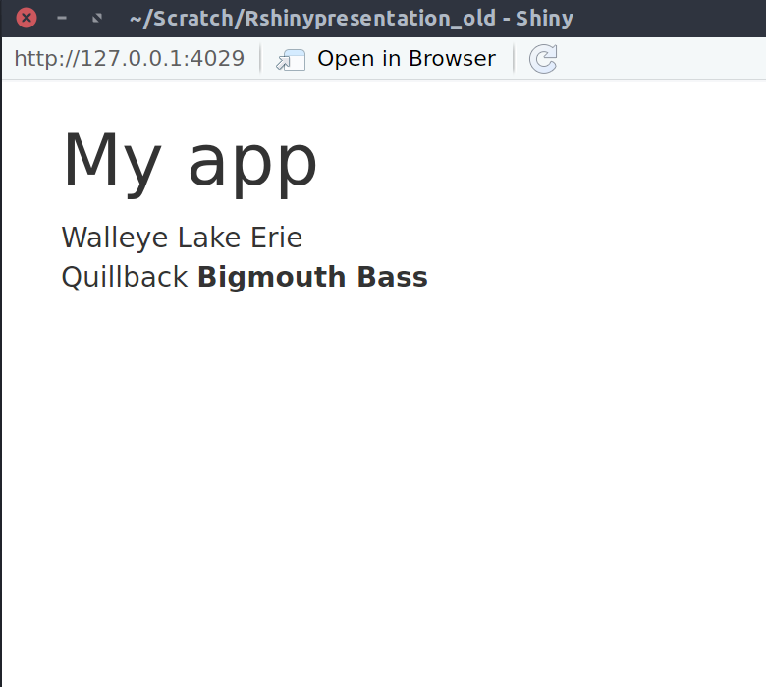
#5.2Add HTML to fluidPage()
fluidPage(
ui
fluidPage(
h1("My app"),
"Walleye",
"Lake Erie",
br(),
"Quillback",
strong("Bigmouth Bass")
)

Slide 18
#5.4 Use a layout
By default, all elements stack up one after the other
Can use different layouts http://shiny.rstudio.com/articles/layout-guide.html
We’ll use sidebarLayout()

Slide 19
# 5.4 Use a layout - sidebarLayout()
fluidPage(
ui
titlePanel("My Shiny app"),
sidebarLayout( sidebarPanel(
"This is a side panel"
),
mainPanel(
"And this is the main stuff"
)
)
)

Slide 20
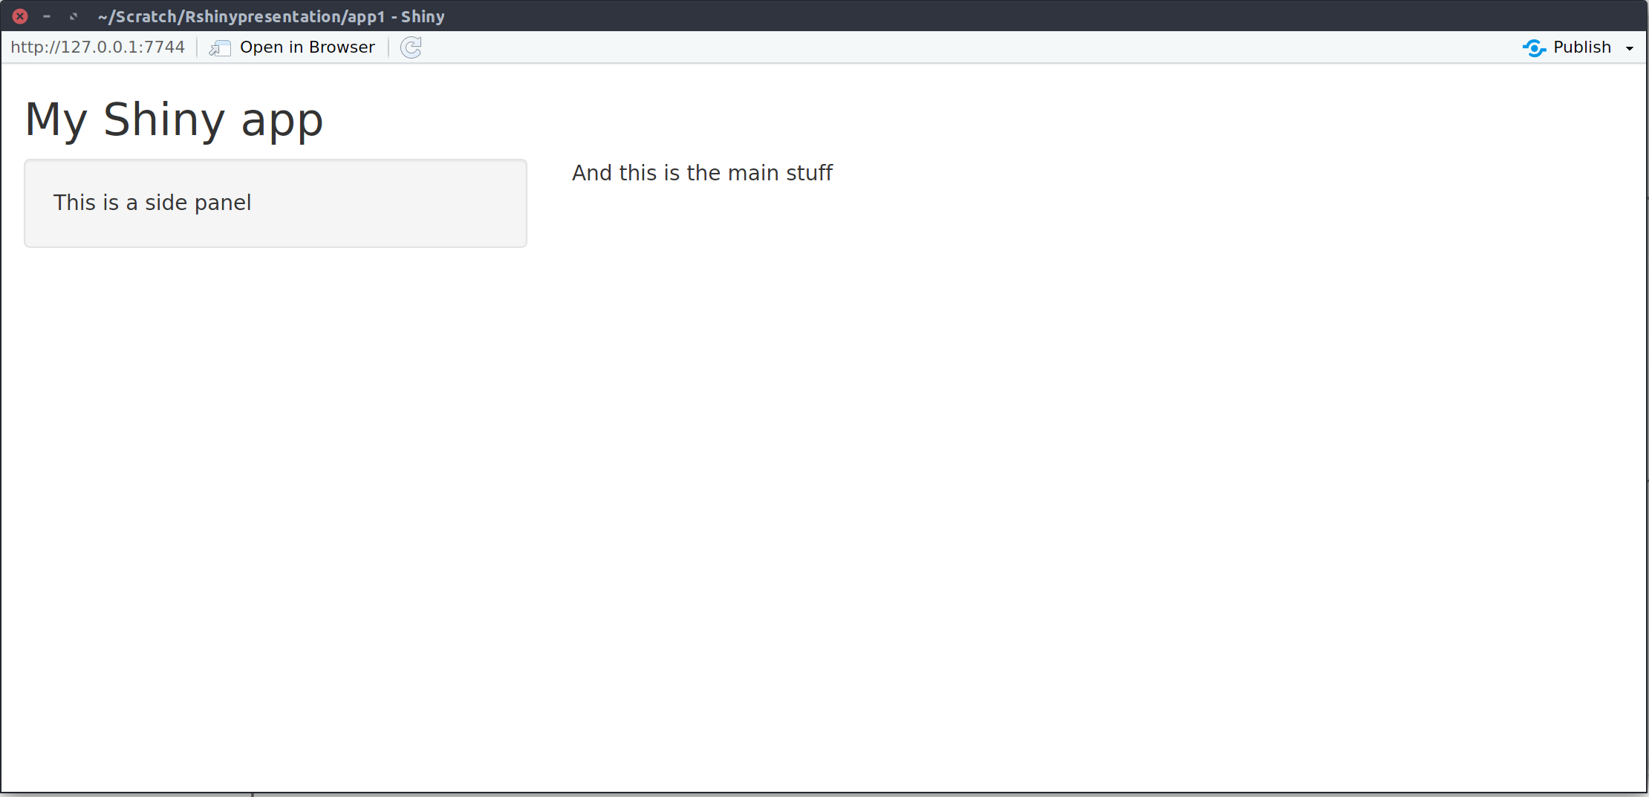
#5.4 Use a layout - sidebarLayout()
titlePanel()
mainPanel()
sidebarPanel()

Slide 21
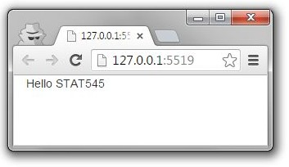
Summary
library(shiny) ui <- fluidPage()
server <- function(input, output) {} shinyApp(ui = ui, server = server)
3) Begin app with template
5 ) Add elements as arguments to
fluidPage()

Slide 22
Work through the tutorial until the end of Section 5

Slide 23
#6 -7Inputs and outputs
For interactivity, app needs inputs and outputs
ui
fluidPage(
# *Input() functions, # *Output() functions
)
●
Inputs
- things user can
toggle
●
Output
- R objects user
can see, often depend on inputs

Slide 24
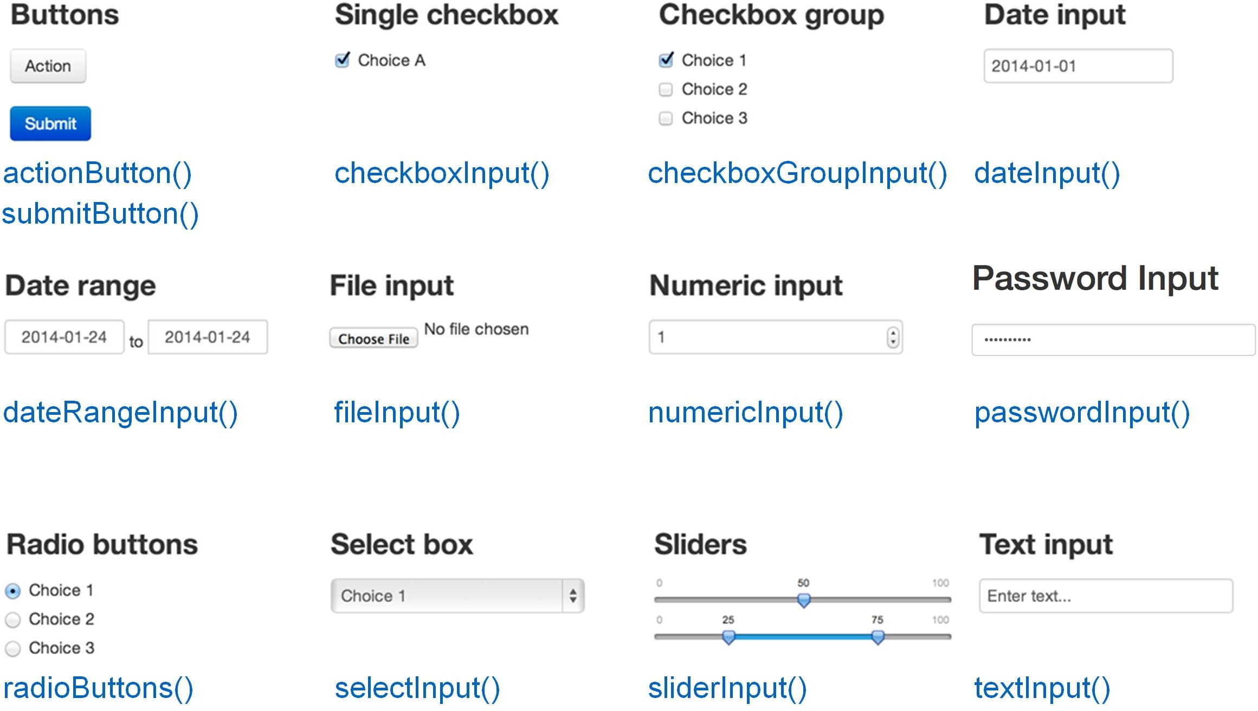
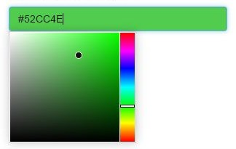
#6 Inputs
Colour input
shinyjs::colourInput()

Slide 25
#6 Inputs
Input-specific arguments
Input name
Label to display
sliderInput("num", "Choose a number", min = 0, max = 100, value = 20)
*Input( inputId, label, ... )
What arguments can I pass to an input function?
?sliderInput

Slide 26
#6 Inputs
sliderInput("num", "Choose a number",
min = 0, max = 100, value = 20)
<div class="form-group shiny-input-container">
<label class="control-label" for="num">Choose a number</label>
<input class="js-range-slider" id="num" data-min="0"
data-max="100" data-from="20" data-step="1" data-grid="true" data-grid-num="10" data-grid-snap="false"
data-prettify-separator="," data-keyboard="true"
data-keyboard-step="1" data-drag-interval="true" data-data-type="number"/>
</div>

Slide 27
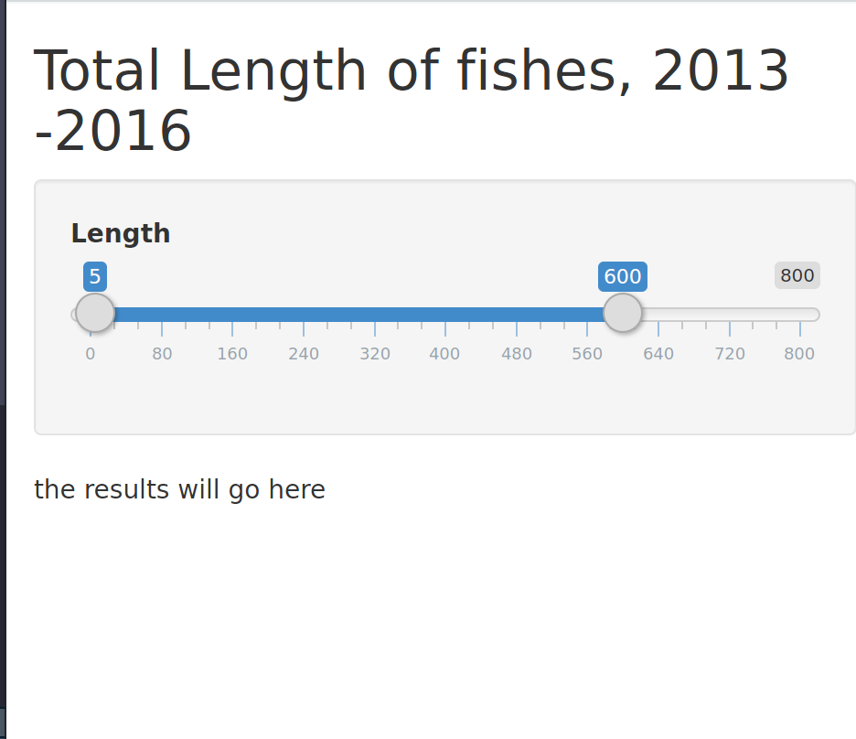
#6 Inputs
library(shiny)
fish_len <- read.csv("WB_ExpandedLengths.csv", stringsAsFactors = FALSE)
ui <- fluidPage(
titlePanel("Total Length of fishes, 2013 -2016"),
sidebarLayout(
sidebarPanel(
sliderInput("lengthInput", "Length", 0, 800, c(5, 600))
),

Slide 28
Work through the tutorial until the end of Section 6

Slide 29
#7Outputs
Plots, tables, text - anything that R creates and users see
Initialize as empty placeholder space until object is created
Function | Outputs
plotOutput() | plot
tableOutput() | table
uiOutput() | Shiny UI element
textOutput() | text

Slide 30
#7Outputs
Output-specific arguments
Output name
plotOutput("myplot", width = "300px")
*Output( outputId, ... )
What arguments can I pass to an output function?
?plotOutput

Slide 31
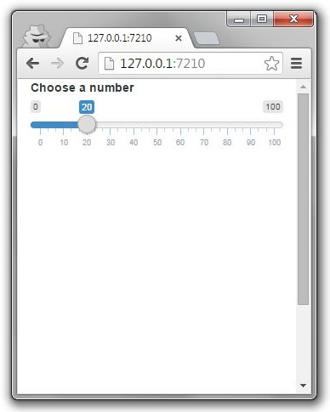
#7Outputs
library(shiny)
ui <- fluidPage(
sliderInput("num", "Choose a number",
0, 100, 20),
plotOutput("myplot")
)
server <- function(input, output) {} shinyApp(ui = ui, server = server)
*Output() adds space for UI object
You need to build the object in server

Slide 32
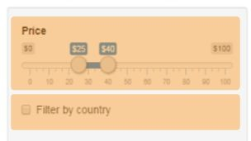
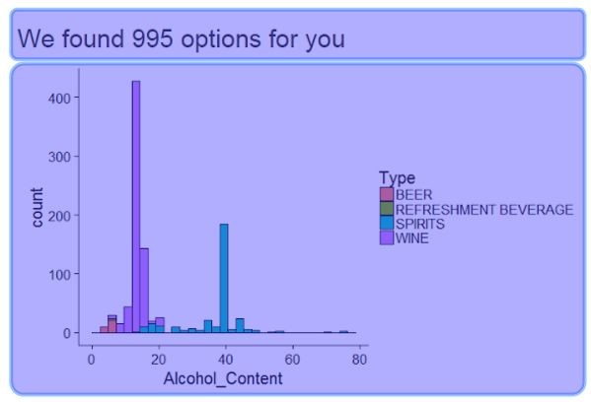
Summary
library(shiny) ui <- fluidPage()
server <- function(input, output) {} shinyApp(ui = ui, server = server)
3) Begin app with template
5 ) Add elements as arguments to
fluidPage()
6)Create inputs with *Input() functions
7)Create outputs with *Output() functions

Slide 33
Work through the tutorial until the end of Section 7

Slide 34
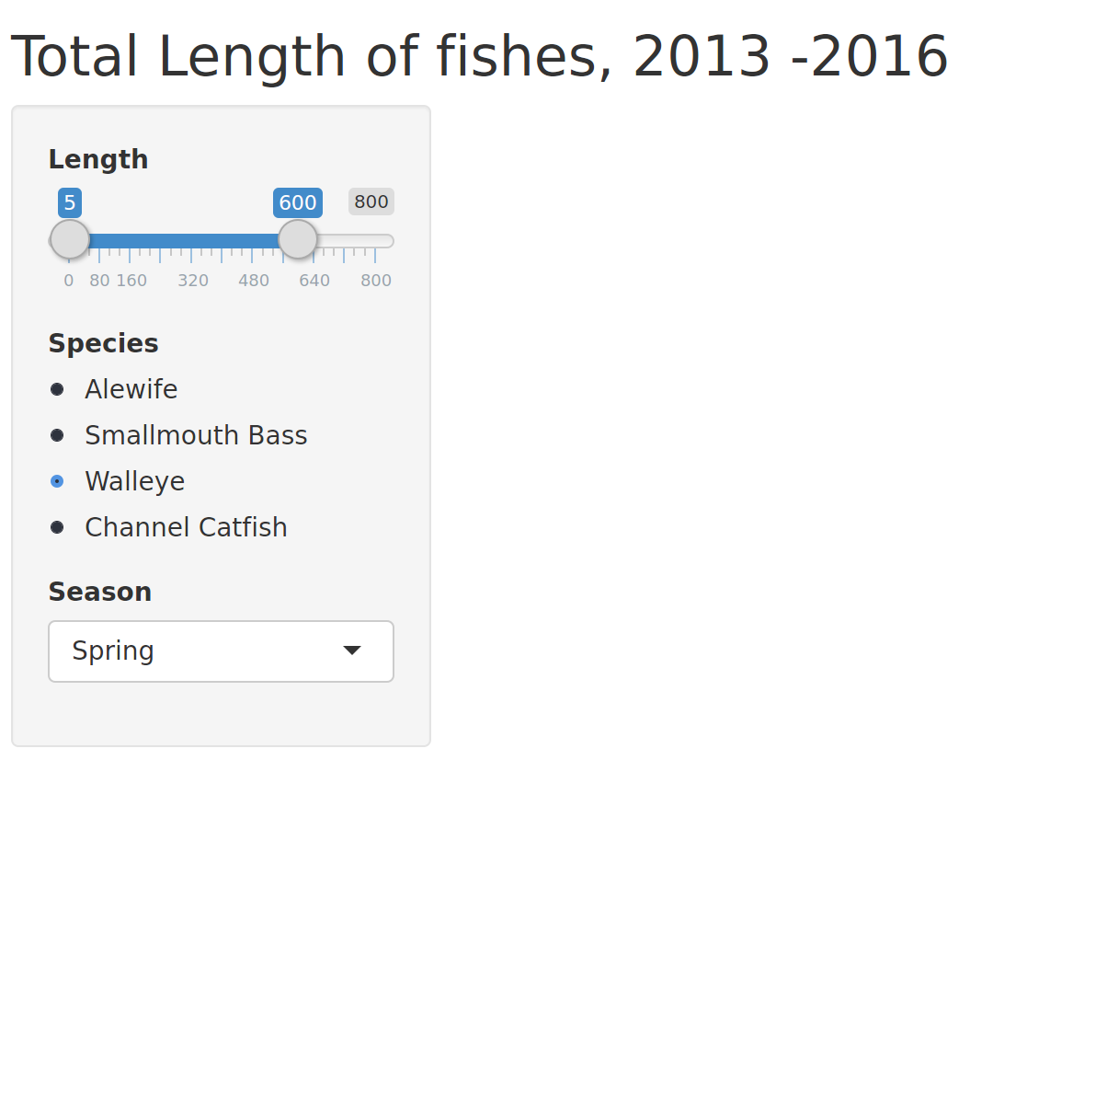
Checkpoint #8

Slide 35
Most common “why isn’t my app running?!” problems
Remember to:
comma-separate all the elements!
not add comma to the last element!
Count your brackets and parentheses!

Slide 36
Work through the tutorial until the end of Section 7

Slide 37

Summary
library(shiny) ui <- fluidPage()
server <- function(input, output) {} shinyApp(ui = ui, server = server)
3) Begin app with template
5 ) Add elements as arguments to
fluidPage()
6)Create inputs with *Input() functions
7)Create outputs with *Output() functions
9)Use server to assemble inputs into outputs

Slide 38
#9 Server: assemble input into outputs with 3 rules
server <- function(input, output) {
output$myplot <- renderPlot({ plot(rnorm(input$num))
})
}

Slide 39
#9.1 Server
1 - Save objects into output$
server <- function(input, output) {
output$myplot <- renderPlot({ plot(rnorm(input$num))
})
# in UI: plotOutput("myplot")
}

Slide 40
#9.1 Server
2 - Build objects with render*
server <- function(input, output) {
output$myplot <- renderPlot({ plot(rnorm(input$num))
})
}

Slide 41
*Output() → render*()
Output function | Render function
plotOutput() | renderPlot({})
tableOutput() | renderTable({})
uiOutput() | renderUI({})
textOutput() | renderText({})

Slide 42
render*() functions build reactive output to display in UI
renderPlot({ plot(rnorm(100)) })
Type of object to build
Code to build the object

Slide 43
#9.1 Server
3 - Access input values with input$
server <- function(input, output) { output$myplot <- renderPlot({
plot(rnorm(input$num))
# in UI:sliderInput("num", ...)
})
}

Slide 44
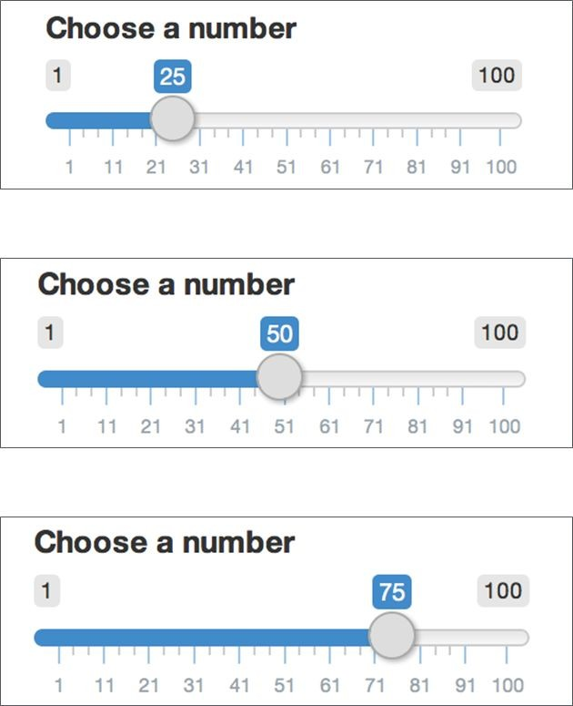
Using input$
input$num returns 25
input$num returns 50
input$num returns 75

Slide 45
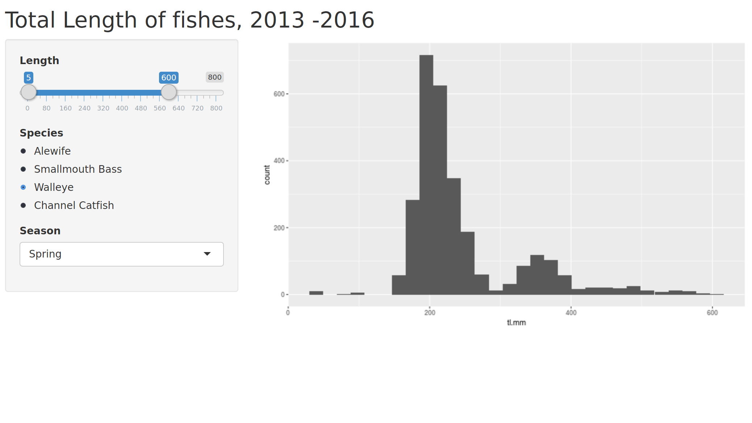
Building outputs
3 - Access input values with input$

Slide 46
Summary
library(shiny) ui <- fluidPage()
server <- function(input, output) {} shinyApp(ui = ui, server = server)
3) Begin app with template
5 ) Add elements as arguments to
fluidPage()
6)Create inputs with *Input() functions
7)Create outputs with *Output() functions
9)Use server to assemble inputs into outputs

Slide 47
Work through the tutorial until the end of Section 9

Slide 48
#10 Reactivity
Shiny uses reactive programming
Supports reactive variables
  When value of variable x changes, anything that relies on x is re-evaluated
  Contrast with regular R:
x <- 5
y <- x + 1 x <- 10
# y is still 6

Slide 49
#10 Reactivity
input$num is a reactive value
output$myplot <- renderPlot({ plot(rnorm(input$num))
})
output$myplot depends on input$num
  input$num changes → output$myplot reacts
All inputs are automatically reactive, so if you use any input inside a render* function, the output will re-render any time input changes

Slide 50
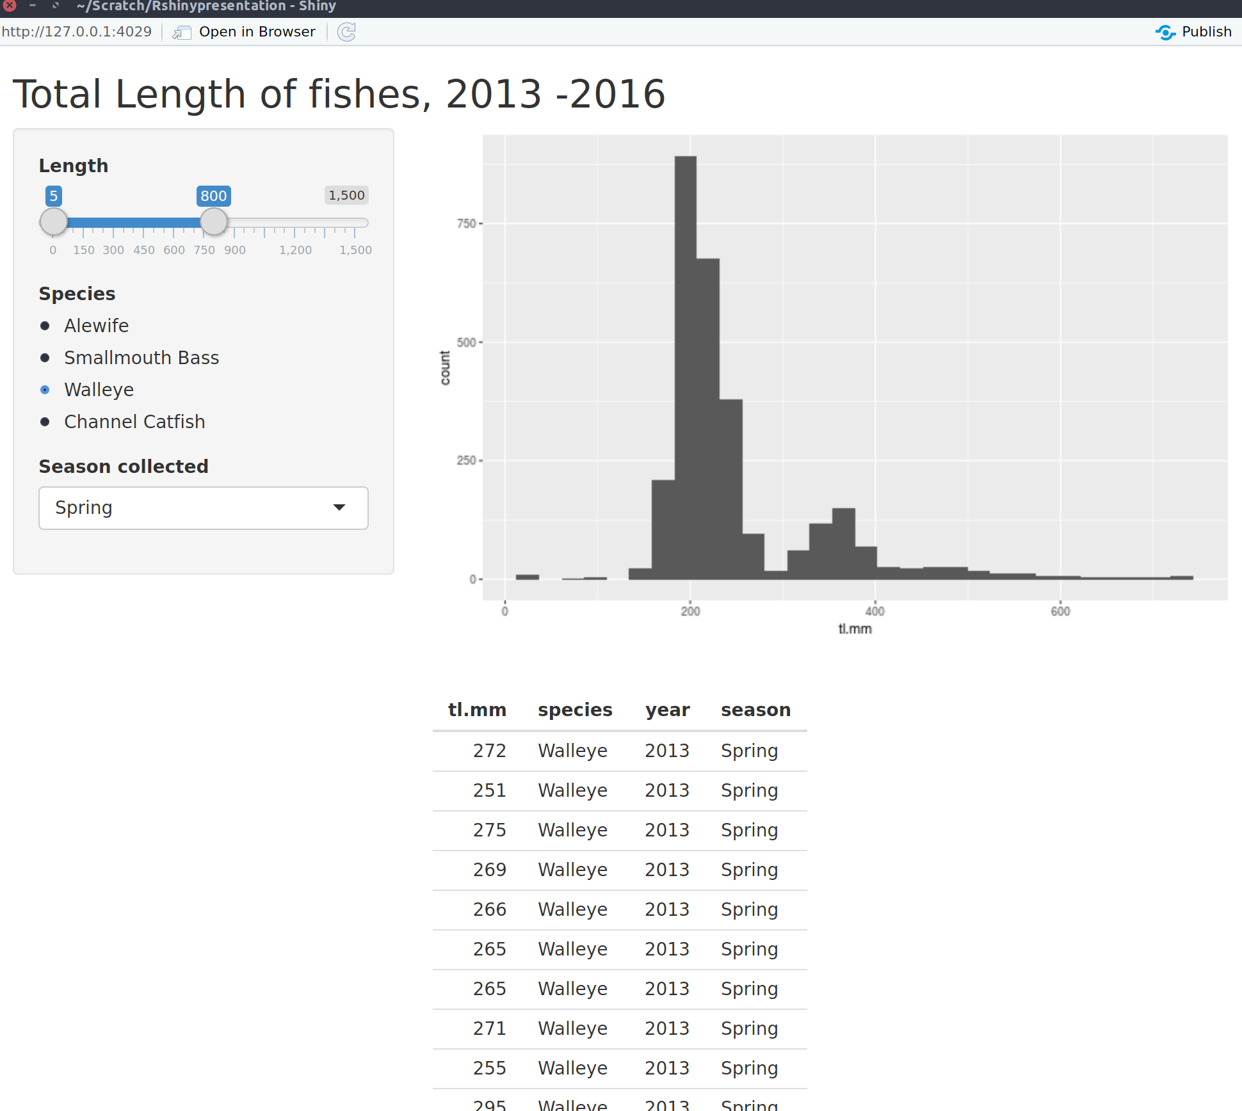
#12 The complete app

Slide 51
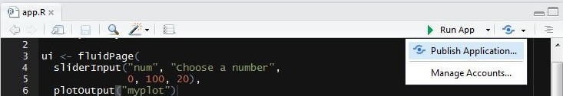
#13 Share your app: shinyapps.io
Go to http://www.shinyapps.io/ and make an account
Make sure all your app files are in an isolated folder
Click “Publish Application” in RStudio
  You might be asked to install a couple packages
Follow instructions from RStudio

Slide 52
PS. Shiny in Rmarkdown
Set output: html_document
Set runtime: shiny
You can now use interactive inputs/outputs in Rmarkdown!
---
output: html_document runtime: shiny
---
```{r echo=FALSE}
sliderInput("num", "Choose a number",
0, 100, 20)
renderPlot({
plot(seq(input$num))
})
```
50

Slide 53
PPS. More things to check out
?conditionalPanel - conditionally show UI elements
global.R - objects here are available to both ui.R and server.R
Use navbarPage() or tabsetPanel() for multiple tabs in UI
Use DT::dataTableOutput() instead of tableOutput() for an interactive table instead of ugly static table
Add images by placing image under “www/image.png” and using UI function img(src = "image.png")
Use update*Input() functions to update input values from R
Know JavaScript/CSS? Use includeScript() or includeCSS()

Slide 54
Recommended add-on packages to Shiny
leaflet (http://rstudio.github.io/leaflet/)
  Add interactive maps to your apps
shinyjs (https://github.com/daattali/shinyjs)
  Enhance user experience in Shiny apps
shinythemes (http://rstudio.github.io/shinythemes/)
  Easily alter the appearance of your app
ggvis (http://ggvis.rstudio.com/)
  Similar to ggplot2 but plots are web-based and more interactive
shinydashboard (https://rstudio.github.io/shinydashboard/)
  Gives you tools to create “dashboards”

Slide 55
Awesome non-intimidating resources
Shiny official tutorial http://shiny.rstudio.com/tutorial
Shiny cheatsheet http://shiny.rstudio.com/images/shiny-cheatsheet.pdf
Lots of short useful topics http://shiny.rstudio.com/articles
Shiny in Rmarkdown http://rmarkdown.rstudio.com/authoring_shiny.html
Get help from https://groups.google.com/forum/#!forum/shiny-discuss or http://stackoverflow.com/questions/tagged/shiny
Publish your app free with RStudio http://www.shinyapps.io
Host your app on your own Shiny server
http://deanattali.com/2015/05/09/setup-rstudio-shiny-server-digital-ocean/

