Slide 1
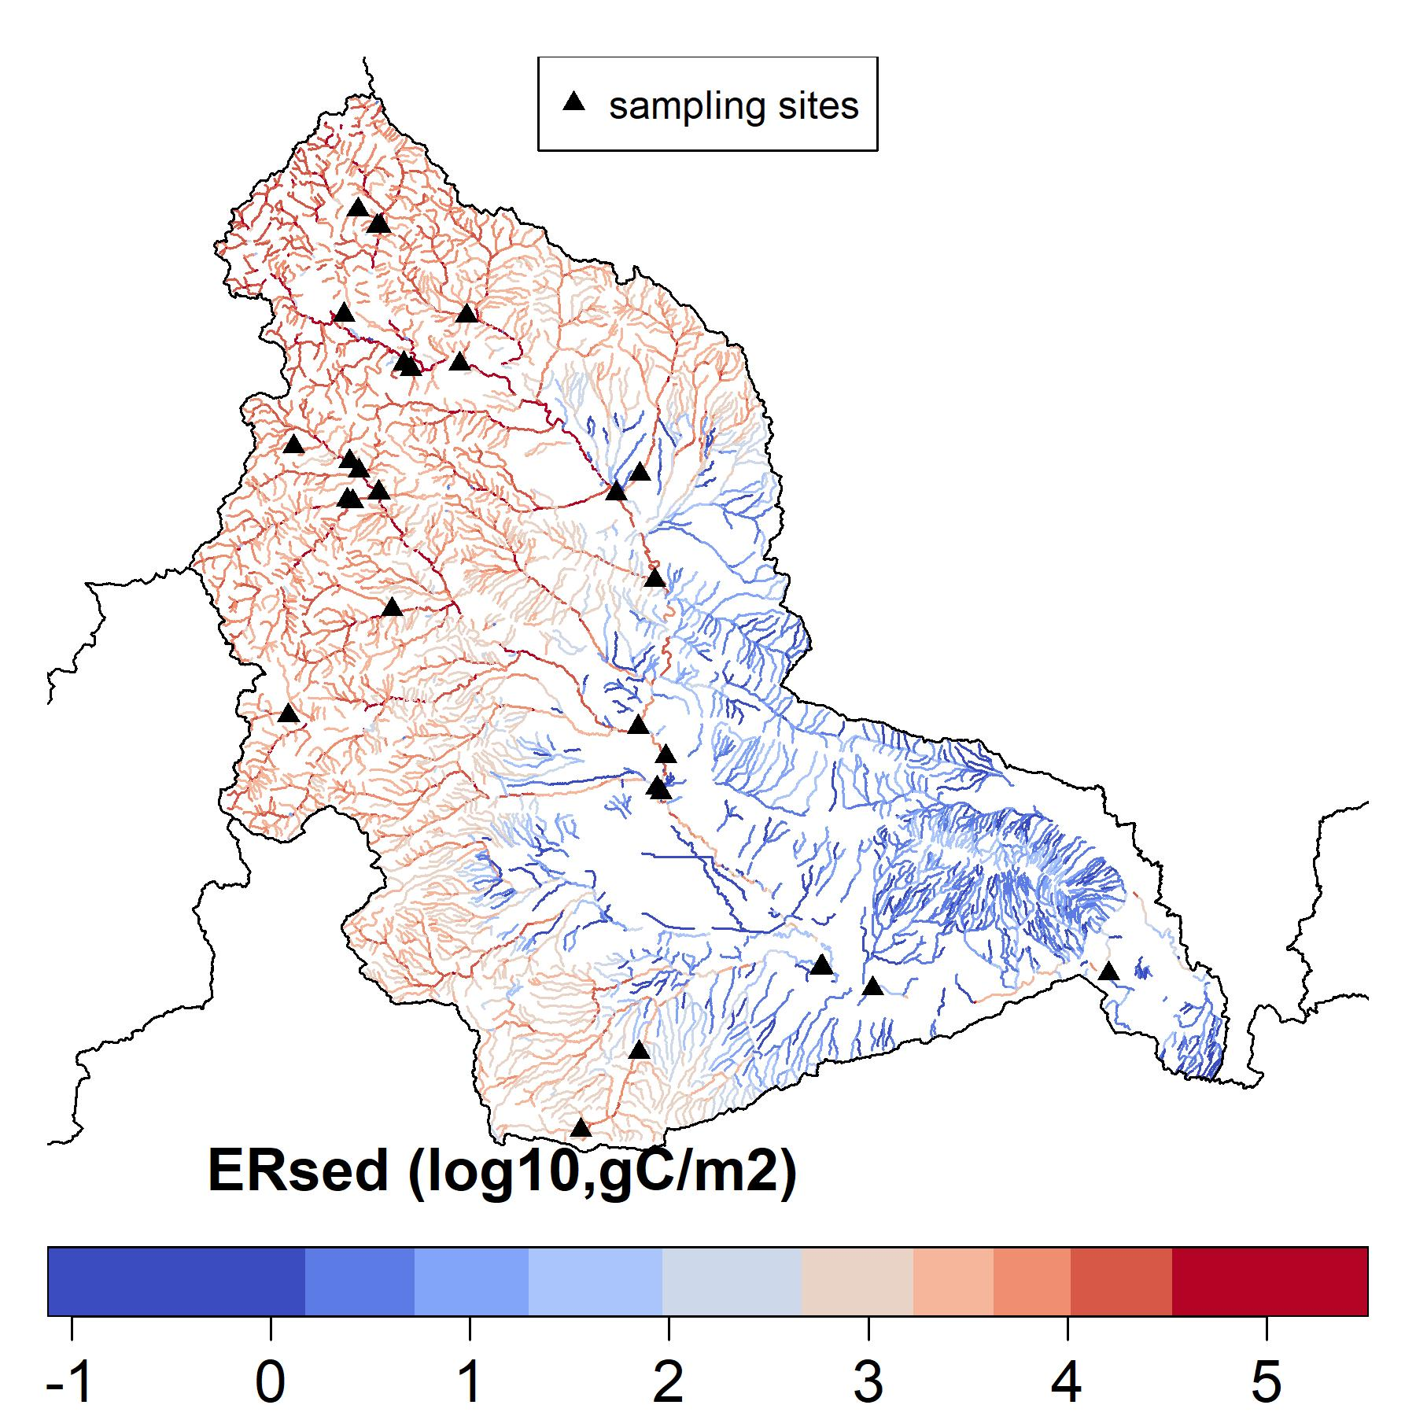
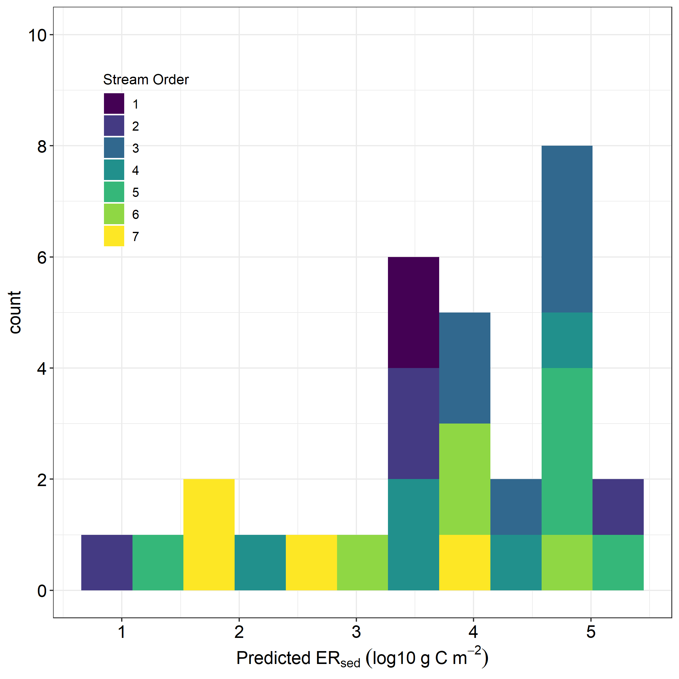
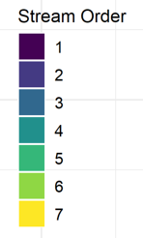
a)
10
b)
Sampling Sites
8
6
Count
4
2
0
1
2
3
4
5
Ersed (log10, gC/m2)
Figure 1. a) Proposed field sites along the YRB; b) Ranges of predicted ERsed and stream order in proposed sites.

