Slide 1
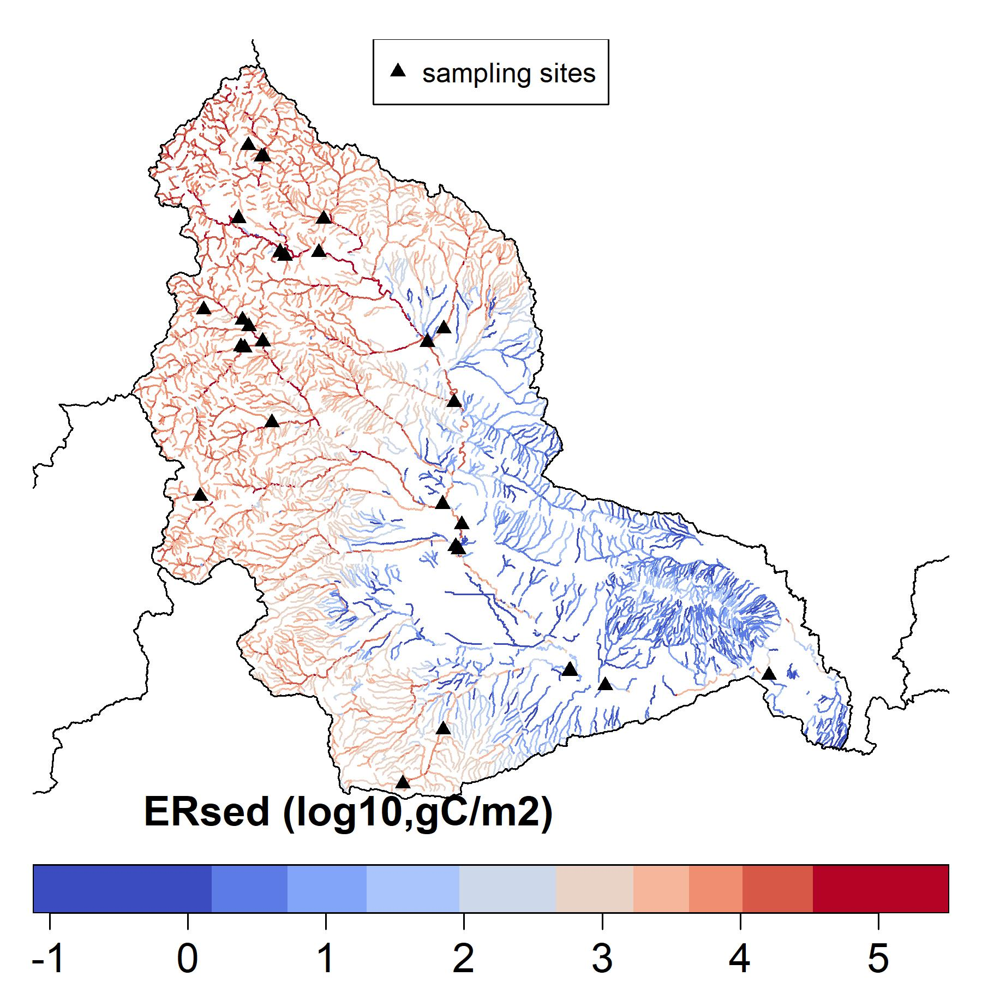
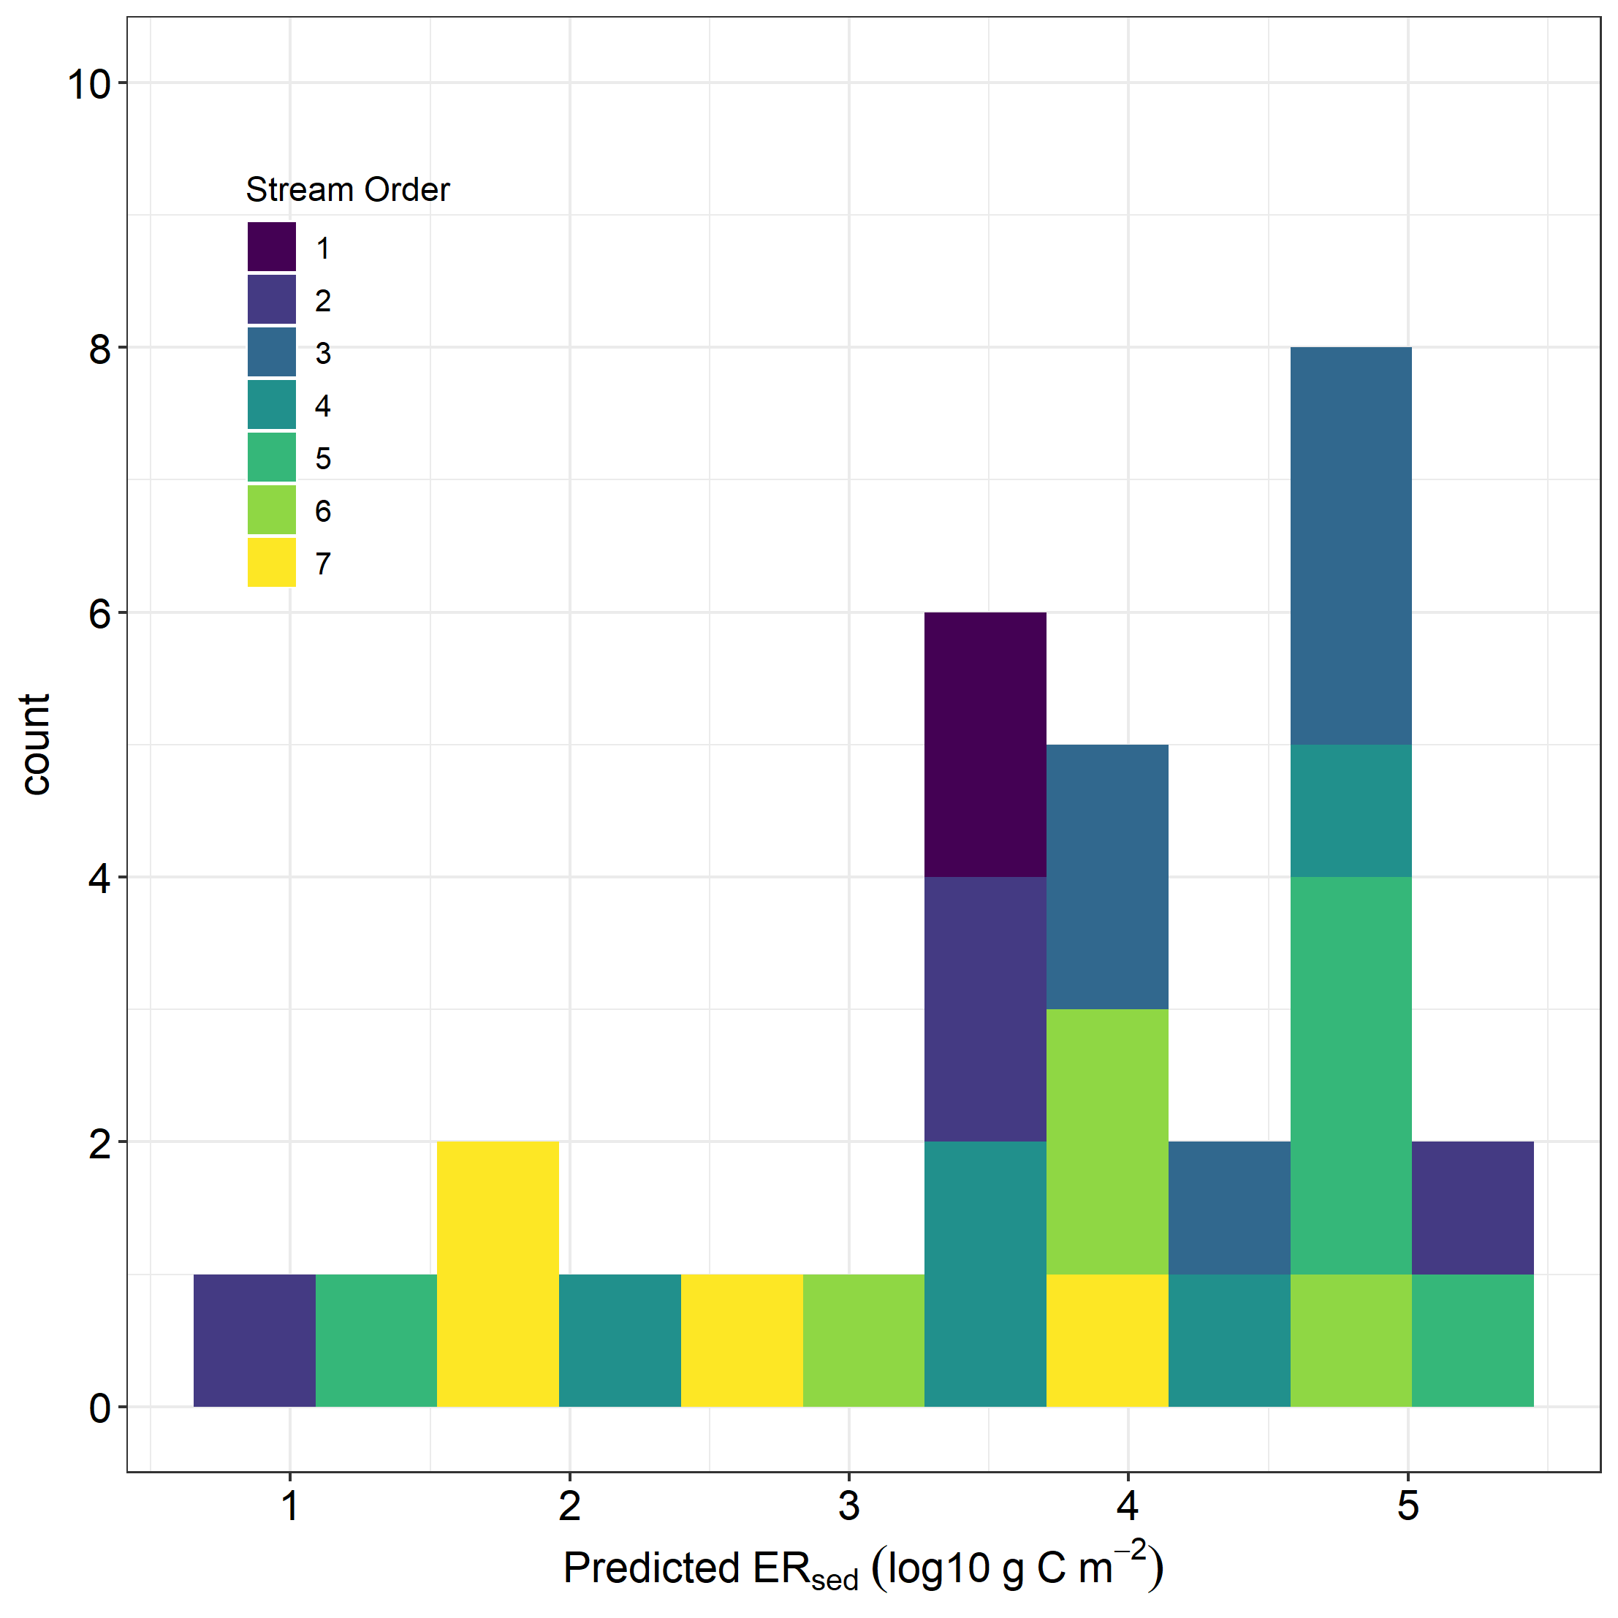
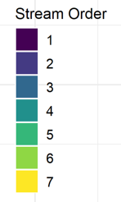
a)
10
b)
Sampling Sites
8
6
Count
4
2
0
1
2
3
4
5
ERsed (log10, gC/m2)
Figure 1. Field sites across the YRB that will be sampled in August 2022. The sites have been selected to span a broad range of predicted ERsed values.

Slide 2
Sampling Sites
Figure 1. Field sites across the YRB that will be sampled in August 2022. The sites have been selected to span a broad range of predicted ERsed values.

