Slide 1
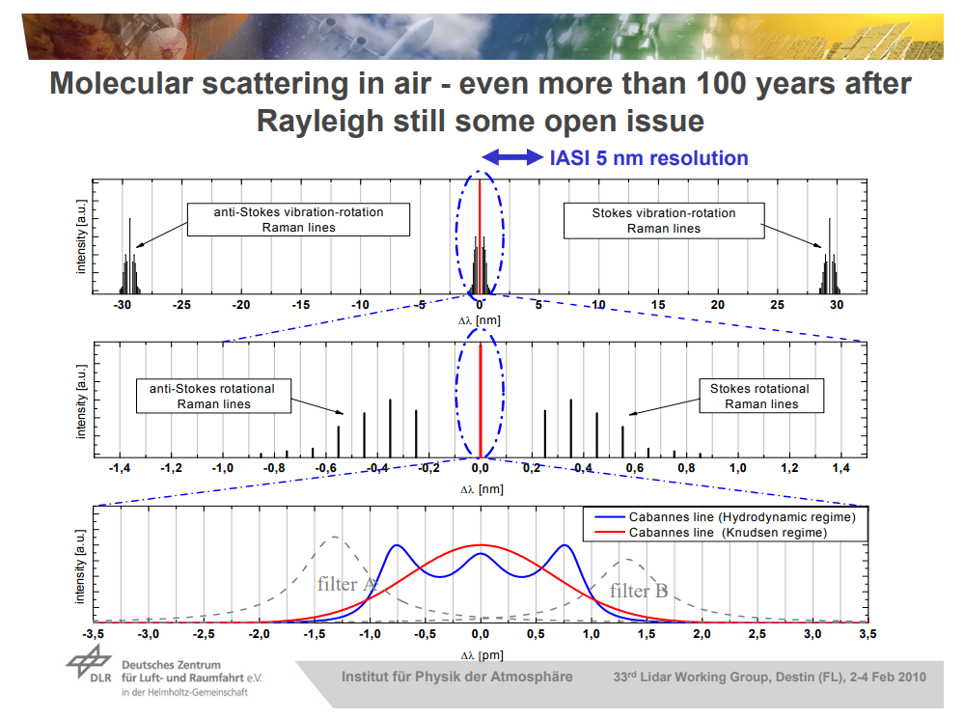
http://www.pa.op.dlr.de/aeolus/Campaigns_Pub/Reitebuch_RBS_VU_Feb10.pdf

