Slide 1
Lidar for Molecular Scattering Simulation (LiMSS)
Zhenping Yin

Slide 2
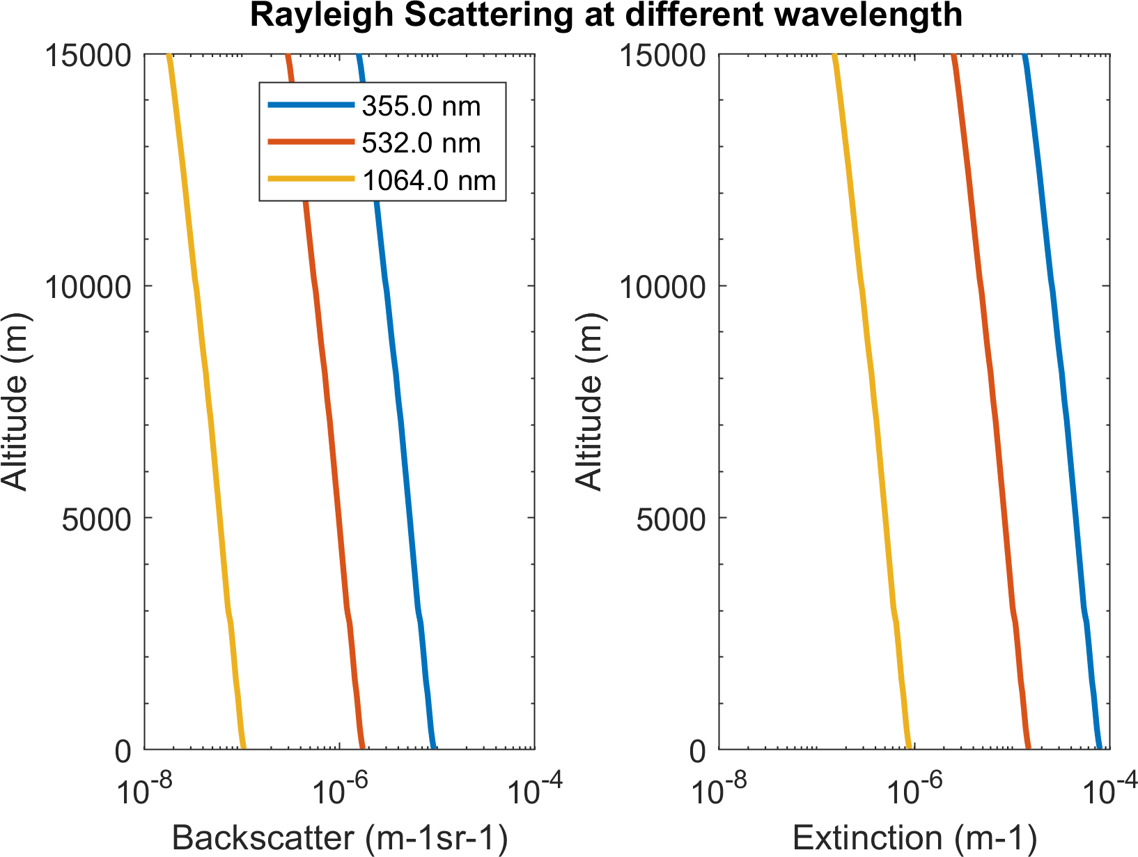
Rayleigh Scattering
跟温度与压强有关
原理参考：Bucholtz, A. Rayleigh-scattering calculations for the terrestrial atmosphere. Appl. Opt. 1995, 34, 2765-2773.

Slide 3
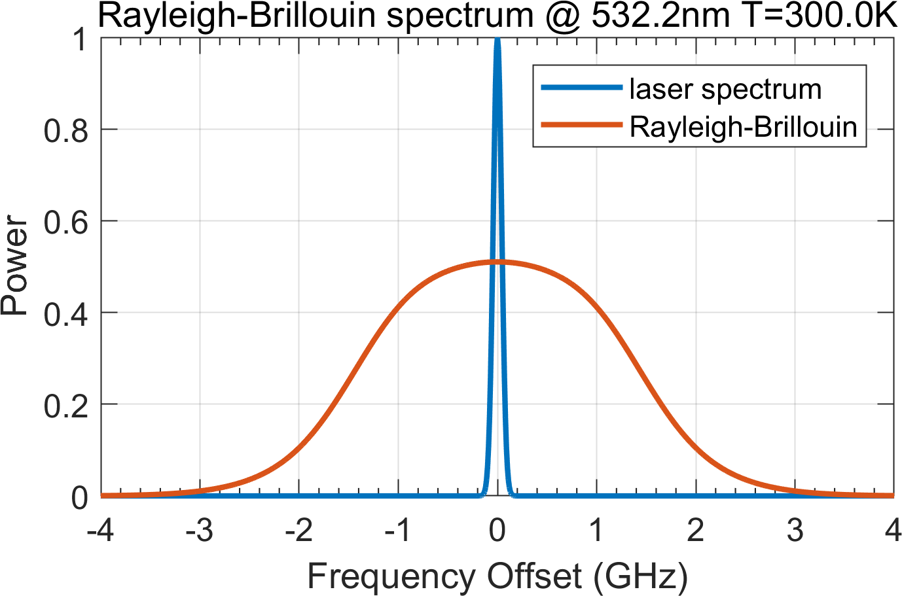
Rayleigh Brillouin Spectra
原理参考：Witschas, B. Analytical model for Rayleigh–Brillouin line shapes in air. Appl. Opt. 2011, 50, 267-270, doi:10.1364/AO.50.000267.

Slide 4
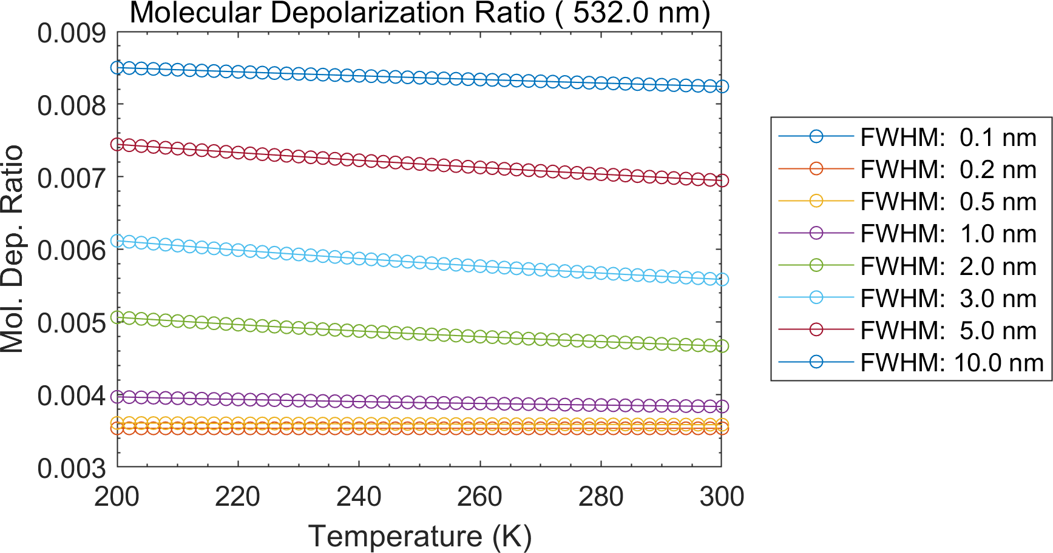
Molecular Depolarization
原理参考：Behrendt, A.; Nakamura, T. Calculation of the calibration constant of polarization lidar and its dependency on atmospheric temperature. Opt Express 2002, 10, 805-817.

Slide 5
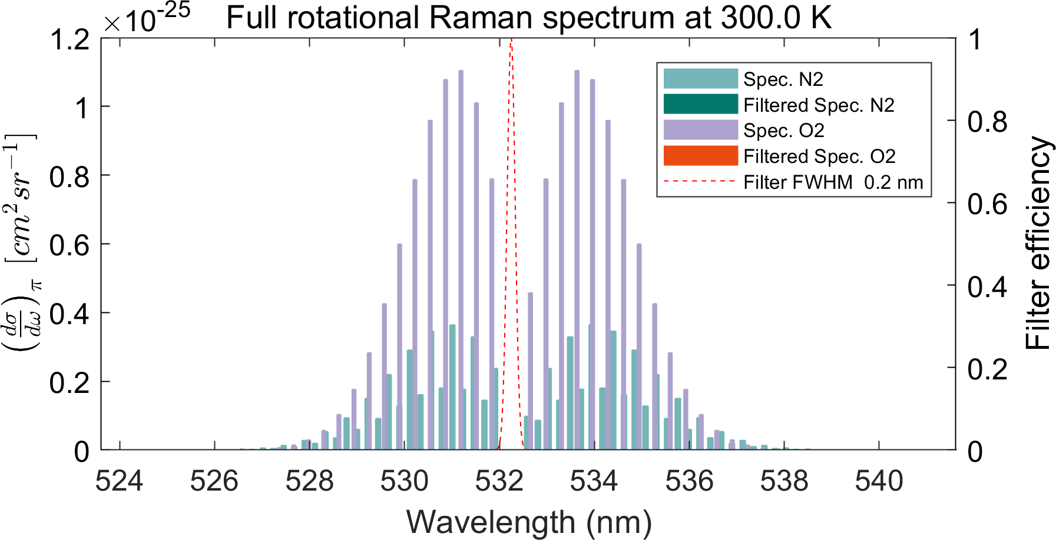
Rotational Raman Spectra
原理参考：Liu, F.; Yi, F. Lidar-measured atmospheric N 2 vibrational-rotational Raman spectra and consequent temperature retrieval. Optics Express 2014, 22, 27833-27844.

Slide 6
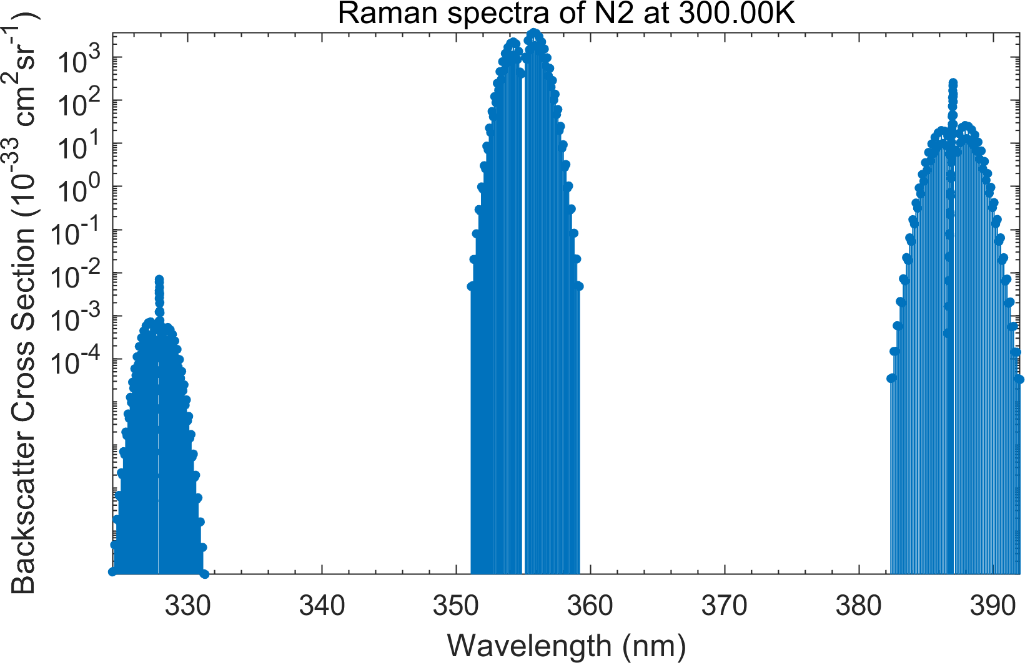
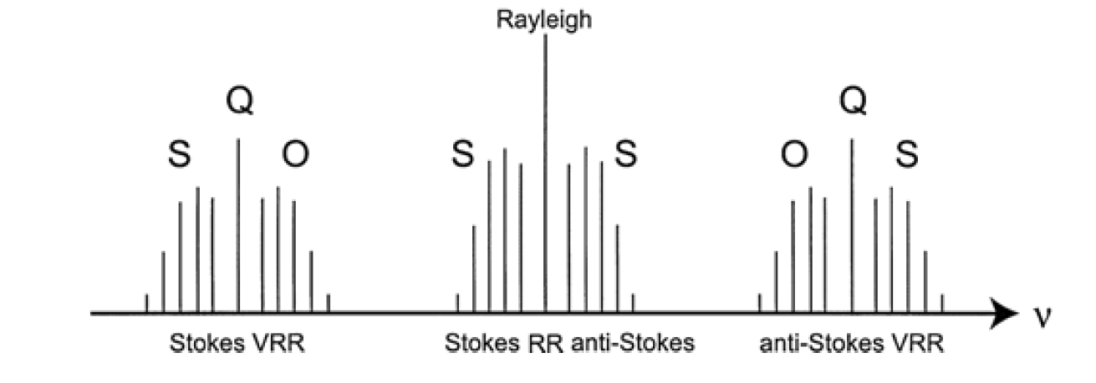
Vibrational Raman Spectra
(Ulla Wandinger, 2005)
RR
anti-stokes VRR
stokes VRR
原理参考：
Ulla Wandinger, Raman Lidar, 2005
Liu, F.; Yi, F. Lidar-measured atmospheric N2 vibrational-rotational Raman spectra and consequent temperature retrieval. Optics Express 2014, 22, 27833-27844.

Slide 7
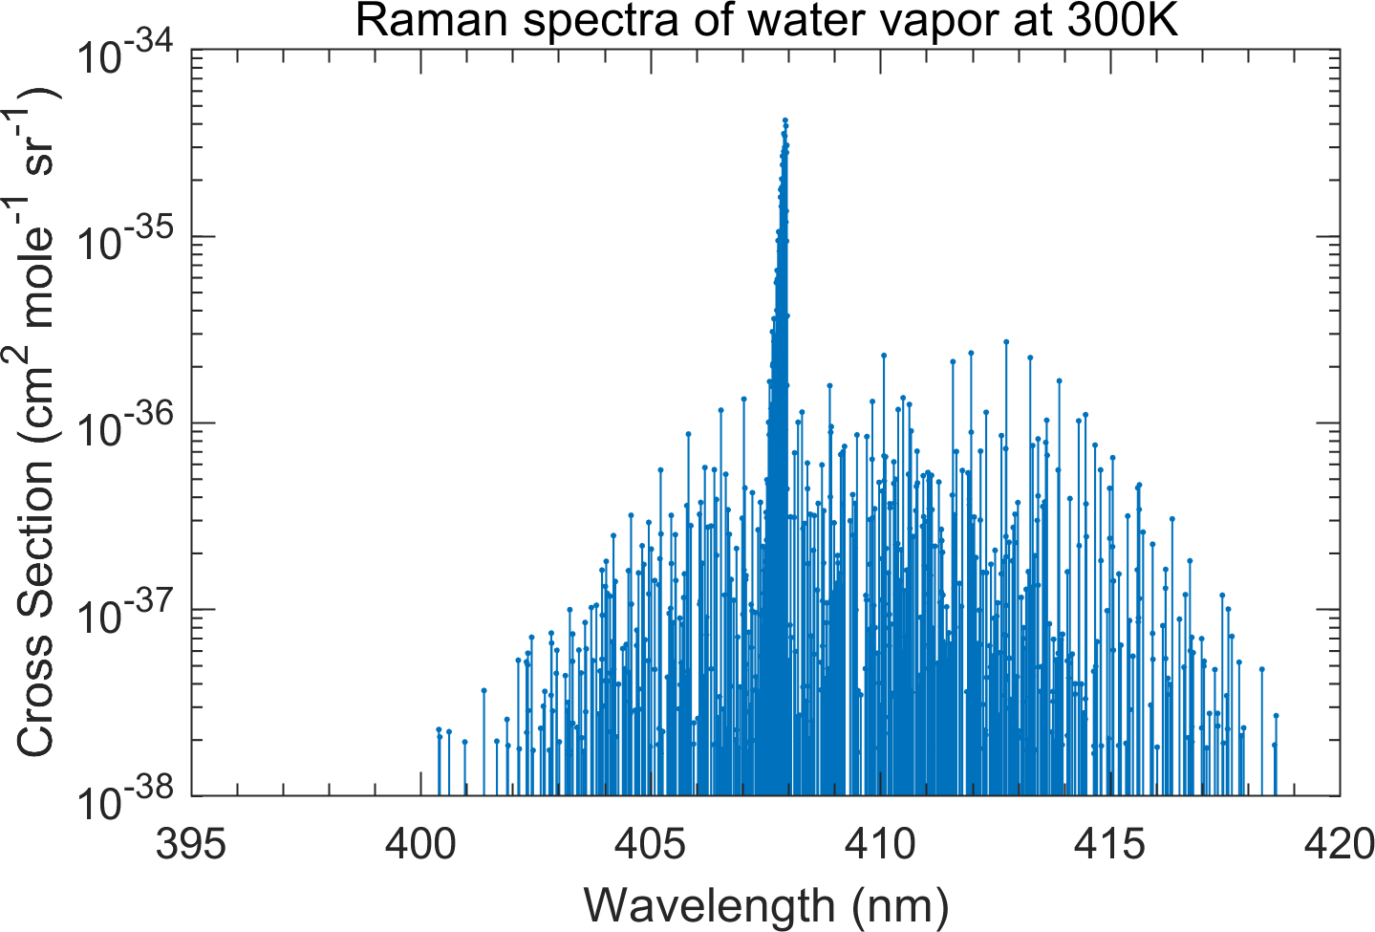
Water Vapor Raman Spectra
原理参考：Liu, F.; Yi, F.; He, Y.; Yin, Z.; Zhang, Y.; Yu, C. Spectrally Resolved Raman Lidar to Measure Backscatter Spectra of Atmospheric Three-Phase Water and Fluorescent Aerosols Simultaneously: Instrument, Methodology, and Preliminary Results. IEEE Transactions on Geoscience and Remote Sensing 2022, 60, 1-13, doi:10.1109/TGRS.2022.3166191.

Slide 8
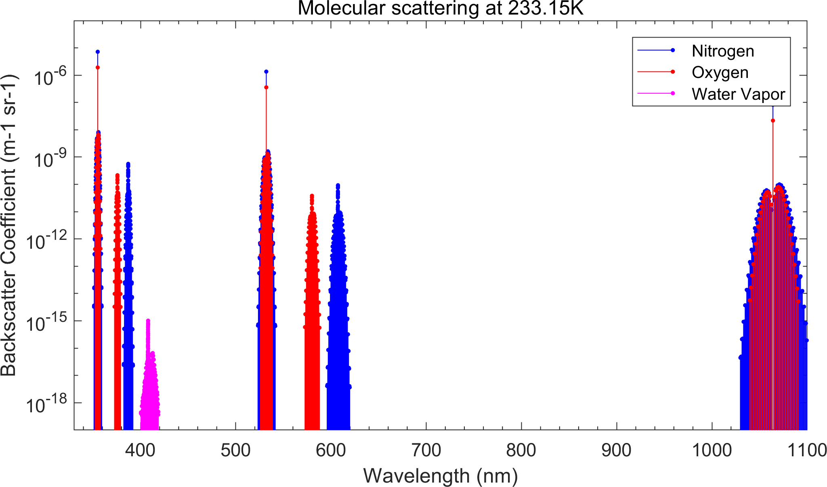
Full Spectrum of Molecular Scattering
355 nm
532 nm
1064 nm

Slide 9
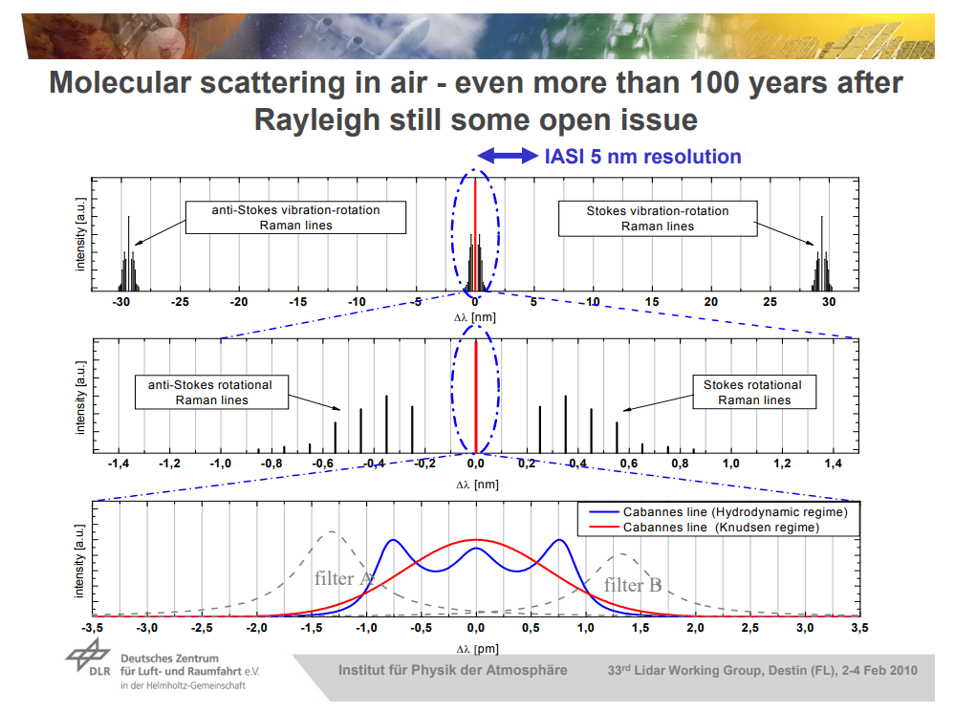
http://www.pa.op.dlr.de/aeolus/Campaigns_Pub/Reitebuch_RBS_VU_Feb10.pdf

Slide 10
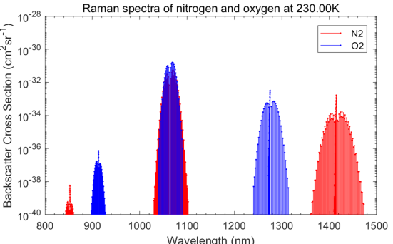
1064 nm vibrational-rotational Raman spectra

