Slide 1
Central bank communication on social media: What, to whom, and how? Yuriy Gorodnichenko, Tho Pham, Oleksandr Talavera (2024)
Present by Li Ziming

Slide 2
Motivation
Various strategies are adopted to improve monetary policy transparency.
Communication via social media become a popular tool in U.S. and U.K.
Understanding how this tool utilized and its effectiveness still limited.
Twitter provides a good platform to study social media communication.
Reliable mapping between Fed, mentioners and followers.
Prior studies focus on the Fed’s tweeting activities, but do not involve how Fed’s tweets attract public’s attention.

Slide 3
Research Questions
(1) What is communicated on Twitter?
(2) Who engages with Fed on Twitter?
(3) Whether Fed’s Twitter has influence on inflation expectations?

Slide 4
Contribution
Contribute to literature on monetary policy affect economic agents’ expectations.
Prior literature: result of change are mixed (Binder, 2017; Claus and Nguyen, 2020); different agents respond to monetary policy varies (Coibion et al., 2022).
Extend: examine influence of Fed’s tweets on inflation expectations.
Contribute to literature on using social media as central bank communication tool.
Prior literature: twitter activities (Korhonen and Newby, 2019); similarity between tweets and press releases (Masciandaro et al., 2020); Fed’s engagement on twitter (Conti-Brown and Feinstein, 2020).
Extend: analyze twitter users’ discussion of Fed, find tweets can shape expectations.

Slide 5
Social media data
Fed timeline
Tweets posted by the accounts of Fed Board of Governors and 12 regional Fed Banks
New York Fed created in 2008.06; Kansas City Fed created in 2011.04
Historical tweets from 2012.01 to 2020.12
Observation: user description, tweet statistics, tweet analytics
Tweets mentioning Fed’s Twitter accounts
All public tweets that mention Fed’s Twitter handles (e.g., @federalreserve)
Four types: retweets(1.45%); quotes(44.08%); replies(4.96%); direct tagging(49.51%)

Slide 6
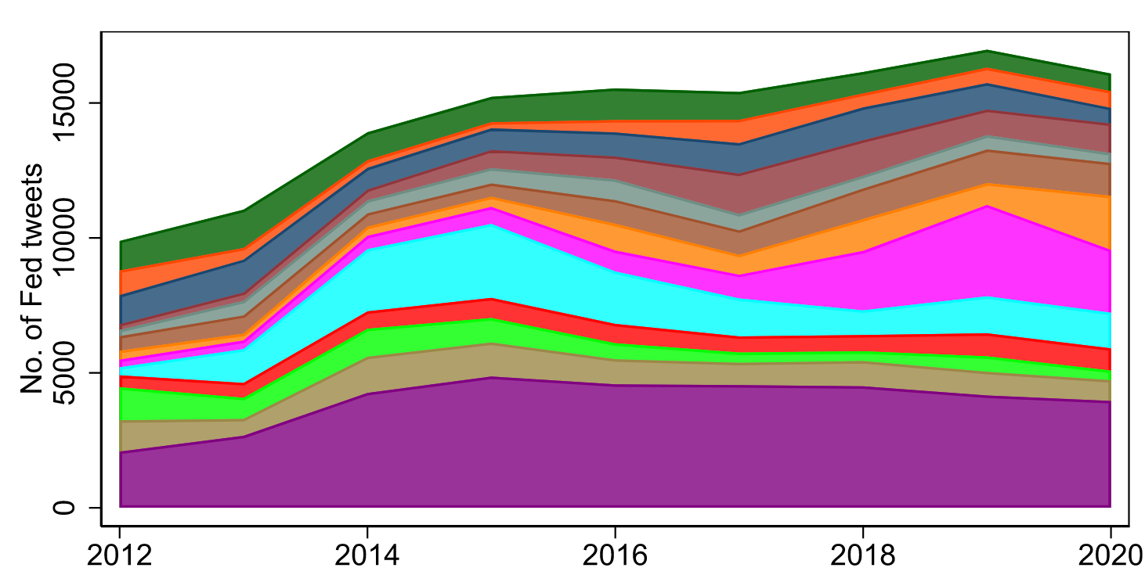
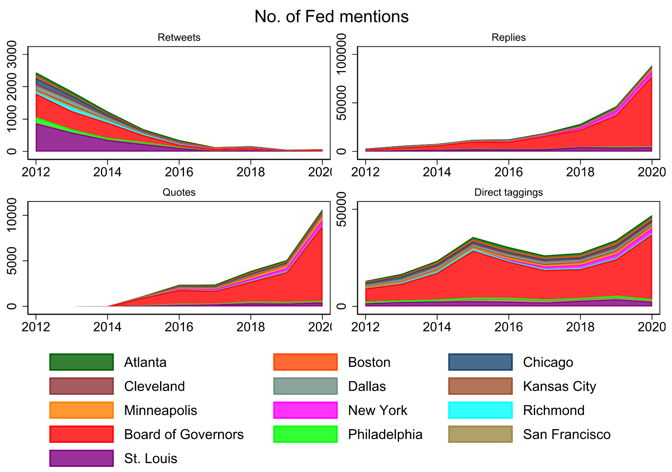
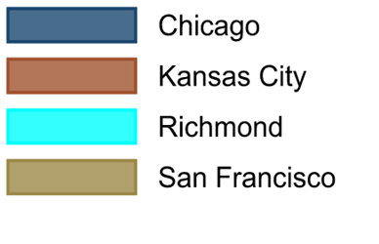

Slide 7
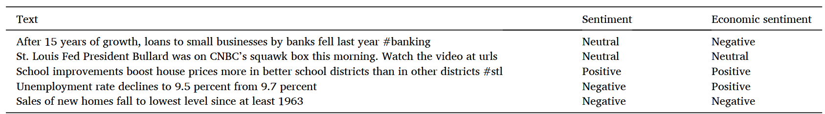
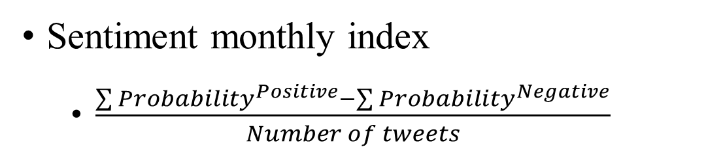
Text analysis
Text sentiment
General sentiment: TweetNLP (Camacho et al., 2022)
Economic sentiment: Sentiment-xDistil
Sentiment monthly index
$\frac{\sum{{Probability}^{Positive}}−\sum{{Probability}^{Negative}}}{Number of tweets}$

Slide 8
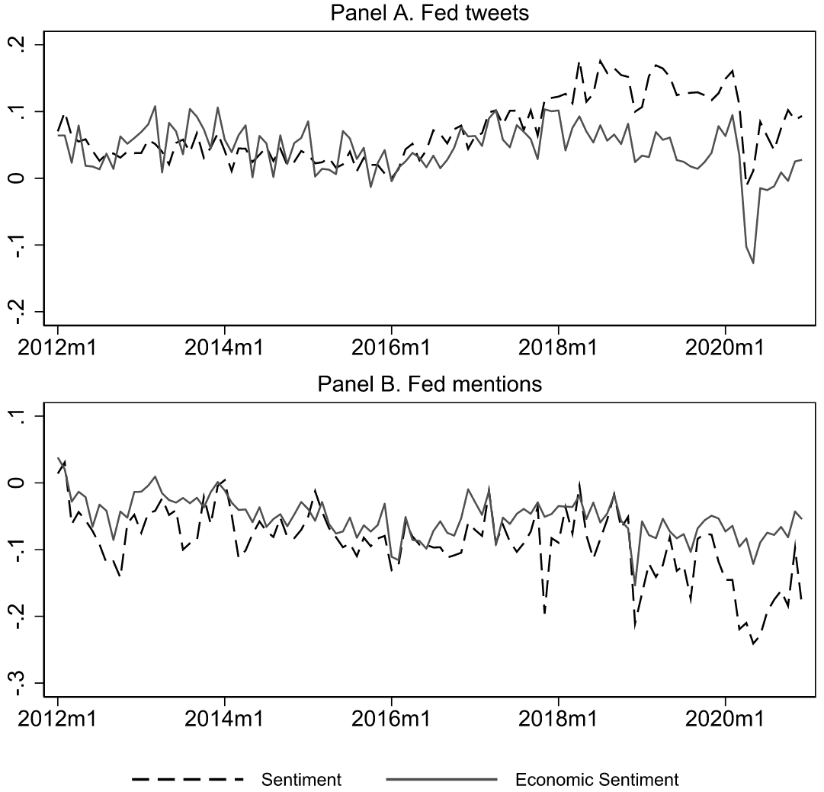

Slide 9
Text analysis
Taxonomy construction
Topics dictionary requires prior knowledge, not scalable for diverse corpora.
LDA weak in interpretation of topics.
Propose a weakly-supervised, scalable framework:
Step 1: Clustering with text embeddings for topic modeling
(1)text embeddings: Google’s USE; (2)dimensionality reduction: UMAP;
(3)clustering: HDBSCAN; (4)keywords generation: TFIDF
Step 2: Hyperparameter finetuning
Step 3: manual taxonomy construction
Clustering is interrelated and over-classied as outliers: manual topic reduction

Slide 10
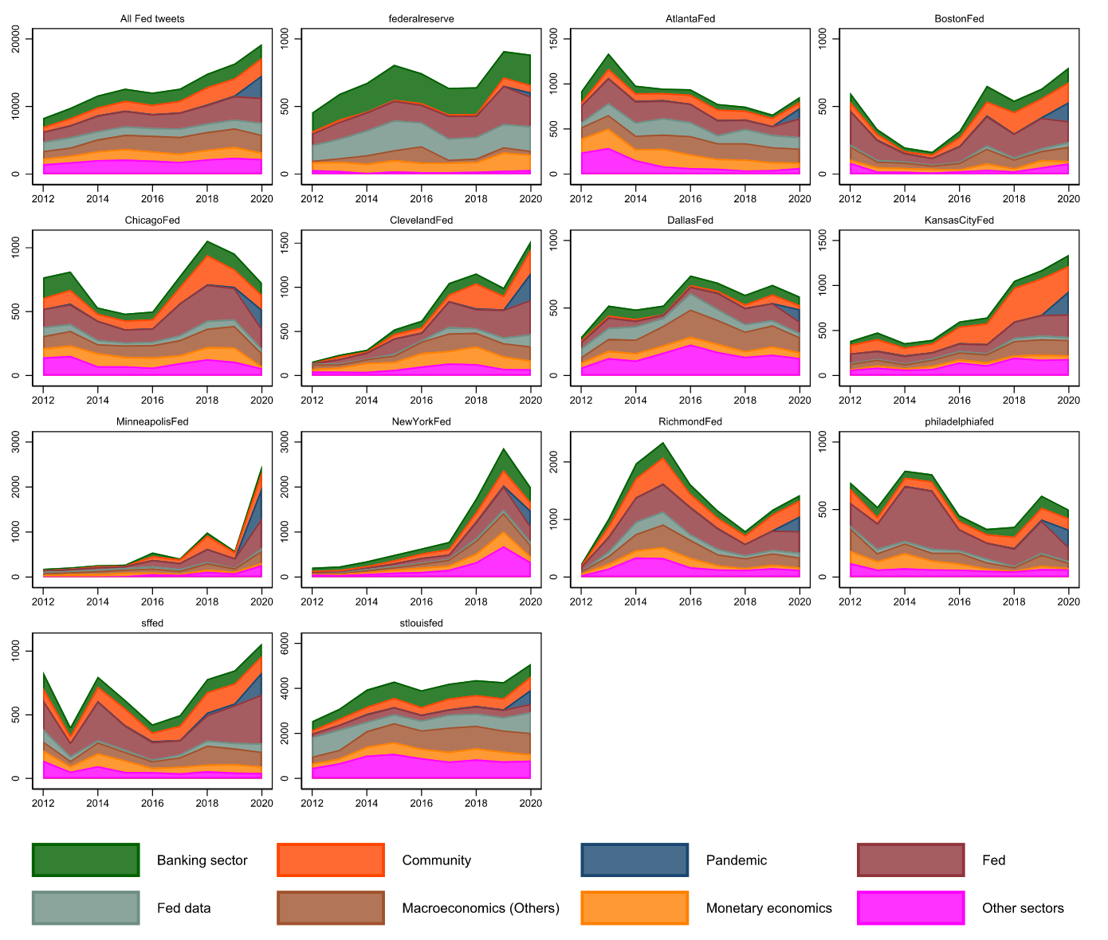

Slide 11
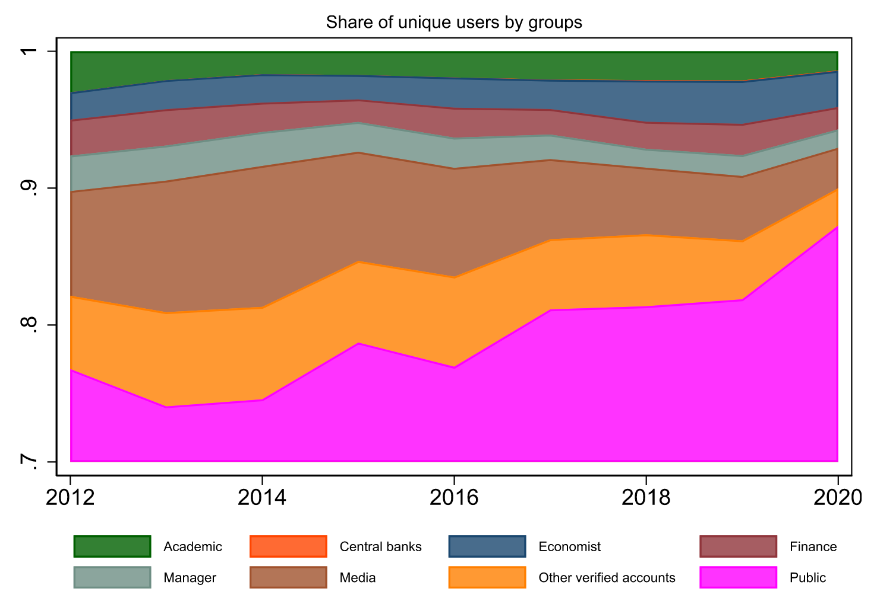
User classification
Apply the taxonomy framework on users’ self-description.
Generate dictionary of eight user groups: media, economist, non-economic-majored academics, finance, manager, central banks, public, other verified accounts.

Slide 12
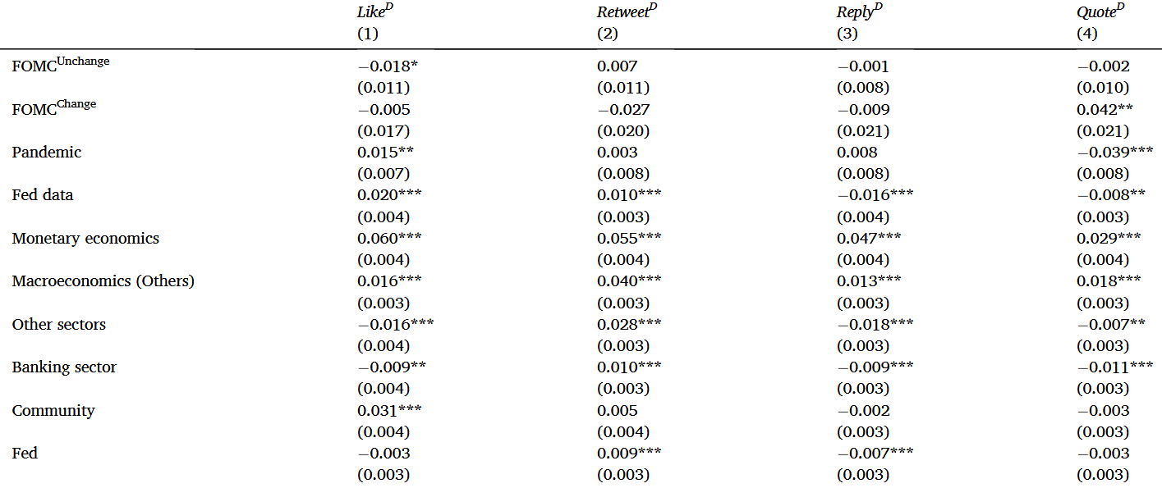
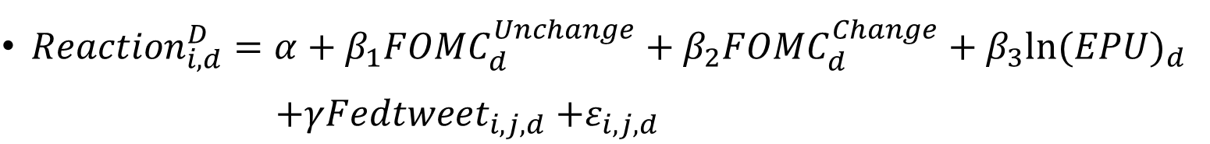
Fed direct engagement on Twitter
${Reaction}_{i,d}^{D}=α+β_{1}{FOMC}_{d}^{Unchange}+β_{2}{FOMC}_{d}^{Change}+β_{3}ln{(EPU)}_{d}$
$$+γ{Fedtweet}_{i,j,d}{+ε}_{i,j,d}$$

Slide 13
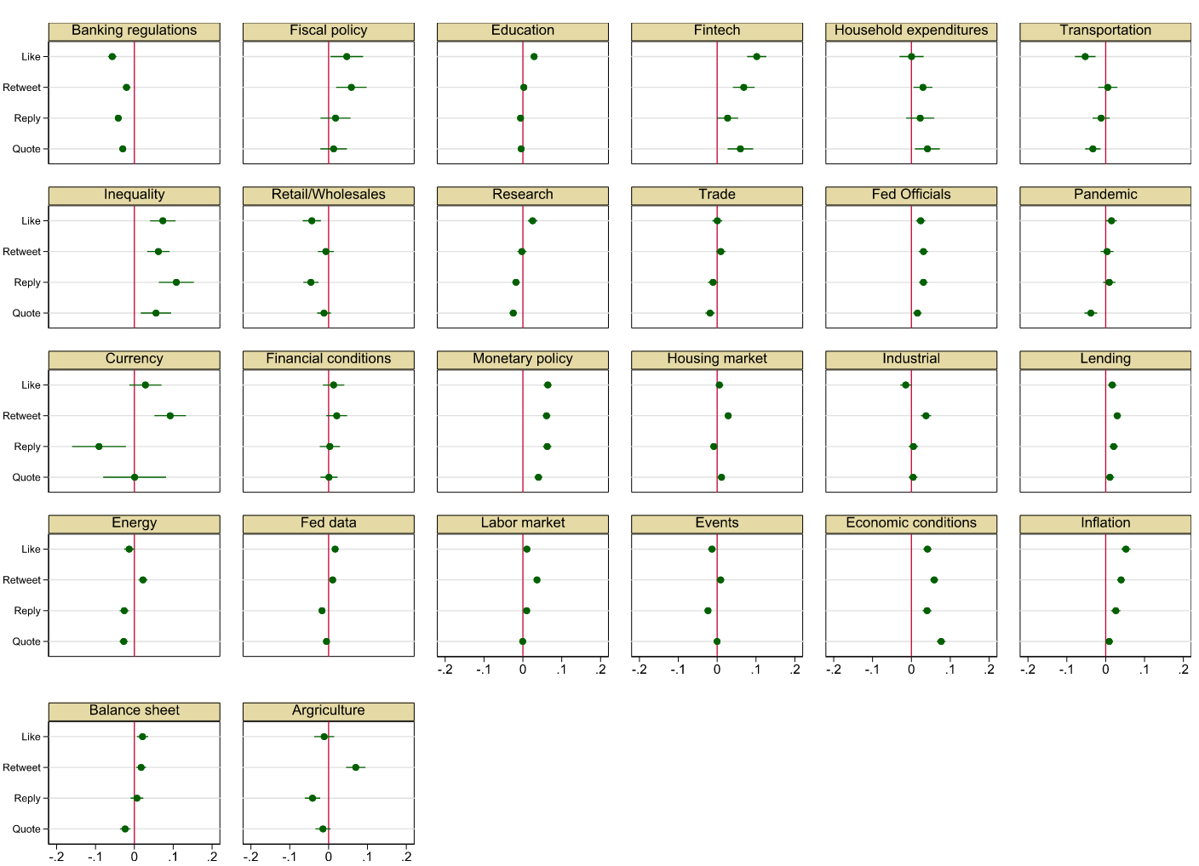

Slide 14
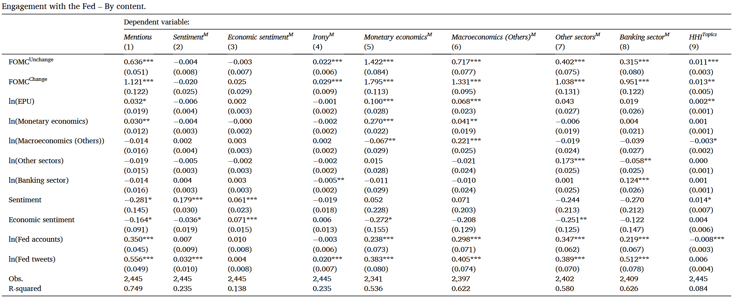
Fed indirect engagement on Twitter

Slide 15
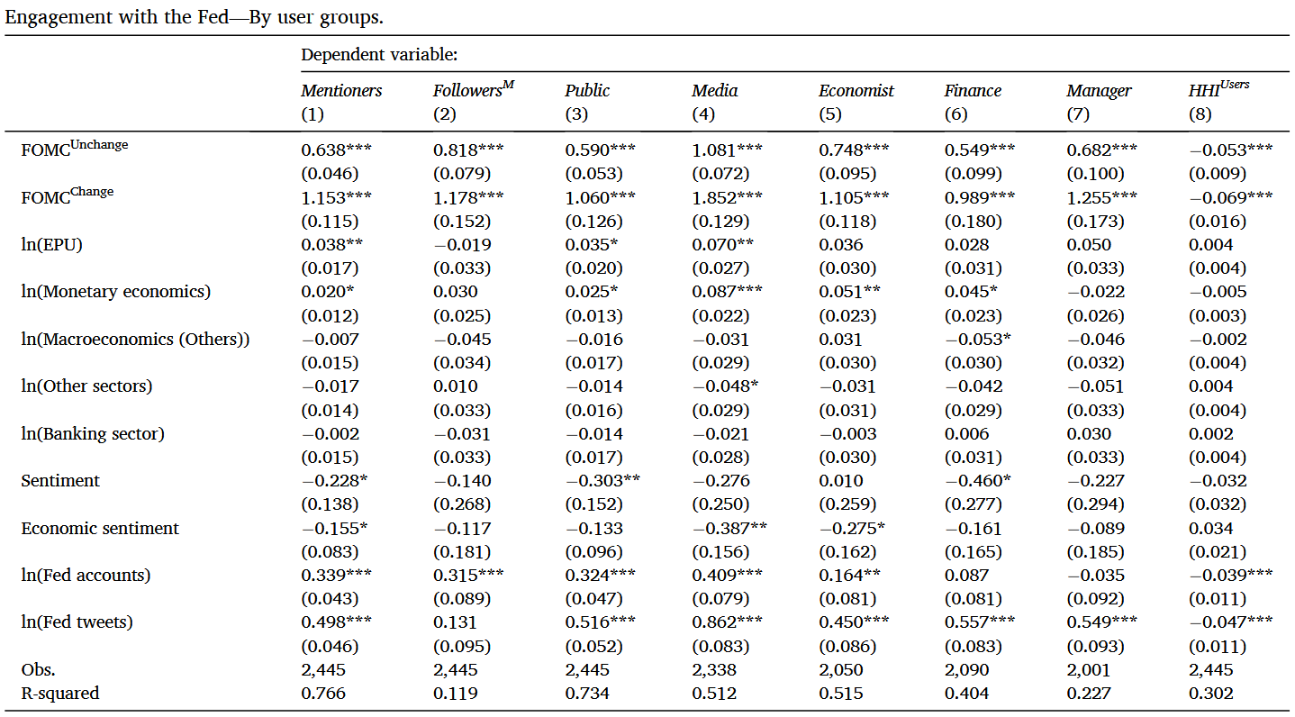

Slide 16
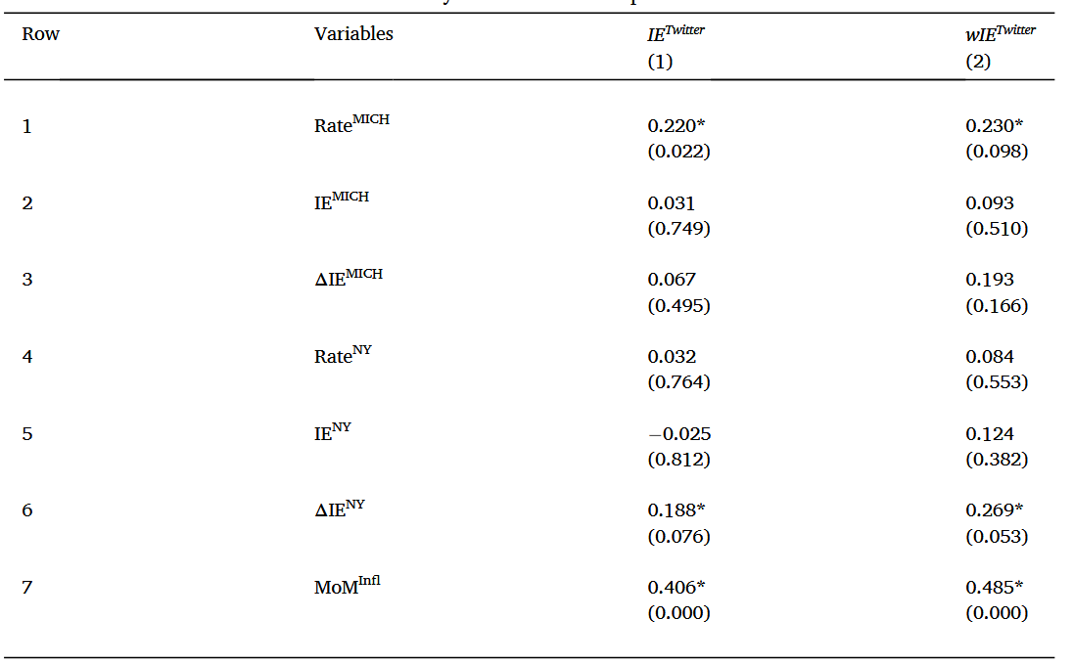
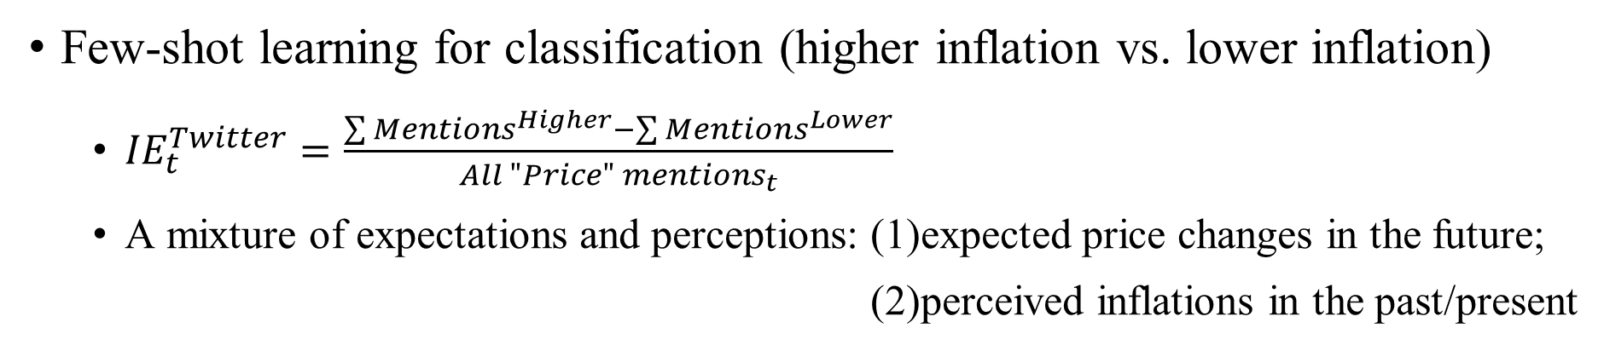
Fed communication and inflation expectations
Few-shot learning for classification (higher inflation vs. lower inflation)
${IE}_{t}^{Twitter}=\frac{\sum{{Mentions}^{Higher}}−\sum{{Mentions}^{Lower}}}{{All "Price" mentions}_{t}}$
A mixture of expectations and perceptions: (1)expected price changes in the future;
(2)perceived inflations in the past/present

Slide 17
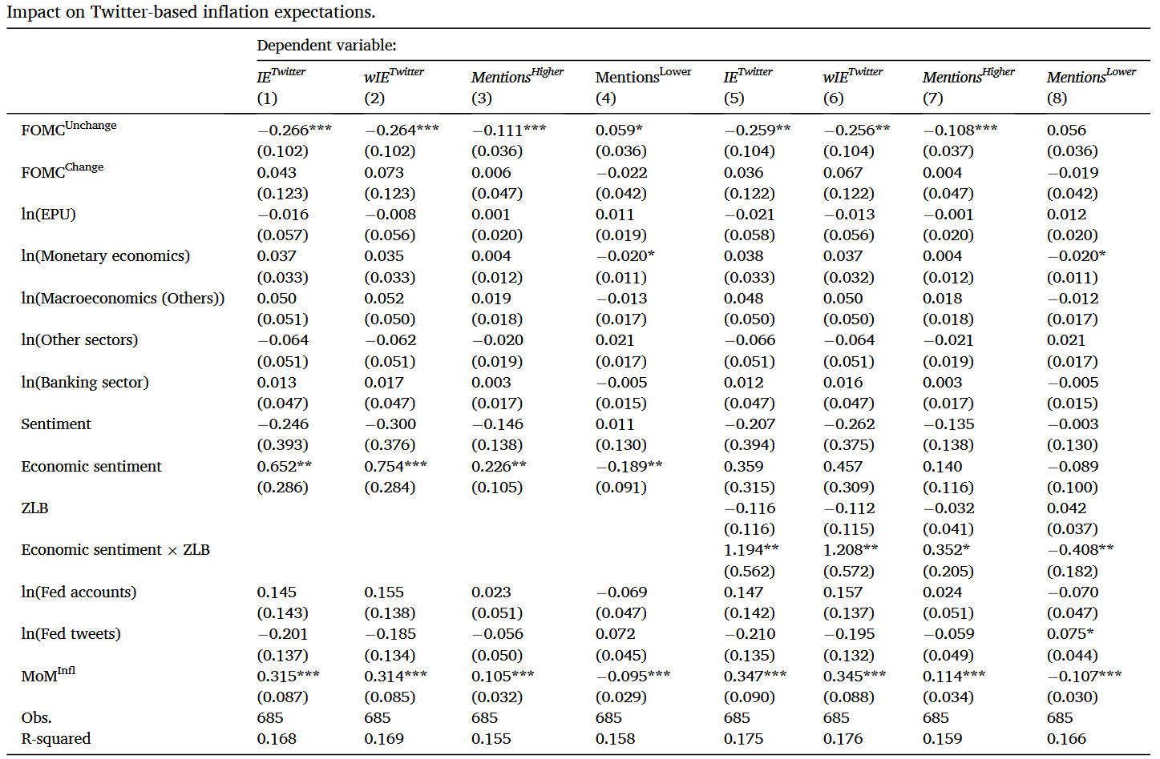

Slide 18
New ideas
Company fundamentals forecast based on Twitter.
Product sales forecast (JAR, 2018)
Earning forecast, fraud detection, valuation forecast

