Slide 1
AI-POWERED (FINANCE) SCHOLARSHIP Robert Novy-Marx Mihail Z. Velikov (NBER, 2025)
Present by Li Ziming

Slide 2
Motivation
Inherent tension between idealized scientific method and practical discovery.
First develop theories, generate predictions, and then test against data.
HARKing (Hypothesizing After Results are Known)
Emergence of LLMs transform the contradiction to technological capability.
Improve scientific reasoning and prediction.
Automatically generate research ideas, conduct experiments and test hypotheses.
How about complete entire academic process?

Slide 3
Research Questions
(1) How LLMs used to automatically generating academic finance papers?
(2) What kind of threat will it pose to traditional academic norms?

Slide 4
Contribution
Contribute to literature comparing AI-generated results and economic theories.
Prior literature: data mining has predictability comparable traditional peer review (Chen, Lopez-Lira, and Zimmermann, 2024).
Extend: LLM can rapidly produce coherent theoretical explanations for mined results.
Contribute to literature on application of LLM in hypotheses generation.
Prior literature: reason and predict (van Inwegen et al., 2023); generate hypotheses (Manning et al., 2024); conduct experiments and produce papers (Lu et al., 2024).
Extend: demonstrate a complete pipeline for automated academic research production in finance, from hypothesis generation through full paper creation.

Slide 5
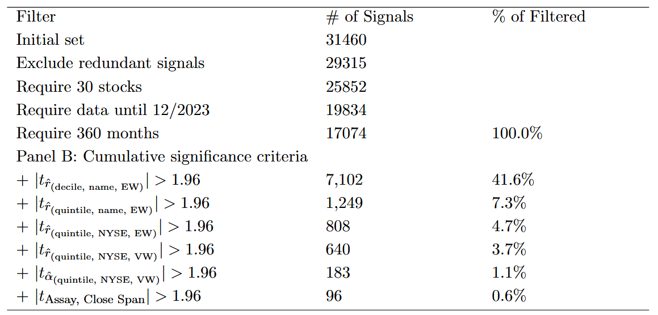
Data-Driven Signal Construction
Return predictors discovery
Initial dataset: 31,460 accounting variables and their temporal difference.
Implement a series of data-quality and sufficiency filters.
Implement a series of increasingly stringent statistical validation tests.

Slide 6
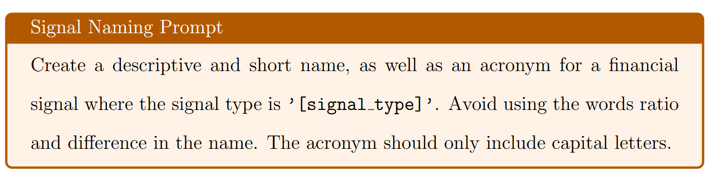
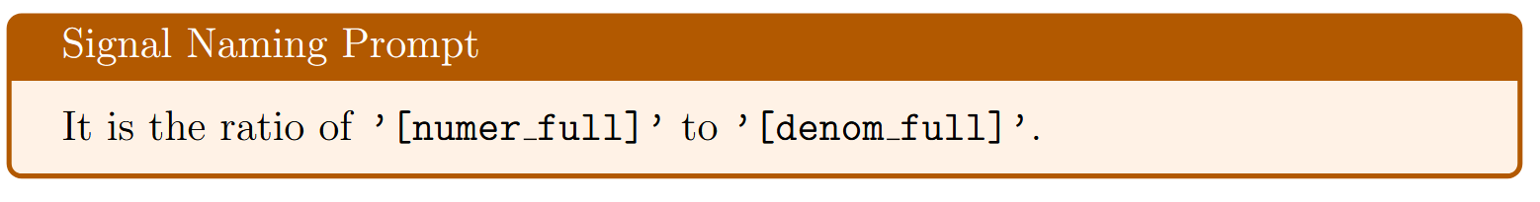
AI-Driven Paper Generation
Systematic Signal Naming (GPT-3.5-turbo)
For each validated signal, assign a descriptive and academically credible name.

Slide 7
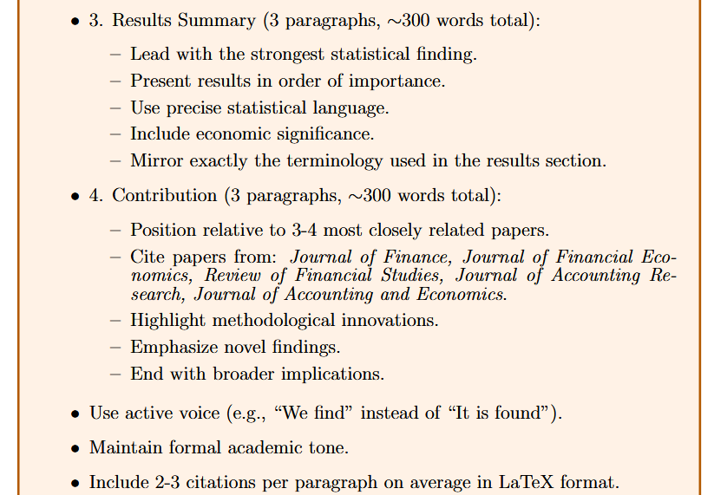
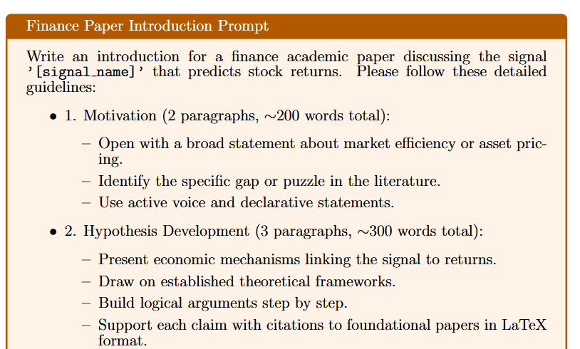
AI-Driven Paper Generation
Content Generation and Structuring (Claude 3.5-Sonnet)
Generate each section of paper following structured prompts.

Slide 8
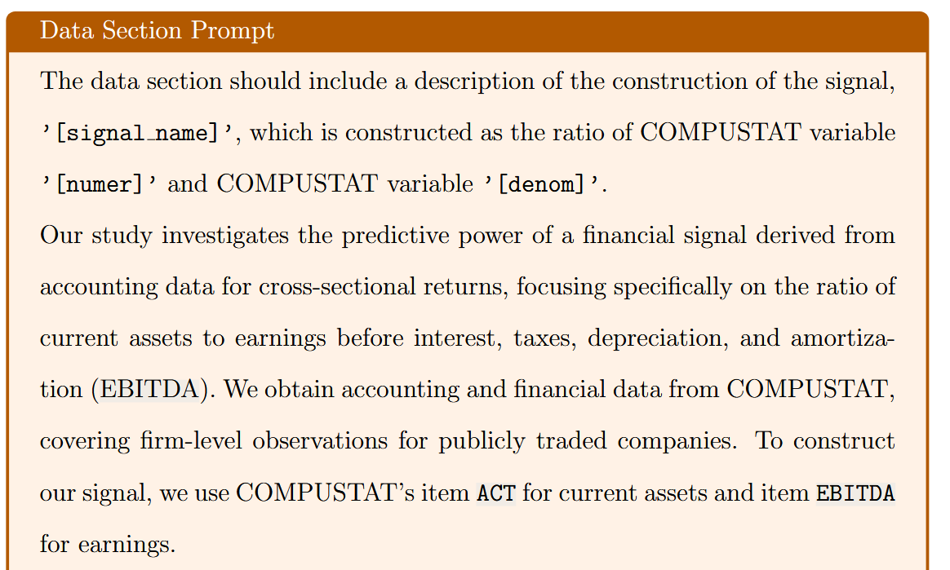
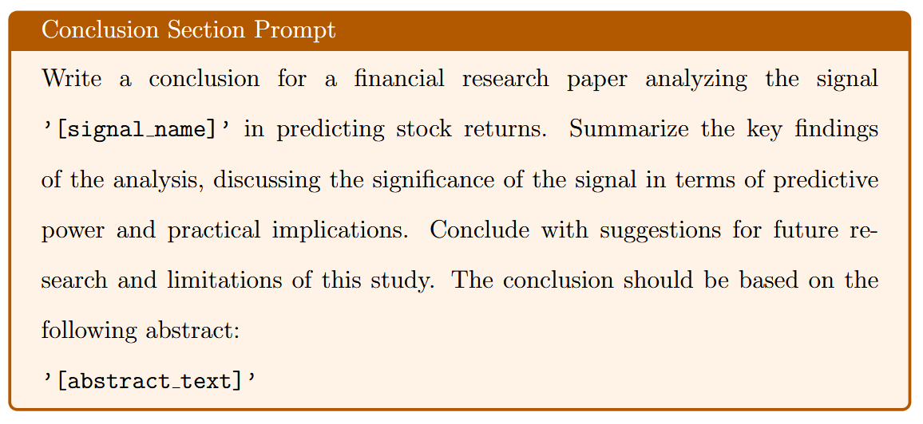
AI-Driven Paper Generation
Content Generation and Structuring (Claude 3.5-Sonnet)
Generate each section of paper following structured prompts.

Slide 9
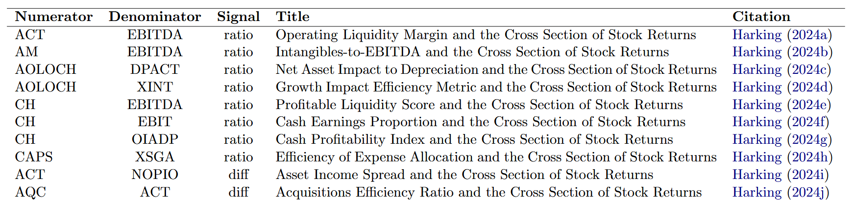
AI-Driven Paper Generation
Document Assembly, Formatting, and Quality Assurance
Programmatically insert AI-generated sections into a standardized LaTeX template.
Create three versions contain different hypotheses and economic explanations.
Output: fully formed, academically styled PDF, suitable for journal submission.

Slide 10
Results
Efficiency of AI-Powered Research
Data mining and validation take about a day of computation time.
Final paper generation takes minutes.
Quality of Generated Content
Signal names and acronyms are descriptive and creative.
Generated introduction, data section and conclusion similar to academic papers.
Further Content Evaluation
Citation accuracy: fictitious references when citing specific or recent work.
Expression alignment: hypotheses, empirical results, description in each section.

Slide 11
Potential and Risks of AI-powered Scholarship
Potential Benefits
Democratize research production: reduce barriers to entry.
Faster eliminate market inefficiency: quickly generate and test multiple hypotheses.
Risks and Challenges
Change notion: rapid iteration between empirical findings and hypothesis development.
Increase p-hacking: theoretical justifications for any statistically significant pattern.
Cause academic arbitrage: boost citation through automated paper generation.
Overwhelm peer review process: determine scientific contribution become challenging.

Slide 12
New Ideas
Can it pass AIGC test?
Current limitations of AI-powered research
Citation hallucination, ambiguous theoretical framing, rote replication
How to deal with these limitations?
Prompt engineering
The quality of content depends heavily on prompt, slight modifications to prompts can produce vastly different narratives.
How to design effective instructions for LLMs?

