Slide 1
The Benefits of Specific Risk-Factor Disclosures
Ole-Kristian Hope
Danqi Hu
Hai Lu
解读人：周颜锐

Slide 2
1 Introduction
1.1 Background
10-K report:
  Audited financial statements;
  Management discussion and analysis (MD&A);
  Information about company operations;
  Risk factors.
    In 2005 the SEC required firms to extend their risk-factor disclosures to their quarterly and annual reports;
    The most significant factors that make the company speculative or risky
    (qualitative description);
武汉大学经济与管理学院-周颜锐

Slide 3
1 Introduction
1.1 Background
Risk factors
  Practitioners: boilerplate
  SEC: attach more importance(After the 2007–2009 financial crisis)
  Analysts: assess fundamental risk
  Invetors: learn information
武汉大学经济与管理学院-周颜锐

Slide 4
1 Introduction
1.2 Research Motivation
Extensive prior research has examined how capital markets react to earnings information to form expectations about stock returns (Kothari (2001)), less is known about how investors incorporate risk information.
Despite the SEC’s call for more specific risk disclosure, there is limited evidence concerning the benefits of such practice.
武汉大学经济与管理学院-周颜锐

Slide 5
1 Introduction
1.2 Research Questions and Hypotheses
Whether investors and analysts benefit from more specific risk-factor disclosure?
How investors and analysts benefit from more specific risk-factor disclosure?
武汉大学经济与管理学院-周颜锐

Slide 6
1 Introduction
1.2 Research Questions and Hypotheses
H1: The stock-market reaction to the 10-K report is positively associated with the level of specificity in risk-factor disclosures.
H2: The reliability of analysts’ fundamental risk assessment is positively associated with the level of specificity in risk-factor disclosures.
武汉大学经济与管理学院-周颜锐

Slide 7
1 Introduction
1.3 Quantify the specificity
We introduce a new measure, Specificity, to quantify the specificity in firms’ risk-factor disclosures;
We construct Specificity as the number of specific entity names;
To extract specific entity names, we use the Named Entity Recognition (NER) technique.
武汉大学经济与管理学院-周颜锐

Slide 8
1 Introduction
1.3 Quantify the specificity
We use Stanford NER tool13 version 3.2.0 to identify entities in seven categories including Time, Location, Organization, Person, Money, Percent, and Date.
In our setting, we feed all Item 1A text into the CRF classifier to obtain extracted entities along with the categories they belong to.
武汉大学经济与管理学院-周颜锐

Slide 9
1 Introduction
1.4 Empirical analyses
First explore the determinants of Specificity:
  Proprietary costs:
    the cost deriving from disclosing information which may be used by competitors;
  Positive:
    The number of risk-related words(Campbell, Chen, Dhaliwal, Lu, and Steele (2014));
    The 10-K report length;
    Proxies for firm risk;
  Negtive:
    Total accruals and firm size.
武汉大学经济与管理学院-周颜锐

Slide 10
1 Introduction
1.4 Empirical analyses
Economic consequences of firms’ more specific risk disclosure:
  We find a strong positive relation between Specificity and the absolute value of three-day cumulative abnormal returns around the 10-K filing date;
  Next, we also find that a higher Specificity enhances the reliability of analysts’ fundamental risk analysis.
武汉大学经济与管理学院-周颜锐

Slide 11
1 Introduction
1.5 Academic Contributions
First, it contributes to the textual-analysis literature by introducing a new measure to quantify the level of specificity of qualitative disclosure.
  Prior work studying management forecasts codes pure qualitative information as the least specific(e.g., Francis, Nanda, and Olsson 2008);
  Within the category of qualitative disclosure, to date there have been few attempts to quantify and calibrate specificity levels.
武汉大学经济与管理学院-周颜锐

Slide 12
1 Introduction
1.5 Academic Contributions
Second, our study complements the extant risk-disclosure literature, particularly the literature on qualitative risk disclosure.
  Prior work studies quantitative risk information such as VaR disclosure as well as quantitative market-risk disclosures (Jorion 2002; Thornton and Welker 2004);
  However, qualitative risk disclosure has not been studied until recently, with the advance of textual-analysis techniques(Campbell et al. (2014));
  While these papers study the amount of risk-related information in qualitative risk-factor disclosures, our study focuses on the specificity of risk disclosure.
武汉大学经济与管理学院-周颜锐

Slide 13
1 Introduction
1.5 Academic Contributions
Third, this is the first study to demonstrate how analysts’ risk assessment is affected by firms’ risk-disclosure practices.
  Lui, Markov, and Tamayo (2007, 2012) ;Joos et al. (2015) have studied sell-side analysts’ risk assessment.
  None of these studies, however, investigates the relation between firms’ risk-disclosure practices and analysts’ risk assessment.
武汉大学经济与管理学院-周颜锐

Slide 14
1 Introduction
1.5 Academic Contributions
Finally, from a policy perspective, this paper provides empirical evidence supporting the SEC’s call for more specific risk disclosures.
  The findings suggest that improved corporate risk reporting—especially more specific risk-factor disclosures—benefits investors, and that risk-factor disclosures are likely not “just boilerplate” (as some suggest).
武汉大学经济与管理学院-周颜锐

Slide 15
2 Research Design
2.1 Estimation of Variables
We define a new measure, Specificity, as the number of specific words or phrases, divided by the number of total words in the risk-factor disclosure section.
These categories include (1) names of persons, (2) names of locations, (3) names of organizations, (4) quantitative values in percentages, (5) money values in dollars, (6) times, and (7) dates.
武汉大学经济与管理学院-周颜锐

Slide 16
2 Research Design
2.1 Estimation of Variables
For example:
  “Our firm has borrowed $100,000 from Microsoft.”
  “Our firm has borrowed some amount of money from a supplier.”
  The latter sentence can be applied to many other firms.
To implement this construct on a large-scale sample of risk-factor disclosure documents:
  we use the Named Entity Recognition (NER) technique to identify and extract specific names belonging to the above seven entity categories.
武汉大学经济与管理学院-周颜锐

Slide 17
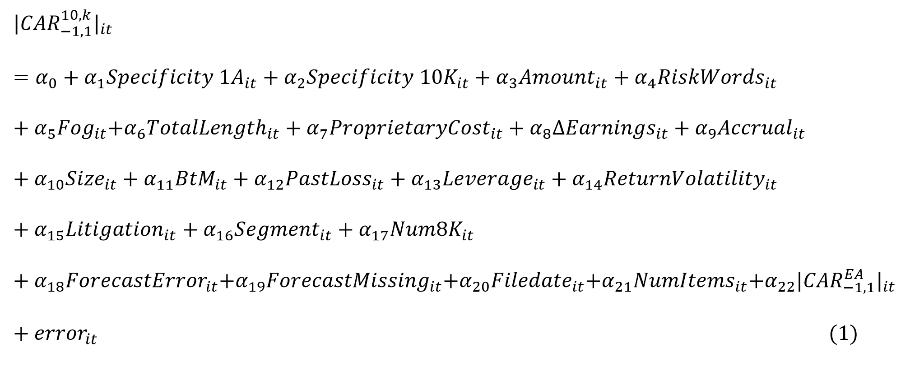
2 Research Design
2.2 Empirical Design
For H1: We study the relation between the absolute value of three-day abnormal returns around the 10-K filing date,|CAR^{10-K}_{-1,1}|,and Specificity, the main variable of interest.
武汉大学经济与管理学院-周颜锐

Slide 18
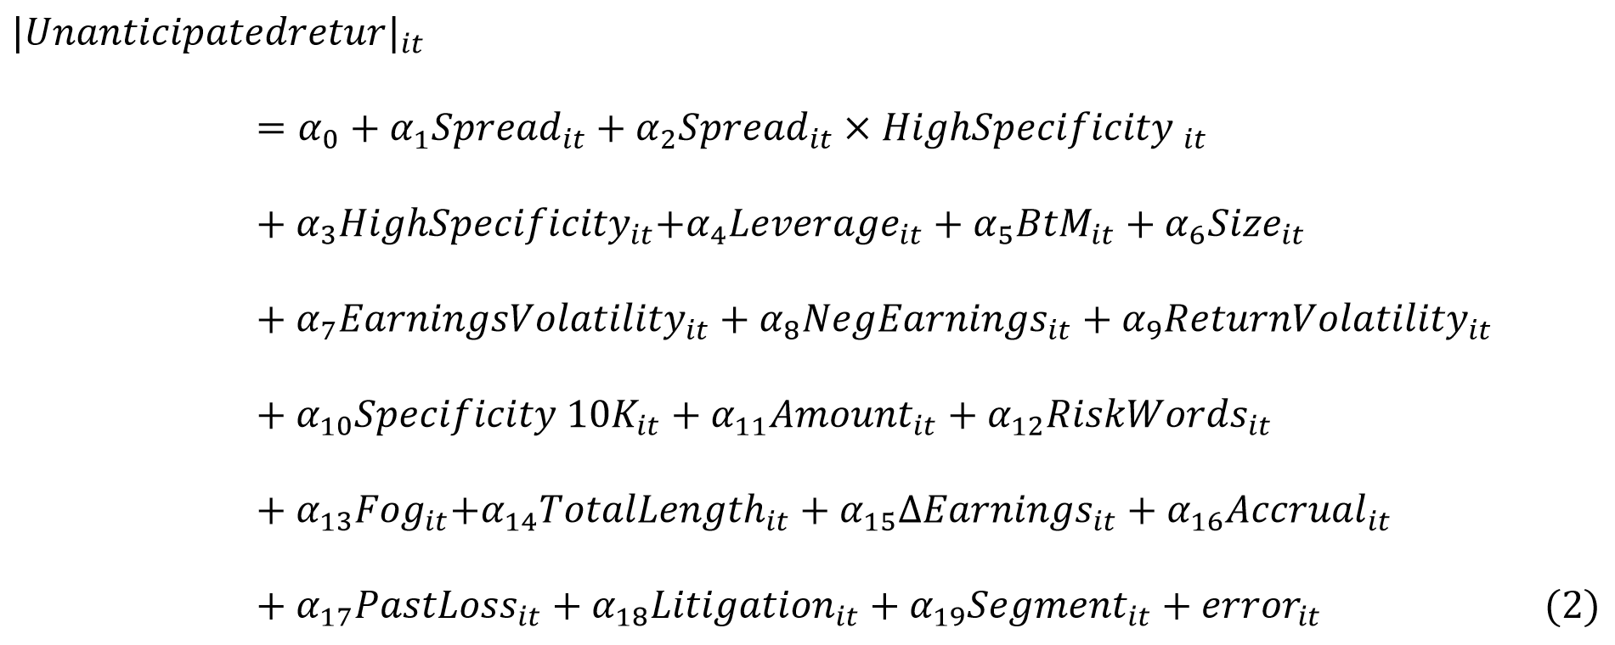
2 Research Design
2.2 Empirical Design
For H2: Analysts’ ability in assessing fundamental risk
武汉大学经济与管理学院-周颜锐

Slide 19
2 Research Design
2.3 Data
We obtain our sample in the following steps:
  First, we download all available 10-Ks from 2006 to 2011 from SEC EDGAR. Then extract risk-factor disclosures from Item 1A in each 10-K report.
  Second, we match the CIK used as identifier in EDGAR with GVKEY (from COMPUSTAT) and PERMNO (from CRSP).
  Third, observations with missing data on controls are excluded from the sample.
  This yields a sample of 14,865 firm-year observations for our full sample.
武汉大学经济与管理学院-周颜锐

Slide 20
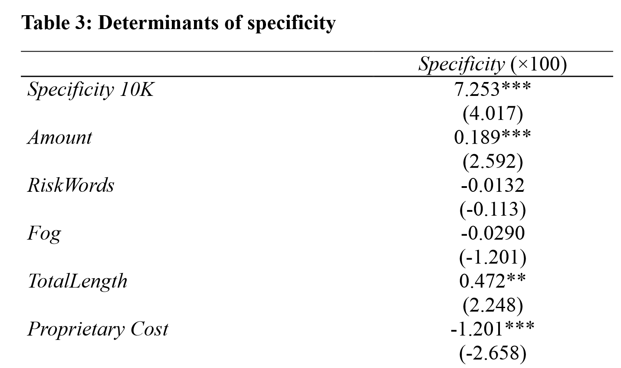
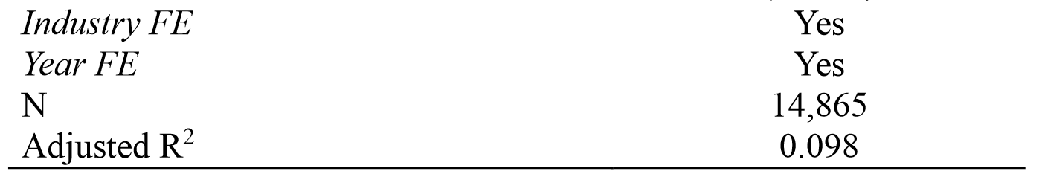
3 Empirical results
3.1 Determinants of Specificity
Most importantly, we find that firms facing higher proprietary costs are less likely to provide specific risk-factor disclosures.
武汉大学经济与管理学院-周颜锐

Slide 21
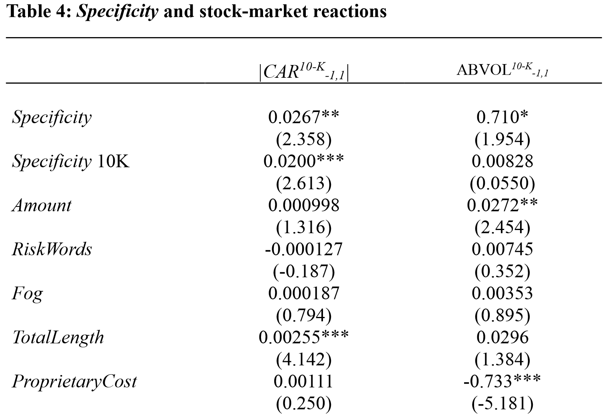
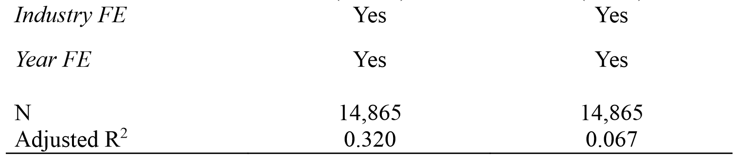
3 Empirical results
3.2 Specificity and stock-market reactions
This result supports H1 that a higher level of specificity in firms’ risk-factor disclosures leads to stronger market reactions to 10-K reports.
武汉大学经济与管理学院-周颜锐

Slide 22
3 Empirical results
3.2 Specificity and stock-market reactions
Pseudo analysis:
  From 2001 to 2004, when risk-factor disclosures were not required by the SEC, we repeat the market-reaction test using Specificity calculated based on risk-factor disclosures in 2006.
Cross-sectional effects of proprietary costs:
  We partition our sample based on the level of proprietary costs;
  Specificity is only significant in the low-proprietary-costs subsamples.
武汉大学经济与管理学院-周颜锐

Slide 23
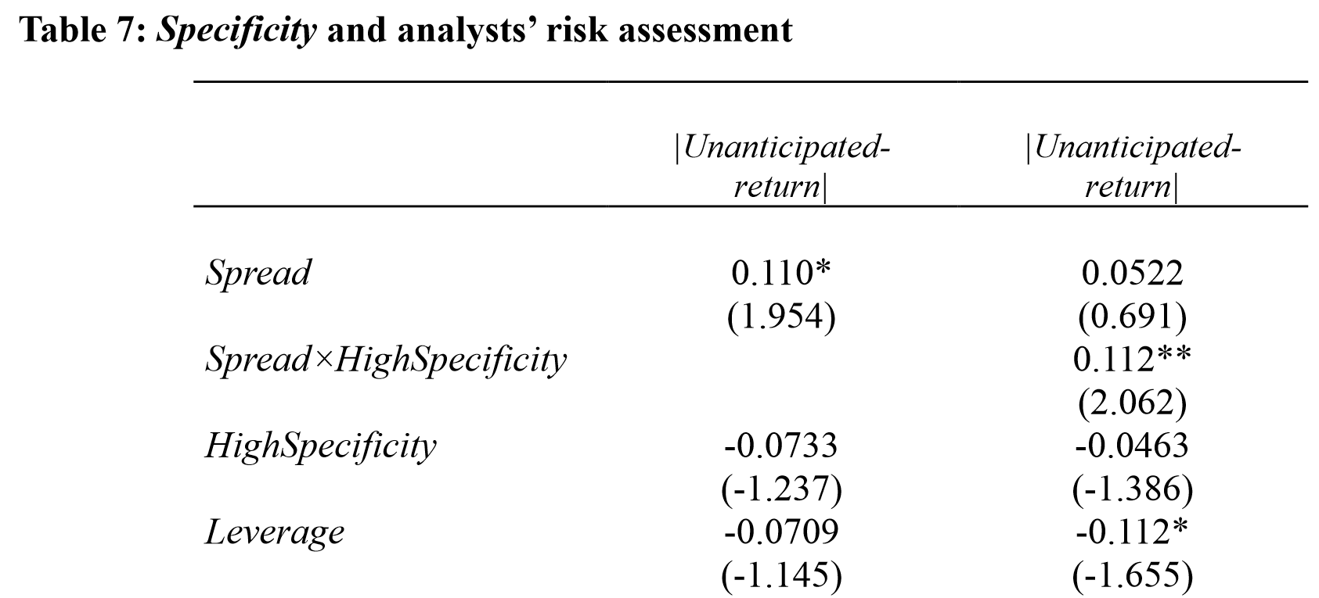
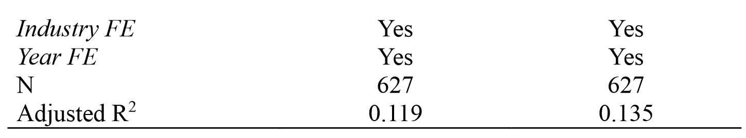
3 Empirical results
3.2 Specificity and analysts’ risk assessment
These results indicate that high specificity helps analysts make better estimations.
武汉大学经济与管理学院-周颜锐

Slide 24
4 Concluding remarks
We develop a new measure of the degree of specificity in firms’ risk-factor disclosures (Item 1A in the 10-K report);
We document that the short-window market reaction to the 10-K file increases in Specificity;
Moreover, we find that analysts’ ex-ante bull-bear price spread is significantly positively correlated with the ex-post base case forecast error when Specificity is high.
武汉大学经济与管理学院-周颜锐

